Slide 1

WEB CONCEPT

Slide 2

WEB CONCEPT
PRESENTATORS
MD. AL-MAMUN SARKAR

Slide 3

WEB CONCEPT
1
WEBSITE
2
WEB PAGE

Slide 4
WEB CONCEPT
1
DOMAIN
2
HOSTING

Slide 5
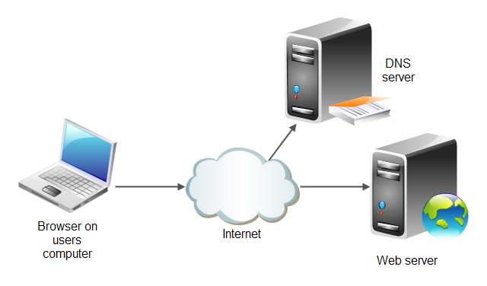
WEB CONCEPT

Slide 6
URL
Uniform Resource Locator

Slide 7
URL
http://www.atovait.com
https://www.facebook.com
1
HTTP / HTTPS
2
WWW
3
OTHERS

Slide 8
HTTP / HTTPS
1
HTTP : Hypertext Transfer Protocol
2
HTTPS : HyperText Transfer Protocol Secure

Slide 9
WWW
World Wide Web

Slide 10
HTML
Hypertext Markup Language

Slide 11
CSS
Cascading Style Sheets

Slide 12
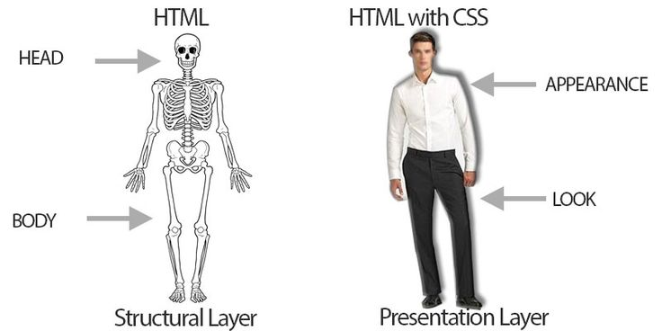
HTML AND CSS

Slide 13
JS
JavaScript

Slide 14
PHP
Hypertext Preprocessor

Slide 15
DATABASE
MySql

Slide 16
QUESTION
?

Slide 17
WEB CONCEPT
1
WEB CONCEPT
2
DOMAIN, HOSTING
3
URL
4
HTTP, HTTPS
5
HTML, CSS, JAVASCRIPT
6
Server side scripting, PHP
6
Database, MYSQL

Slide 18
THANK YOU

