Slide 1
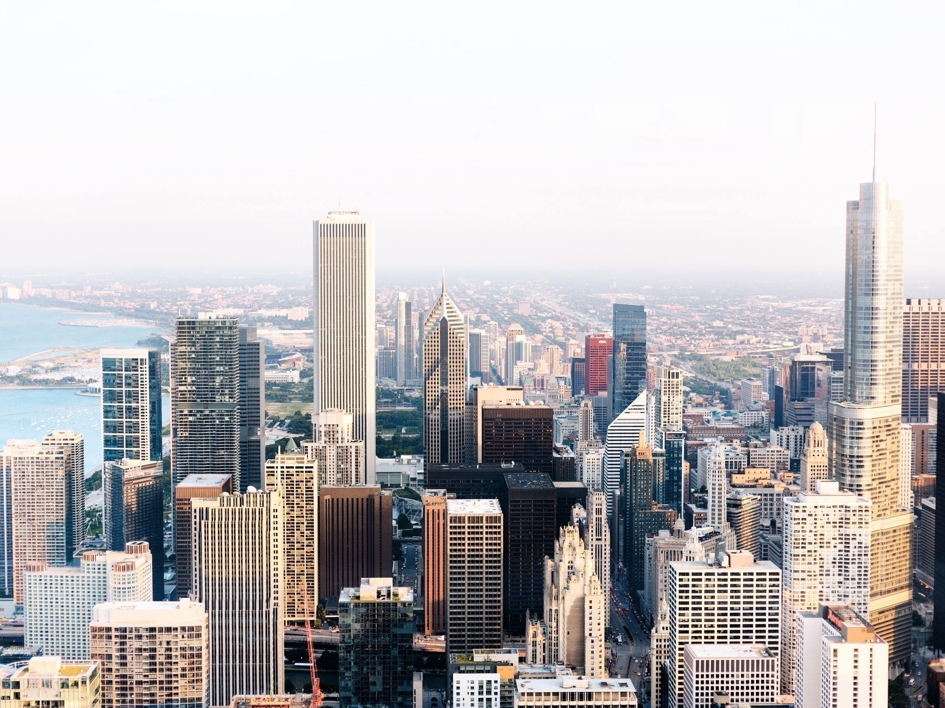
WEB DESIGN

Slide 2

WEB DESIGN
1
IFRAME
2
COLOR
3
ENTITIES AND SYMBOLS
3
4
AUDIO AND VIDEO

Slide 3

HTML IFRAME
<iframe src="URL"></iframe>

Slide 4
HTML COLOR
RED, GREEN, BLUE
#FF0000, #00FF00, #0000FF
rgb(255,0,0), rgb(0,255,0), rgb(0,0,255)

Slide 5
ENTITIES AND SYMBOLS
&entity_name; OR &#entity_number;
Example:
& | ampersand | &amp; | &#38;
¢ | cent | &cent; | &#162;
£ | pound | &pound; | &#163;
¥ | yen | &yen; | &#165;
€ | euro | &euro; | &#8364;
© | copyright | &copy; | &#169;

Slide 6
ENTITIES AND SYMBOLS
♠ | &#9824; | &spades; | BLACK SPADE SUIT
♣ | &#9827; | &clubs; | BLACK CLUB SUIT
♥ | &#9829; | &hearts; | BLACK HEART SUIT
♦ | &#9830; | &diams; | BLACK DIAMOND SUIT

Slide 7
ENTITIES AND SYMBOLS
∇ | &#8711; | &nabla; | NABLA
∈ | &#8712; | &isin; | ELEMENT OF
∉ | &#8713; | &notin; | NOT AN ELEMENT OF
∋ | &#8715; | &ni; | CONTAINS AS MEMBER
∏ | &#8719; | &prod; | N-ARY PRODUCT
∑ | &#8721; | &sum; | N-ARY SUMMATION

Slide 8
HTML AUDIO
<audio controls> <source src="horse.ogg" type="audio/ogg"> <source src="horse.mp3" type="audio/mpeg"> Your browser does not support the audio element. </audio>

Slide 9
HTML AUDIO
<video width="320" height="240" controls> <source src="movie.mp4" type="video/mp4"> <source src="movie.ogg" type="video/ogg"> Your browser does not support the video tag. </video>

Slide 10
THANK YOU

