Slide 1
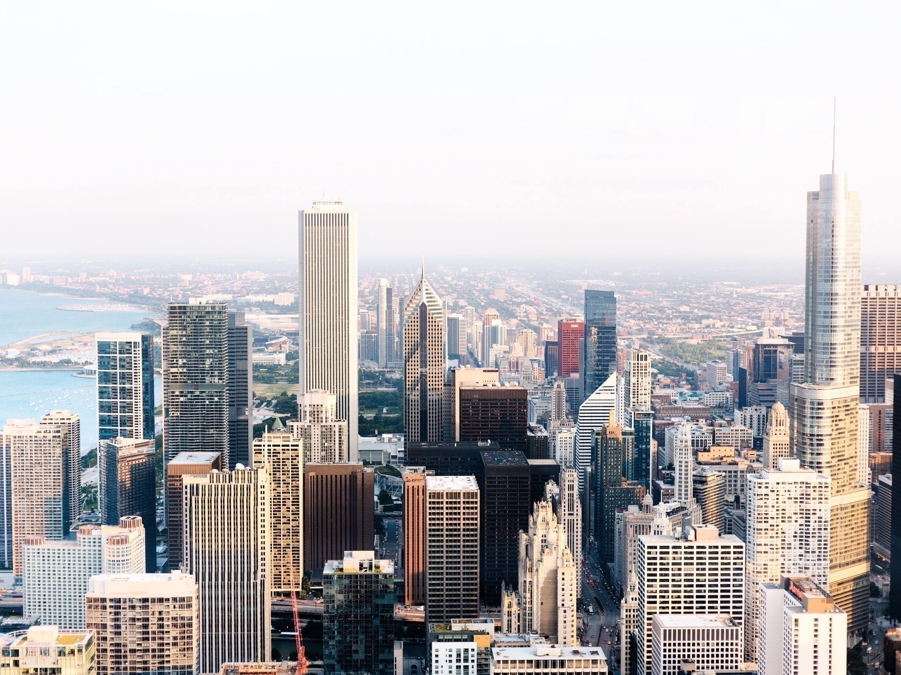
WEB DESIGN

Slide 2

CSS
1
Floating
2
2
Align
3
Pseudo-elements
Navigation Bar
5
4
6
Create a CSS image Gallery
7
Image Opacity

Slide 3

Floating
float: left;
float: right;

Slide 4
Align
text-align: left;
text-align: center;
text-align: right;

Slide 5
Pseudo-elements
selector::pseudo-element {
property:value;
}
Example:
:focus
:hover
:last-child
:nth-child(n)
:nth-last-child(n)

Slide 6
Navigation Bar

Slide 7
Create a CSS image Gallery

Slide 8
Pseudo-elements
selector::pseudo-element {
property:value;
}
Example:
:focus
:hover
:last-child
:nth-child(n)
:nth-last-child(n)

Slide 9
Image Opacity
selector::pseudo-element {
property:value;
}
Example:
:focus
:hover
:last-child
:nth-child(n)
:nth-last-child(n)

Slide 10
THANK YOU

