Slide 1
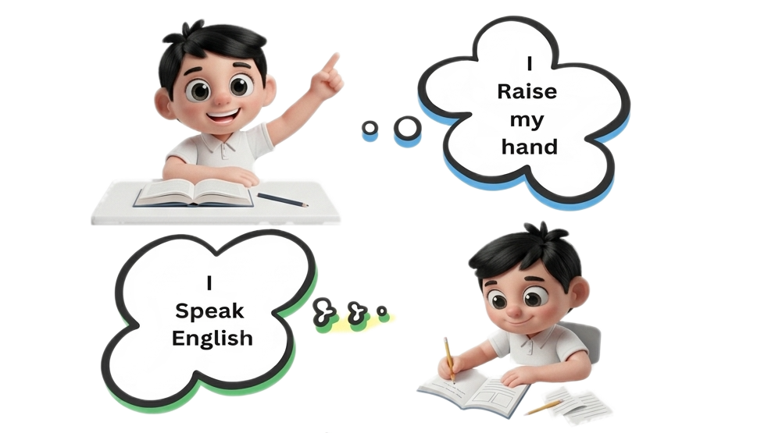
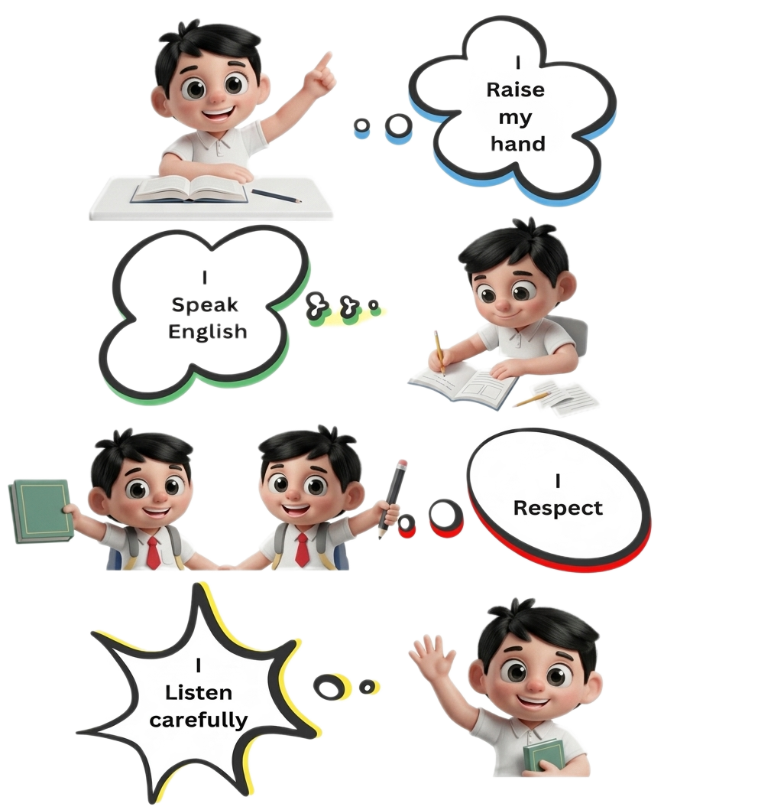
Classroom Rules

Slide 2
The date is ..

Slide 3
s
Today is ..

Slide 4
UNIT 3:
LET’S CELEBRATE!
WH QUESTIONS
DONE BY:
T. SARAH TARADAH
GRADE 4

Slide 5
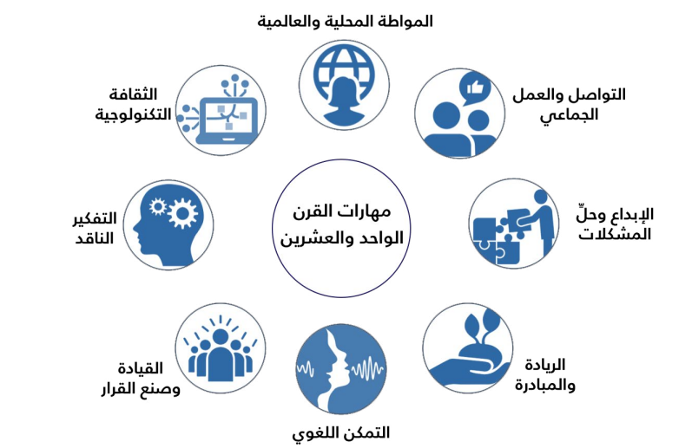
LESSON OBJECTIVES:
Students should be able to:
1. Ask questions about the past with Who, What, When, Where, Why + did.
2. Answer the questions using the past simple and "because".

Slide 6

Allocated time
Target Skill
Learning Strategy
21st Century Skills
Let’s learn!
WH questions ask for information.
1 min
?
Who?
➜ used for: people
?
What?
➜ used for: things or actions
reading
listening
?
When?
➜ used for: time
Super reader
?
Where?
➜ used for: places
?
Why?
➜ used for: reasons (Because...)

Slide 7
Allocated time
Target Skill
Learning Strategy
21st Century Skills
Let’s learn!
Asking questions about the past: WH + did
1 min
WH question
did
Pronoun
Verb
Extra words
Past time
?
What / Where
Who / When
Why
did
I / She
He / We
You / They
go / wear
eat / see
play
to the park
at school
...
yesterday
last night
last week
?
Where
did
you
go
-
last night
?
reading
listening
➜ I went to the park.
Super reader
Remember: We use the past simple in answers.
go
↓
went
wear
↓
wore
eat
↓
ate
see
↓
saw
play
↓
played

Slide 8
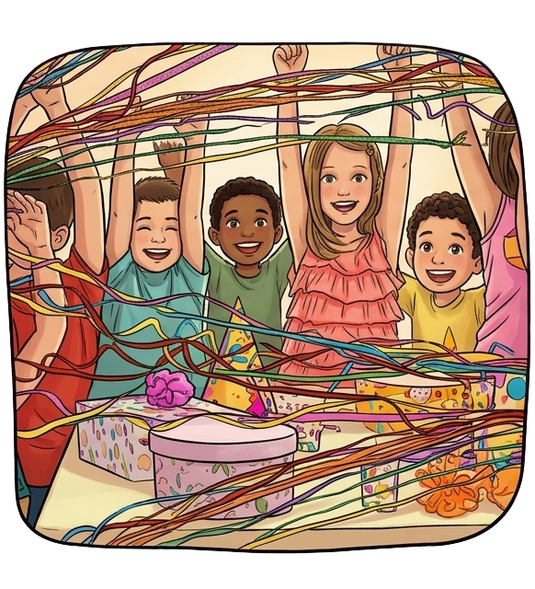
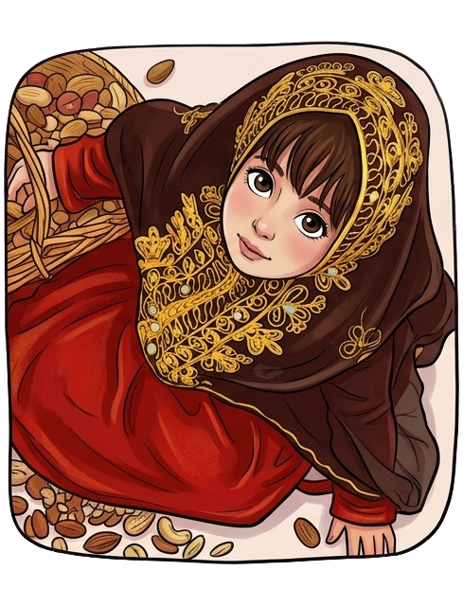
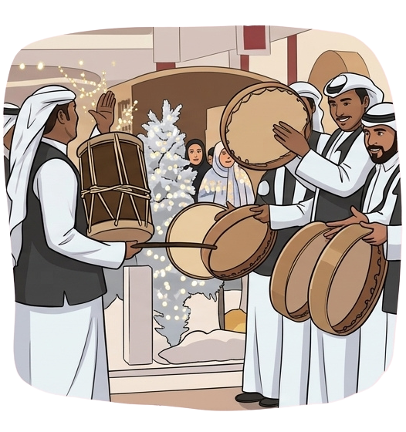
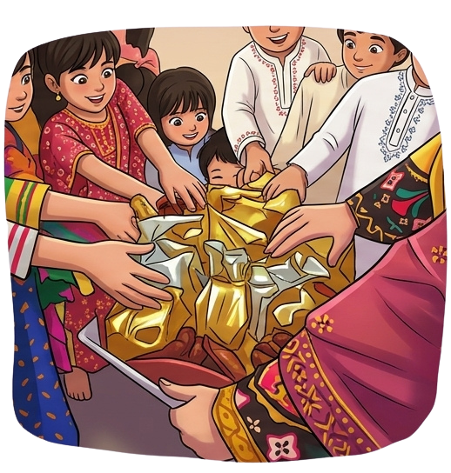

Allocated time
Target Skill
Learning Strategy
21st Century Skills
Let’s read!
Talking about Eid
1 min
What did she wear on Eid?
➜ She wore a traditional dress.
Who did you eat luqaimat with?
➜ I ate luqaimat with my grandma.
reading
listening
Where did you see the drummers?
➜ I saw the drummers in Manama.
Super reader
When did you throw streamers?
➜ I threw streamers in the evening.
Why did the kids smile?
➜ Because they got presents.

Slide 9


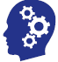
Allocated time
Target Skill
Learning Strategy
21st Century Skills
Practice
1 min
Read and match
1- Where did you go?
2
I saw parades in Manama.
2- What did you see?
3
I slept at nine o'clock.
reading
writing
3- When did you sleep?
5
I met my friend earlier.
Individual work
4- Why did you cry?
1
I went to the park.
5- Who did you meet?
4
I cried because I watched a sad film.
Click the box to check and listen!

Slide 10
Allocated time
Target Skill
Learning Strategy
21st Century Skills
Practice
1 min
Complete the questions and answers
Q0:
Where
did he go
last night?
- He went to the Seef cinema.
Q1:
Who
?
did you see
in school?
reading
writing
- I saw my friends and teachers.
Q2:
Why
did Amal go to the Salmanya hospital?
- Because
?
Individual work
she broke her arm.
Q3:
?
What did you wear
on Eid?
- I wore traditional clothes.
Q4:
?
When did you play football?
?
- I played football yesterday.
Click the blank to check and listen!

Slide 11
Allocated time
Target Skill
Learning Strategy
21st Century Skills
Practice
1 min
Read and answer
Complete the questions:
When
Where
What
Who
Why
1-
?
Where
are you from?
- I'm from
...
Bahrain.
reading
writing
2-
?
When
is your birthday?
- My birthday is
...
in March.
3-
?
Individual work
What
was the best present you got?
- The best present I got was
...
a bike.
4-
?
Who
is your best friend?
- My best friend is
...
Ali.
5-
?
Why
do you love your best friend?
- Because he is
...
kind.

Slide 12
Allocated time
Target Skill
Learning Strategy
21st Century Skills
Practice
1 min
Re-order the words to form a question
did
Who
you
see
?
yesterday
reading
writing
Who
did
you
see
yesterday
?
Click the words in the right order!
Individual work

Slide 13
Allocated time
Target Skill
Learning Strategy
21st Century Skills
Practice
1 min
Re-order the words to form a question
What
?
last week
she
did
wear
reading
writing
What
did
she
wear
last week
?
Click the words in the right order!
Individual work

Slide 14
Allocated time
Target Skill
Learning Strategy
21st Century Skills
Practice
1 min
Re-order the words to form a question
go
?
they
on Eid
Where
did
reading
writing
Where
did
they
go
on Eid
?
Click the words in the right order!
Individual work

Slide 15
Game Time!
Choose the right question word!
Click the right answer!

Slide 16
Question 1/5
______ did you go on Eid?
Where did you go on Eid?
- I went to my grandma's house.
Who
Where
When
✔ Great job!
✖ Try again!

Slide 17
Question 2/5
______ did you eat at the party?
What did you eat at the party?
- I ate cake and sweets.
What
Why
Where
✔ Great job!
✖ Try again!

Slide 18
Question 3/5
______ did you meet at the mall?
Who did you meet at the mall?
- I met my cousins.
When
What
Who
✔ Great job!
✖ Try again!

Slide 19
Question 4/5
______ did you go to bed?
When did you go to bed?
- At nine o'clock.
When
Where
Who
✔ Great job!
✖ Try again!

Slide 20
Question 5/5
______ did you cry?
Why did you cry?
- Because I lost my toy.
What
Why
When
✔ Great job!
✖ Try again!

Slide 21
Allocated time
Target Skill
Learning Strategy
21st Century Skills
Let’s write!
Write questions and answers about your last Eid.
5 min
What?
What did you wear? - I wore a new thobe.
Where?
Where did you go? - I went to my uncle's house.
reading
writing
Who?
Who did you visit? - I visited my grandparents.
Individual work
When?
When did you wake up? - I woke up at 6 o'clock.
Why?
Why did you smile? - Because I got Eidiya.
Click to see an example

Slide 22

LET’S READ!
The End

