Slide 1
ForteBank Vision
What is achievable in 48 hours with 42 labeled examples, no GPU, no cloud,
and a legal constraint that the model must be explainable.
Nazarbayev University Datathon 2026
almansur.kakimov@nu.edu.kz | github.com/almansur04/forte-cash-cv

Slide 2
The constraints define the problem
This is not a paper. It is a feasibility study under four simultaneous constraints.
DATA
COMPUTE
• 42 labeled clips (22 positive, 20 negative)
• 10 to 73 seconds per clip
• No bounding boxes, one timestamp per violation
• 48 hours, one M1 laptop
• No GPU at inference (branch server target)
• Deployment target: $5/month VPS
LEGAL
EVALUATION
• No cloud inference (data residency)
• Every output cites an RK normative clause
• No hallucinated citations
• Test set filmed from a different camera angle
• No published baseline for this task
• F1 is the target metric
2 / 12

Slide 3
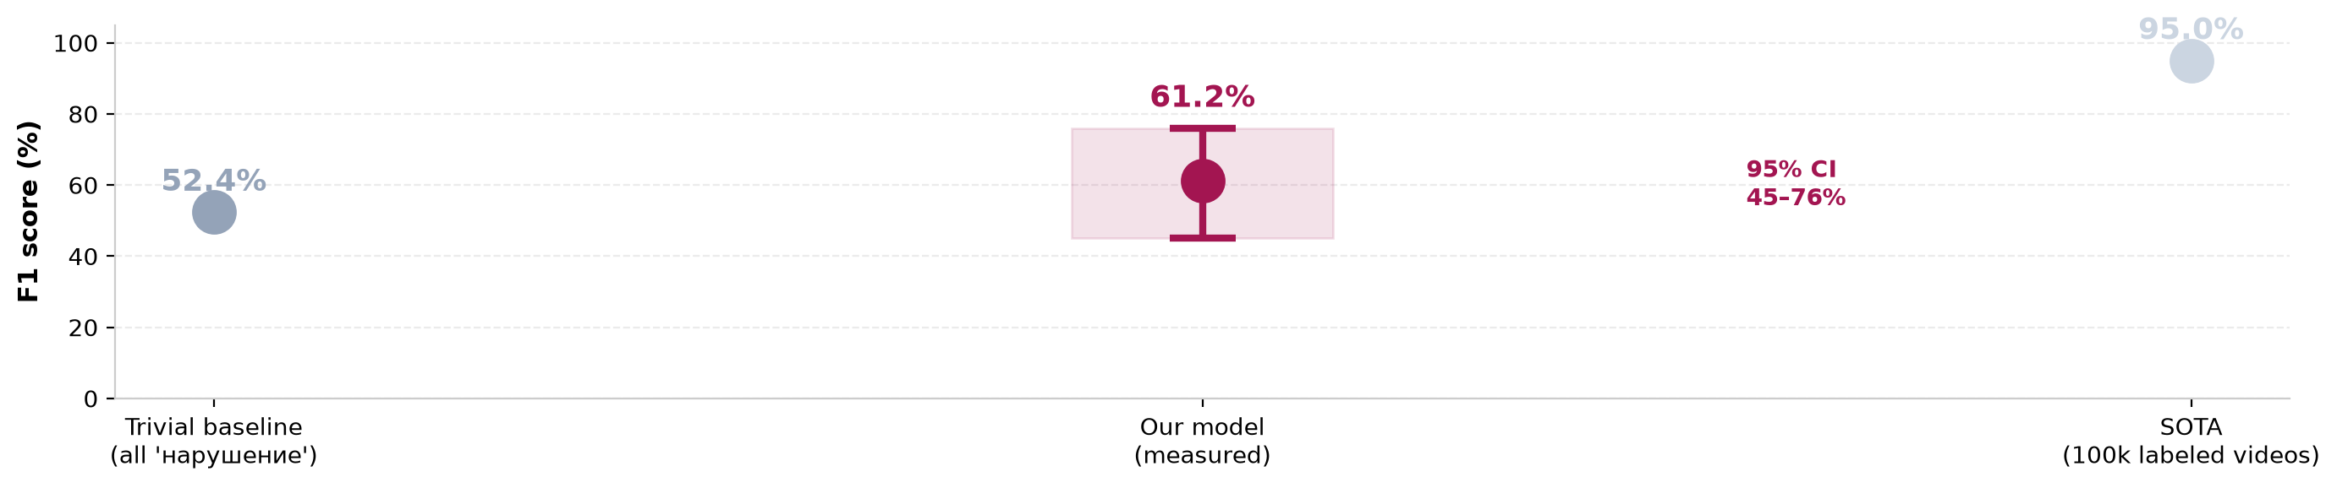
Statistical validity: n=42 spans 30 F1 points
Every number on subsequent slides inherits this uncertainty.
WHAT THIS MEANS
• 95% CI on F1 is 45–76%. The lower bound overlaps the trivial baseline.
• Required sample size for ±5% CI at 95% confidence is ~400 clips. We had 42.
• Treat every number on subsequent slides as an existence proof, not a performance claim.
3 / 12

Slide 4
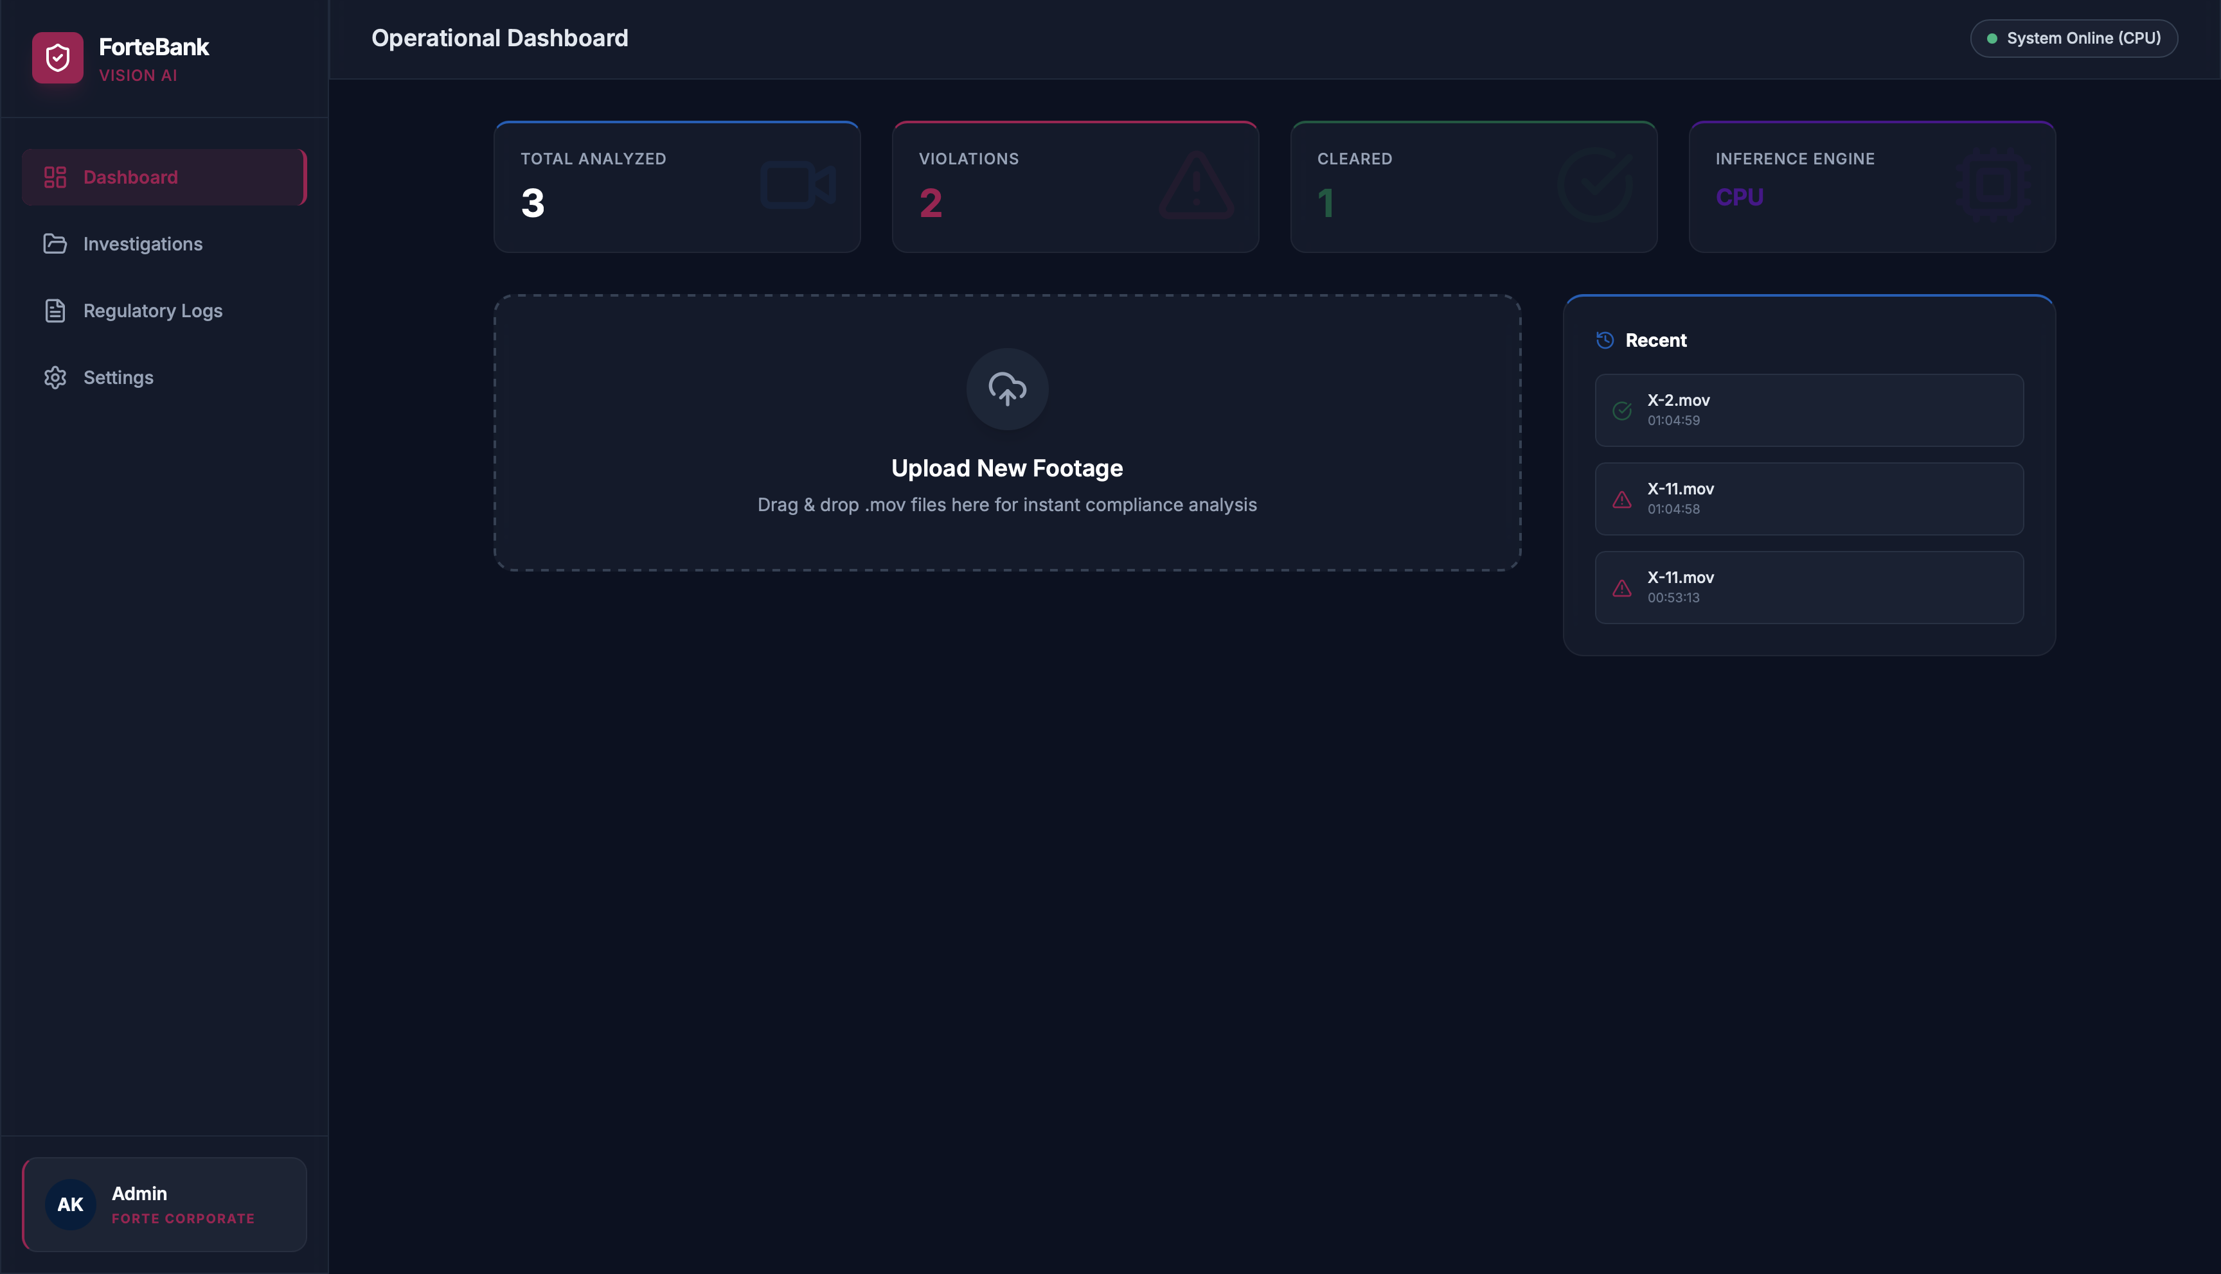
What we shipped: the verifiable subset
One rule. Deterministic. Cited. Runs on a branch server, offline.
THE RULE
• Detects: cashier leaves workstation zone for more than 1.2s
• Cites: NBRK Resolution 231, Article 22, verified on adilet.zan.kz
• Output: timestamp, evidence JPEG, article number, direct URL
THE SYSTEM
• 1.0s per 25s video on M1 CPU, 179 MB peak RAM
• Docker image, fully offline after pull
• Live demo, working API, deterministic output
4 / 12

Slide 5
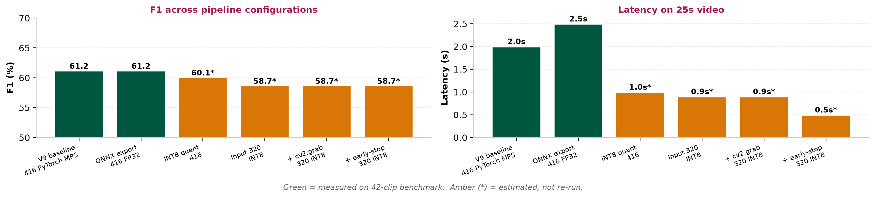
Ablation: what we measured vs. what we estimated
The shipped configuration has NOT been re-benchmarked on all 42 clips.
HONEST READING
• Full F1 benchmark was run on V9 PyTorch MPS only. Post-ONNX numbers are estimated.
• The shipped INT8 320x320 model was spot-checked on X-11 (correct) and X-48 (correct).
• Re-running the benchmark on the shipped model is the first task for Phase 2.
5 / 12

Slide 6
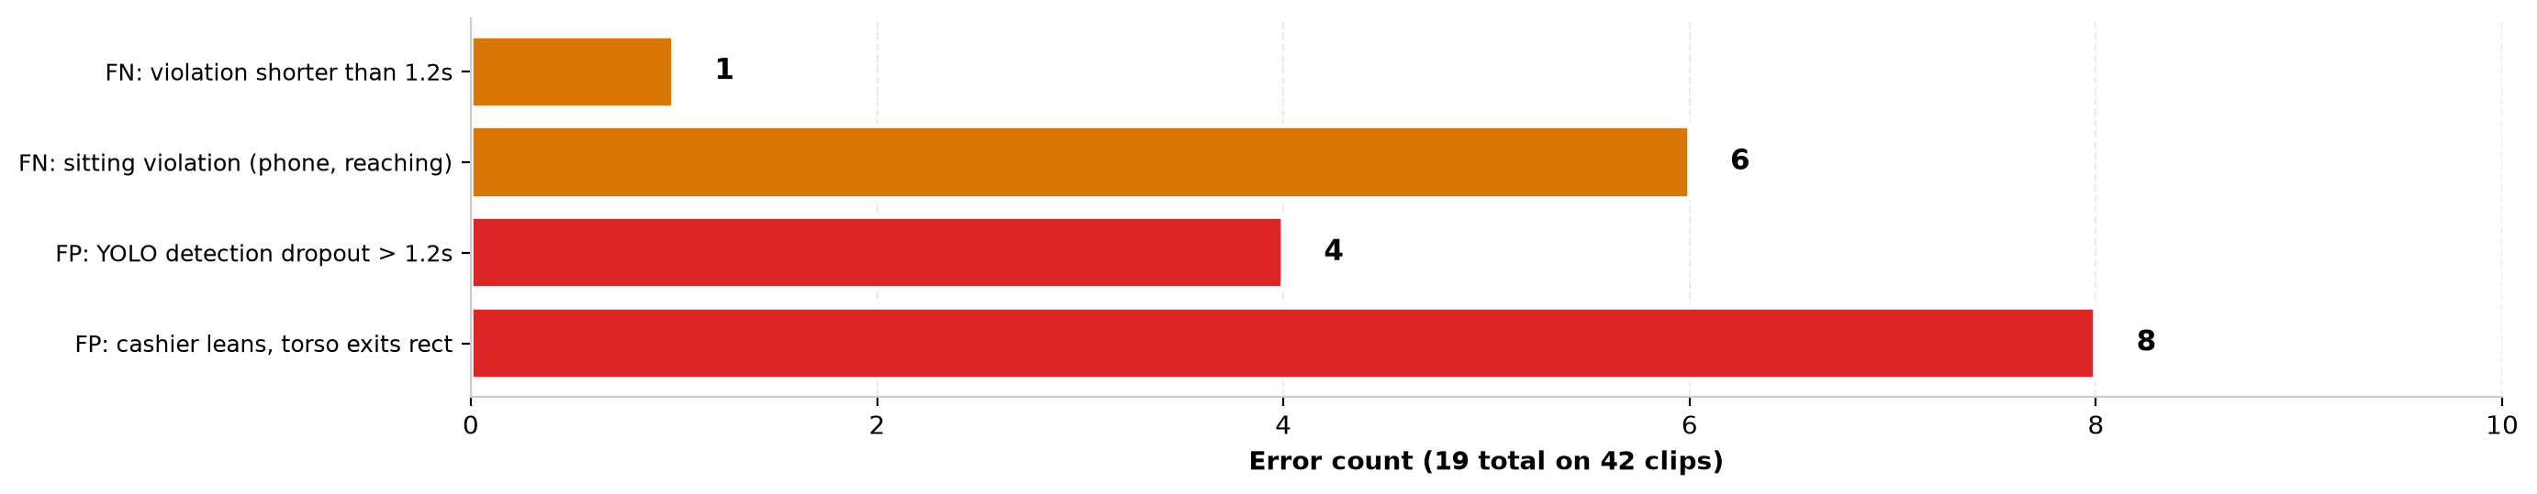
Failure taxonomy: 19 errors, 4 root causes
Not 'the model is bad'. Specific failure modes with specific fixes.
WHAT IS FIXABLE VS. WHAT IS NOT
• 8 FPs from lean: tighten the vertical rect boundary. One line. May cost a few TPs.
• 4 FPs from detection dropout: require 2 consecutive frames of no-detection before firing.
• 6 FNs from sitting violations: needs an action classifier. Not fixable in 48h.
• 1 FN from short violation: lower streak threshold from 6 to 4. Risk: more FPs.
6 / 12

Slide 7
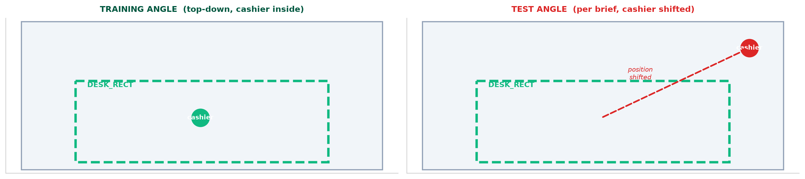
Generalization: the biggest honest limitation
The dataset brief says test is filmed from a different angle. We did not solve this.
TWO VIABLE PATHS, BOTH OUT OF 48H SCOPE
• Approach A: per-video desk detection using YOLO's 'dining table' class + homography
• Approach B: manual desk-corner annotation at inference time (UI prompt before analysis)
• Both require 1–2 days of implementation and validation. Deferred to Phase 2.
7 / 12

Slide 8
What we rejected: with proper caveats
Two single tests. We do not claim these generalize to the categories.
MOONDREAM2 (VLM)
YOLOV8S-POSE
• Prompt: 'Is there a mobile phone visible?' (single-sentence, no chain-of-thought)
• n=4 clean videos. All 4 produced false positives.
• Root cause: IP desk phone on every desk. VLM answered 'yes'.
• n=2 real violations. Both answered 'no'. Phone too small.
• Head/wrist keypoints as proxy for presence and phone use
• Failure 1: keypoints drop for 1-3 frames on lean-forward (12/12 FPs)
• Failure 2: chin-rest and phone-call are geometrically identical in 2D
• No threshold separates them at this resolution
CAVEAT
• Each test was a single experiment. n=4 and n=12 respectively. Single prompt, single model.
• Not tried: alternative prompts, chain-of-thought, or other VLMs. That is the study a real researcher would run.
• We do not claim 'VLMs fail'. We claim 'this VLM with this prompt failed'.
8 / 12

Slide 9
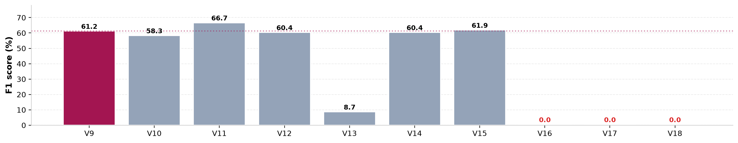
The iteration story: measurement as ground truth
9 versions. 3 produced 0% F1. Each looked correct before measurement.
WHAT BROKE AND WHY
• V13 (central column): box expanded to 70% of frame → everything counted as 'at desk' → 8.7% F1
• V16 (adaptive home base): cashier never exceeded threshold → streak never fired → 0% F1
• V17 (no-null-detection guard): guard prevented streak from building → 0% F1
• V18 (y2=1.0): box covered bottom of frame, same failure as V17 → 0% F1
9 / 12

Slide 10
Related work and the honest gap
We do not beat SOTA. We characterize the achievable floor under constraint.
Approach | Resource requirement | Why not used here
AVA, MOMA, SlowFast | 100k+ labeled videos, 8-128 GPUs | Not applicable: 42 videos, 1 M1
Retail fraud (Chen et al. 2019) | 10k+ labeled transactions | Not public, not obtainable in 48h
Pose-based action recognition | Requires stable keypoints | Fails at this resolution (slide 8)
VLM zero-shot (GPT-4V, Llama-Vision) | Cloud APIs or 7 GB local models | Prohibited by data residency
This work | 42 clips, 48h, CPU-only, offline | 61.22% F1, verifiable, deployable
POSITIONING
• This is not SOTA. It is 'what can you ship today under the constraints above'.
• The gap to SOTA is order-of-magnitude on data and compute. Not closeable in 48h.
• The contribution is a feasibility bound and a legal-anchoring pattern, not a new model.
10 / 12

Slide 11
The ask: statistical power, not features
What would move this from pilot study to validated claim.
WEEKS 1 TO 6
Label 400 clips (from 42). Two annotators.
Moves CI from ±15% to ±5%
WEEKS 7 TO 10
Fine-tune 3D action classifier for sitting violations
Target: +5 F1 on phone/reaching
WEEKS 11 TO 12
Per-video desk detection for angle invariance
Target: generalizes to test angle
WEEKS 13 TO 16
One pilot branch, 30 days live footage
Success: 80% catch, <10% FP
WHAT WE NEED FROM YOU
• 400 historical clips for labeling · one pilot branch contact · nothing else
11 / 12

Slide 12
This is a pilot study.
We proved: deterministic, legally-anchored, CPU-deployable CV is achievable in 48h.
We did not prove: generalization, statistical significance, or action recognition.
The gap is measurable, not hidden.
github.com/almansur04/forte-cash-cv
docker run -p 8000:8000 almansur04/forte-cash-api:latest
API key: forte-hack-2026

