Slide 1
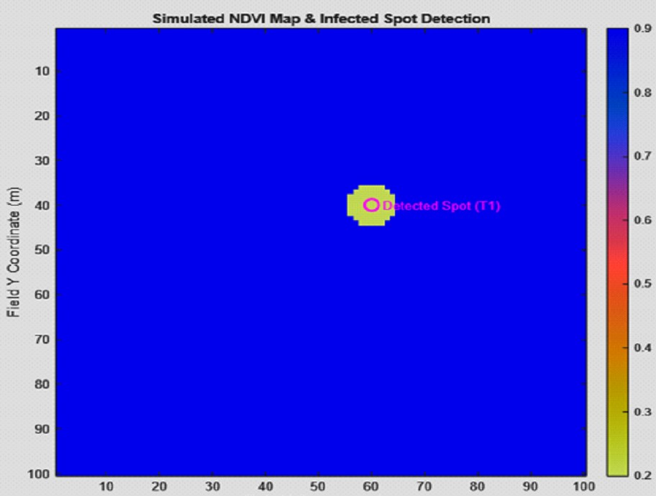
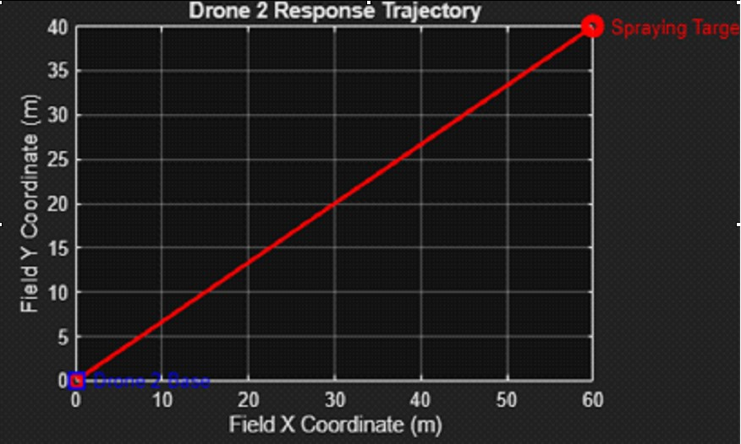
Drone-to-Drone Collaboration for Agricultural Surveillance
Ali Hassan Abushaheen
Mohammed Jassim Aleid
Ali Abdulnasser Almashan
Abstract
To address water waste in farming, this project uses a two-drone system simulated in MATLAB. The first drone identifies dry areas using NDVI (plant health) sensors and sends the location to a second drone via MQTT communication. Results show a very fast response time of 61.33 ms, proving the system is an efficient tool.
Keywords
UAV, Drone Collaboration, NDVI, MQTT, Smart Farming, Agricultural
IV. Experimental Results
MATLAB allows accurate simulation and visualization.
Positive: Easy testing without hardware cost.
Negative: Simulation may not include real-world uncertainties
Result Parameter | Value
Simulated Field Area | 100 × 100 meters
Detected Spot Coordinates | (60, 40)
Communication Delay (MQTT) | 61.3317 ms
Flight Distance (Drone 2) | 72.111 meters
I. Introduction (22 point font, bold letters )
Farming is important for food. But old ways of farming waste water and it is hard to find small problems in big fields. We need Smart Farming which uses tech to help plants in the right spots. The best tool for this is the Drone.
Drones can fly high and use special cameras to take pictures. These pictures help us know if plants are sick. We use NDVI for this.
Our work is about Drone Collaboration (drones working together):
⦁ Drone 1 (The Checker): Finds the bad spots using NDVI.
⦁ Drone 2 (The Helper): Flies right to the bad spot to spray the medicine.
Our main goal is to build a test in MATLAB to show how fast it is.
Fig. 1. Experimental Results
The system detected the problem at (60, 40) accurately.
This is positive because accurate location reduces unnecessary drone movement.
II. Motivation of the Project
The motivation behind this project is the need for efficient, fast, and energy-saving agricultural monitoring systems. Single-drone systems waste energy because the drone must fly over the entire field even if only a small area has a problem.
By using collaborative drones, tasks can be divided. This reduces unnecessary movement, saves battery power, and increases system lifetime. This motivation is especially important for large farms where efficiency directly affects cost and productivity.
Traditional farming methods suffer from several disadvantages. First, manual inspection is slow and cannot cover large areas efficiently. Second, water and fertilizers are often applied to the entire field instead of specific areas, which causes waste. Third, single-drone monitoring systems suffer from long flight paths and high energy consumption.
Fig. 2. Detection Accuracy
III. Proposed Methodology
The methodology is divided into clear steps to ensure system reliability.
Positivity: Step-by-step workflow reduces errors and improves accuracy.
V. Energy Efficiency
The flight distance was 72.111 meters.
Positive: Shorter distance saves battery power.
Negative: Energy savings depend on path optimization.
A. NDVI Analysis
NDVI helps detect plant stress early.
Positive: Early detection reduces crop loss and chemical usage.
This is important because it saves money and protects the environment.
Negative: NDVI accuracy depends on sensor quality and lighting conditions.
B. MQTT Communication
MQTT enables fast message delivery.
Positive: Low latency improves response time.
This is critical because fast response prevents problem spread.
Negative: Requires a stable communication channel.
System Architecture
The system architecture ensures smooth communication between drones.
Positive: Central broker simplifies message exchange.
Negative: Broker failure can affect the whole system.
C. MATLAB Implementation
MQTT enables fast message delivery.
Positive: Low latency improves response time.
This is critical because fast response prevents problem spread.
Negative: Requires a stable communication channel.
System Architecture
The system architecture ensures smooth communication between drones.
Positive: Central broker simplifies message exchange.
Negative: Broker failure can affect the whole system.
Fig. 3. Distance Traveled
VI. Conclusion
This project clearly demonstrates that Drone-to-Drone Collaboration is a highly effective solution for agricultural surveillance. The detailed analysis of advantages and disadvantages shows that the benefits strongly outweigh the limitations. By combining NDVI, MQTT, and MATLAB simulation, the system provides a reliable foundation for future smart farming technologies.
References
⦁ Implementing a Communication Network between Bases Station applied for Group of Drones
https://ieeexplore.ieee.org/document/9951038/
⦁ Drones for Normalized Difference Vegetation Index (NDVI).
https://www.researchgate.net/publication/312497233_Drones_for_Normalized_Difference_Vegetation_Index_NDVI_to_Estimate_Crop_Health_for_Precision_Agriculture_A_Cheaper_Alternative_for_Spatial_Satellite_Sensors

