Slide 1
DC20082
UMD DC2020

Slide 2

GOAL:
“Making your vision a reality”

Slide 3

OVERALL PROBLEM:
In the aspect of Training Topics, what demographics should be be targeted?

Slide 4
A Better look...
Business status
Format
County
Start Date
Gender
Attendee (ID)
Event (Name)
Topic
Race
Center Name
Hispanic
Region

Slide 5
Advertisement model
TOPIC
FORMAT
DEMOGRAPHICS
When targeting the right audience we must:
Determine the topics
Observe the #1 ranked topic for Webinar/Seminar
Asses the demographics that will achieve the highest outcome

Slide 6

PROBLEM:
Which topics are the most successful amongst the formats?

Slide 7
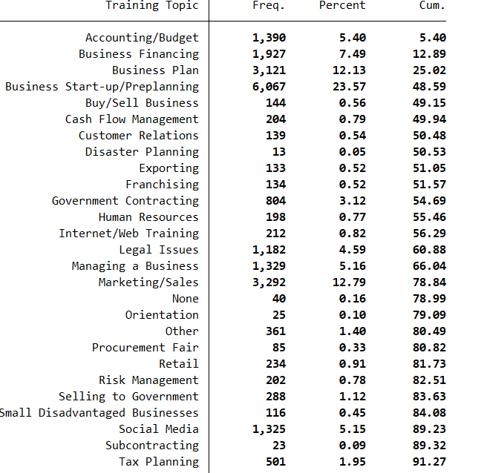
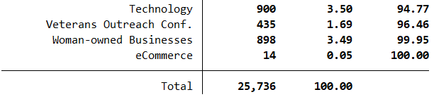
What format should be offered based upon the topic of the training?
Seminar or Webinar

Slide 8
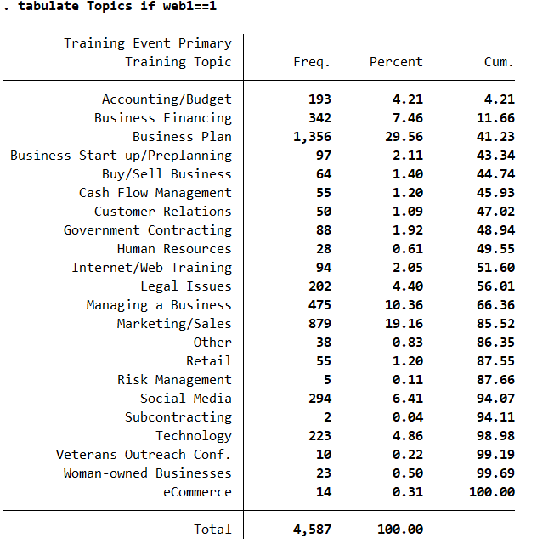
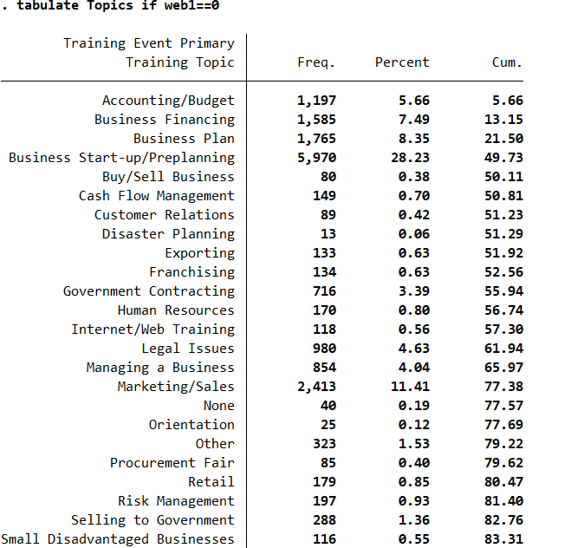
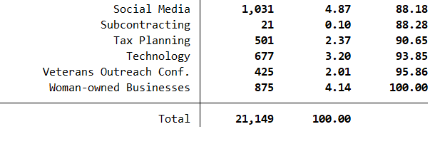

Slide 9
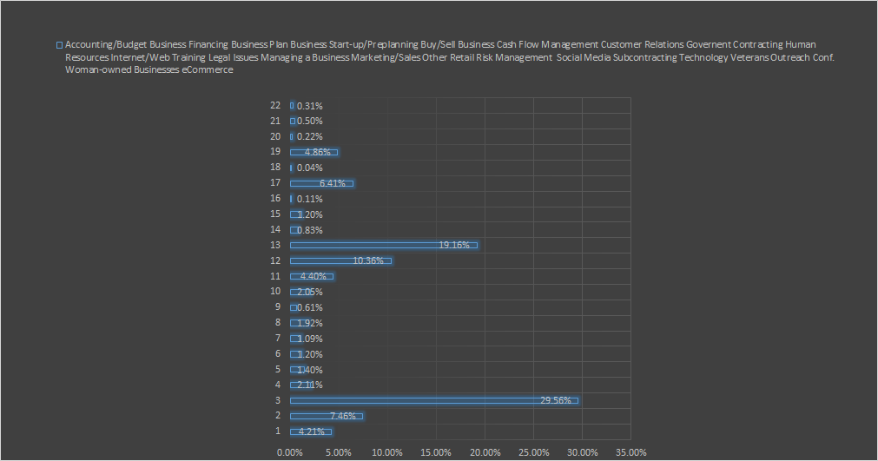
ONLINE VIDEO/WEBINAR
Accounting/Budget
Business Financing
Business Plan
Business Start-up/Preplanning
Buy/Sell Business
Cash Flow Management
Customer Relations
Government Contracting
Human Resources
Internet/Web Training
Legal Issues
Managing a Business
Marketing/Sales
Other
Retail
Risk Management
Social Media
Subcontracting
Technology
Veterans Outreach Conf.
Woman-owned Businesses
eCommerce

Slide 10
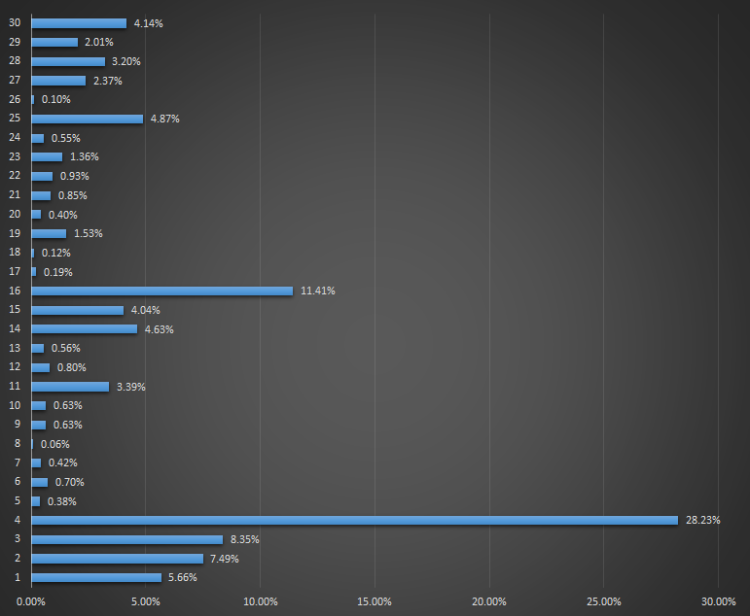
SEMINAR
Accounting/Budget
Business Financing
Business Plan
Business Start-up/Preplanning
Buy/Sell Business
Cash Flow Management
Customer Relations
Disaster Planning
Exporting
Franchising
Government Contracting
Human Resources
Internet/Web Training
Legal Issues
Managing a Business
Marketing/Sales
None
Orientation
Other
Procurement Fair
Retail
Risk Management
Selling to Government
Small Disadvantaged Businesses
Social Media
Subcontracting
Tax Planning
Technology
Veterans Outreach Conf.
Woman-owned Businesses

Slide 11
Observations
801 attendees went to more than 1 webinar
2665 individuals attended a seminar
30% repetition rate
738 attendees went to more than 1 seminar
11771 individuals attended 1 seminar
6.3% repetition rate
If you want more customers = choose Seminar
If you want more REPEAT customers = Webinar
Notes:
986 people did both a seminar and a webinar

Slide 12
PROBLEM:
Are there topics that preferentially divide amongst gender?

Slide 13
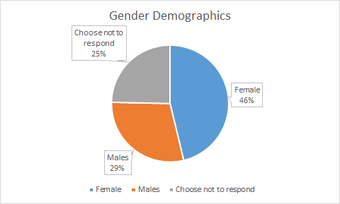
Female above average
Tax planning - 61.5%
Orientation - 64%
Human Resources - 66%
Male above average
Selling to gov - 41.6%
Disadvantaged business - 37.6%
Veterans outreach - 49.8%
Interesting side note
Small/disadvantaged business
3.2% - Choose not to respond
We are interested in topics that have deviation from these overall averages
Demographics - Gender
Notes:
Other topics female above average: Franchising (58%), social media (60.5%), procurment fair (60.2%), Woman-owned business (73.6%)
Males above average - Government contacting 36.5%, exporting 36%, financing 36.5%

Slide 14
PROBLEM:
Do businesses in different stages prefer different formats?

Slide 15
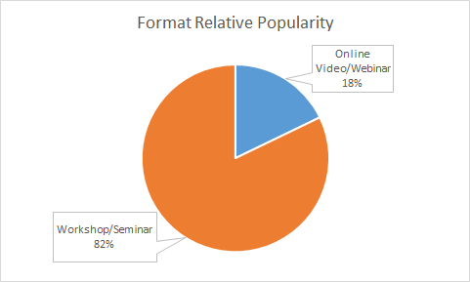
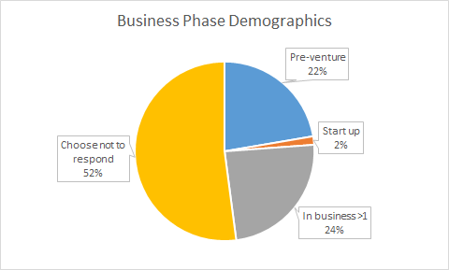
Start-up (in bus. < 1 year)
Seminar - 84.95%
Webinar - 15.05%
Choose not to respond
Webinar - 19.08%
Seminar - 80.92%
Pre-venture/Nascent
Webinar - 16.56%
Seminar - 83.44%
In Business (> 1 year)
Seminar - 83.13%
Webinar - 16.87%
Businesses in different stages have no indicative preference for one format over the other
Participants are dominantly pre-venture or established in business
Start-ups may lack the capital to attend

Slide 16
PROBLEM:
Based on region of the training event what attendee counties should be targeted?

Slide 17
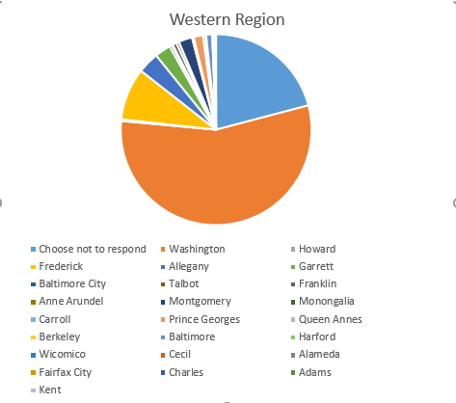
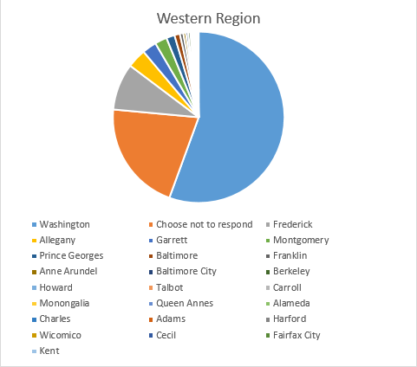
Washington 925
Choose not to respond 348
Frederick 147
Allegany 60
Garrett 45
Montgomery 38
Prince Georges 26
Baltimore 17
Franklin 11
Anne Arundel 8
Baltimore City 7
Berkeley 7
Howard 5
Talbot 3
Carroll 3
Monongalia 2
Queen Annes 2
…

Slide 18
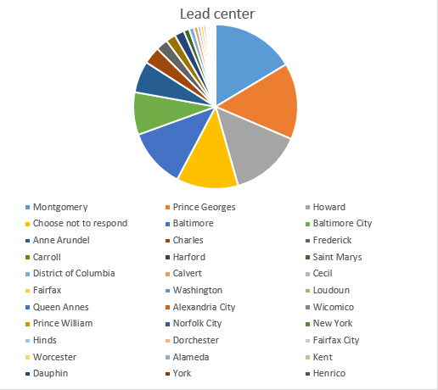
Montgomery 256
Prince Georges 235
Howard 221
Choose not to respond 190
Baltimore 183
Baltimore City 131
Anne Arundel 97
Charles 53
Frederick 37
Carroll 30
Harford 30
Saint Marys 17
District of Columbia 15
Calvert 12
Cecil 9
Fairfax 9
Washington 7
Loudoun 4
Queen Annes 4
…

Slide 19
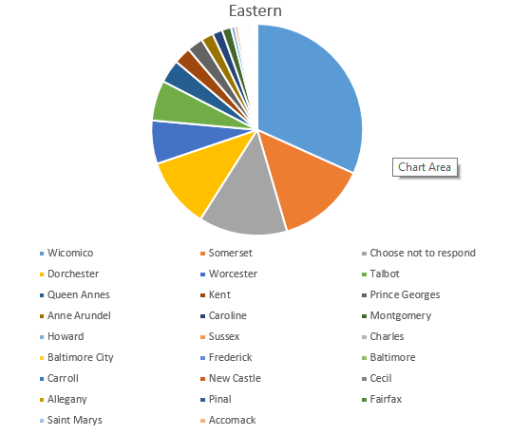
Wicomico 206
Somerset 89
Choose not to respond 88
Dorchester 70
Worcester 43
Talbot 40
Queen Annes 23
Kent 17
Prince Georges 16
Anne Arundel 12
Caroline 10
Montgomery 9
Howard 4
Sussex 3
Charles 2
Baltimore City 2
Frederick 2
Baltimore 2
...

Slide 20
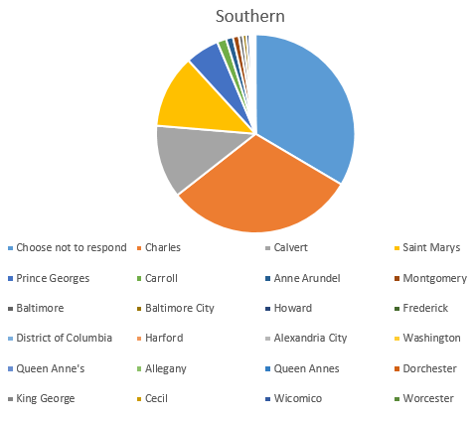
Choose not to respond 830
Charles 766
Calvert 295
Saint Marys 295
Prince Georges 136
Carroll 37
Anne Arundel 28
Montgomery 24
Baltimore 16
Baltimore City 14
Howard 12
Frederick 7
District of Columbia 3
Harford 2
Alexandria City 2
Washington 2
Queen Anne's 2
Allegany 1
Queen Annes 1
Dorchester 1
King George 1
...

Slide 21
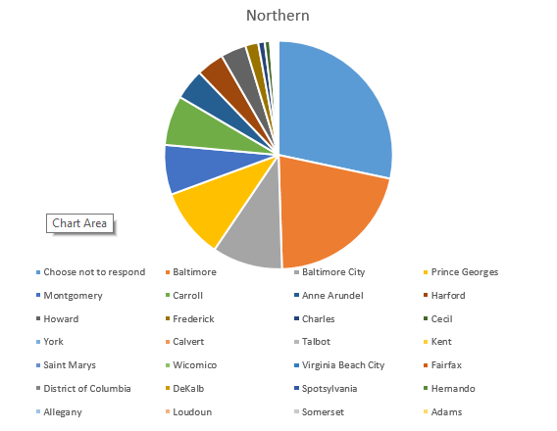
Choose not to respond 684
Baltimore 511
Baltimore City 240
Prince Georges 239
Montgomery 170
Carroll 170
Anne Arundel 105
Harford 94
Howard 87
Frederick 44
Charles 22
Cecil 18
York 4
Calvert 3
Talbot 3
Kent 3
Saint Marys 3
Wicomico 2
Virginia Beach City 2
Fairfax 1
District of Columbia 1
...

Slide 22
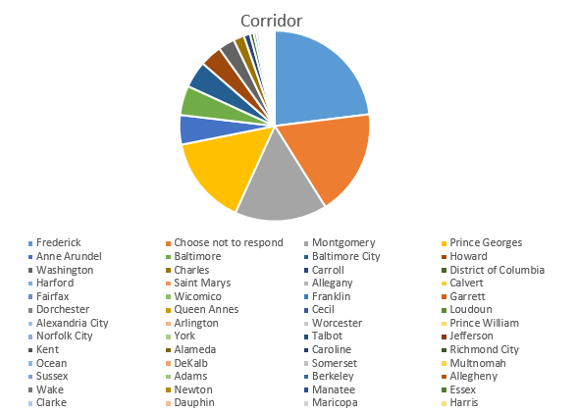
Frederick 3908
Choose not to respond 3068
Montgomery 2660
Prince Georges 2555
Anne Arundel 850
Baltimore 847
Baltimore City 769
Howard 634
Washington 476
Charles 310
Carroll 177
District of Columbia 108
Harford 82
Saint Marys 72
Allegany 53
Calvert 50
Fairfax 40
Wicomico 29
Franklin 25
Garrett 23
….

