Slide 1
Tristan Almada
GA Data Science
Final Project 6 Dec 2016
Predictors of HPV Vaccine Uptake in
New York City: A Community District Analysis

Slide 2

Paulette Should Still be Living Today
Inoculation with one of the two HPV vaccines, Gardasil and Cervarix
Screening protocols that detect and treat pre-cancer many years before it turns into late-stage disease
Improved therapeutic options that replace the antiquated chemotherapy cocktail that has scarcely improves patient outcomes for decades
Paulette Isabel Crowther,
1956 - 2010
Notes:
We learned the terrible consequences of late-stage diagnosis of an HPV-related cancer in 2008.
Our beloved mother Paulette was 51 when she was diagnosed with stage IV anal cancer. Despite exhausting every avenue we could think of and showering her with our constant love and affection, she passed away only two years later.
Based on our experiences, extensive research, and large network of clinical, scientific, and governmental contacts, we have identified three ways how Paulette, and the many HPV-related cancer patients like her, could still be living healthily today:
Inoculation with one of the two HPV vaccines, Gardasil and Cervarix, which offer safe and effective protection against the most common cancer-causing HPV strains.
Screening protocols that detect and treat precancer many years before it turns into late-stage disease. Anal cancer, like cervical cancer, tends to have specific, definable risk factors and often displays early, detectable symptoms.
Improved therapeutic options that replace the antiquated chemotherapy cocktail that scarcely improves patient outcomes. We believe that a breakthrough drug for any HPV-related disease could benefit the entire spectrum of HPV-related malignancies.

Slide 3
What is HPV?
HPV is a very contagious virus that lives on the skin, passed through sexual contact, passionate kissing, pregnant women to their babies, but also inanimate objects like doorknobs and toilet seats.
Four out of five people contract one type of HPV at least once in their life
An estimated 5% of all cancers worldwide are caused by HPV – and rising, especially in men
Both males and females suffer from HPV-related infection and disease
No standardized screening programs to detect HPV-related oral and anal cancer
No standardized therapeutics to cure HPV-related cancer
But there is a VACCINE.
Notes:
We learned the terrible consequences of late-stage diagnosis of an HPV-related cancer in 2008.
Our beloved mother Paulette was 51 when she was diagnosed with stage IV anal cancer. Despite exhausting every avenue we could think of and showering her with our constant love and affection, she passed away only two years later.
Based on our experiences, extensive research, and large network of clinical, scientific, and governmental contacts, we have identified three ways how Paulette, and the many HPV-related cancer patients like her, could still be living healthily today:
Inoculation with one of the two HPV vaccines, Gardasil and Cervarix, which offer safe and effective protection against the most common cancer-causing HPV strains.
Screening protocols that detect and treat precancer many years before it turns into late-stage disease. Anal cancer, like cervical cancer, tends to have specific, definable risk factors and often displays early, detectable symptoms.
Improved therapeutic options that replace the antiquated chemotherapy cocktail that scarcely improves patient outcomes. We believe that a breakthrough drug for any HPV-related disease could benefit the entire spectrum of HPV-related malignancies.

Slide 4
Why investigate this problem?
The U.S. Department of Health and Human Services' Healthy People 2020 mission states that the goal is to have an 80% vaccine rate by 2020. For HPV, Australia >75% and the UK >90%.
Current progress in the USA for HPV (all doses): girls (41.9%), boys (28.1%) vs Tdap >88%. We have a vaccine that prevents cancer yet there is resistance. Why?
Problem to solve: Why are HPV vaccine rates in the USA so low? What are the barriers? How can local-level data help inform this?
Notes:
We learned the terrible consequences of late-stage diagnosis of an HPV-related cancer in 2008.
Our beloved mother Paulette was 51 when she was diagnosed with stage IV anal cancer. Despite exhausting every avenue we could think of and showering her with our constant love and affection, she passed away only two years later.
Based on our experiences, extensive research, and large network of clinical, scientific, and governmental contacts, we have identified three ways how Paulette, and the many HPV-related cancer patients like her, could still be living healthily today:
Inoculation with one of the two HPV vaccines, Gardasil and Cervarix, which offer safe and effective protection against the most common cancer-causing HPV strains.
Screening protocols that detect and treat precancer many years before it turns into late-stage disease. Anal cancer, like cervical cancer, tends to have specific, definable risk factors and often displays early, detectable symptoms.
Improved therapeutic options that replace the antiquated chemotherapy cocktail that scarcely improves patient outcomes. We believe that a breakthrough drug for any HPV-related disease could benefit the entire spectrum of HPV-related malignancies.

Slide 5
My Project
Identify the broad set of conditions that predict HPV vaccinate rates on a local-level basis.
The CDC uses state-by-state sample as part of the NIS (National Immunization Survey) to generate their data. There is aggregation bias/sampling errors inherent in this approach, particularly when comparing means.
New York City keeps track of immunizations as part of the NYIIS (New York Immunization Information Survey). In theory, every known vaccination is recorded in that data set. For the scope of this project, I examined Community-District level aggregates. Unfortunately, there are only 59 CDs and 58 features.
I started by trying to compare county-level data from other states, but the formats were very different.
Notes:
We learned the terrible consequences of late-stage diagnosis of an HPV-related cancer in 2008.
Our beloved mother Paulette was 51 when she was diagnosed with stage IV anal cancer. Despite exhausting every avenue we could think of and showering her with our constant love and affection, she passed away only two years later.
Based on our experiences, extensive research, and large network of clinical, scientific, and governmental contacts, we have identified three ways how Paulette, and the many HPV-related cancer patients like her, could still be living healthily today:
Inoculation with one of the two HPV vaccines, Gardasil and Cervarix, which offer safe and effective protection against the most common cancer-causing HPV strains.
Screening protocols that detect and treat precancer many years before it turns into late-stage disease. Anal cancer, like cervical cancer, tends to have specific, definable risk factors and often displays early, detectable symptoms.
Improved therapeutic options that replace the antiquated chemotherapy cocktail that scarcely improves patient outcomes. We believe that a breakthrough drug for any HPV-related disease could benefit the entire spectrum of HPV-related malignancies.

Slide 6
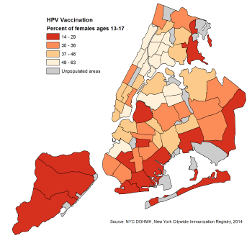
Visualizing NYC HPV vaccine coverage
Notes:
We learned the terrible consequences of late-stage diagnosis of an HPV-related cancer in 2008.
Our beloved mother Paulette was 51 when she was diagnosed with stage IV anal cancer. Despite exhausting every avenue we could think of and showering her with our constant love and affection, she passed away only two years later.
Based on our experiences, extensive research, and large network of clinical, scientific, and governmental contacts, we have identified three ways how Paulette, and the many HPV-related cancer patients like her, could still be living healthily today:
Inoculation with one of the two HPV vaccines, Gardasil and Cervarix, which offer safe and effective protection against the most common cancer-causing HPV strains.
Screening protocols that detect and treat precancer many years before it turns into late-stage disease. Anal cancer, like cervical cancer, tends to have specific, definable risk factors and often displays early, detectable symptoms.
Improved therapeutic options that replace the antiquated chemotherapy cocktail that scarcely improves patient outcomes. We believe that a breakthrough drug for any HPV-related disease could benefit the entire spectrum of HPV-related malignancies.

Slide 7
Data Sourcing
Primarily from NYC Open Data.
Secondarily from Board of Elections. Election data is not aggregated by community district, but by electoral district. I mapped the neighborhoods in the electoral districts to the community districts so I could include Trump Support as a feature in the dataset.
At this time, NYC Open Data only has Community-District level resolution available for HPV vaccine. There are 59 Community Districts in NYC
The dependent variable is HPV Vaccination, from the New York Citywide Immunization Registry
The independent variables are (sources) all in ‘rates’, i.e., % of population, unless otherwise noted
Overall population, by race and age (NYC DOHMH modified from US Census in 2013)
Residents born outside US (US Census, American Community Survey)
Self-reported health, Current Smokers, Sugary Drink Consumption, Fruit Consumption, Obesity, Diabetes, Any Physical Activity, Health Insurance, Flu Vaccination, Ever tested for HIV (NYC DOHMH, Community Health Survey)
Life expectancy, Avertable Deaths, Preterm births, teen births, Premature Mortality Rate, Leading Causes of Death (Bureau of Vital Statistics)
Maintenance Defects (NYC Housing Survey)
Air pollution (Community Air Survey)
Adult Educational attainment, Poverty, Unemployment, Rent-burdened Households (US Census, American Community Survey)
Trump Support (from Board of Elections)
Notes:
We learned the terrible consequences of late-stage diagnosis of an HPV-related cancer in 2008.
Our beloved mother Paulette was 51 when she was diagnosed with stage IV anal cancer. Despite exhausting every avenue we could think of and showering her with our constant love and affection, she passed away only two years later.
Based on our experiences, extensive research, and large network of clinical, scientific, and governmental contacts, we have identified three ways how Paulette, and the many HPV-related cancer patients like her, could still be living healthily today:
Inoculation with one of the two HPV vaccines, Gardasil and Cervarix, which offer safe and effective protection against the most common cancer-causing HPV strains.
Screening protocols that detect and treat precancer many years before it turns into late-stage disease. Anal cancer, like cervical cancer, tends to have specific, definable risk factors and often displays early, detectable symptoms.
Improved therapeutic options that replace the antiquated chemotherapy cocktail that scarcely improves patient outcomes. We believe that a breakthrough drug for any HPV-related disease could benefit the entire spectrum of HPV-related malignancies.

Slide 8
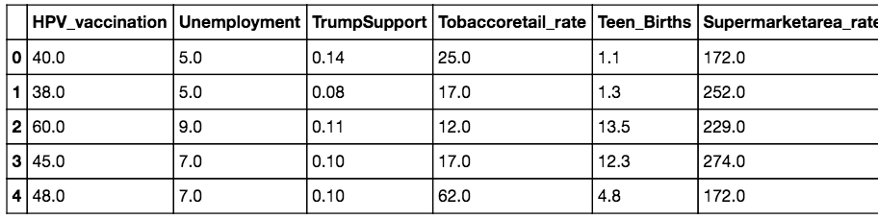
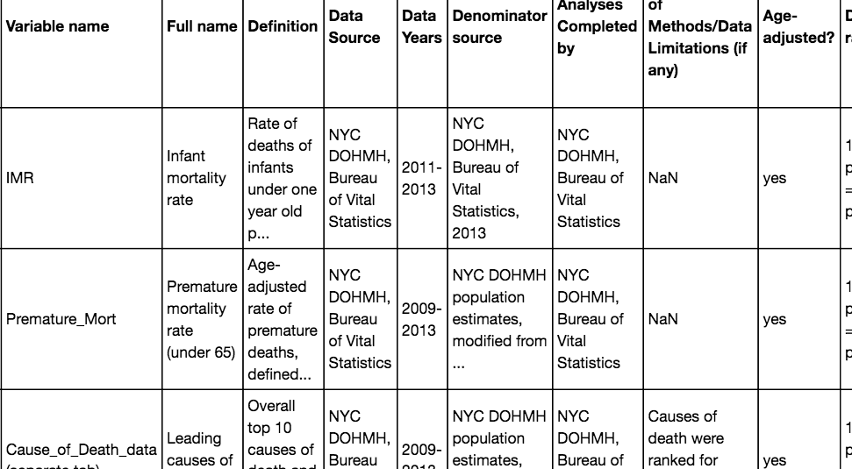
Data Snapshot / Data Dictionary
Notes:
We learned the terrible consequences of late-stage diagnosis of an HPV-related cancer in 2008.
Our beloved mother Paulette was 51 when she was diagnosed with stage IV anal cancer. Despite exhausting every avenue we could think of and showering her with our constant love and affection, she passed away only two years later.
Based on our experiences, extensive research, and large network of clinical, scientific, and governmental contacts, we have identified three ways how Paulette, and the many HPV-related cancer patients like her, could still be living healthily today:
Inoculation with one of the two HPV vaccines, Gardasil and Cervarix, which offer safe and effective protection against the most common cancer-causing HPV strains.
Screening protocols that detect and treat precancer many years before it turns into late-stage disease. Anal cancer, like cervical cancer, tends to have specific, definable risk factors and often displays early, detectable symptoms.
Improved therapeutic options that replace the antiquated chemotherapy cocktail that scarcely improves patient outcomes. We believe that a breakthrough drug for any HPV-related disease could benefit the entire spectrum of HPV-related malignancies.

Slide 9
Hypothesis
The richer, the whiter, and more educated the Community District, the more likely it is to have lower HPV vaccine rates.
I had seen some state-level data that suggest the same, but a lot can vary from state-to-state making it an apples-to-oranges comparison. The purpose of this study was to examine HPV vaccine rate causality on a micro level (NYC may have more consistency in health-care policy across all districts, for example, emphasizing the importance of certain features)
Notes:
We learned the terrible consequences of late-stage diagnosis of an HPV-related cancer in 2008.
Our beloved mother Paulette was 51 when she was diagnosed with stage IV anal cancer. Despite exhausting every avenue we could think of and showering her with our constant love and affection, she passed away only two years later.
Based on our experiences, extensive research, and large network of clinical, scientific, and governmental contacts, we have identified three ways how Paulette, and the many HPV-related cancer patients like her, could still be living healthily today:
Inoculation with one of the two HPV vaccines, Gardasil and Cervarix, which offer safe and effective protection against the most common cancer-causing HPV strains.
Screening protocols that detect and treat precancer many years before it turns into late-stage disease. Anal cancer, like cervical cancer, tends to have specific, definable risk factors and often displays early, detectable symptoms.
Improved therapeutic options that replace the antiquated chemotherapy cocktail that scarcely improves patient outcomes. We believe that a breakthrough drug for any HPV-related disease could benefit the entire spectrum of HPV-related malignancies.

Slide 10
Modeling Approach
Considering that I had a continuous variable (HPV Vaccine rate) and all of my independent variables were also continuous, I chose OLS as my base model
Step 1: start with “intuitive features”
Multiple-least squares fit (Trump Support, Poverty, Insurance, Flu_Vaccination, Education Attainment > some college)
Step 2: use ML techniques to decide features
Lasso / Ridge
Step 3: Compare
Notes:
We learned the terrible consequences of late-stage diagnosis of an HPV-related cancer in 2008.
Our beloved mother Paulette was 51 when she was diagnosed with stage IV anal cancer. Despite exhausting every avenue we could think of and showering her with our constant love and affection, she passed away only two years later.
Based on our experiences, extensive research, and large network of clinical, scientific, and governmental contacts, we have identified three ways how Paulette, and the many HPV-related cancer patients like her, could still be living healthily today:
Inoculation with one of the two HPV vaccines, Gardasil and Cervarix, which offer safe and effective protection against the most common cancer-causing HPV strains.
Screening protocols that detect and treat precancer many years before it turns into late-stage disease. Anal cancer, like cervical cancer, tends to have specific, definable risk factors and often displays early, detectable symptoms.
Improved therapeutic options that replace the antiquated chemotherapy cocktail that scarcely improves patient outcomes. We believe that a breakthrough drug for any HPV-related disease could benefit the entire spectrum of HPV-related malignancies.

Slide 11
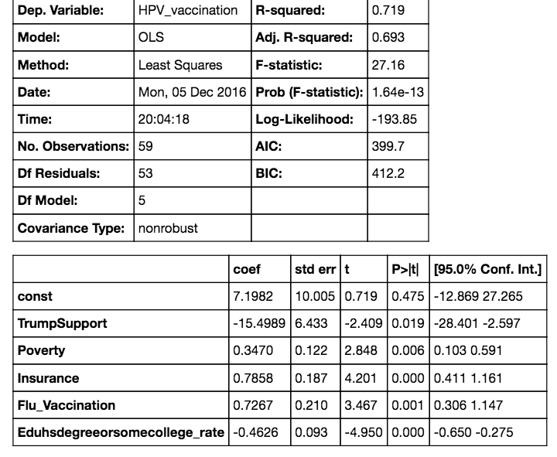
Step 1: Intuitive Approach & Results
Notes:
We learned the terrible consequences of late-stage diagnosis of an HPV-related cancer in 2008.
Our beloved mother Paulette was 51 when she was diagnosed with stage IV anal cancer. Despite exhausting every avenue we could think of and showering her with our constant love and affection, she passed away only two years later.
Based on our experiences, extensive research, and large network of clinical, scientific, and governmental contacts, we have identified three ways how Paulette, and the many HPV-related cancer patients like her, could still be living healthily today:
Inoculation with one of the two HPV vaccines, Gardasil and Cervarix, which offer safe and effective protection against the most common cancer-causing HPV strains.
Screening protocols that detect and treat precancer many years before it turns into late-stage disease. Anal cancer, like cervical cancer, tends to have specific, definable risk factors and often displays early, detectable symptoms.
Improved therapeutic options that replace the antiquated chemotherapy cocktail that scarcely improves patient outcomes. We believe that a breakthrough drug for any HPV-related disease could benefit the entire spectrum of HPV-related malignancies.

Slide 12

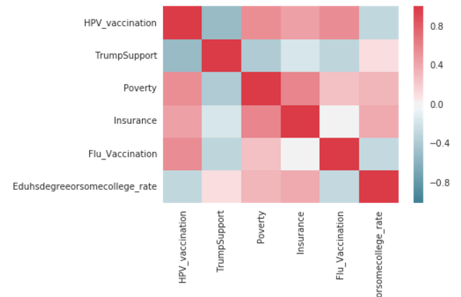
Step 1: How good is the model?
The density fxn shows normal distribution of residuals
The correlation matrix shows Trump Support and Some College Experience or higher to be negative predictors of HPV vaccine coverage. Poverty, Insurance, and Flu Vaccination are positive factors for HPV vaccine coverage.
Notes:
We learned the terrible consequences of late-stage diagnosis of an HPV-related cancer in 2008.
Our beloved mother Paulette was 51 when she was diagnosed with stage IV anal cancer. Despite exhausting every avenue we could think of and showering her with our constant love and affection, she passed away only two years later.
Based on our experiences, extensive research, and large network of clinical, scientific, and governmental contacts, we have identified three ways how Paulette, and the many HPV-related cancer patients like her, could still be living healthily today:
Inoculation with one of the two HPV vaccines, Gardasil and Cervarix, which offer safe and effective protection against the most common cancer-causing HPV strains.
Screening protocols that detect and treat precancer many years before it turns into late-stage disease. Anal cancer, like cervical cancer, tends to have specific, definable risk factors and often displays early, detectable symptoms.
Improved therapeutic options that replace the antiquated chemotherapy cocktail that scarcely improves patient outcomes. We believe that a breakthrough drug for any HPV-related disease could benefit the entire spectrum of HPV-related malignancies.

Slide 13
Step 2: ML Approach
I used all of the features in the dataset and then ran three scoring models: OLS, Lasso, and Ridge. Lasso showed a lower R2 (93 vs 99), but that was expected due to the fact that it drops features. My goal in using Lasso was to reduce the feature set. Lasso is a regularization technique often used when you want to reduce the number of features in a data set.
Using Grid Search, I found the best lasso hyper-parameter based on the scoring parameter of “R2” to be alpha = 10.
Plugging alpha=10 back into the model generated an R2 of 86 with only 17 features (down from 58 originally)
Somewhat bizarrely, the results included a lot of features I did not expect, such as Jail Incarceration, Premature Mortality, Stroke Hospitalizations, and Avoidable Asthma – very few of the features I thought would be relevant.
Looking into the p_vals of some of these features selected, they do not seem very good at all (.399 pvalue for Stroke for example?)
Notes:
We learned the terrible consequences of late-stage diagnosis of an HPV-related cancer in 2008.
Our beloved mother Paulette was 51 when she was diagnosed with stage IV anal cancer. Despite exhausting every avenue we could think of and showering her with our constant love and affection, she passed away only two years later.
Based on our experiences, extensive research, and large network of clinical, scientific, and governmental contacts, we have identified three ways how Paulette, and the many HPV-related cancer patients like her, could still be living healthily today:
Inoculation with one of the two HPV vaccines, Gardasil and Cervarix, which offer safe and effective protection against the most common cancer-causing HPV strains.
Screening protocols that detect and treat precancer many years before it turns into late-stage disease. Anal cancer, like cervical cancer, tends to have specific, definable risk factors and often displays early, detectable symptoms.
Improved therapeutic options that replace the antiquated chemotherapy cocktail that scarcely improves patient outcomes. We believe that a breakthrough drug for any HPV-related disease could benefit the entire spectrum of HPV-related malignancies.

Slide 14
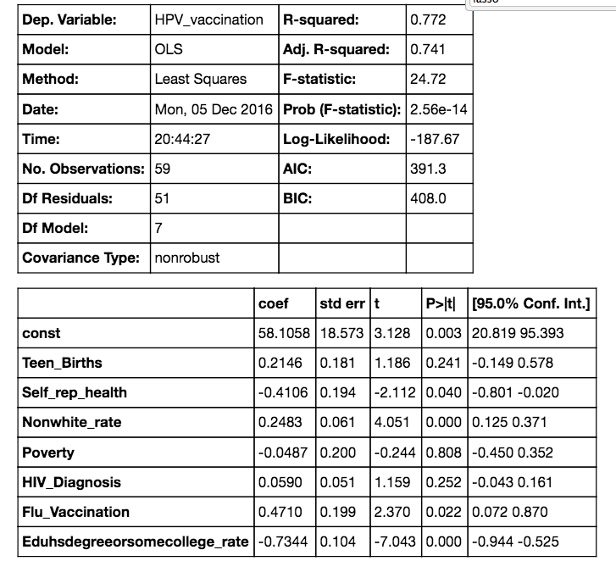
Step 2.5: ML Approach (Hybrid?)
I was concerned that I was skewing the data by over-fitting redundant information, such as the age groups. I ran another feature set: Unemployment, TrumpSupport, TeenBirths, Self-reported Health, Rent Burden, Poverty, Non-White Status, Insurance, Housing Defects, HIV_Testing, HIV_Diagnosis, Fruit_Veg, Flu_Vaccination, Exercise, Education Degree > College. I ran another Lasso which dropped down the feature set to 7. Results were good with an R-squared of 0.772 and most parameters with significant p-values.
Notes:
We learned the terrible consequences of late-stage diagnosis of an HPV-related cancer in 2008.
Our beloved mother Paulette was 51 when she was diagnosed with stage IV anal cancer. Despite exhausting every avenue we could think of and showering her with our constant love and affection, she passed away only two years later.
Based on our experiences, extensive research, and large network of clinical, scientific, and governmental contacts, we have identified three ways how Paulette, and the many HPV-related cancer patients like her, could still be living healthily today:
Inoculation with one of the two HPV vaccines, Gardasil and Cervarix, which offer safe and effective protection against the most common cancer-causing HPV strains.
Screening protocols that detect and treat precancer many years before it turns into late-stage disease. Anal cancer, like cervical cancer, tends to have specific, definable risk factors and often displays early, detectable symptoms.
Improved therapeutic options that replace the antiquated chemotherapy cocktail that scarcely improves patient outcomes. We believe that a breakthrough drug for any HPV-related disease could benefit the entire spectrum of HPV-related malignancies.

Slide 15
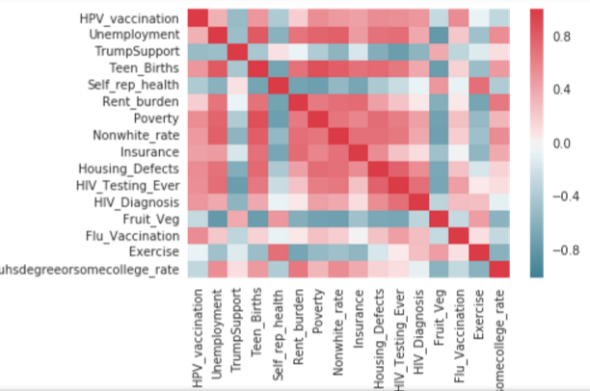
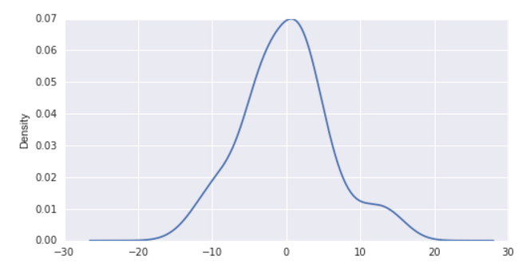
Step 2: ML Approach (Hybrid)
Notes:
We learned the terrible consequences of late-stage diagnosis of an HPV-related cancer in 2008.
Our beloved mother Paulette was 51 when she was diagnosed with stage IV anal cancer. Despite exhausting every avenue we could think of and showering her with our constant love and affection, she passed away only two years later.
Based on our experiences, extensive research, and large network of clinical, scientific, and governmental contacts, we have identified three ways how Paulette, and the many HPV-related cancer patients like her, could still be living healthily today:
Inoculation with one of the two HPV vaccines, Gardasil and Cervarix, which offer safe and effective protection against the most common cancer-causing HPV strains.
Screening protocols that detect and treat precancer many years before it turns into late-stage disease. Anal cancer, like cervical cancer, tends to have specific, definable risk factors and often displays early, detectable symptoms.
Improved therapeutic options that replace the antiquated chemotherapy cocktail that scarcely improves patient outcomes. We believe that a breakthrough drug for any HPV-related disease could benefit the entire spectrum of HPV-related malignancies.

Slide 16
What are certain features telling us?
HIV testing / Teen Births: HPV Vaccines are often administered in a number of settings: GP, school, or sexual health clinics. Areas that have high HIV Testing / High Teen Birth may expose girls to sexual health best medical practices (i.e. they are routinely administered HPV Vaccine if/when they go to Planned Parenthood, etc.)
It may be that white, educated people believe that their sources of medical information supersede that of the medical establishment. Non-whites (especially Hispanics) are perhaps less likely to supersede the advice of medical providers.
Trump Support is a statistically significant feature. I was interested to explore Trump Support because Red States do tend to have lower vaccine rates, but comparing across geographies presents challenges. It is Trump Support, or Republican party, that is the predictor?
Flu Vaccinations are an interesting predictor of HPV vaccine rates – if flu vaccination rates are low it may indicate general anti-vaccine sentiment in the area. Considering that there is very good real-time, high-resolution flu vaccination data, it could be an interesting
Notes:
We learned the terrible consequences of late-stage diagnosis of an HPV-related cancer in 2008.
Our beloved mother Paulette was 51 when she was diagnosed with stage IV anal cancer. Despite exhausting every avenue we could think of and showering her with our constant love and affection, she passed away only two years later.
Based on our experiences, extensive research, and large network of clinical, scientific, and governmental contacts, we have identified three ways how Paulette, and the many HPV-related cancer patients like her, could still be living healthily today:
Inoculation with one of the two HPV vaccines, Gardasil and Cervarix, which offer safe and effective protection against the most common cancer-causing HPV strains.
Screening protocols that detect and treat precancer many years before it turns into late-stage disease. Anal cancer, like cervical cancer, tends to have specific, definable risk factors and often displays early, detectable symptoms.
Improved therapeutic options that replace the antiquated chemotherapy cocktail that scarcely improves patient outcomes. We believe that a breakthrough drug for any HPV-related disease could benefit the entire spectrum of HPV-related malignancies.

Slide 17
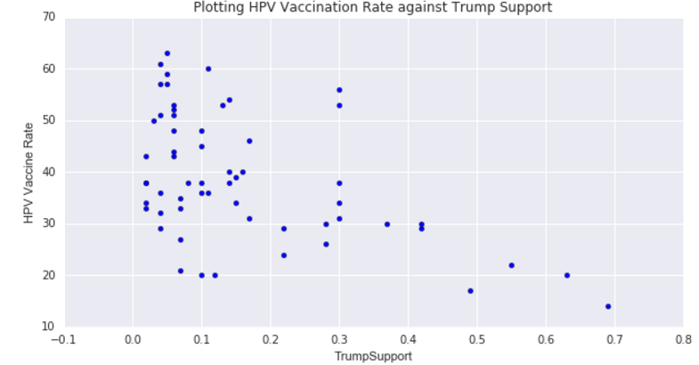
Trump Support vs HPV Vaccination
Notes:
We learned the terrible consequences of late-stage diagnosis of an HPV-related cancer in 2008.
Our beloved mother Paulette was 51 when she was diagnosed with stage IV anal cancer. Despite exhausting every avenue we could think of and showering her with our constant love and affection, she passed away only two years later.
Based on our experiences, extensive research, and large network of clinical, scientific, and governmental contacts, we have identified three ways how Paulette, and the many HPV-related cancer patients like her, could still be living healthily today:
Inoculation with one of the two HPV vaccines, Gardasil and Cervarix, which offer safe and effective protection against the most common cancer-causing HPV strains.
Screening protocols that detect and treat precancer many years before it turns into late-stage disease. Anal cancer, like cervical cancer, tends to have specific, definable risk factors and often displays early, detectable symptoms.
Improved therapeutic options that replace the antiquated chemotherapy cocktail that scarcely improves patient outcomes. We believe that a breakthrough drug for any HPV-related disease could benefit the entire spectrum of HPV-related malignancies.

Slide 18
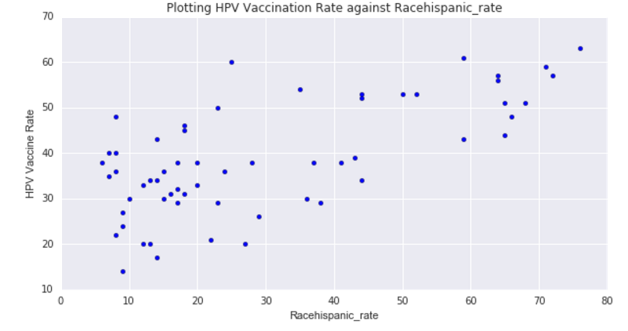
Hispanic Rate vs HPV Vaccination
Notes:
We learned the terrible consequences of late-stage diagnosis of an HPV-related cancer in 2008.
Our beloved mother Paulette was 51 when she was diagnosed with stage IV anal cancer. Despite exhausting every avenue we could think of and showering her with our constant love and affection, she passed away only two years later.
Based on our experiences, extensive research, and large network of clinical, scientific, and governmental contacts, we have identified three ways how Paulette, and the many HPV-related cancer patients like her, could still be living healthily today:
Inoculation with one of the two HPV vaccines, Gardasil and Cervarix, which offer safe and effective protection against the most common cancer-causing HPV strains.
Screening protocols that detect and treat precancer many years before it turns into late-stage disease. Anal cancer, like cervical cancer, tends to have specific, definable risk factors and often displays early, detectable symptoms.
Improved therapeutic options that replace the antiquated chemotherapy cocktail that scarcely improves patient outcomes. We believe that a breakthrough drug for any HPV-related disease could benefit the entire spectrum of HPV-related malignancies.

Slide 19
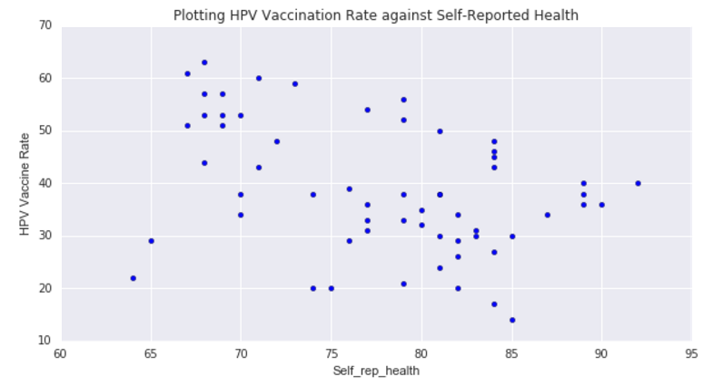
Self-reported health v HPV Vaccination
My favorite: answer to the question: percent of adults reporting that their health is “excellent,” "very good," or “good”
Notes:
We learned the terrible consequences of late-stage diagnosis of an HPV-related cancer in 2008.
Our beloved mother Paulette was 51 when she was diagnosed with stage IV anal cancer. Despite exhausting every avenue we could think of and showering her with our constant love and affection, she passed away only two years later.
Based on our experiences, extensive research, and large network of clinical, scientific, and governmental contacts, we have identified three ways how Paulette, and the many HPV-related cancer patients like her, could still be living healthily today:
Inoculation with one of the two HPV vaccines, Gardasil and Cervarix, which offer safe and effective protection against the most common cancer-causing HPV strains.
Screening protocols that detect and treat precancer many years before it turns into late-stage disease. Anal cancer, like cervical cancer, tends to have specific, definable risk factors and often displays early, detectable symptoms.
Improved therapeutic options that replace the antiquated chemotherapy cocktail that scarcely improves patient outcomes. We believe that a breakthrough drug for any HPV-related disease could benefit the entire spectrum of HPV-related malignancies.

Slide 20
Data Limitations & Discussion
The limitations in the robustness of my data set clearly presenting some challenges in generalizing the results (only 59 rows). It’s just not enough to make any major conclusions at this time and merits further study. Furthermore, I am dealing with aggregate data meaning that true insights may be hidden in higher resolution.
On the other hand, cross-sectional analysis in NYC is revealing due to its confined geography (with health care policies / access presumably being relatively constant across community district). Comparing a random county in NY versus a random county in another state presents challenges due to varying health policies.
My major hypothesis surrounding the important features, however, appears at least somewhat valid when evaluating based on R2 and p-values. The data is telling us that there is a negative relationship between Trump Support, Racial Status being White, Level of Educational Attainment and HPV Vaccination status. There is a positive relationship between Hispanic Race, Flu Vaccinations, Lower Levels of Educational Attainment, Poverty, HIV Testing and Teen Births.
Notes:
We learned the terrible consequences of late-stage diagnosis of an HPV-related cancer in 2008.
Our beloved mother Paulette was 51 when she was diagnosed with stage IV anal cancer. Despite exhausting every avenue we could think of and showering her with our constant love and affection, she passed away only two years later.
Based on our experiences, extensive research, and large network of clinical, scientific, and governmental contacts, we have identified three ways how Paulette, and the many HPV-related cancer patients like her, could still be living healthily today:
Inoculation with one of the two HPV vaccines, Gardasil and Cervarix, which offer safe and effective protection against the most common cancer-causing HPV strains.
Screening protocols that detect and treat precancer many years before it turns into late-stage disease. Anal cancer, like cervical cancer, tends to have specific, definable risk factors and often displays early, detectable symptoms.
Improved therapeutic options that replace the antiquated chemotherapy cocktail that scarcely improves patient outcomes. We believe that a breakthrough drug for any HPV-related disease could benefit the entire spectrum of HPV-related malignancies.

Slide 21
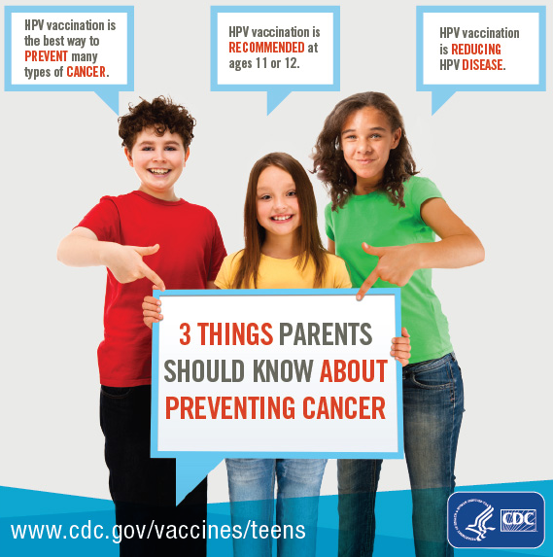
What will we do about it?
If the results are confirmed on a more general basis, the question remains: what can we do about it? If white, educated people above the poverty line are less likely to vaccinate, what would convince them otherwise (our primary tool is even more awareness/education?)
One potential reason for higher vaccine coverage in poverty areas in NY is perhaps related to consumer choice. Parents may not want to vaccinate their children, or may introduce further anxiety by overemphasizing the risks, but children may be presented/encouraged with the option without their parents consent at the local sexual health clinic. One strategy would be to make it more difficult for parents to refuse to vaccine their children. Certain states, such as Rhode Island, have enacted this strategy and vaccine rates are > 80%.
Does this work?
Notes:
We learned the terrible consequences of late-stage diagnosis of an HPV-related cancer in 2008.
Our beloved mother Paulette was 51 when she was diagnosed with stage IV anal cancer. Despite exhausting every avenue we could think of and showering her with our constant love and affection, she passed away only two years later.
Based on our experiences, extensive research, and large network of clinical, scientific, and governmental contacts, we have identified three ways how Paulette, and the many HPV-related cancer patients like her, could still be living healthily today:
Inoculation with one of the two HPV vaccines, Gardasil and Cervarix, which offer safe and effective protection against the most common cancer-causing HPV strains.
Screening protocols that detect and treat precancer many years before it turns into late-stage disease. Anal cancer, like cervical cancer, tends to have specific, definable risk factors and often displays early, detectable symptoms.
Improved therapeutic options that replace the antiquated chemotherapy cocktail that scarcely improves patient outcomes. We believe that a breakthrough drug for any HPV-related disease could benefit the entire spectrum of HPV-related malignancies.

Slide 22
Next Steps
Despite the limitations of the dataset, the results at least somewhat validated an interesting hypothesis, certainly enough to merit further study.
Next steps would include:
Investigate county-level data in all of New York State (ex-NYC)
Investigate county-level data across all states
Investigate state-by-state immunization registries – the real big data problem
Once we have the immunization registry, switch this to a logistic regression problem.
Notes:
We learned the terrible consequences of late-stage diagnosis of an HPV-related cancer in 2008.
Our beloved mother Paulette was 51 when she was diagnosed with stage IV anal cancer. Despite exhausting every avenue we could think of and showering her with our constant love and affection, she passed away only two years later.
Based on our experiences, extensive research, and large network of clinical, scientific, and governmental contacts, we have identified three ways how Paulette, and the many HPV-related cancer patients like her, could still be living healthily today:
Inoculation with one of the two HPV vaccines, Gardasil and Cervarix, which offer safe and effective protection against the most common cancer-causing HPV strains.
Screening protocols that detect and treat precancer many years before it turns into late-stage disease. Anal cancer, like cervical cancer, tends to have specific, definable risk factors and often displays early, detectable symptoms.
Improved therapeutic options that replace the antiquated chemotherapy cocktail that scarcely improves patient outcomes. We believe that a breakthrough drug for any HPV-related disease could benefit the entire spectrum of HPV-related malignancies.

Slide 23
Appendix
Data Sources
NYC Data: nycopendata.socrata.com/
BOE Data: enrweb.boenyc.us/index.htm
References
https://www.cdc.gov/mmwr/volumes/65/wr/mm6533a4.htm
Technical Terminology
OLS: method for estimating the unknown parameters in a linear regression model, with the goal of minimizing the sum of the squares of the differences
Regularization: process of introducing additional information in order to solve an ill-posed problem or to prevent overfitting
Lasso: regression analysis method that performs both variable selection and regularization in order to enhance the prediction accuracy and interpretability of the statistical model it produces.
Cross-validation: divide training data, train model for a fixed value of λλ and test it on the remaining subsets and repeat this procedure while varying λλ
Notes:
We learned the terrible consequences of late-stage diagnosis of an HPV-related cancer in 2008.
Our beloved mother Paulette was 51 when she was diagnosed with stage IV anal cancer. Despite exhausting every avenue we could think of and showering her with our constant love and affection, she passed away only two years later.
Based on our experiences, extensive research, and large network of clinical, scientific, and governmental contacts, we have identified three ways how Paulette, and the many HPV-related cancer patients like her, could still be living healthily today:
Inoculation with one of the two HPV vaccines, Gardasil and Cervarix, which offer safe and effective protection against the most common cancer-causing HPV strains.
Screening protocols that detect and treat precancer many years before it turns into late-stage disease. Anal cancer, like cervical cancer, tends to have specific, definable risk factors and often displays early, detectable symptoms.
Improved therapeutic options that replace the antiquated chemotherapy cocktail that scarcely improves patient outcomes. We believe that a breakthrough drug for any HPV-related disease could benefit the entire spectrum of HPV-related malignancies.

Slide 24
Thank you!
Thank you Sri, John, and Wei Wei for this year’s class
Thank you to the other people in the class – learned a lot from you!
Thank you to Jane Zucker at NYIIS
Notes:
We learned the terrible consequences of late-stage diagnosis of an HPV-related cancer in 2008.
Our beloved mother Paulette was 51 when she was diagnosed with stage IV anal cancer. Despite exhausting every avenue we could think of and showering her with our constant love and affection, she passed away only two years later.
Based on our experiences, extensive research, and large network of clinical, scientific, and governmental contacts, we have identified three ways how Paulette, and the many HPV-related cancer patients like her, could still be living healthily today:
Inoculation with one of the two HPV vaccines, Gardasil and Cervarix, which offer safe and effective protection against the most common cancer-causing HPV strains.
Screening protocols that detect and treat precancer many years before it turns into late-stage disease. Anal cancer, like cervical cancer, tends to have specific, definable risk factors and often displays early, detectable symptoms.
Improved therapeutic options that replace the antiquated chemotherapy cocktail that scarcely improves patient outcomes. We believe that a breakthrough drug for any HPV-related disease could benefit the entire spectrum of HPV-related malignancies.

