Slide 1

Presentation by: Almaza Farce, Shir Amsalem,
Itay Levy, Sol Krengel
Lecturer: Omer Casspy

Slide 2

Netflix
Netflix is an American streaming service
More than 182 million consumers worldwide
Based on Cloud technology
Netflix developed video-recommendation algorithm

Slide 3

IMDb
Internet Movie Database
Contains approximately 6.5 million titles
83 million users worldwide
Users rate contents on a scale of 1 to 10
Mean-rating method

Slide 4

Objectives
Observe the influence of each characteristic on ranking
How characteristics integration affects rank
Find the ratio between rank and duration

Slide 5





Methods
Weka
MATLAB
Python 3.7
CMD windows version
Excel (CSV file type)

Slide 6
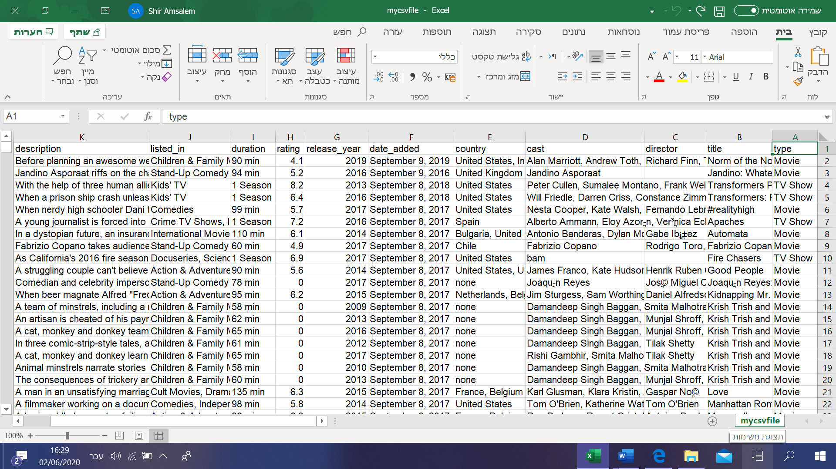
Pre-Processing
Data Reduction and Transformation
Remove columns
Index
Title
Description

Slide 7
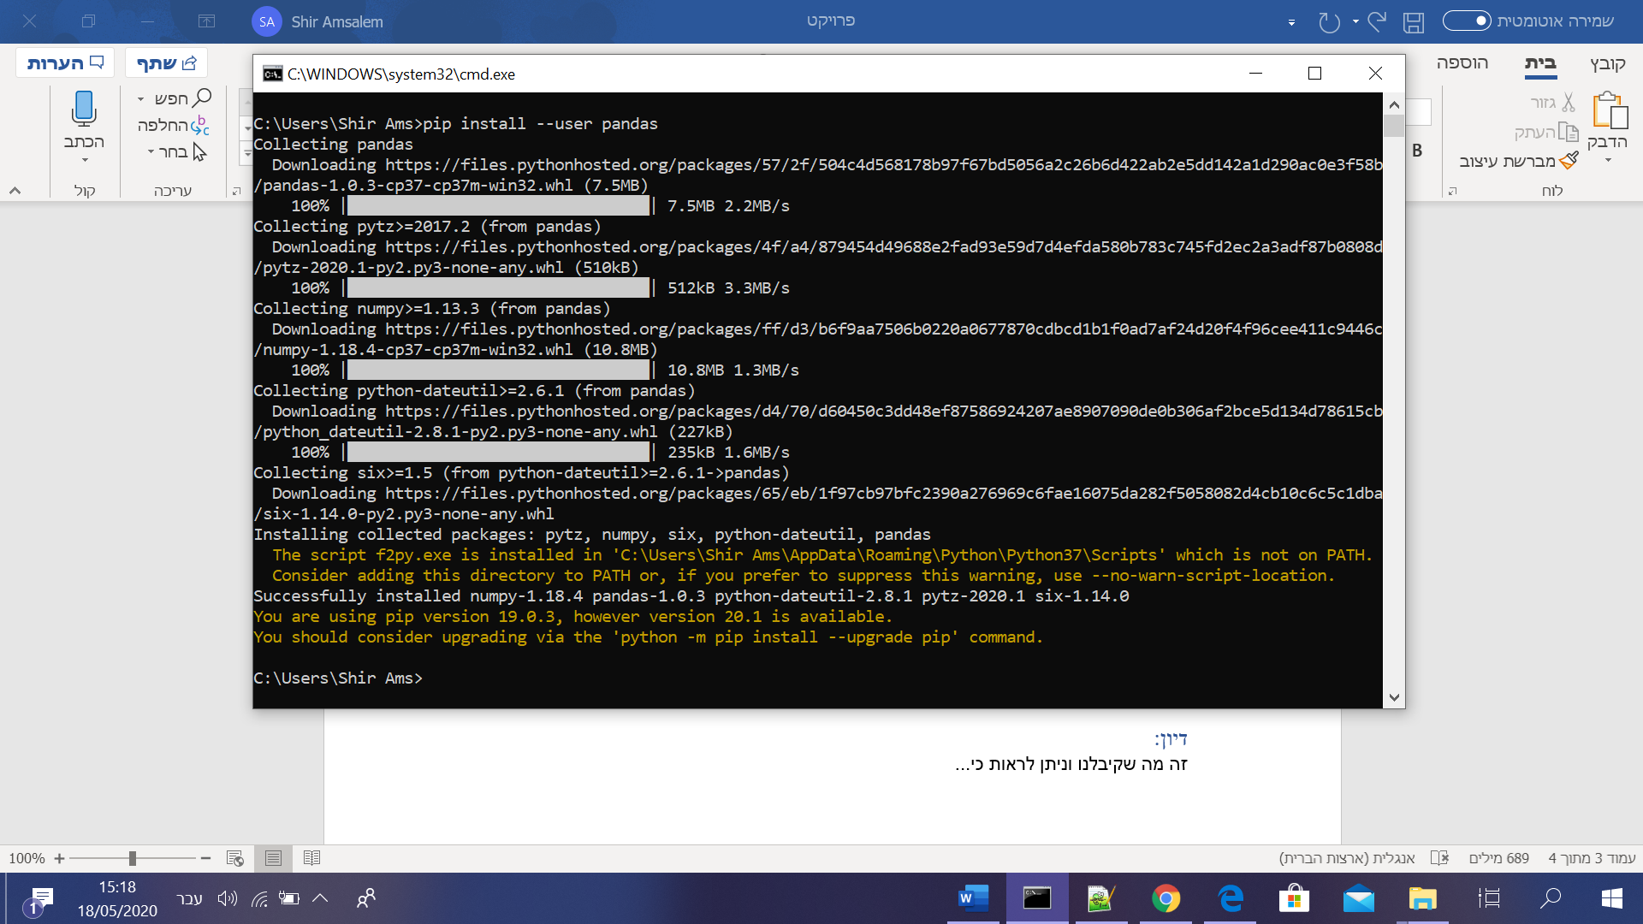
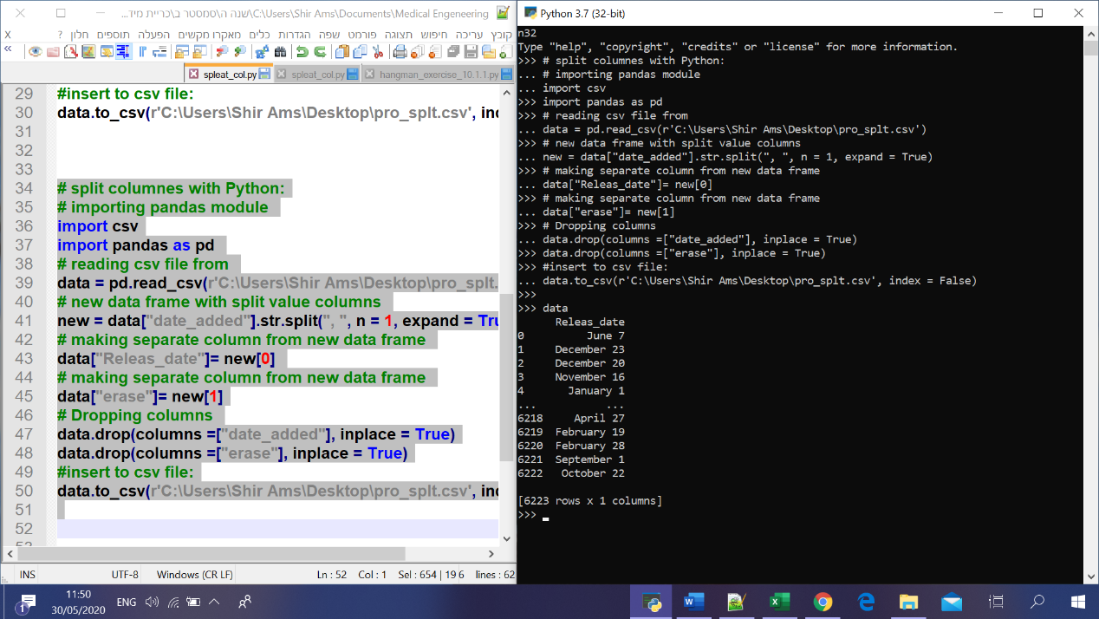
Pre-Processing
Data Reduction and Transformation
Split columns:
Actor
Country
Released date
Director
Genera
CMD, Python (Pandas, CSV), Excel

Slide 8
Pre-Processing
Data Reduction and Transformation
Removing lines
Removing columns
Completing missing cells
Removing rows
Discretization

Slide 9
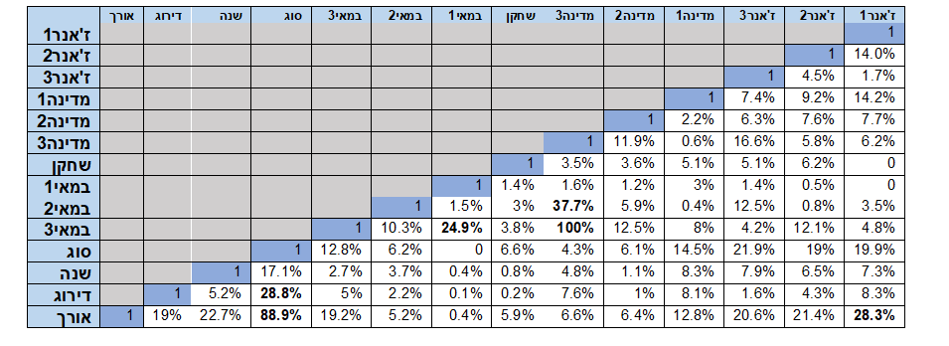

Algorithms
Correlation

Slide 10
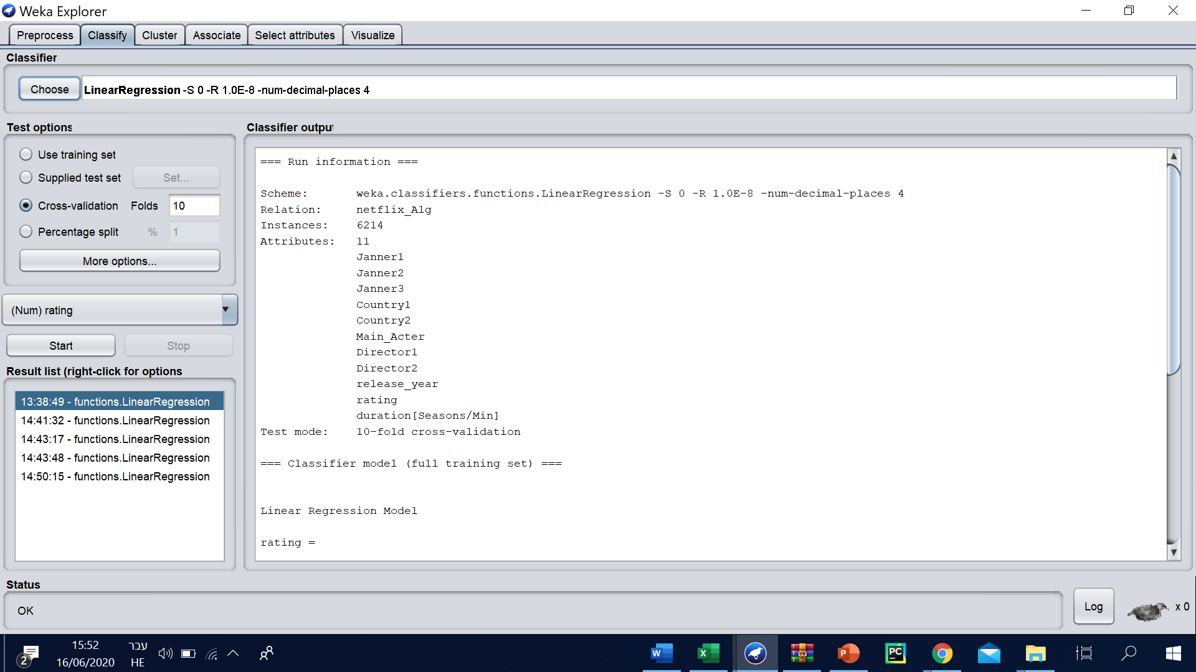
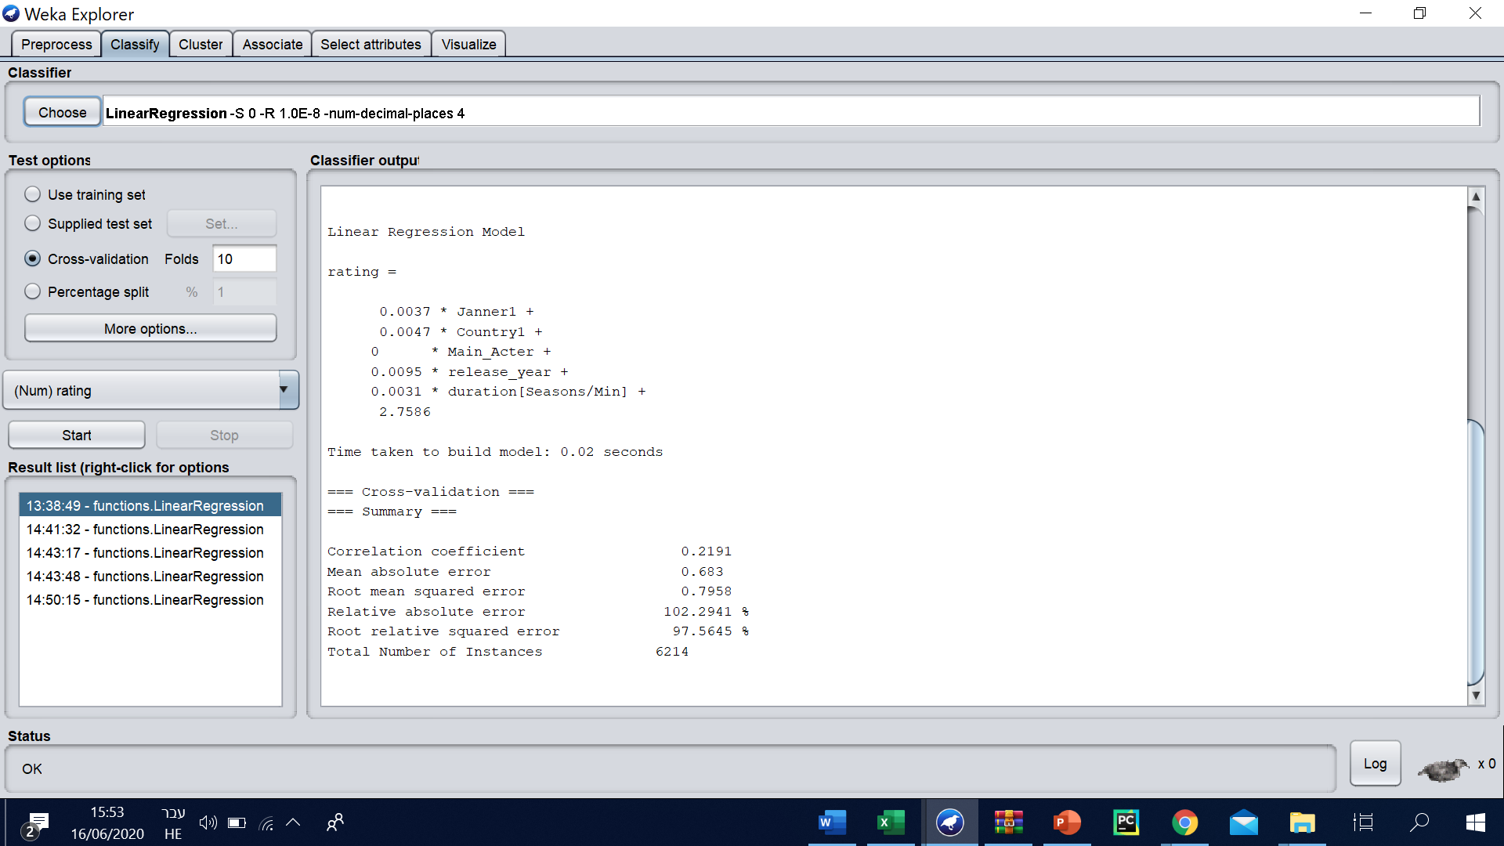
Results
Regression Algorithm
Long duration of content tend to get higher ranking score
Nowadays, users tend to rank higher than before

Slide 11
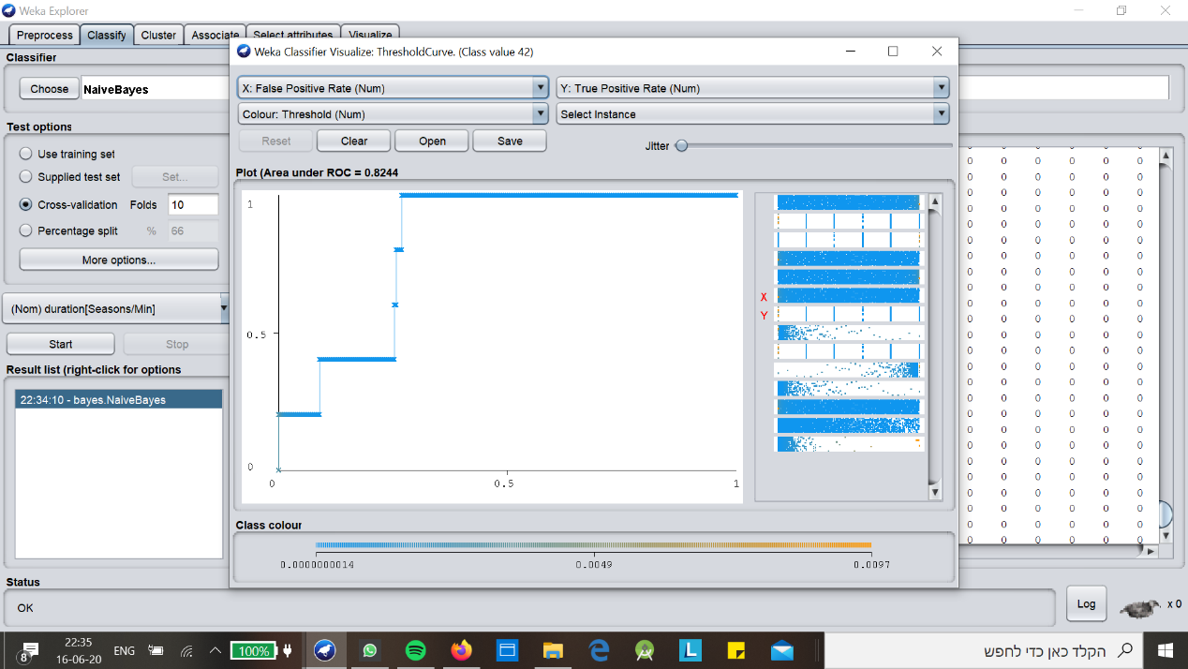
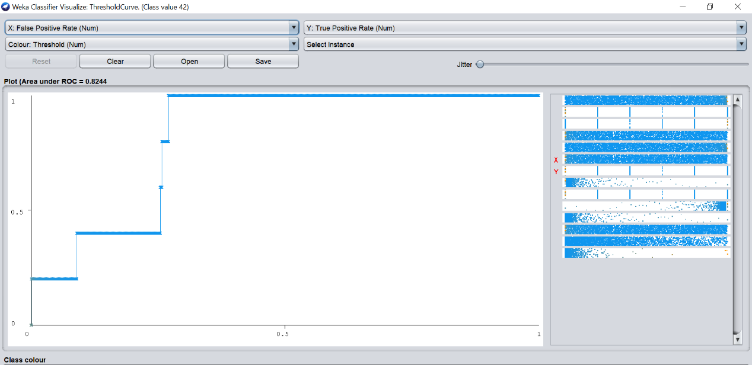
Results
Bayes Algorithm
For this algorithm, the resulted ROC has a high precision value of 82.44%

Slide 12
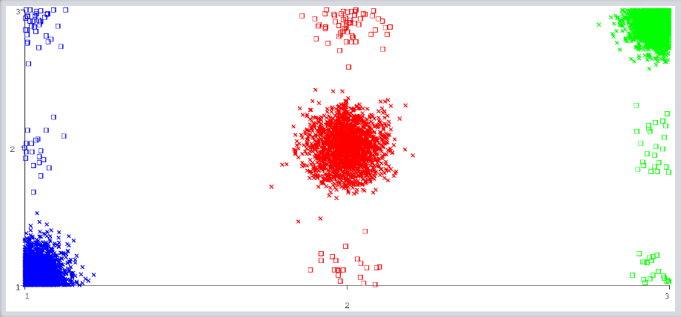
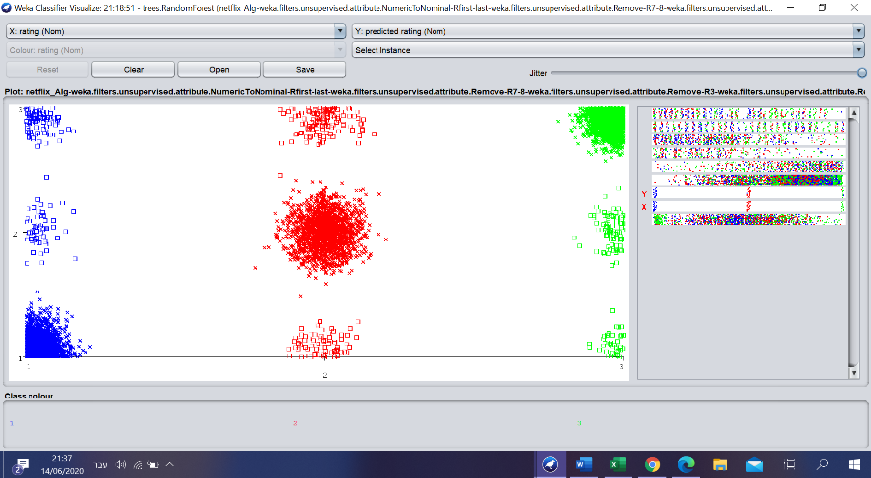
Results
RandomForest Algorithm
Module run for 5 columns - general result a
For each index and runs, the algorithm yielded high accuracy percentage – over 95%
Module run for 7 columns - general result a

Slide 13

Discussion
Regression:
Newer contents are highly ranked
Countries impact ranking
Some genres get more audience than others
Each feature impact on ranking with 41.2% accuracy
Duration of content does influence its success
Bayes:
Each feature impacts on ranking with 82.44% accuracy.
A specific actor is highly impacting on ranking
RandomForest:
There isn’t overfitting for actor column

Slide 14

Conclusions
based on Bayes, a specific actor has high impact on contents ranking
Newer contents yield higher ranking – more streaming based on countries and genres
Contents duration has direct connection on impact of contents success
Countries and genres integration has an influence

