Slide 1
Relatedness of subpopulations of an alpine butterfly in Grand Teton National Park
Audrey McCombs
EEOB 563
April 29, 2021

Slide 2
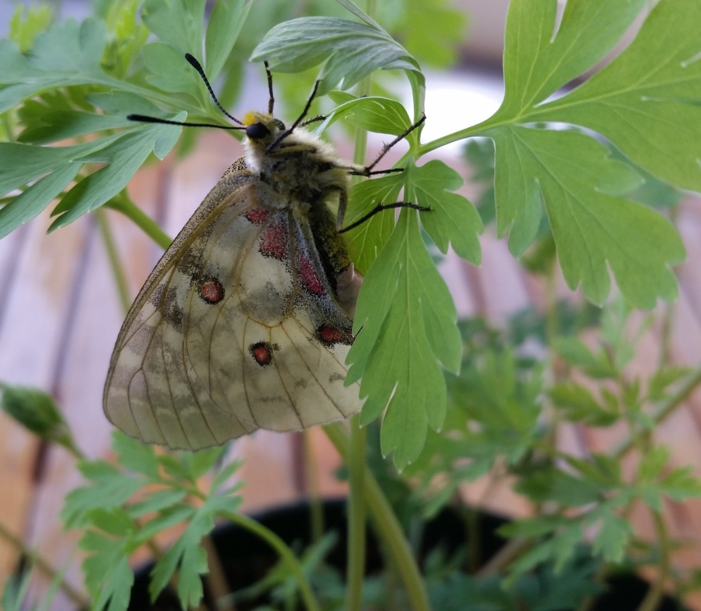
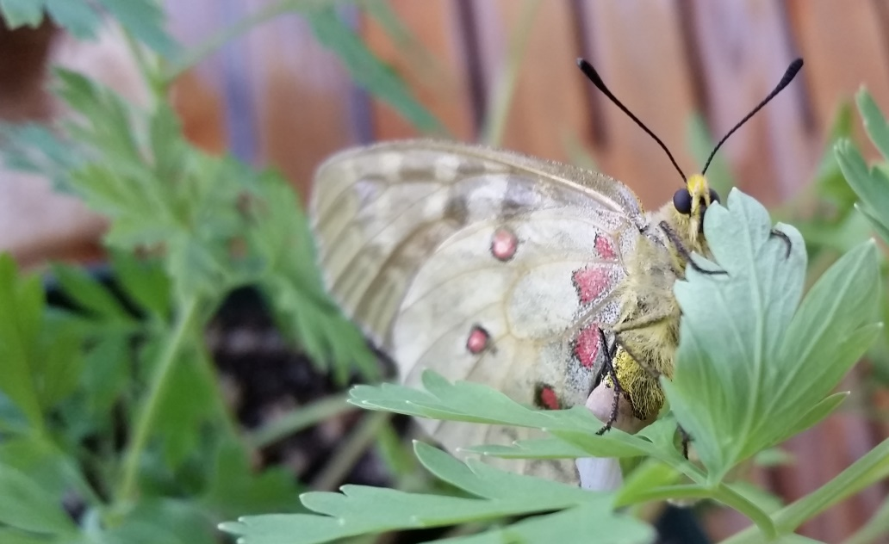
Parnassius clodius butterflies

Slide 3
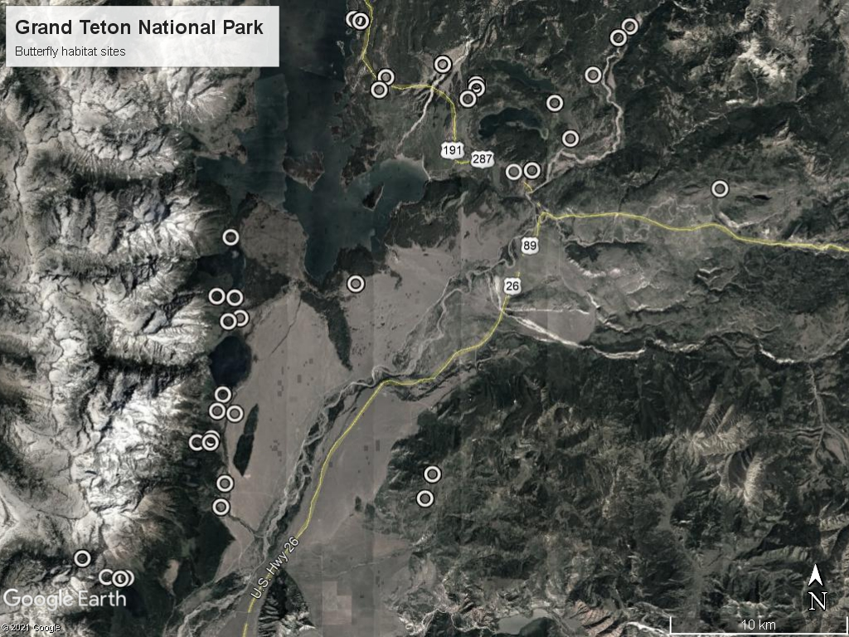

Slide 4
Hypotheses
Panmixia
Mainland-island
Stepping stone
Isolated population

Slide 5


Distance Measures
Nei’s Distance
Accounts for mutation and drift
Reynolds’ Distance
Accounts for drift only
Based on coancestry coefficient

Slide 6
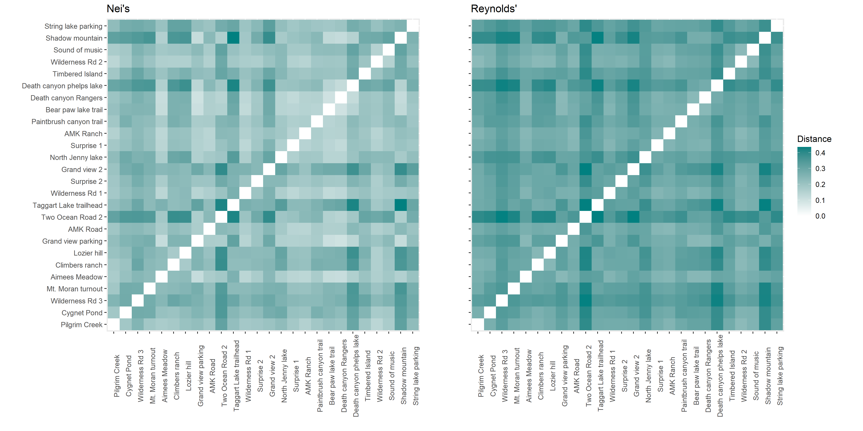
Pairwise Distances

Slide 7
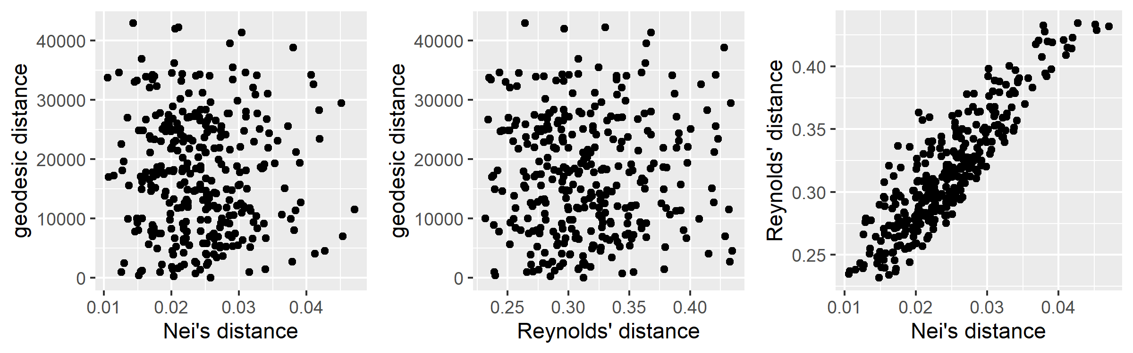
Pairwise Distance Plots

Slide 8
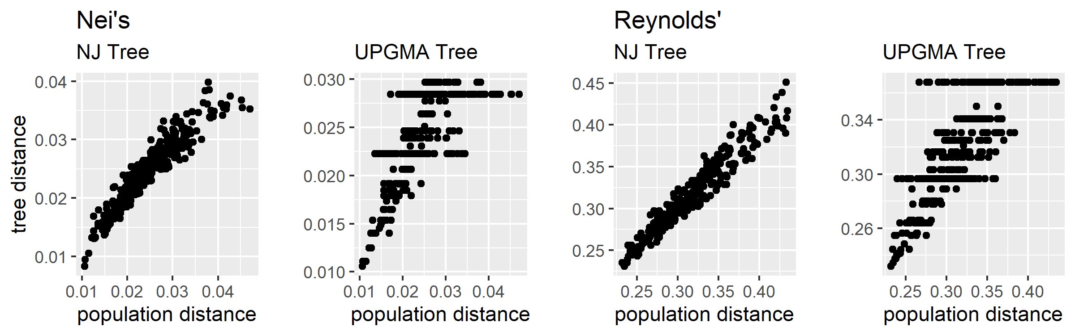
Cophenetics Plot

Slide 9
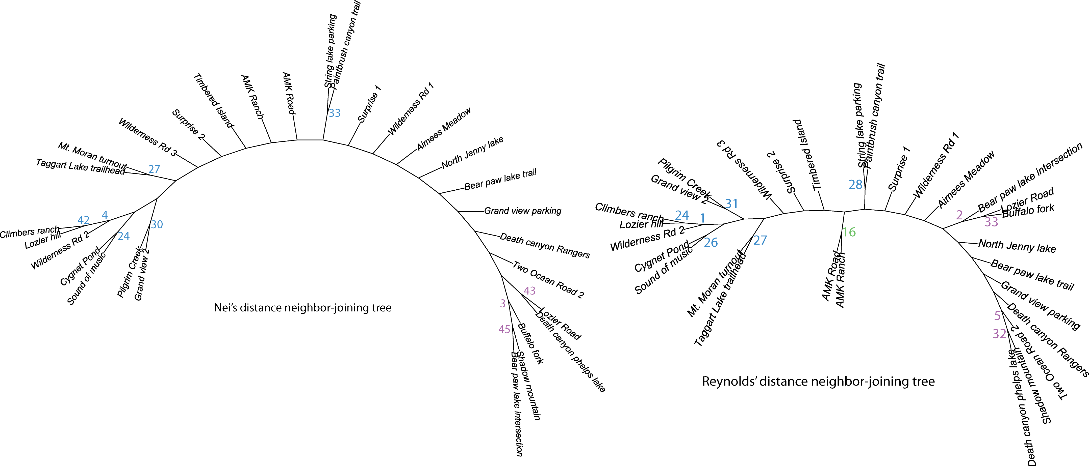
Phylogenetic Trees

Slide 10
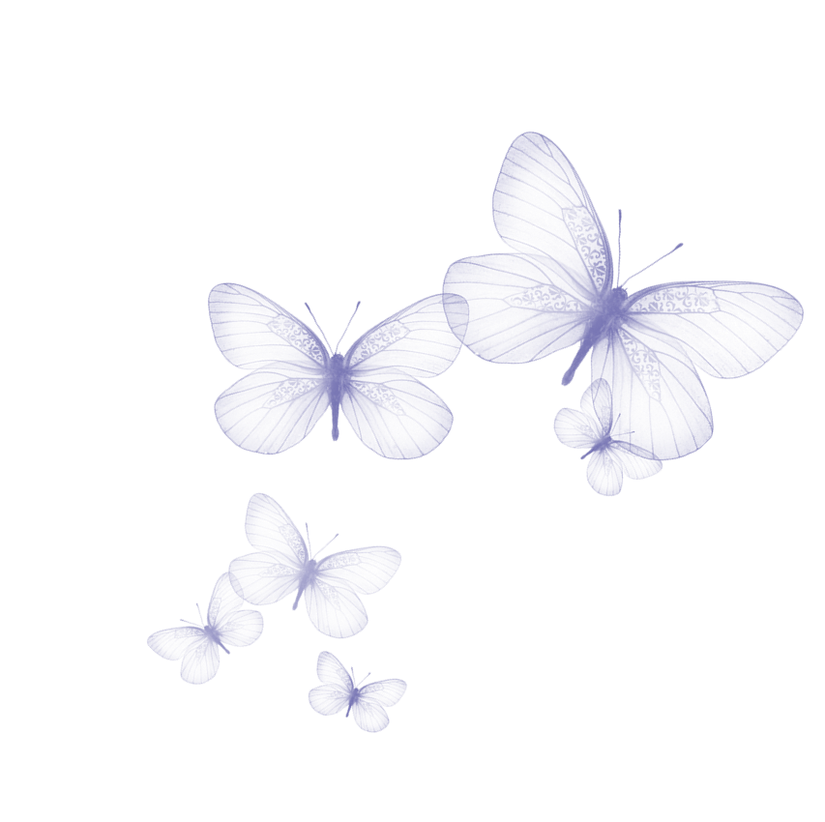
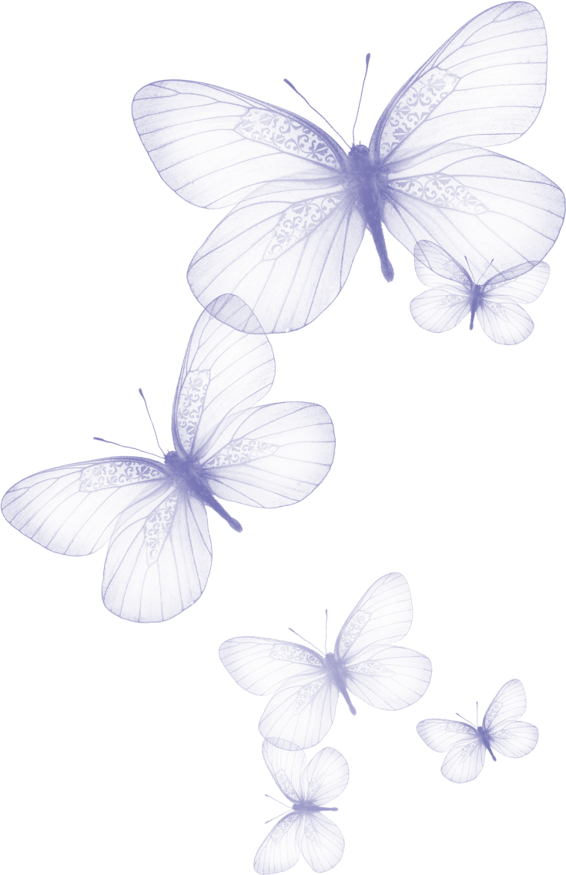


Conclusion
Panmixia!

Slide 11
Thank you!
Questions?

