Slide 1

“Heaven’s Light Is Our Guide” Rajshahi University of Engineering & Technology Department of Electrical & Electronic Engineering
Course Code: EEE 4116
Course Title: Industrial Training
Industrial Attachment Overview in BTCL, Rajshahi
Company Name: Bangladesh Telecommunication Company Limited (BTCL)
Training Period: 2 Weeks
Presenter:
Alsadi Md. Promi
Roll: 2101098
Dept.: EEE
RUET, Rajshahi-6204, Bangladesh
Contact: 2101098@student.ruet.ac.bd

Slide 2
Presentation Outline
Corporate Introduction
Network Evolution (NGN & IMS)
GPON Technical Framework
Field Operations & Maintenance
Training Outcomes
Future Prospects & Challenges
Conclusion
2

Slide 3
Introduction
Telecommunication allows the exchange of information over long distances.
In Bangladesh, it is managed by BTCL (Bangladesh Telecommunication Company Limited).
BTCL is the largest telecommunication company in the country.
It provides high-speed internet services.
It offers landline telephone services. It supports both domestic and international calls. It operates a 24-hour customer care center. It manages the red telephone exchange for VIPs.
BTCL is essential for the advancement of Bangladesh’s telecommunication system.

Slide 4
Motivation
The motivations of this industrial training are as follows:
Premier state-owned telecom operator shaping Bangladesh’s digital future.
Direct exposure to nationwide telecom backbone and core infrastructure.
Hands-on learning with cutting-edge technologies (Fiber, Broadband, Switching).
Platform to transform academic knowledge into industry expertise.
Mentorship from experienced professionals and real-time industry practices.
Strategic step toward building a strong career in telecommunication.

Slide 5
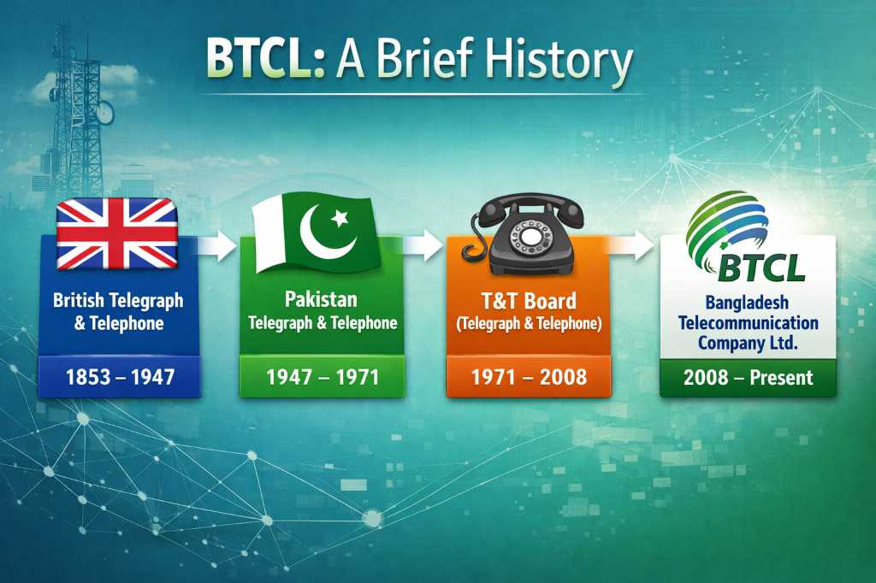
History and Evolution of BTCL

Slide 6
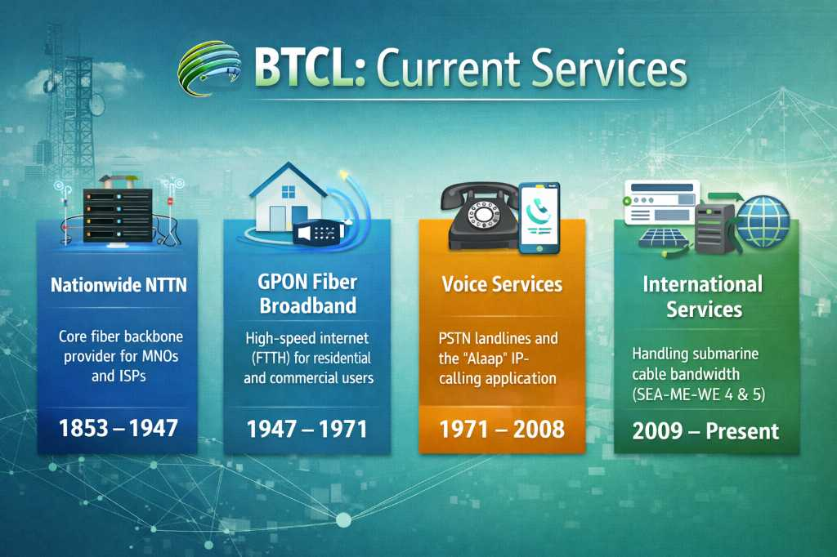
Current Services of BTCL
6

Slide 7
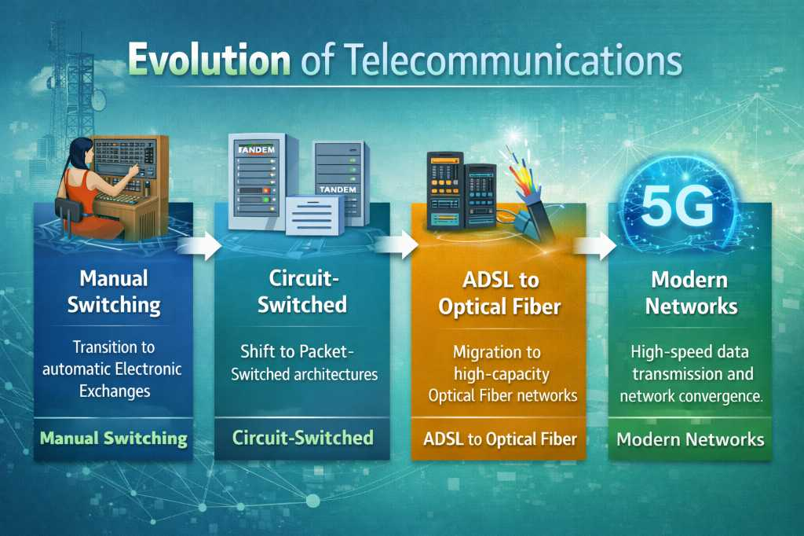
Evolution of Telecommunications
7

Slide 8

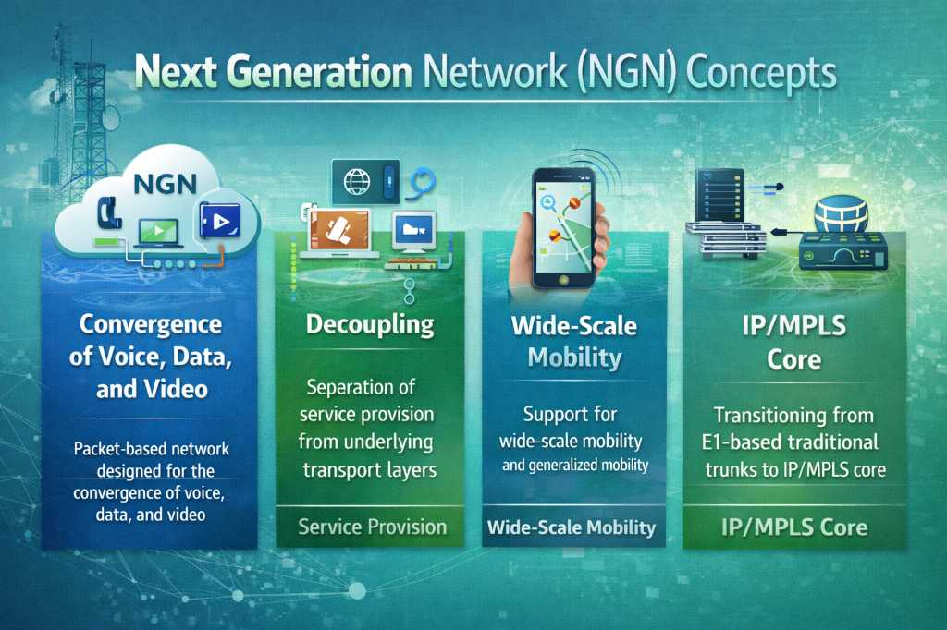
8

Slide 9
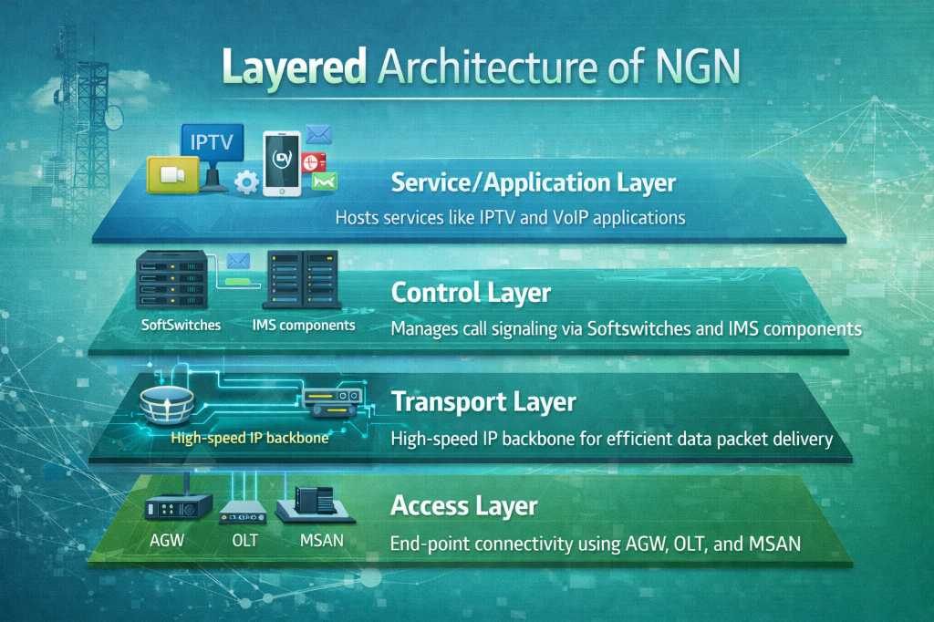
Layered Architecture of NGN
9

Slide 10
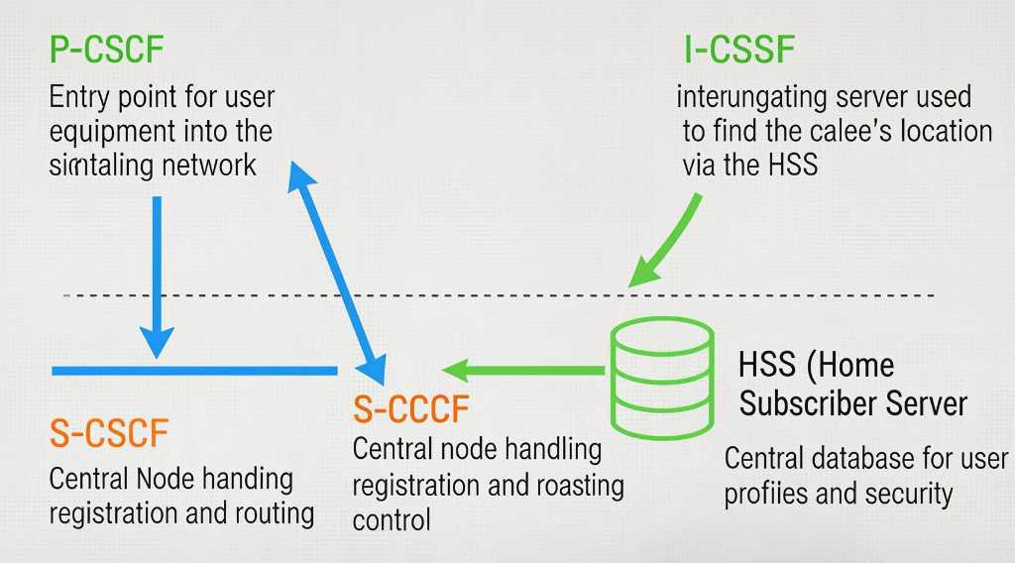
IP Multimedia Subsystem (IMS) Core
10

Slide 11
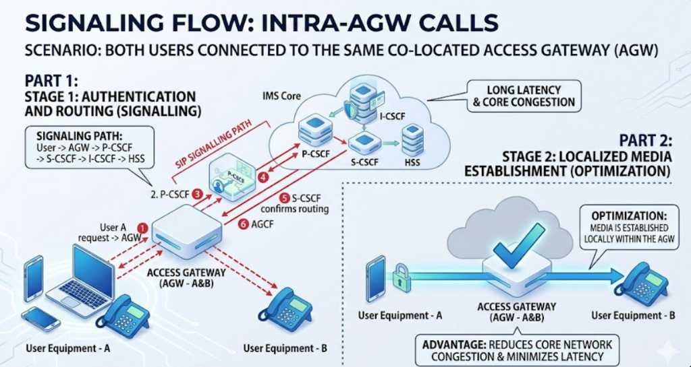
Signaling Flow: Intra-AGW Calls
11

Slide 12
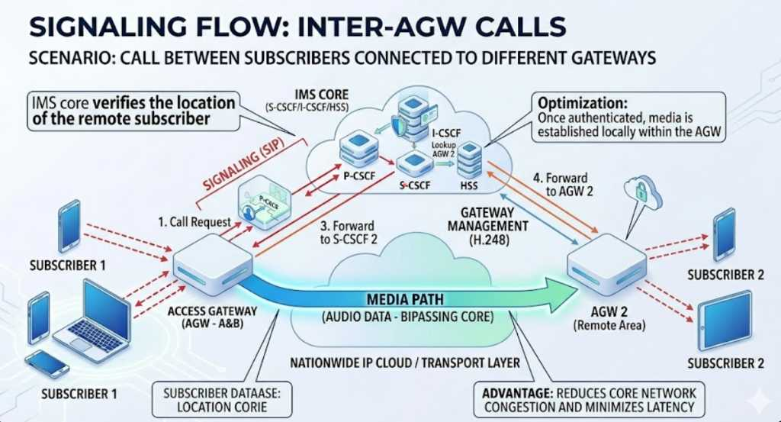
12

Slide 13

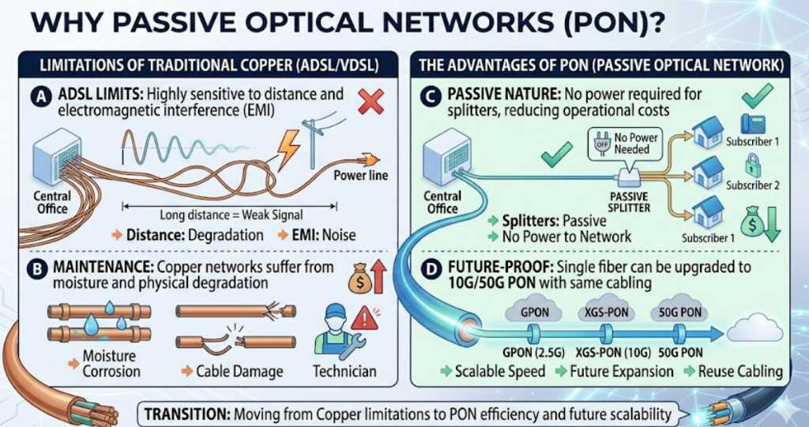
13

Slide 14
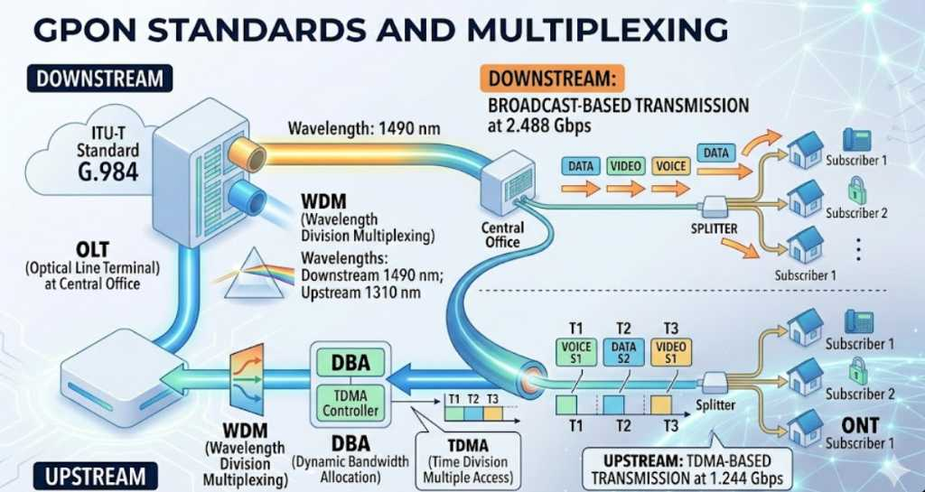
14

Slide 15
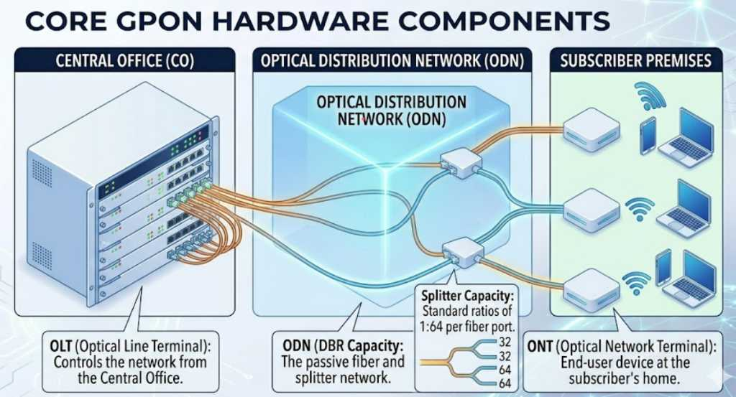
15

Slide 16

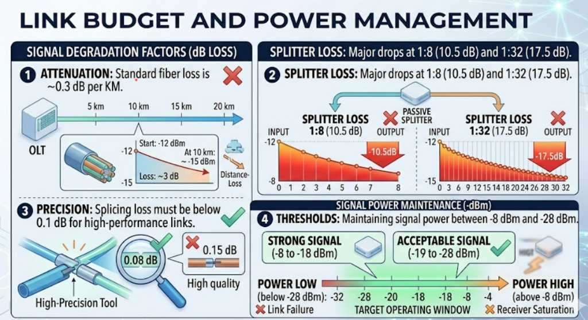
16

Slide 17
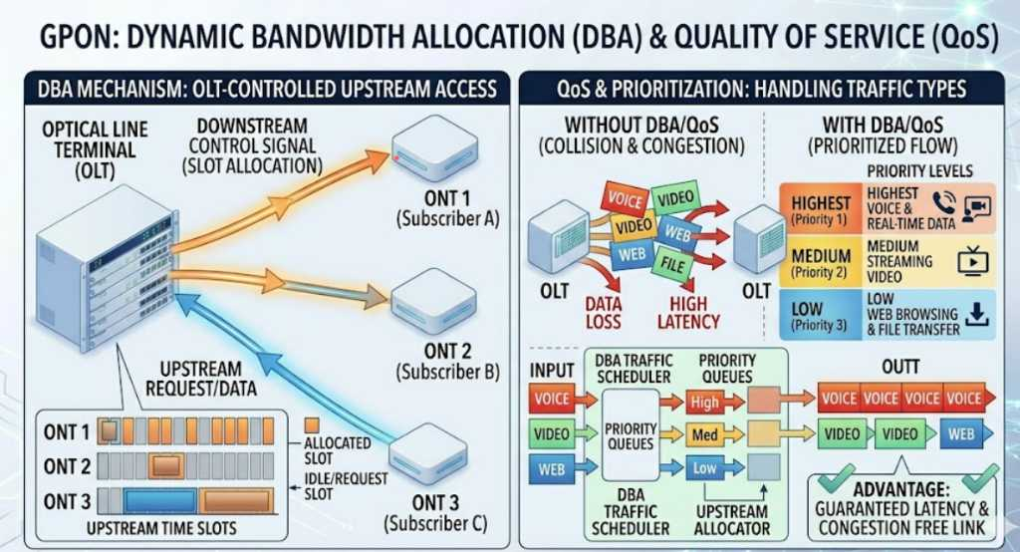
17

Slide 18
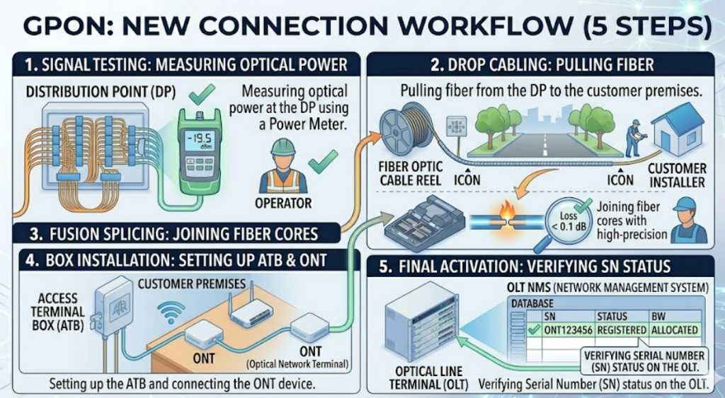
18

Slide 19
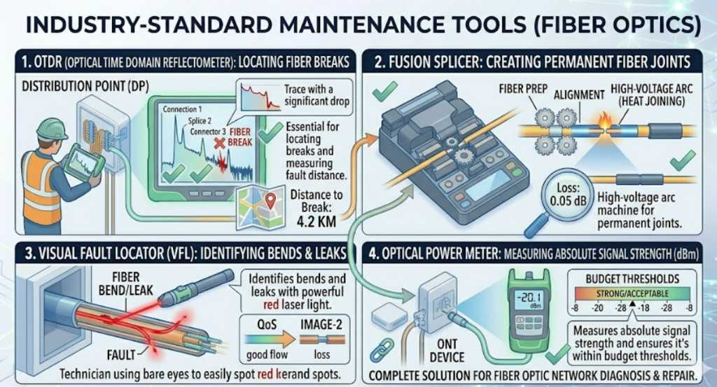
19

Slide 20
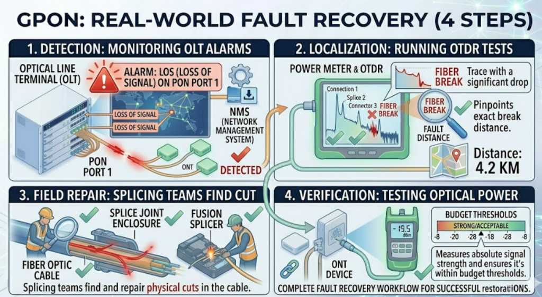
20

Slide 21
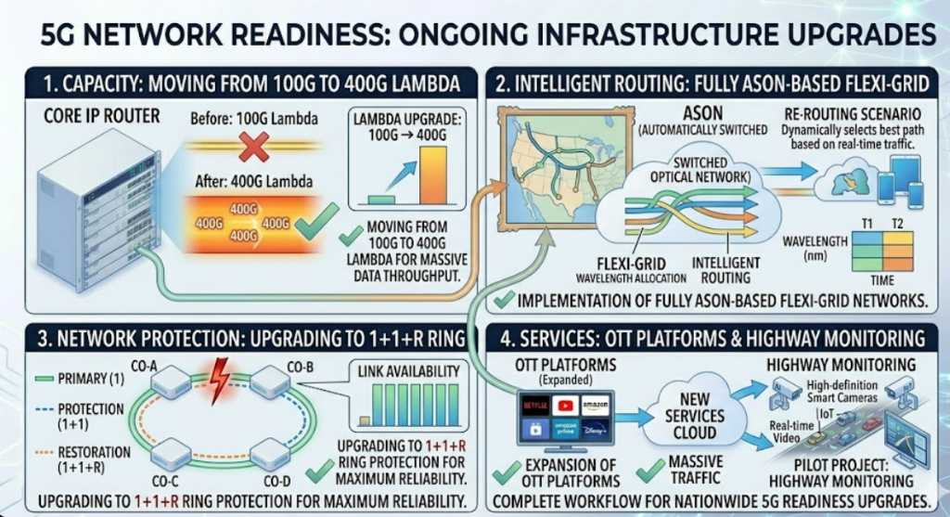
21

Slide 22
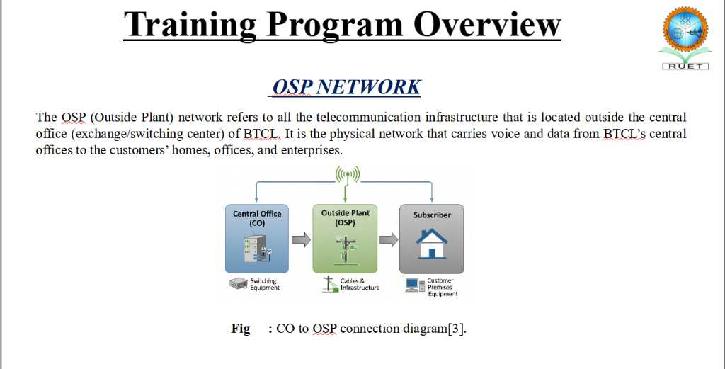

Slide 23
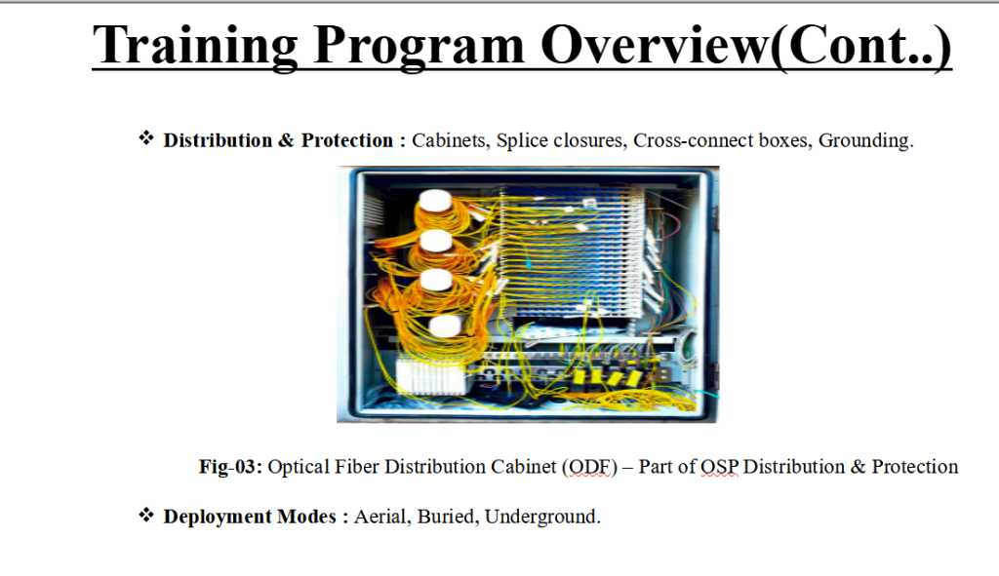
23

Slide 24
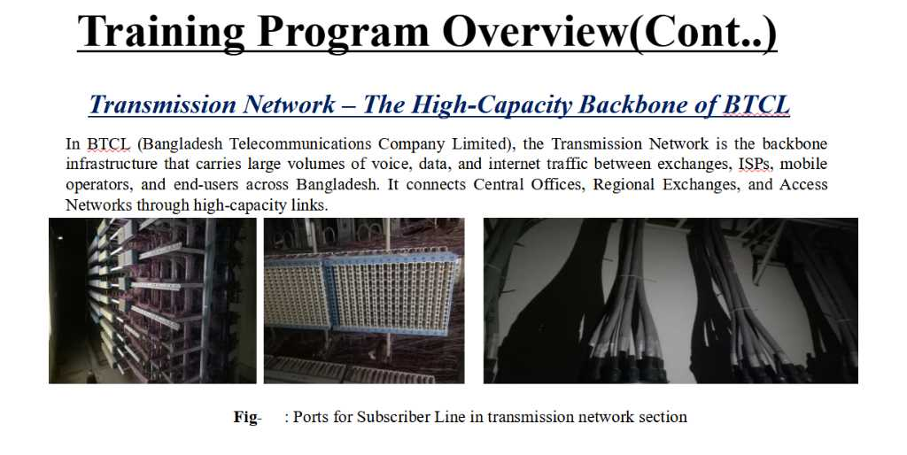
24

Slide 25
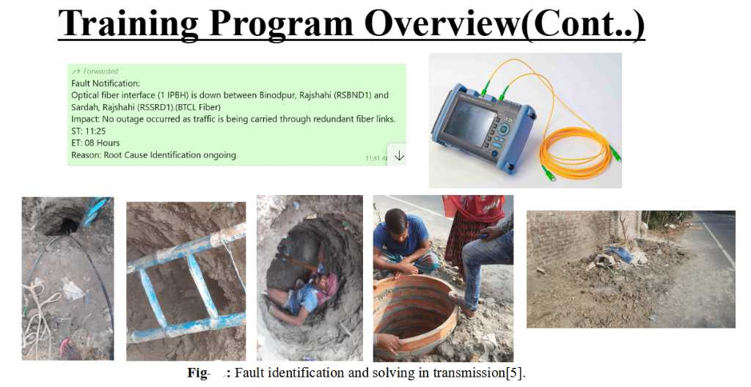
25

Slide 26
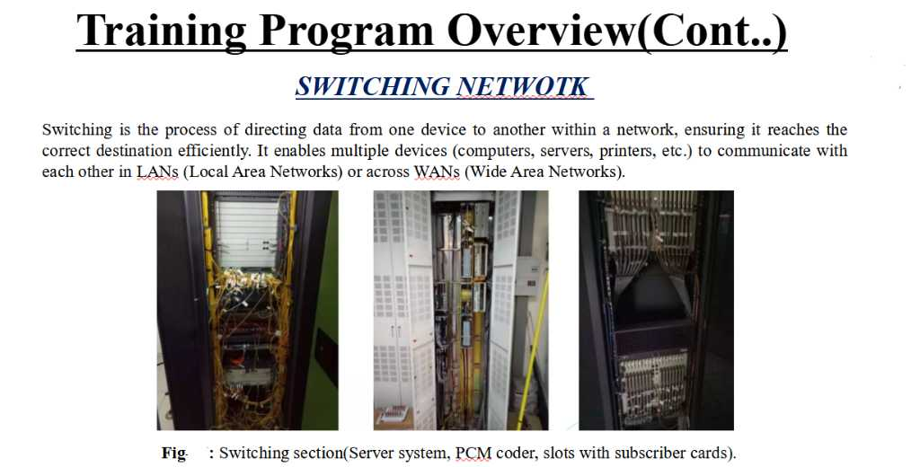
26

Slide 27
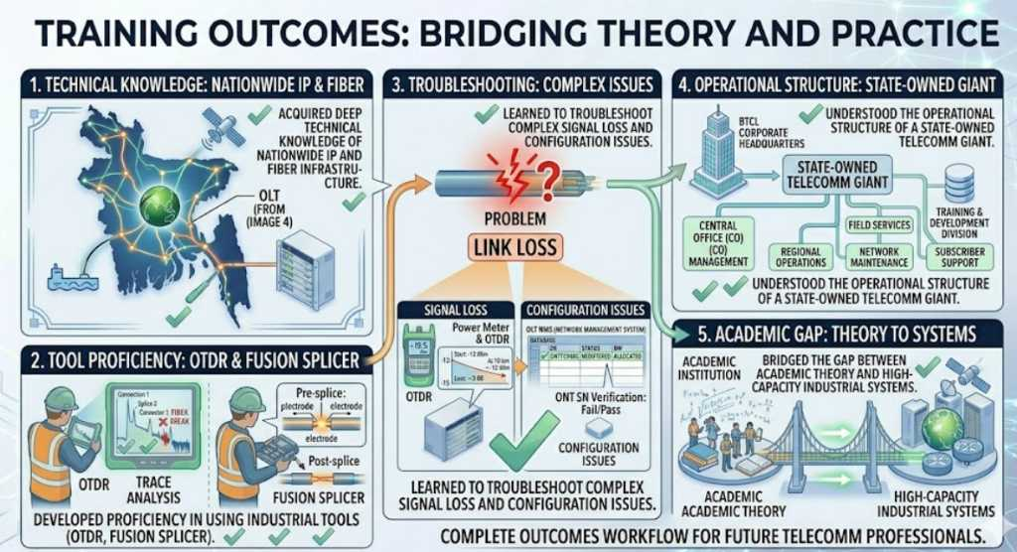
27

Slide 28
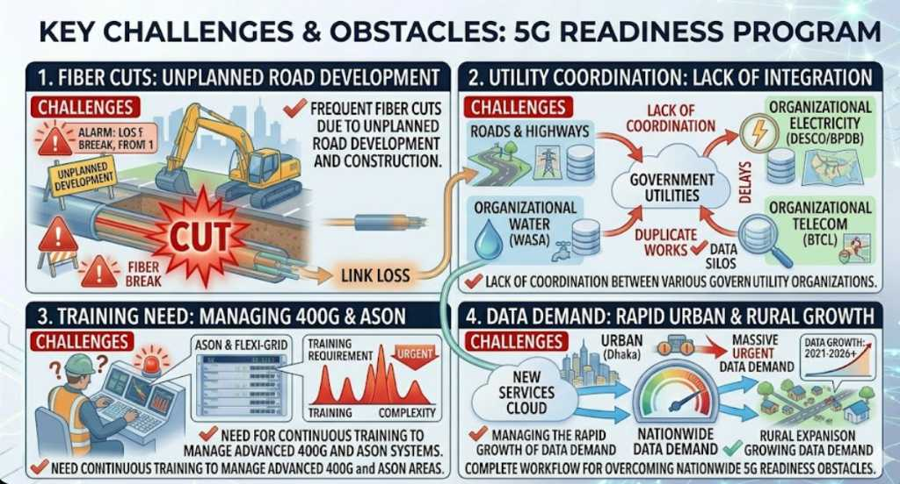
28

Slide 29
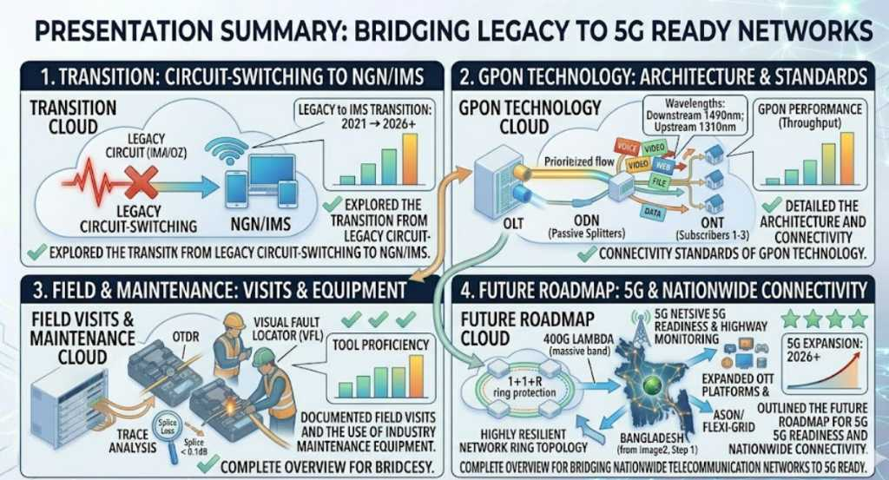
29

Slide 30
Conclusion
Thank you for your attention.
Industrial training at BTCL has been an invaluable learning experience.
The floor is now open for any questions.
30

Slide 31
Thank you.
31

