Slide 1
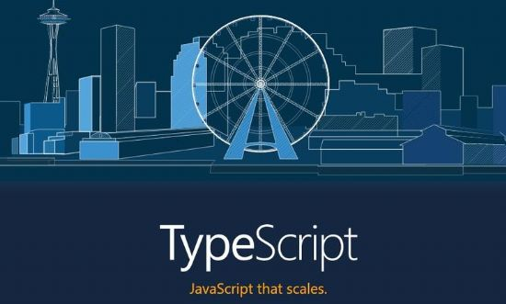

Slide 2
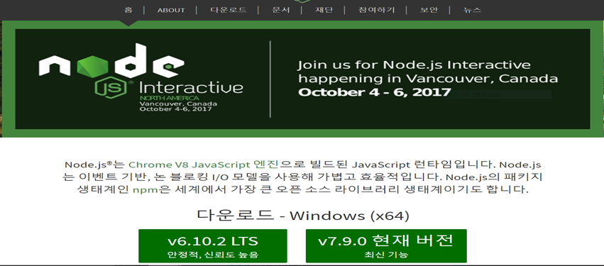
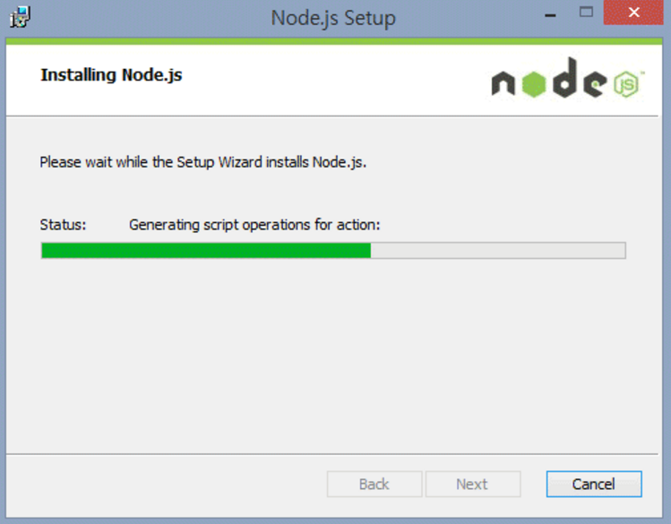
Node.js with npm
have to use the latest version

Slide 3
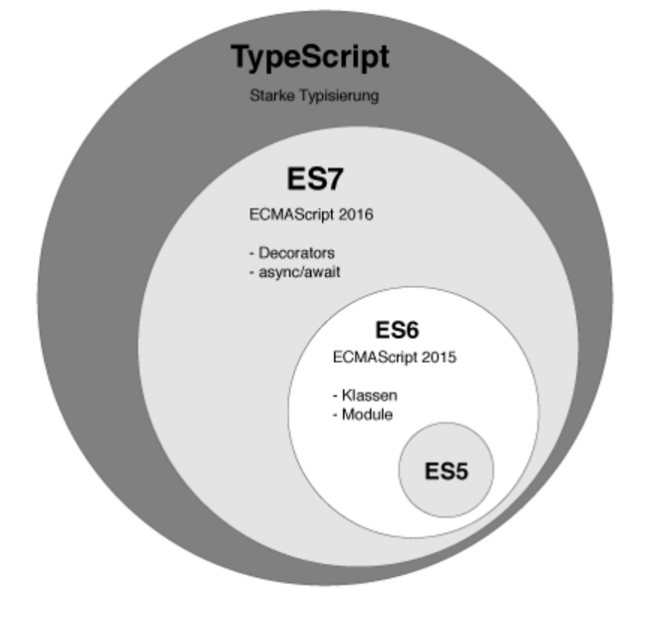
Introduction to TypeScript
TypeScript is developed and maintained by Microsoft and it is an open source.
It supports all of the syntax and semantics of JavaScript while providing some extra features such as static typing and richer syntax by being a superset of ECMAScript.

Slide 4
COMPILING VS TRANSPILING
Compiling is the general term for taking source code written in one language and transforming into another.
Transpiling is a specific term for taking source code written in one language and transforming into another language that has a similar level of abstraction.

Slide 5
Transpiler Languages and New Feature
One of the main advantages of transpiler languages is adding new feature into them.
TypeScript is added with interface, abstract class, data type and etc, does not uses additional lib.
Transpiler Language supplements JavaScript with new feature. If you know nothing about that, You’ll not be faced with the problem by using interface.

Slide 6
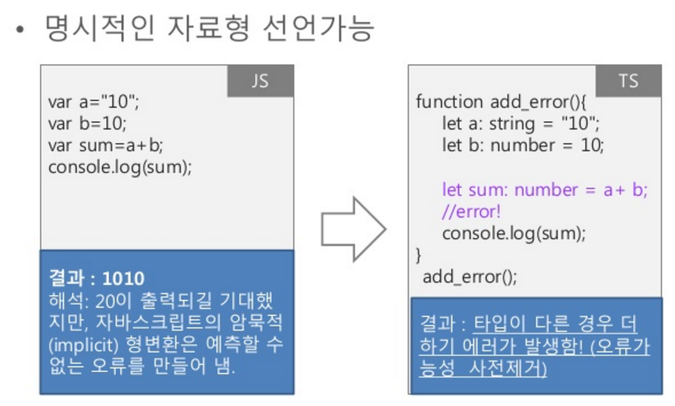
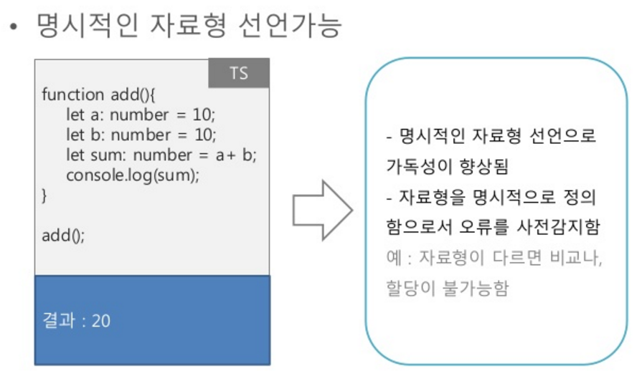
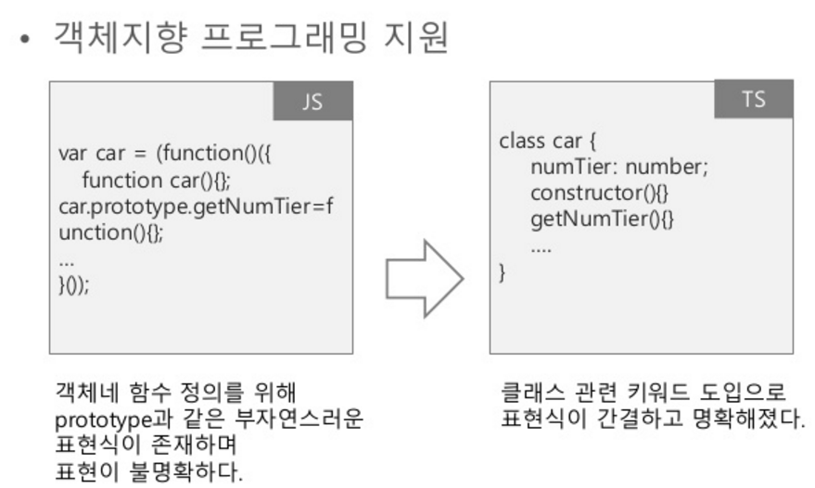
TypeScript vs JavaScript
TypeScript = JavaScript + type
Correct errors in compile type using explicit type
Support object-oriented programming

Slide 7
Strong point of TypeScript
Class
Interface
Type check in Compile time
Install TypeScript
npm install –g typescript
npm install –g typings

Slide 8
What is Angular?
Angular is an open source framework for developing web applications. The framework makes it simpler to create custom components that can be added to HTML documents and to implement application logic.

Slide 9
QuickStart
The QuickStart live-coding / downloadable example example is an Angular playground. It's not where you'd develop a real application. You should develop locally on your own machine ... and that's also how we think you should learn Angular.
Setting up a new project on your machine is quick and easy with the QuickStart seed, maintained on github.
Make sure you have node and npm installed. Then ...
Create a project folder (you can call it quickstart and rename it later)
Clone or download the QuickStart seed into your project folder
Install npm packages
Run npm start to launch the sample application

Slide 10
Clone
Perform the clone-to-launch steps with these terminal commands.
git clone https://github.com/angular/quickstart.git quickstart
cd quickstart
npm install
npm start

Slide 11
package.json
The package.json will contain the packages that our apps require. These packages are installed and maintained with npm (Node Package Manager). To install npm click here

Slide 12
tsconfig.json
tsconfig.json which is the TypeScript compiler configuration file. It guides the compiler to generate JavaScript files.
typings.json
Typings.json which loads external libraries including node, jasmine, core-js etc.

Slide 13
Delete non-essential files (optional)
You can quickly delete the non-essential files that concern testing and QuickStart repository maintenance (including all git-related artifacts such as the .git folder and .gitignore!).
for /f %i in (non-essential-files.txt) do del %i /F /S /Q
rd .git /s /q
rd e2e /s /q

Slide 14
A large number of libraries of the JavaScript extends JavaScript environment with features and syntax which is not natively recognized by the TypeScript compiler. The typings.json file is used to identify TypeScript definition files in your Angular application.
In the above code, there are three typing files as shown below:
core-js: It brings ES2015/ES6 capabilities to our ES5 browsers.
jasmine: It is the typing for Jasmine test framework.
node: It is used for the code that references objects in the nodejs environment.
These typings are used in development of larger Angular applications.

Slide 15
Declare variables in TypeScript
Uses let keyword
let name : type
example
let decimal : number = 1;
let fruits : string[] = [“banana”, “apple”, “mango”];
let arr : Array<number> = new Array<number>();

Slide 16
Union Type in TypeScript
Union type sets bound that variables have two types.
example
var unionX : string | number = 1;
var unionY : boolean | string = true;
output
unionX will be printed as type of number
unionY will be printed as type of boolean

Slide 17
lambda expression
In JavaScript, Function declaration var f = function() {}
but using lambda expression f is converted to f = () => {}
lambda is for anonymous class
example
var pow1 = function(x) { return x*x; };
var pow2 = (x) => { return x*x; }; ( == var pow2 = x => { return x*x; };
var pow3 = x => {
return x*x;
};
For prompt execute
((x) => { console.log(x * x); })(3);
↑what is the result of code?

Slide 18
class
class Person {
name : string;
phone : number;
Person() {
name = “Mun”
phone = 000;
}
getName() : string {
return name;
}
}
class aaa extends Person {
birth : number;
aaa() {
super();
birth = 1;
}
}

Slide 19
interface and abstract class
interface Person {
name : string;
}
abstract class Person {
abstract getName() : name;
}

