Slide 1


Slide 2
Index
Prerequisite
Node.js with npm
TypeScript
Angular
QuickStart
Architecture

Slide 3
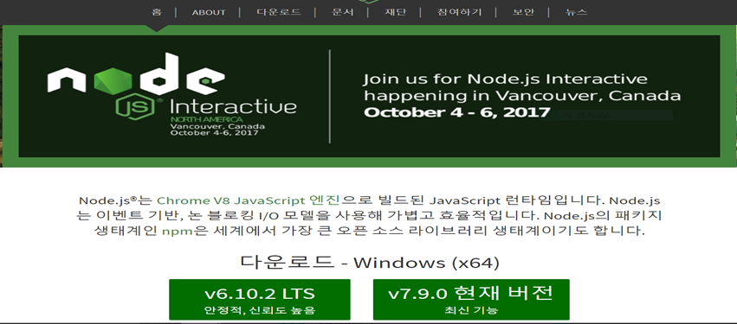
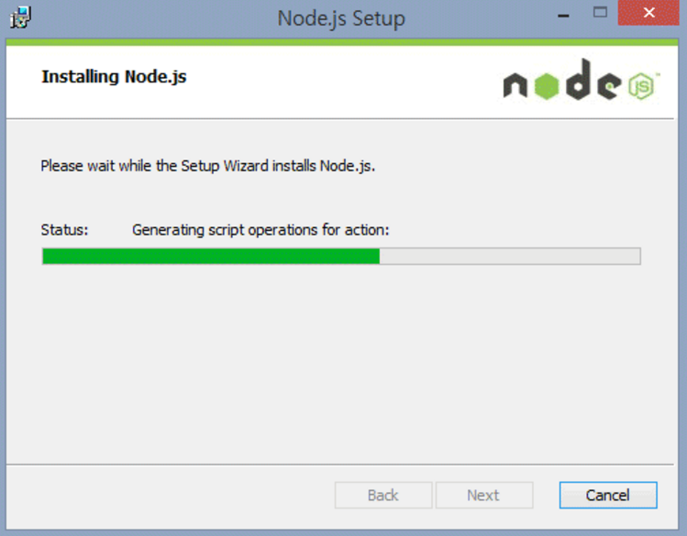
Node.js with npm
have to use the latest version

Slide 4
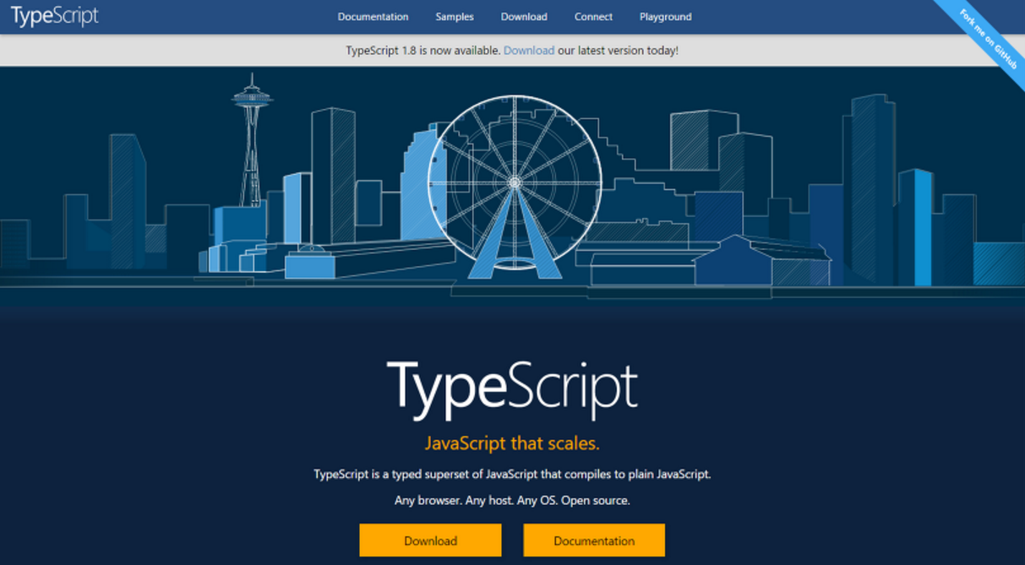
TypeScript

Slide 5
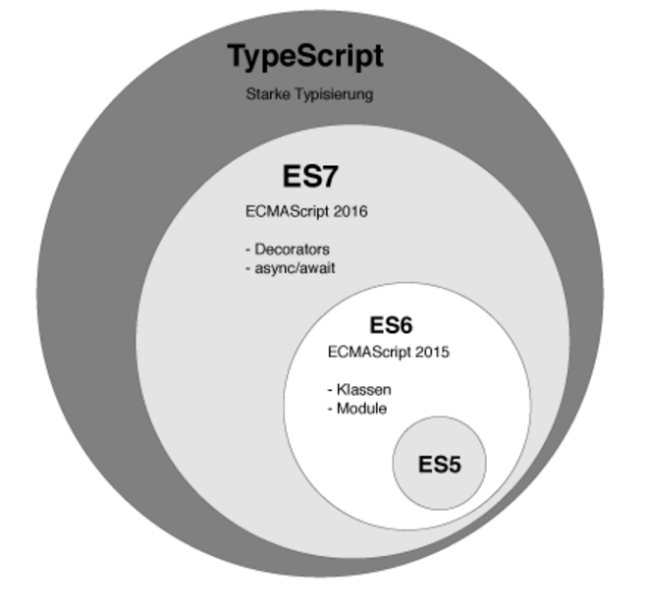
Introduction to TypeScript
TypeScript is developed and maintained by Microsoft and it is an open source.
It supports all of the syntax and semantics of JavaScript while providing some extra features such as static typing and richer syntax by being a superset of ECMAScript.

Slide 6
COMPILING VS TRANSPILING
Compiling is the general term for taking source code written in one language and transforming into another.
Transpiling is a specific term for taking source code written in one language and transforming into another language that has a similar level of abstraction.

Slide 7
Transpiler Languages and New Feature
One of the main advantages of transpiler languages is adding new feature into them.
TypeScript is added with interface, abstract class, data type and etc, does not uses additional lib.
Transpiler Language supplements JavaScript with new feature. If you know nothing about that, You’ll not be faced with the problem by using interface.

Slide 8
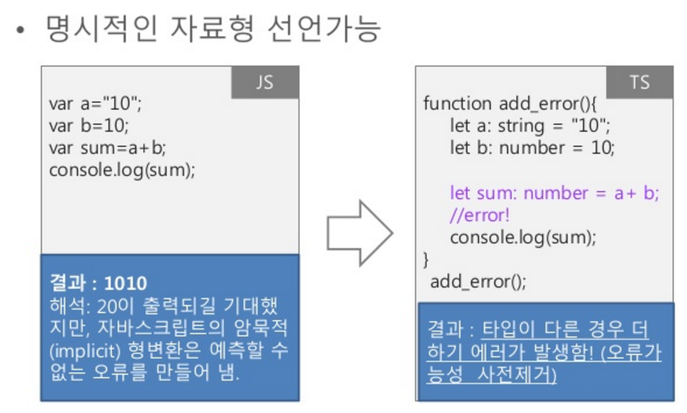
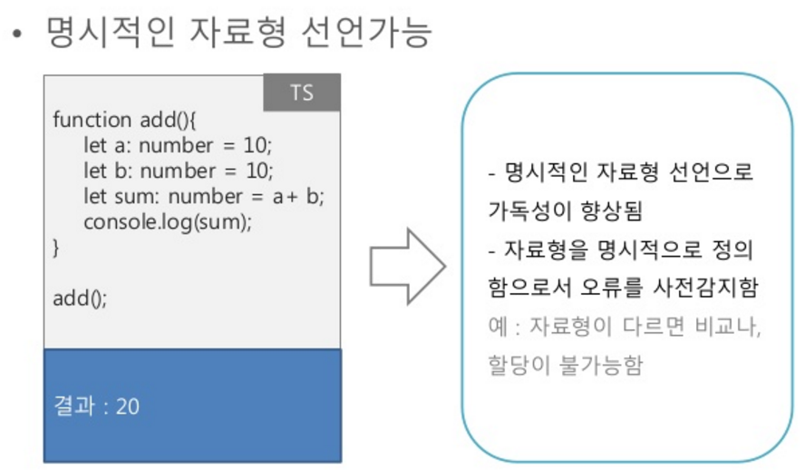
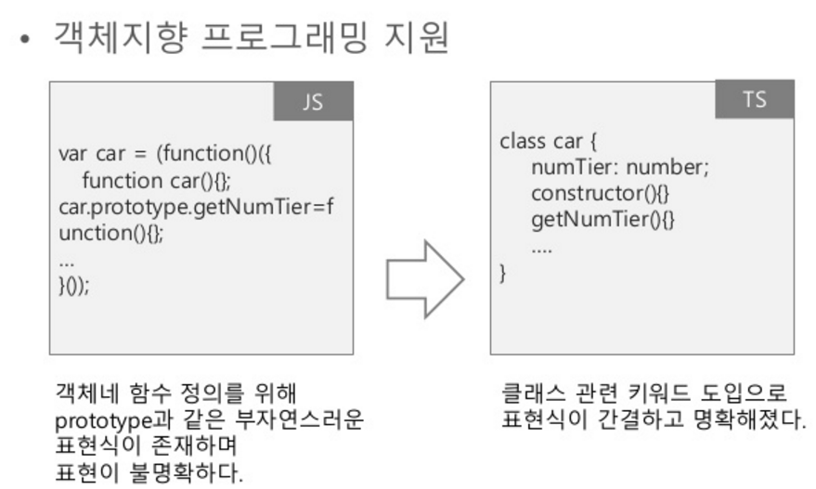
TypeScript vs JavaScript
TypeScript = JavaScript + type
Correct errors in compile type using explicit type
Support object-oriented programming

Slide 9
Strong point of TypeScript
Class
Interface
Type check in Compile time
Install TypeScript
npm install –g typescript
npm install –g typings

Slide 10
What is Angular?
Angular is an open source framework for developing web applications. The framework makes it simpler to create custom components that can be added to HTML documents and to implement application logic.

Slide 11
Step(1)
Create a project folder in your local drive by typing below commands in the command prompt.
mkdir angular2-demo
cd angular2-demo

Slide 12
Creating Configuration Files Step(2)
You need to create tsconfig.json which is the TypeScript compiler configuration file. It guides the compiler to generate JavaScript files.
Step(3)
Create a typings.json file in your project folder angular2-demo as shown below:

Slide 13
tsconfig.json
{
"compilerOptions": {
"target": "es5",
"module": "system",
"moduleResolution": "node",
"sourceMap": true,
"emitDecoratorMetadata": true,
"experimentalDecorators": true,
"removeComments": false,
"noImplicitAny": false
},
"exclude": [
"node_modules",
"typings/main",
"typings/main.d.ts"
]
}

Slide 14
typings.json
{
"globalDependencies": {
"core-js": "registry:dt/core-js#0.0.0+20160602141332",
"jasmine": "registry:dt/jasmine#2.2.0+20160621224255",
"node": "registry:dt/node#6.0.0+20160621231320"
}
}

Slide 15
A large number of libraries of the JavaScript extends JavaScript environment with features and syntax which is not natively recognized by the TypeScript compiler. The typings.json file is used to identify TypeScript definition files in your Angular application.
In the above code, there are three typing files as shown below:
core-js: It brings ES2015/ES6 capabilities to our ES5 browsers.
jasmine: It is the typing for Jasmine test framework.
node: It is used for the code that references objects in the nodejs environment.
These typings are used in development of larger Angular applications.

Slide 16
Step(4)
Add package.json file to your angular2-demo project folder with the below code:
The package.json will contain the packages that our apps require. These packages are installed and maintained with npm (Node Package Manager). To install npm click here

Slide 17
package.json
{
"name": "angular2-demo",
"version": "1.0.0",
"scripts": {
"start": "concurrent \"npm run tsc:w\" \"npm run lite\" ",
"tsc": "tsc",
"tsc:w": "tsc -w",
"lite": "lite-server",
"typings": "typings",
"postinstall": "typings install"
},
"license": "ISC",
"dependencies": {
"angular2": "2.0.0-beta.7",
"systemjs": "0.19.22",
"es6-promise": "^3.0.2",
"es6-shim": "^0.33.3",
"reflect-metadata": "0.1.2",
"rxjs": "5.0.0-beta.2",
"zone.js": "0.5.15"
},
"devDependencies": {
"concurrently": "^2.0.0",
"lite-server": "^2.1.0",
"typescript": "^1.7.5",
"typings":"^0.6.8"
}
}

Slide 18
Step(5)
To install packages, run the below npm command in command prompt.
npm install
Creating Our First Angular Component
A component is the fundamental concept of Angular.
A component is a class that controls a view template – a part of a web page where information to the user is displayed and user feedback is responded.
Components are required to build Angular apps.

Slide 19
Step(6)
Create a sub-folder called app/ inside your project folder to the place Angular app components. You can use the below command to create the folder:
mkdir app
cd app

Slide 20
Step(7)
The files which you create need to be saved with .ts extension. Create a file called environment_app.component.ts in your app/ folder with the below code:

Slide 21
environment_app.component.ts
import {Component, View} from "angular2/core";
@Component({
selector: 'my-app'
})
@View({
template: '<h2>My First Angular 2 App</h2>'
})
export class AppComponent { }

Slide 22
The above code will import the Component and View package from angular2/core.
The @Component is an Angular 2 decorator that allows you to associate metadata with the component class.
The my-app can be used as HTML tag to injecting and can be used as a component.
The @view contains a template that tells Angular how to render a view.
The export specifies that, this component will be available outside the file.

Slide 23
Step(8)
Next, create environment_main.ts file with the below code:
environment_main.ts
import {bootstrap} from "angular2/platform/browser"
import {AppComponent} from "./environment_app.component"
bootstrap(AppComponent);

Slide 24
The environment_main.ts file tells Angular to load the component.
To launch the application, we need to import both Angular's browser bootstrap function and root component of the application.
After importing, the bootstrap is called by passing the root component type i.e. AppComponent.

Slide 25
Step(9)
Now create a index.html in your project folder angular2-demo/ with the below code:
Angular will launch the app in the browser with our component and places it in a specific location on index.html.

Slide 26
index.html
<!DOCTYPE html>
<html>
<head>
<title>Hello World</title>
<script src="https://cdnjs.cloudflare.com/ajax/libs/es6-shim/0.33.3/es6-shim.min.js"></script>
<script src="https://cdnjs.cloudflare.com/ajax/libs/systemjs/0.19.20/system-polyfills.js"></script>
<script src="https://code.angularjs.org/2.0.0-beta.6/angular2-polyfills.js"></script>
<script src="https://code.angularjs.org/tools/system.js"></script>
<script src="https://code.angularjs.org/tools/typescript.js"></script>
<script src="https://code.angularjs.org/2.0.0-beta.6/Rx.js"></script>
<script src="https://code.angularjs.org/2.0.0-beta.6/angular2.dev.js"></script>
<script>
System.config({
transpiler: 'typescript',
typescriptOptions: { emitDecoratorMetadata: true },
packages: {'app': {defaultExtension: 'ts'}},
map: { 'app': './angular2/src/app' }
});
System.import('app/environment_main').then(null, console.error.bind(console));
</script>
</head>
<body>
<my-app>Loading...</my-app>
</body>
</html>

Slide 27
Compile and Run Step(10)
To run the application, type the below command in a terminal window:
npm start
The above command runs two parallel node processes as listed below:
TypeScript compiler in the watch mode
The lite-server (static server) loads the index.html in a browser and refreshes the browser as application files change.
After few moments, a browser tab will get open with the following output:

Slide 28
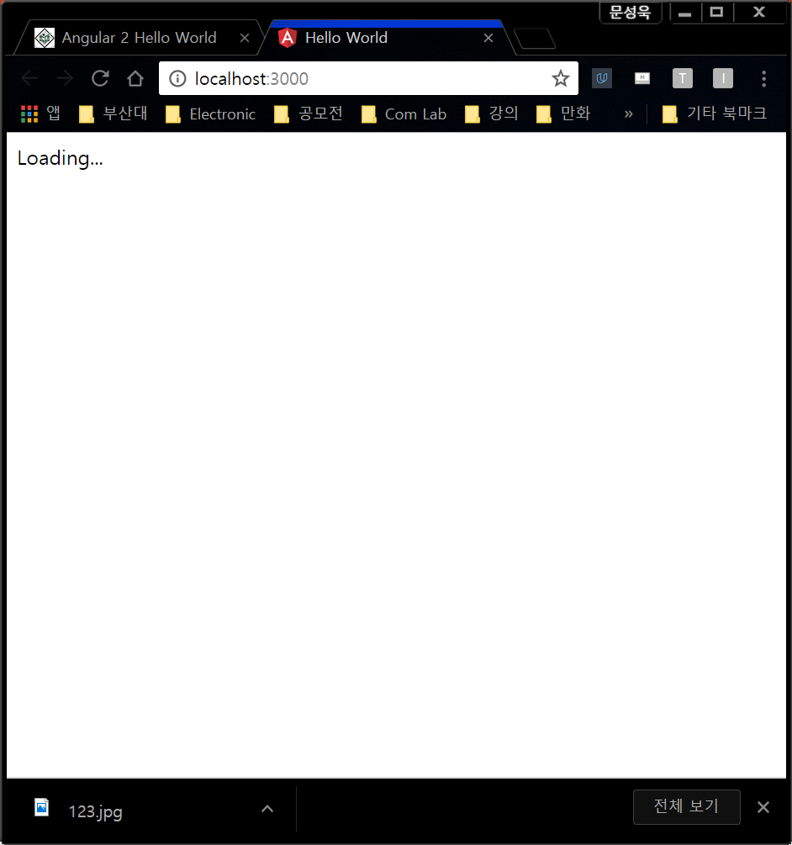

Slide 29
Step(11)
Correct index.html with the below code:
System.import('app/environment_main').then(null, console.error.bind(console));
System.import('app/hello_world_main').then(null, console.error.bind(console));
The above code includes the following configuration options:

Slide 30
You can configure the index.html file using typescript version. The SystemJS transpile the TypeScript to JavaScript before running the application by using the transpiler option.
If you do not transpile to JavaScript before running the application, you could see the compiler warnings and errors which are hidden in the browser.
The TypeScript generates metadata for each and every class of the code when the emitDecoratorMetadata option is set. If you don't specify this option, large amount of unused metadata will be generated which affects the file size and impact on the application runtime.
Angular 2 includes the packages form the app folder where files will have the .ts extension.
Next it will load the main component file from the app folder. If there is no main component file found, then it will display the error in the console.
When Angular calls the bootstrap function in main.ts, it reads the Component metadata, finds the 'app' selector, locates an element tag named app, and loads the application between those tags.

Slide 31
Step(12)
To run the code, you need the following TypeScript(.ts) files which you need to save under the app folder.
hello_world_main.ts
import {bootstrap} from "angular2/platform/browser"
import {MyHelloWorldClass} from "./hello_world_app.component"
bootstrap(MyHelloWorldClass);

Slide 32
Step(13)
Now we will create a component in TypeScript(.ts) file as shown below:
hello_world_app.component.ts
import {Component, View} from "angular2/core";
@Component({
selector: 'my-app'
})
@View({
template: '<h2>Hello World !!</h2>'
})
export class MyHelloWorldClass {
}

Slide 33
The @Component is a decorator which uses configuration object to create the component.
The selector creates an instance of the component where it finds <my-app> tag in parent HTML.
The @view contains a template that tells Angular how to render a view.
The export specifies that the component will be available outside the file.

Slide 34
Output
Let's carry out the following steps to see how above code works:
Save above HTML code as index.html file as how we created in environment chapter and use the above app folder which contains .ts files.
Open the terminal window and enter the below command:
npm start
After few moments, a browser tab should open and displays the output as shown below.
OR you can run this file in another way:
Save above HTML code as angular2_hello_world.html file in your server root folder.
Open this HTML file as http://localhost/angular2_hello_world.html and output as below gets displayed.

