Slide 1
Promise
By Almira & Charvi

Slide 2
Agenda
What is Promise?
Advantages & Disadvantages
Coding Style
Questions

Slide 3
What is Promise?
A Promise is an object , that may produce a single value some time in a future.
Either its produce Resolve or Reject
It can be used to deal with asynchronous operation in JavaScript.
Emit only single value at a time.
Not possible to cancelled.
It not provides any operators.
Error handling is done using .then() and .catch() methods.

Slide 4
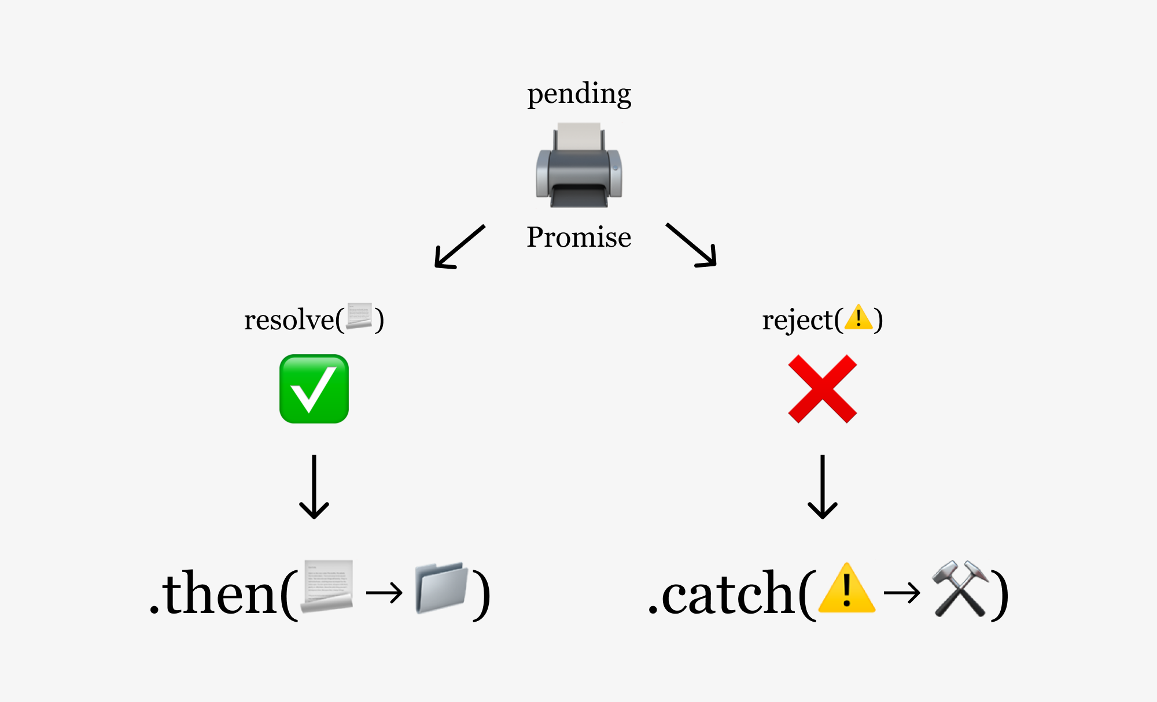
A Promise has 3 States.
pending: initial state, neither fulfilled nor rejected.
fulfilled: meaning that the operation was completed successfully. (e.g., resolve() was called)
rejected: meaning that the operation failed. (e.g., reject() was called)

Slide 5
Syntax of Promise
Normal Function
const mypromise = new Promise(function(resolve, reject){
})
Arrow Function
const mypromise= new Promise((resolve, reject)=>{
})

Slide 6
Let see the simple example
const mypromise=new Promise((resolve,reject)=>{
let a=5,b=6;
If(a==b)
console.log(“Resolved”);
else
console.log(“Reject”);
})
mypromise.then((value)=>{console.log(value)})
.catch((error)=>{console.log(error)});
Producing Code
Consuming Code

Slide 7
Advantages & Disadvantages
Advantages
Disadvantages
Better defined and organized control flow of asynchronous logic
Highly reduced coupling
We have integrated error handling
Enhanced readability
It kills the purpose of asynchronous non-blocking input and output.
Only one object can be returned
We cannot return multiple arguments

Slide 8
Questions?

