Slide 1
PARKING SENSOR
Almira GÜRKAN

Slide 2
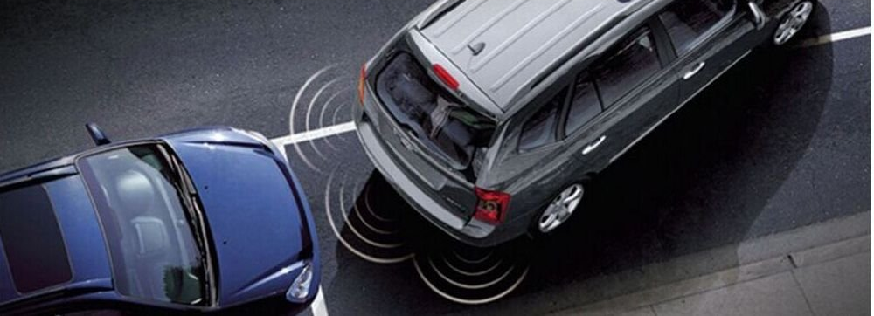
PURPOSE
In this project, it is aimed to inform the user about the distance of an embedded system-basedmodel vehicle via a smartphone application with Android operating system.
In addition, the user will be warned with the sound and light on the system depending on the distance. In this way, drivers will be able to park their cars more comfortably and parking accidents will be reduced.

Slide 3
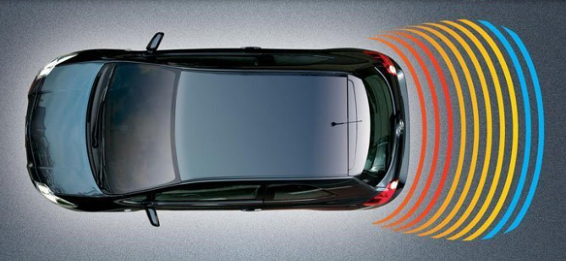
DESCRIPTION
In this system, your distance between two vehicles or your proximity to the object to be approached is measured with the help of sensors as the main function.
With the sound and led, you can understand the distance.
This will be achieved by increasing the density of the LED's blinking and buzzer's sounds as the distance between the vehicle and the object decreases.
In addition, the distance between the vehicle and the object will display with the application running on the smart phone.
High Voice
Medium Voice
Low Voice

Slide 4

The proposed system consists of two parts, a hardware and a software.
The hardware consists of electronic components and middleware running on it.
The software consists of an application running on an Android operating system based smartphone.

Slide 5
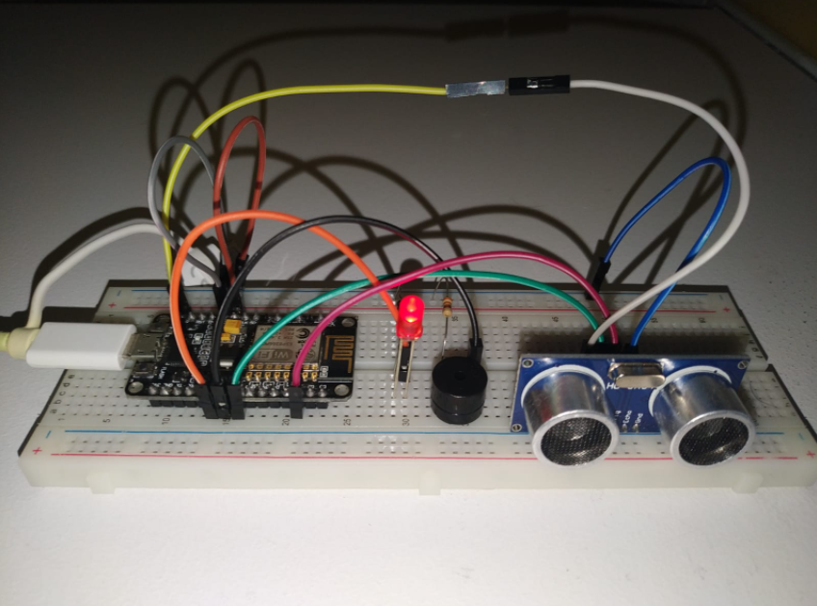
EMBEDDED SYSTEM KIT
Nodemcu Lolin ESP8266
A breadboard
An ultrasonic distance meter sensor
A Wifi module
A buzzer
A led
Resistor
Jumper cables.

Slide 6
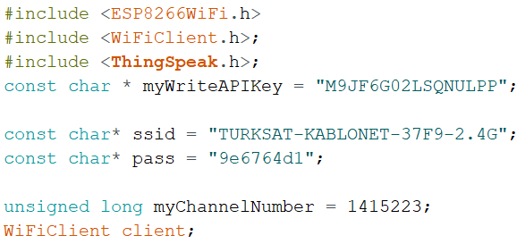
Ardunio was used for system coding.

Slide 7
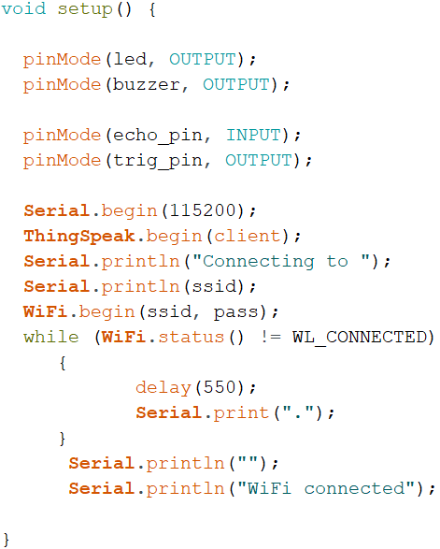
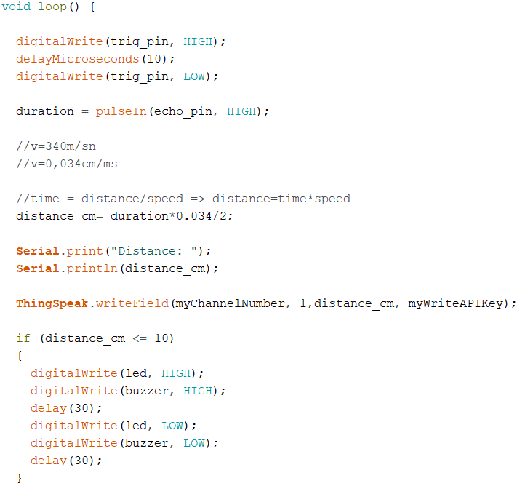

Slide 8
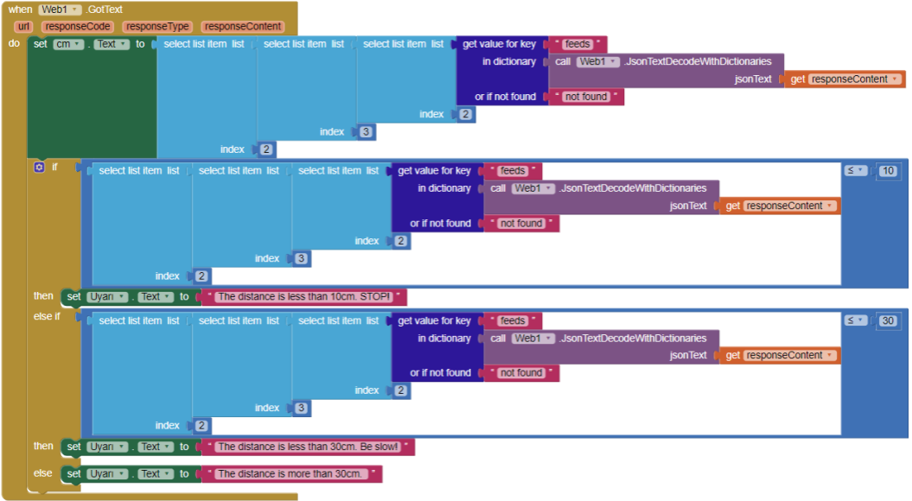
Thingspeak and Mit App Inventor were used, while making this app.

Slide 9
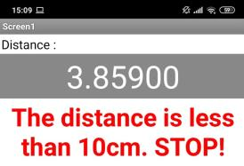
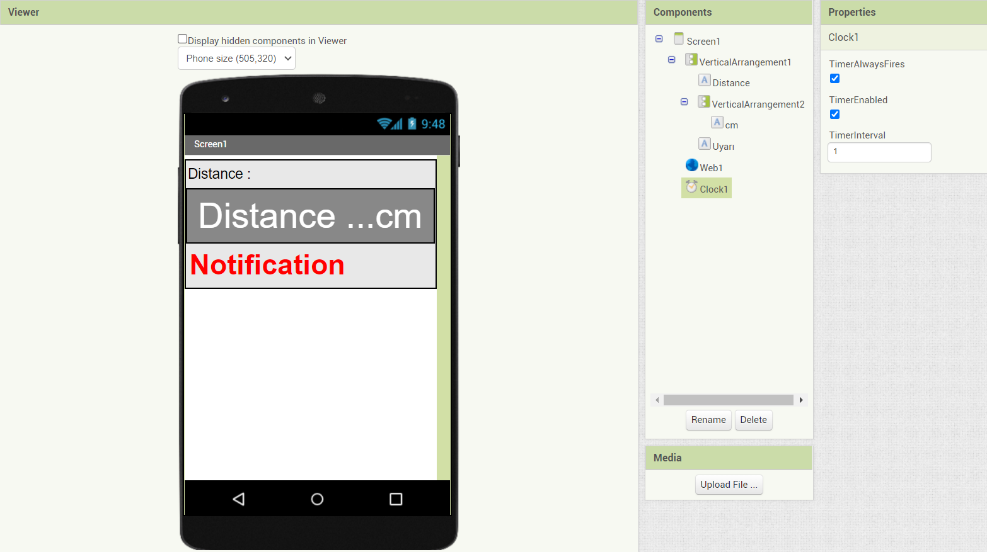
A mobile application is built for Android as IoT

Slide 10
CONCLUSION
As a result, we learned Arduino.
We learned the Arduino code sequence.
Thanks to the simulation, we saw our mistakes before installing the system.
We developed an application with thingspeak and mit app inventor.
We combined this application with our project.
Thanks to these, we made parking sensors.
We found out what is required for the parking sensor. We learned the general usage areas of Arduino systems.

