Slide 1
InvestoBank Digicoins Transactions
Alexandros Mittas Lazaridis

Slide 2
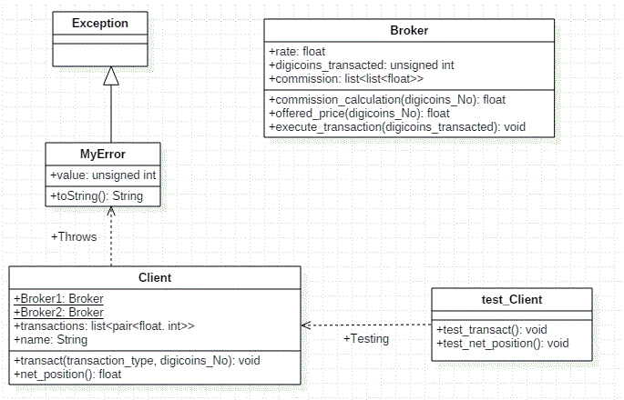
Modelling Diagram

Slide 3
Implementation Details
Broker
rate – Positive float corresponding to the rate the Broker is offering per Digicoin eg 1.49
digicoins_transacted – A sum of the orders of Digicoin that have been transacted so far by the Broker.
commission. A collection of floats out of which commission_calculations(digicoins_No) returns a float. This float represents a percentage the bank is charging for transacting a specific amount of Digicoins.

Slide 4
Client
Broker 1 and Broker 2 static Variables.
Every Client needs to access both Brokers, so he can get offers from both of them and be able to choose the best offer.
Since a specific Broker is a unique object it has been defined as static member.
Transactions
Transactions is a list of pairs of floats and integers. For every transaction processed a new pair is being inserted in the list.
Eg. A transaction of10 Digicoins at 15.645 inserts in the list the pair [15.645, 10]
Name
Every Client has a name which is being stored on this member variable

Slide 5
Exceptions
An exception class has been defined to handle requests of Digicoins which are not multiples of 10.
Suppose Client B requests to transact 11 Digicoins
=> Exception Thrown
The transaction Fails.
MyError exception inherits from the parent Exception class and can be thrown in such cases.

Slide 6
Testing Mechanisms
For every method developed in Client Class, we have also developed the corresponding test_method
Unit Tests Implemented using Python’s unittest Framework.

Slide 7
Thank you for your time reading this and checking my developed solution.
Thank you also for the opportunity I got to deal with this interesting project. ☺
Alexandros

