Slide 1
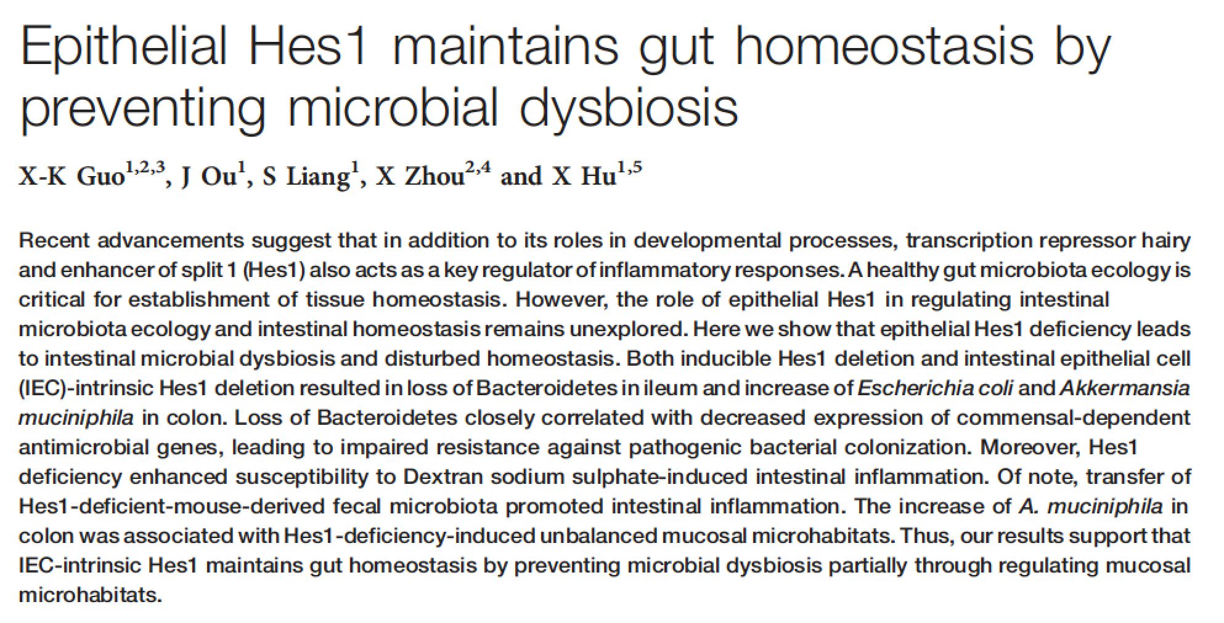
IEC-KO and inducible KO

Slide 2
Required background for paper
Inhibits inflammation
Hes1
(transcriptional repressor)
Notch
Drives IEC lineage
(Hes3, Hes5 known to be required for IEC renewal in adult mouse gut)
AMPs
mucus
Paneth
goblet

Slide 3
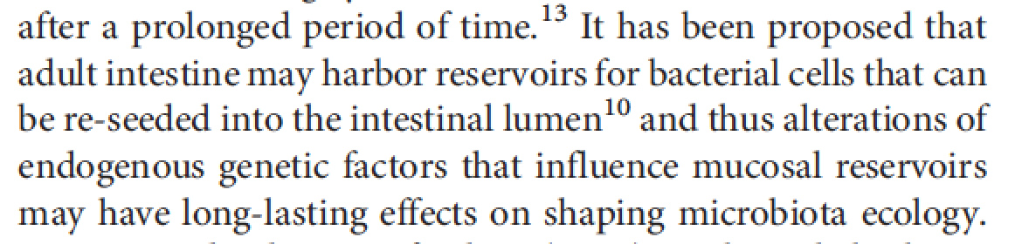
Significance:

Slide 4
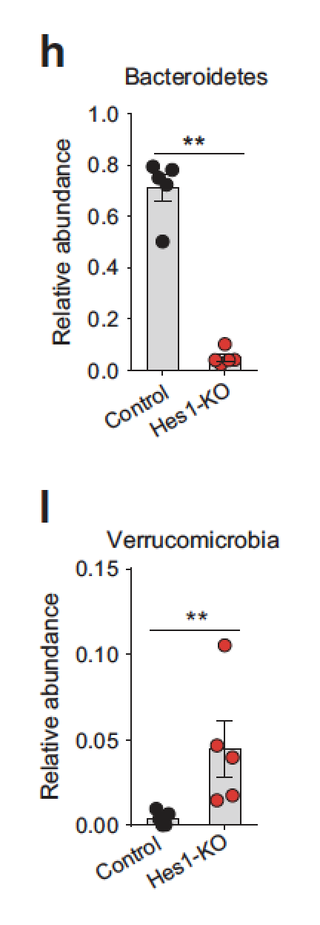
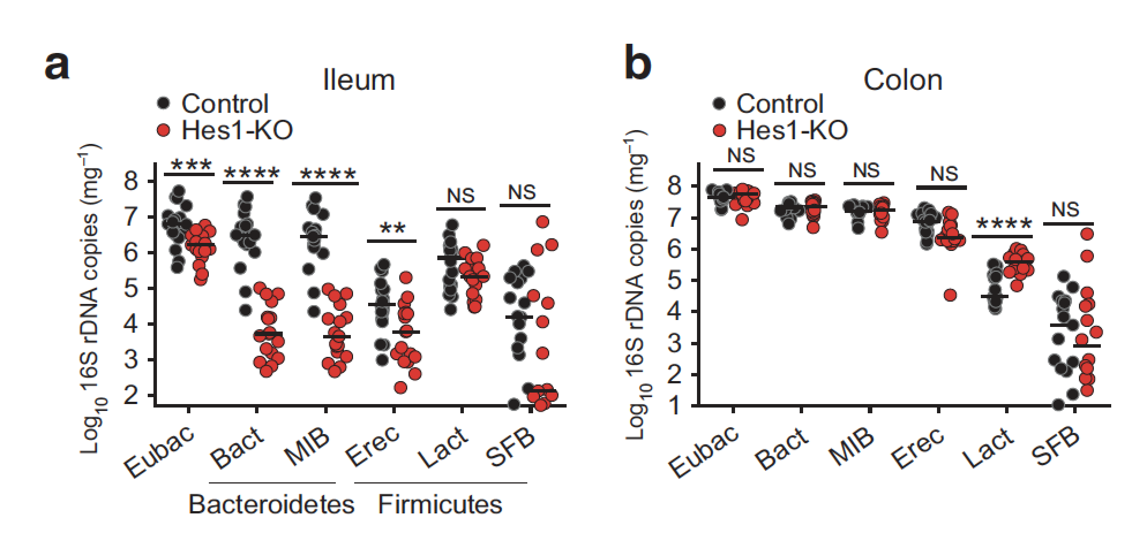
Hes1 deficiency leads to microbiota differences
ielum
From changes in O2?
colon
Figure 1

Slide 5
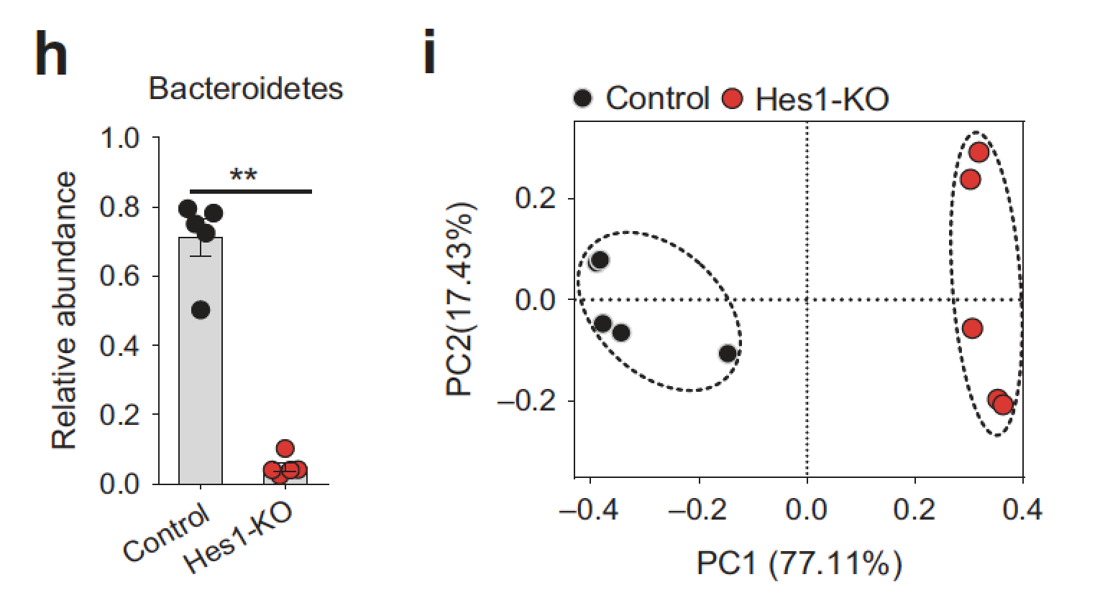
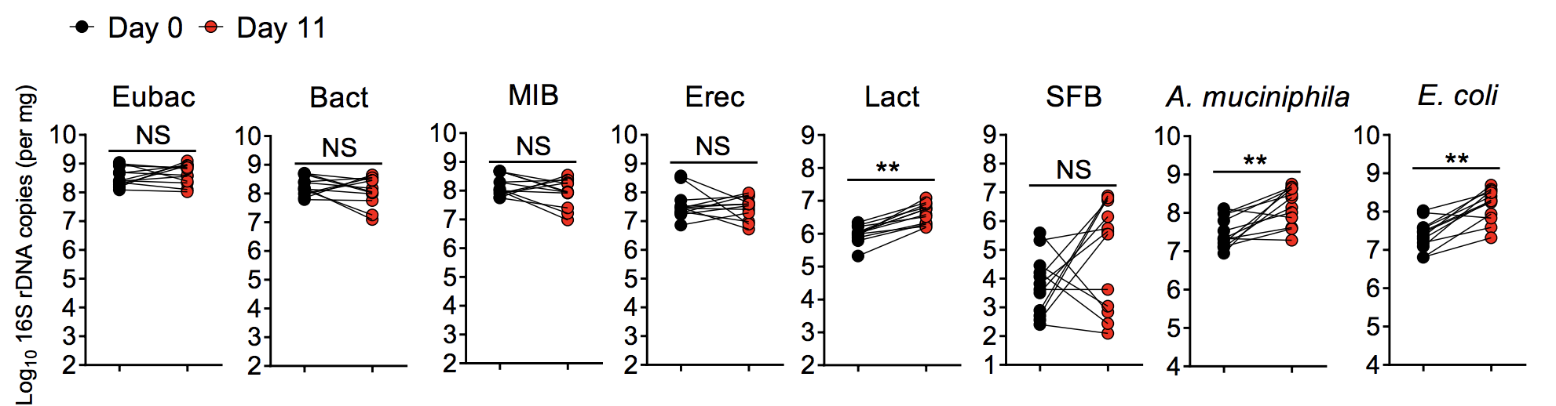
Clear distinction between Hes1+ and Hes1-
Fig 1
Fig S2b, same mouse, feces before and after depletion

Slide 6
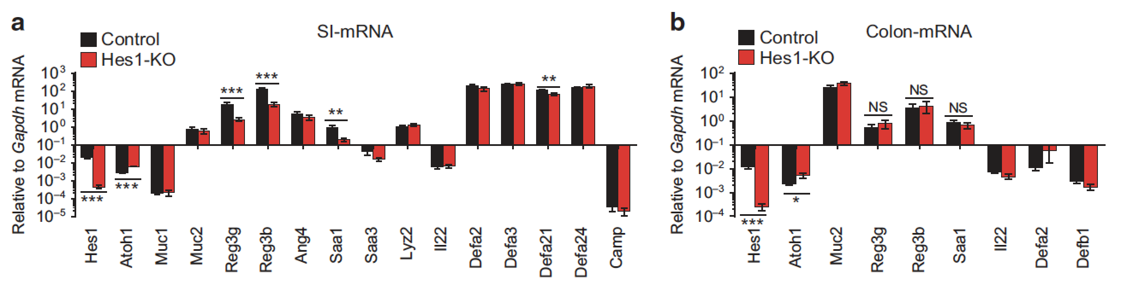
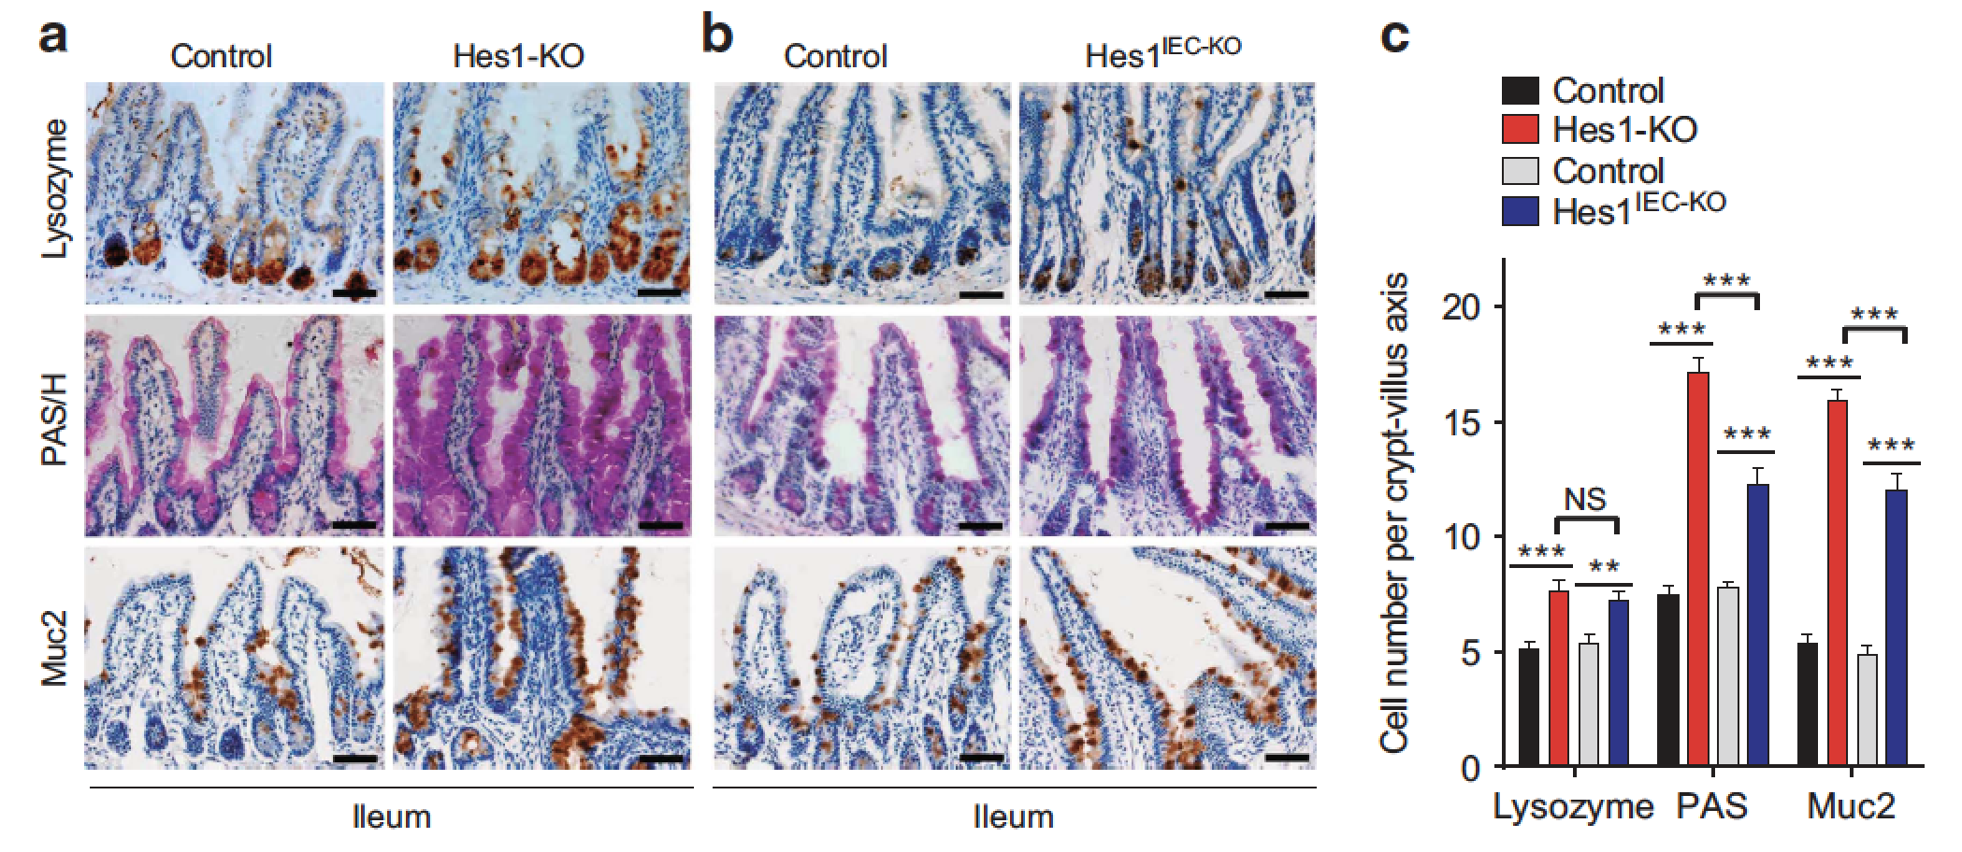
Hes1 loss leads to decreased AMPs
Figure 2
Figure 5
Increased Paneth cells
Authors do not address

Slide 7
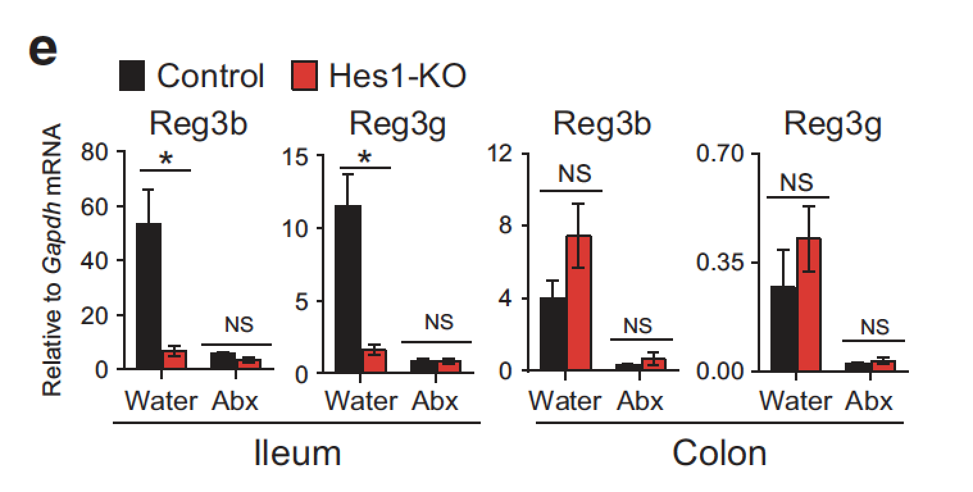
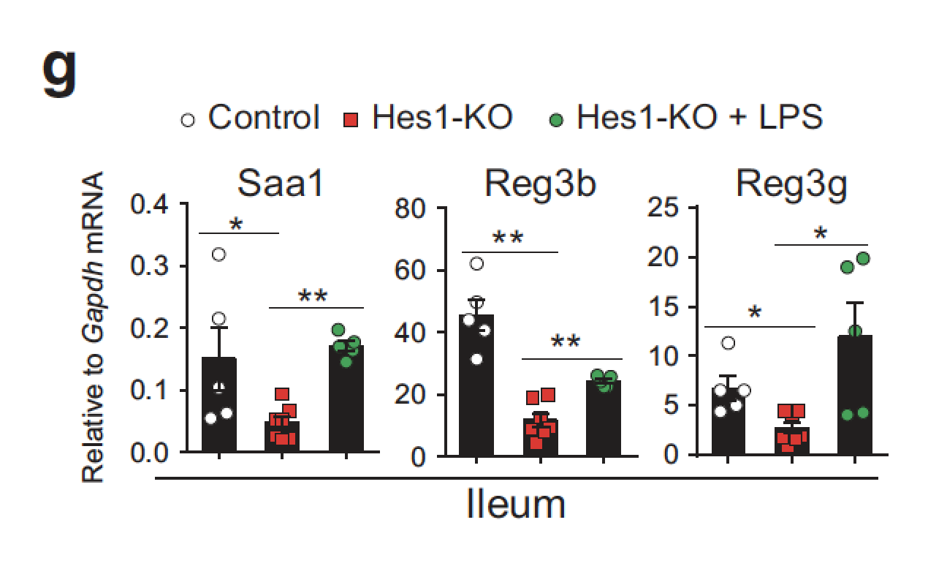
AMP expression is commensal-dependent
Only look at certain AMPs
Figure 2

Slide 8
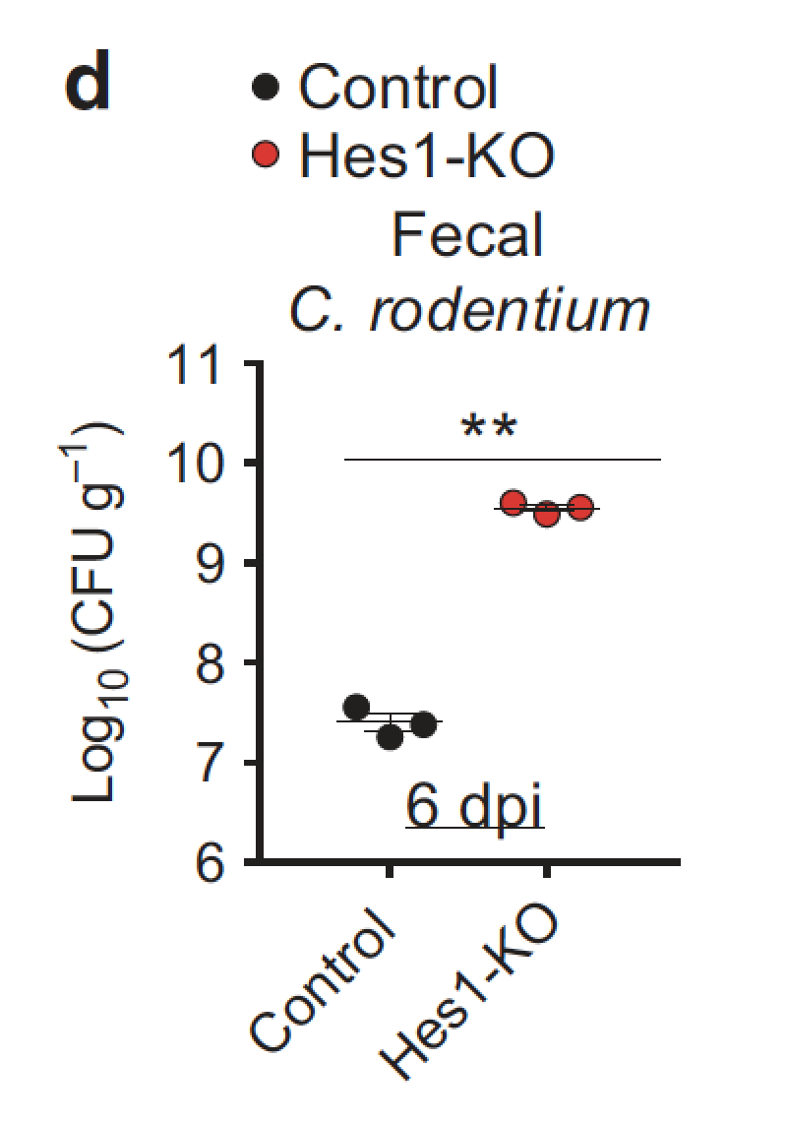
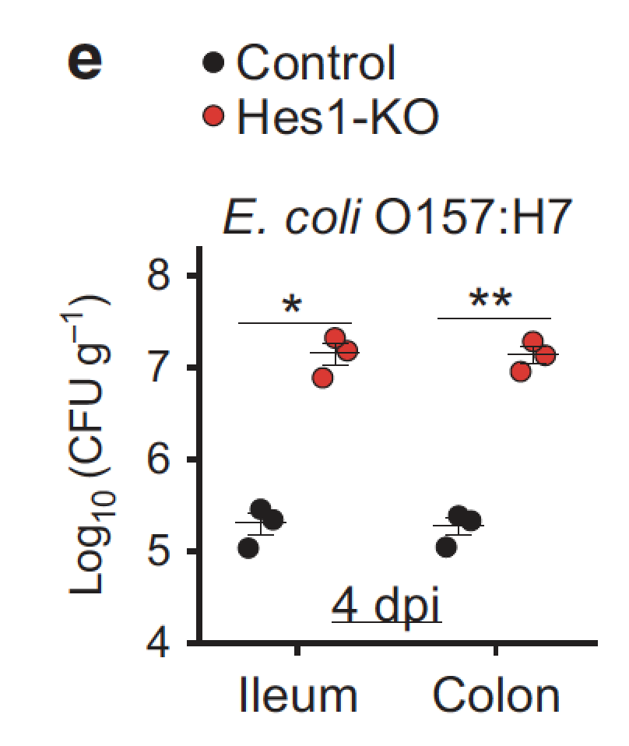
Hes1 required for colonization resistance
Figure 3

Slide 9
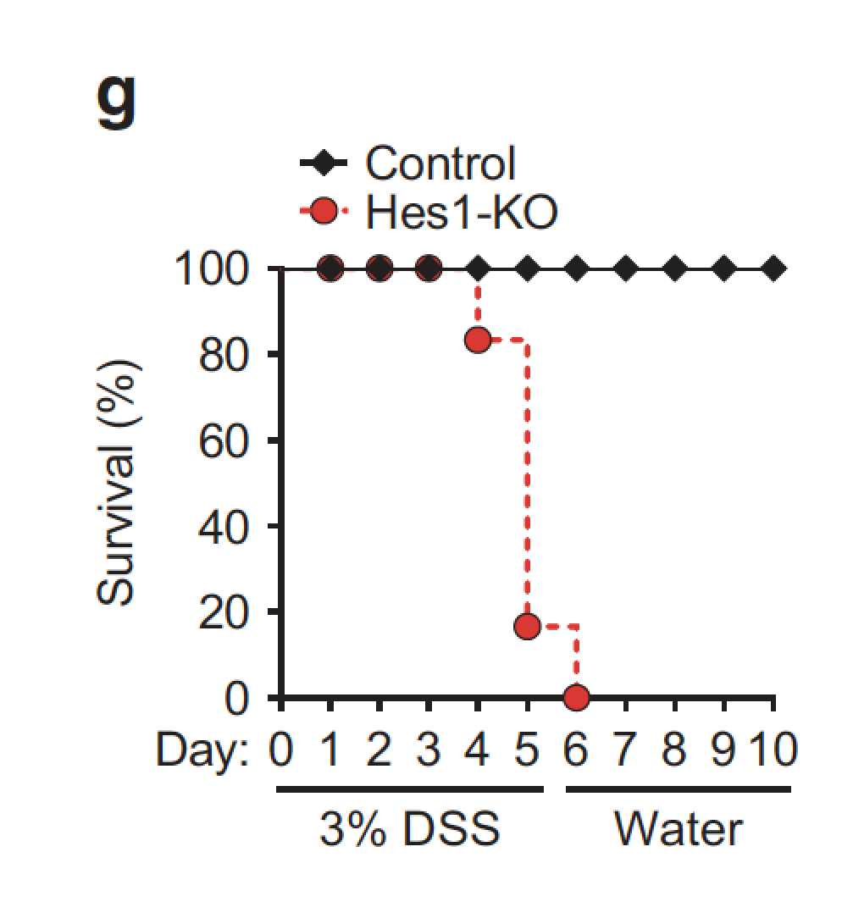
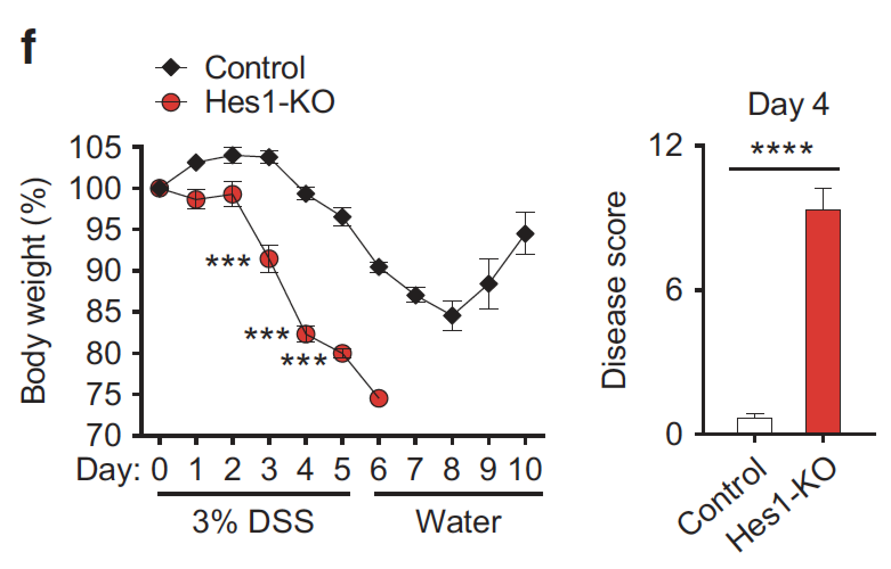
Hes1 loss sensitizes to DSS-colitis
Figure 3

Slide 10
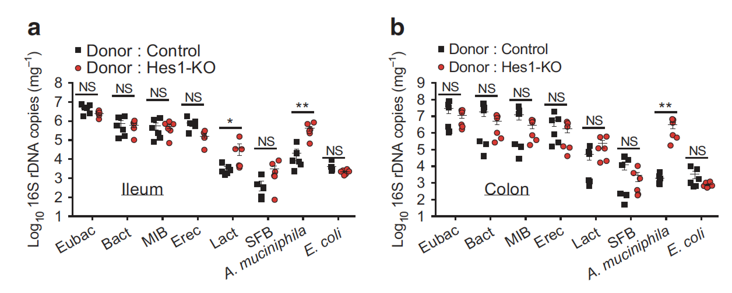
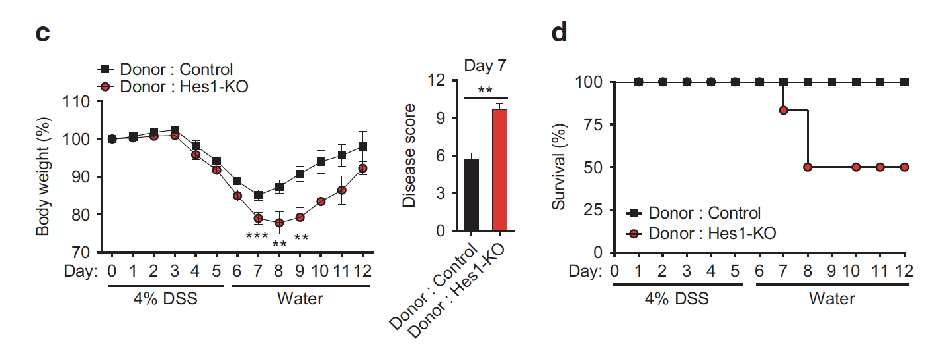
Inflammation is also commensal dependent
Figure 4
16S after FMT
DSS-colitis after FMT
Would Ctrl into Hes1-KO rescue?

Slide 11
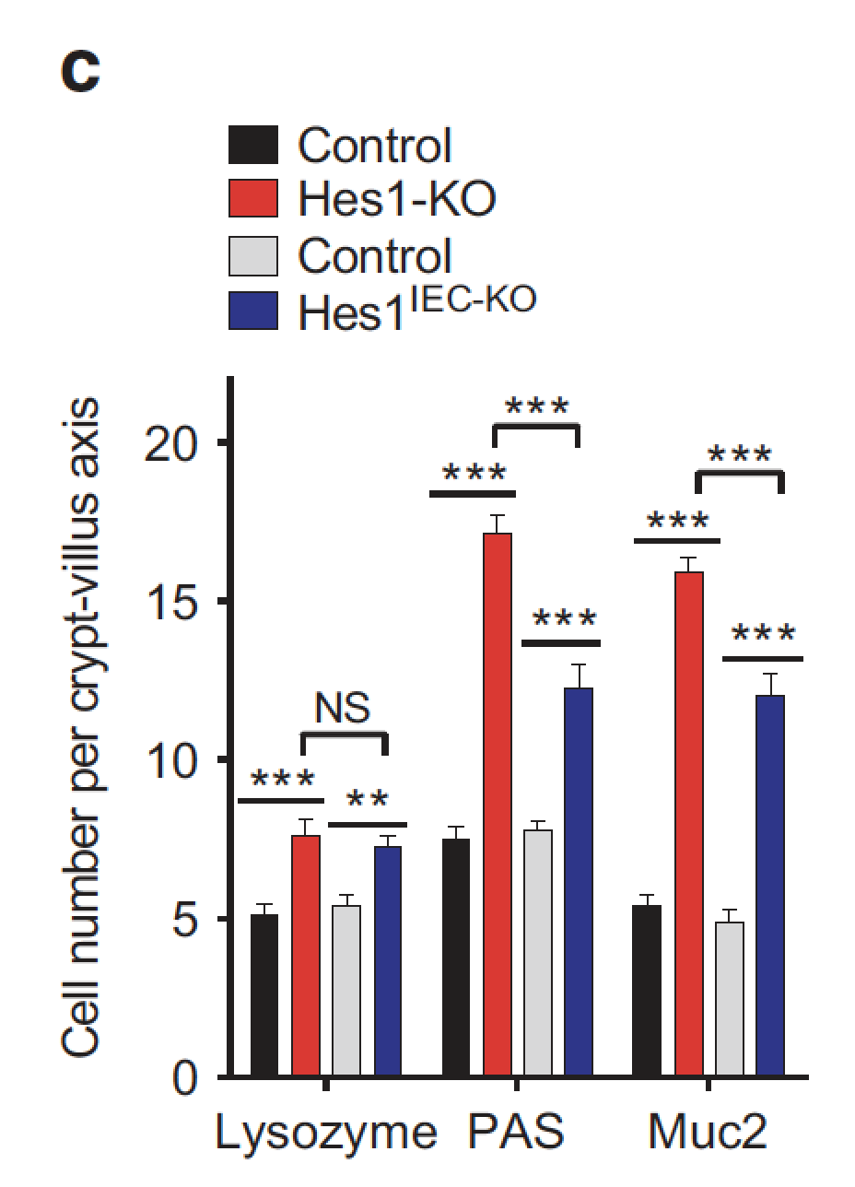
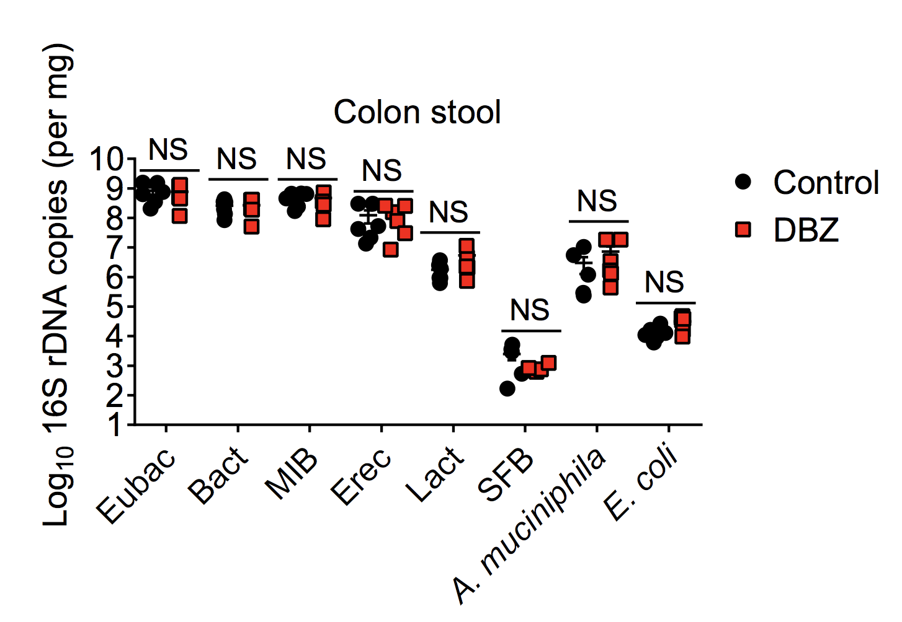
Hes1 alters mucus
Figure 5
Fig S7
Notch inhibitor
“mucus hyperplasia”
Which is not simply due to lost Notch signaling (yes hyperplasia, no dysbiosis)

Slide 12
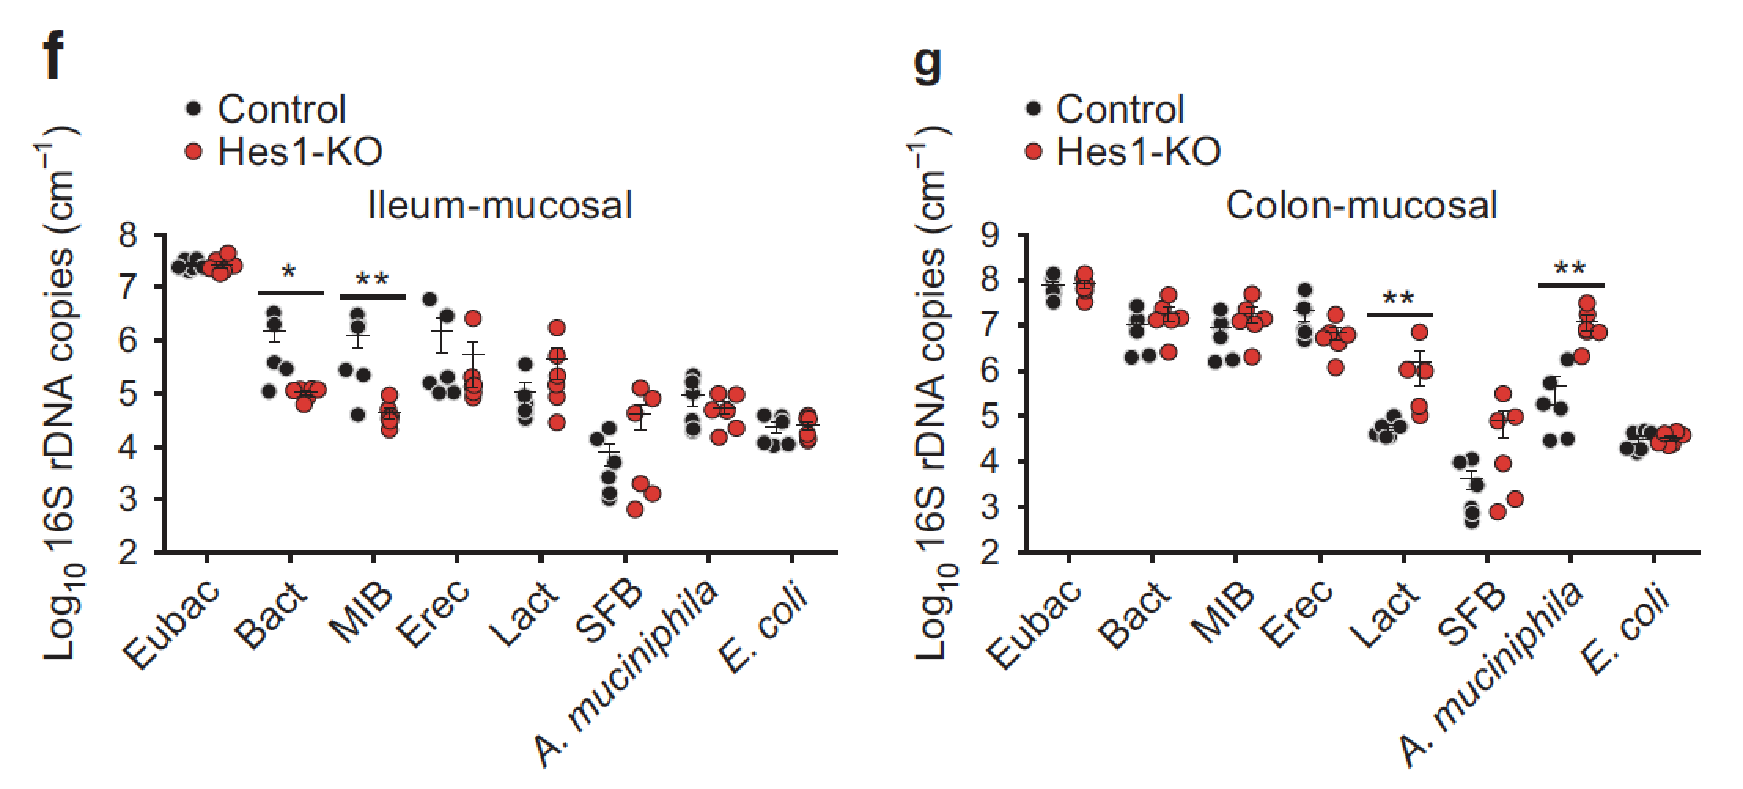
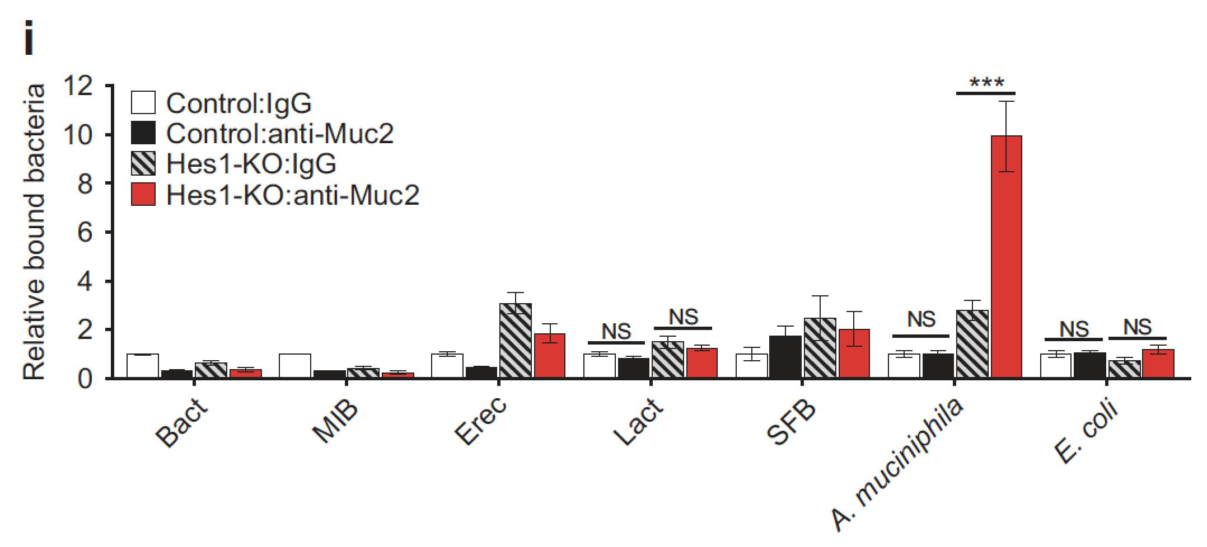
Hes1 altered mucus alters microbiota
Figure 5
Unclear how they ruled out the possibility that Akkermansia→mucus
Muc2 pulldown, increased Am

