Slide 1
The 16S Workshop
Claire Duvallet
Thomas Gurry, Scott Olesen
March 9, 2016

Slide 2
after this workshop, I hope you will understand:
the steps involved in processing 16S data
what the AWS pipeline can do for you
how to troubleshoot some pipeline troubles
and 16S processing in general
where to find resources for help
mostly your eyes and your brain

Slide 3
the AWS pipeline is not trying to be qiime
AWS pipeline will one day be much more than qiime
different data types
automatic analyses
having an in-house pipeline offers other advantages
looking inside the black box
adding functionalities
troubleshooting with humans
qiime is great and you should totally use it if you want
but make sure you’re using it wisely

Slide 4
“4” “easy” “steps” with 16S data
0. figure out what data you have
your eyes and your brain
1. pre-process data
AWS pipeline
2. build OTU table
AWS pipeline
3. analyze
your eyes and your brain

Slide 5
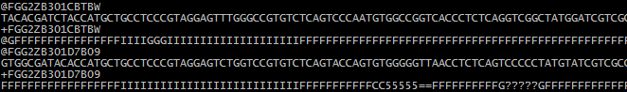
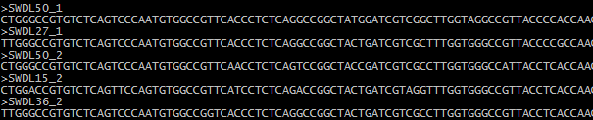
step 0. know your data
How were your regions sequenced?
barcode – fwd primer – region – (rev primer)
What kind(s) of file(s) do you have?

Slide 6
step 0. know your data
How were your regions sequenced?
barcode – fwd primer – region – (rev primer)
What kind(s) of file(s) do you have?
fastq
fasta

Slide 7
step 0. understand your data
single end reads? paired end? already merged?
if not merged, you need to do this step yourself
one single fastq? one fastq file per sample?
if downloading data: already a fasta?
what about the sequences?
barcodes removed?
primers removed?
length trimmed already?
every sequencing center does it differently!!
use your eyes and your brain

Slide 8
step 0. paired-end sequencing will require merging
merge forward and reverse reads
can use usearch or Scott’s script
note: barcodes may be in a separate index file
AWS pipeline does not do this step
fwd read, R1
barcode
fwd primer
first part of 16S region
second part of 16S region
rev primer
rev read, R2
barcode
fwd primer
16S region
rev primer

Slide 9
“4” “easy” “steps” for 16S data
0. figure out what data you have
your eyes and your brain
1. pre-process data
AWS pipeline
2. build OTU table
AWS pipeline
3. analyze
your eyes and your brain

Slide 10
step 1. pre-processing
16S MAGIC
raw data many possible formats
neat data
dereplicated fasta + dereplication map
Raw data options:
one fastq or multiple fastq files
with or without barcodes in sequences
with or without primers in sequences
all different lengths, possibly low quality
can also take in a fasta
Outputs:
dereplicated fasta: all of the unique sequences
dereplication map: counts of each sequence per sample

Slide 11
step 1. pre-processing with AWS pipeline
which steps are done depends on inputs
talk to pipeline via summary_file.txt
AWS pipeline calls a medley of scripts
lab scripts (2.split_by_barcodes.py, etc)
usearch functions
de-multiplex
trim primers
quality trim
length trim
de-replication

Slide 12
step 1.1: need to split by barcodes if fastqs aren’t already demultiplexed
if you only have one fastq file with all samples in it, need to split by barcodes
basically put sample IDs in the fastq sequence IDs
sequencing centers often demultiplex fastqs for you
i.e. you have one file per sample
de-multiplex
trim primers
quality trim
length trim
de-replication

Slide 13
step 1.1: split by barcodes
barcodes can be in multiple places
beginning of sequence, sequence ID, index file
this can be specified in summary_file.txt
pipeline calls 2.split_by_barcodes.py
or simply renames sequences with sample IDs if fastq is already de-multiplexed
de-multiplex
trim primers
quality trim
length trim
de-replication

Slide 14
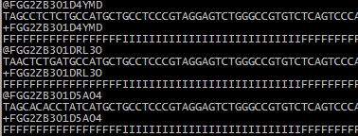
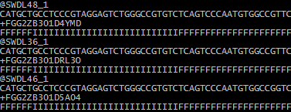
step 1.1: demultiplexing also trims off barcode and relabels sequences
barcode
primer
16S region
primer
16S region
xaa
or original fastq file name
xaa.sb
sample IDs in seq IDs
barcodes removed
no seqs with barcode mismatches

Slide 15
step 1.2: remove primers if they’re still in sequences
should manually check if primers are in seqs
pipeline calls wrapper to 1.remove_primers.py
checks for primers in forward and reverse complement sequence
primer
16S region
16S region
de-multiplex
trim primers
quality trim
length trim
de-replication

Slide 16
step 1.3: quality trimming
you need to figure out quality score encoding
use usearch –fastq_chars to make a guess
specify in ASCII_ENCODING in summary file
AWS quality trims with usearch –fastq_filter
truncates at first base with p(error) > 0.003
default Q=25, can specify in summary file
what kind of quality filtering do you prefer?
de-multiplex
trim primers
quality trim
length trim
de-replication

Slide 17
step 1.4: length trimming
sequences must be same length for later steps
i.e. alignment and clustering
AWS length trims with usearch –fastx_truncate
AWS default is 101, specify in TRIM_LENGTH
results are in *.raw_trimmed.fasta
has all of the reads for all samples
all same length, no barcodes or primers
sample IDs are in sequence headers
we’re almost there!
de-multiplex
trim primers
quality trim
length trim
de-replication

Slide 18
step 1.5: dereplication
keeps only the unique sequences
in AWS these are in *.raw_dereplicated.fasta
and does “provenancing”
i.e. maps how many times each sequence appeared in each sample
in AWS this file is *.dereplication_map
pipeline calls 3.dereplication.py
de-multiplex
trim primers
quality trim
length trim
de-replication

Slide 19
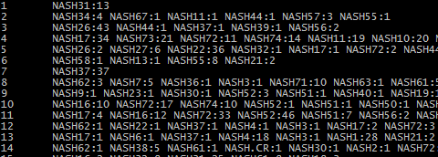
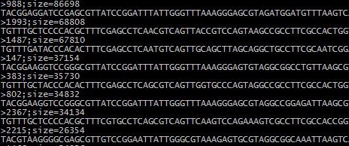
step 1.5: dereplication documentation is confusing but outputs are recognizable
dereplication map
sequence 1 occurred 13 times in sample NASH31
sequence 2 occurred 4 times in sample NASH34, 1 time in NASH67, 1 time in NASH11, …
sequence 3 occurred 43 times in NASH26, 1 time in NASH37, 1 time in NASH39, and 2 times in NASH6
dereplicated fasta
unique sequences only
sequences sorted by counts

Slide 20
step 1: dereplicated fasta and map are the end goal of pre-processing
pipeline handles many possible inputs
one fastq or multiple fastq files
with or without barcodes in sequences
with or without primers in sequences
all different lengths, possibly low quality
can also take in a fasta
all of this gets specified in summary_file.txt
if there are no primers/barcodes, put None
for other options, read documentation
de-multiplex
trim primers
quality trim
length trim
de-replication

Slide 21
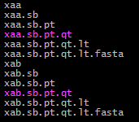
step 1: AWS pipeline saves intermediate files, identified with suffixes
de-multiplex
trim primers
quality trim
length trim
*.sb
*.pt
*.qt
*.lt
so you can use your eyes and your brain

Slide 22
processing: eyes and brain practice
datasets on Alm lab node
what data do we have?
fastq or fasta?
de-multiplexed already?
primers in there?
need to merge?
trimmed yet?
Notes:
autism_kb_data
crc_zhao (everything in all files)
edd_singh (primers aren’t in files, have fasta)
ibd_gevers (need to merge, primers aren’t in files (I think))
sci_gungor (need barcopes womp womp)
ob_escobar (no primers in files)

Slide 23
processing: eyes and brain practice
datasets on workshop node
ssh -i 16S_workshop.pem ubuntu@52.70..179.175
for datasets 7-10: what happened?
where would you start de-bugging?
where can you find more info about what went wrong?

Slide 24
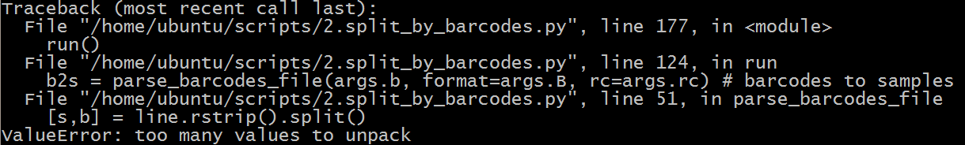
where did it fail? what went wrong?
dataset7
dataset8
dataset9
expected 128 samples, got 56
have intermediate files
dataset10
USEARCH broke
have intermediate files
Notes:
dataset7 = RA_Littman already has primers removed; this run I asked to remove primers
- dataset8 = messed up tab delimitation in barcode map file; samples were lost at the split by barcodes point (CRC_Xiang, but actually it breaks the code rather than returning lost samples)
- dataset9 = length trim was too high, empty files after length trim (comes from Engstrand)
- dataset10 = wrong ASCII encoding leads to throwing out lots of files leads to nothing getting past the MIN_COUNT filter!

Slide 25


what went wrong? (hints)
dataset7
no useful errors sry
dataset8
dataset9
dataset10

Slide 26
“4” “easy” “steps” for 16S data
0. figure out what data you have
your eyes and your brain
1. pre-process data
AWS pipeline
2. build OTU table
AWS pipeline
3. analyze
your eyes and your brain

Slide 27
step 1. pre-processing
16S MAGIC
raw data
dereplicated fasta + map
step 2. build OTU table
CLUSTERING MAGIC
dereplicated fasta + map
OTU table
Raw data options:
one fastq or multiple fastq files
with or without barcodes in sequences
with or without primers in sequences
all different lengths, possibly low quality
can also take in a fasta
Outputs:
dereplicated fasta: all unique sequences
dereplication map: counts of each sequence per sample

Slide 28
step 2: building an OTU table is essentially combining dictionaries
an OTU table is a nested dictionary
it shows the counts for each OTU in each sample
{sample1: {OTU1: counts, OTU2: counts}…}
so we first need to map:
sequence ID → OTU ID for each original seq sequence ID → counts for each sample

Slide 29
step 2: building an OTU table is essentially combining dictionaries
dereplicated fasta is used to map sequences to OTUs
dereplication map already contains the map of sequence counts to samples
define OTUs
{seq1: OTU1, seq2: OTU2, seq3: OTU1, seq4: OTU3…}
dereplicated fasta
{sample1: {OTU1: 13, OTU2: 15…}, sample 2: {OTU1: 5, OTU2: 25…}
{sample1: {seq1: 3, seq2: 15, seq3: 10…}, sample 2: {seq1: 0, seq2: 25, seq3: 5…}
dereplication map
this is basically an OTU table

Slide 30
step 2: there are 3 categories of methods for defining OTUs
de novo
make OTUs based only on sequences (ATCG)
no database
closed reference
map sequences to a database to define OTUs
throw out anything that doesn’t match
most commonly: map to Green Genes
open reference
map sequences to a database
then do de novo clustering on leftover sequences
and add to the mapped sequences

Slide 31
step 2: denovo OTU calling approaches
similarity based OTU clustering
simplest and most common
usearch –cluster_otus
also removes chimeras
oligotyping
uses information theory to separate meaningful sequences
distribution-based clustering (DBC)
uses both similarity and distribution of sequences to call OTUs
DADA2
seems awesome, only works for Illumina data
if not using usearch, you need to remove chimeras!
at some point in the processing pipeline

Slide 32
step 2: all OTU calling approaches have pros and cons
denovo
pro: no need for database
con: need to do more work for taxonomic info
con: can’t compare across datasets
closed reference
pro: get taxonomic info for cheap
pro: might be able to compare across datasets
con: database-dependent
con: how clustering method deals with ties is important
con: throws out all unmatched sequences
open reference
pro: you don’t throw out your unknown sequences
pro: have taxonomic info for some OTUs
cons: same disadvantages as denovo and closed
cons: is the distance metric really the same?

Slide 33
step 2: AWS pipeline spits out heaps of files
*.raw_dereplicated .fasta
map to green genes with usearch_global
*.otu_table.97.gg .consensusN
Green Genes OTUs
unmapped OTUs
cluster with usearch, set % identity with OTU_SIMILARITY
cluster with usearch, set % identity with OTU_SIMILARITY
denovo OTUS
concatenate
denovo OTUS
*.otu_table.97.denovo
*.otu_table.97.gg.consensusN .open_ref

Slide 34
step 2: but wait there’s more!
*.otu_table.97.denovo
*.otu_seqs.97.fasta
contains representative sequences for the denovo OTUs
find unique seqs within each denovo OTU
assign Latin names, set confidence with RDP_CUTOFF
*.otu_table.97.gg .consensusN
GreenGenes assignment obtained by taking the consensus of the top N hits when aligned to the GreenGenes database
*.otu_table.97 .denovo_oligotypes
*.otu_table.97.denovo .rdp_assigned

Slide 35
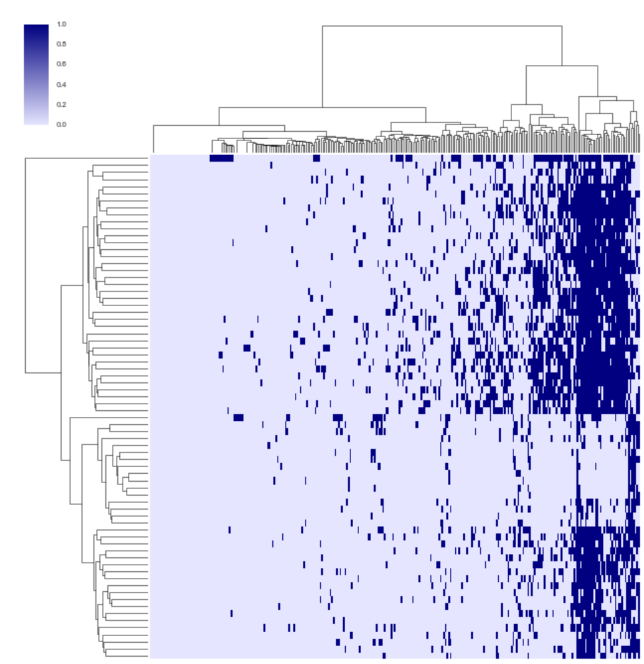

step 3: analyze data – sanity checks
sanity checks
what’s in your OTU table
number of reads per sample
distribution of OTUs across samples
heatmap of abundances

Slide 36
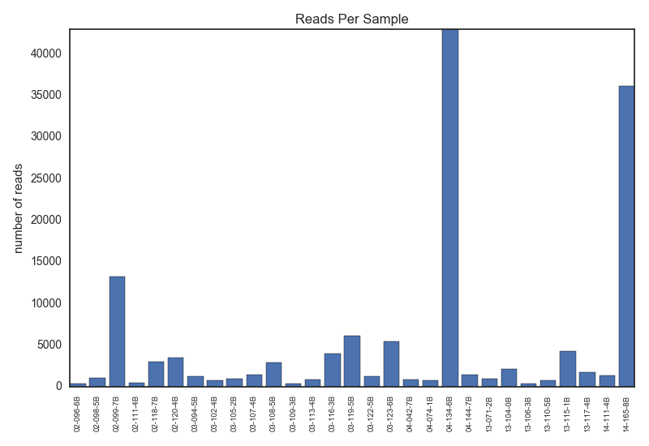
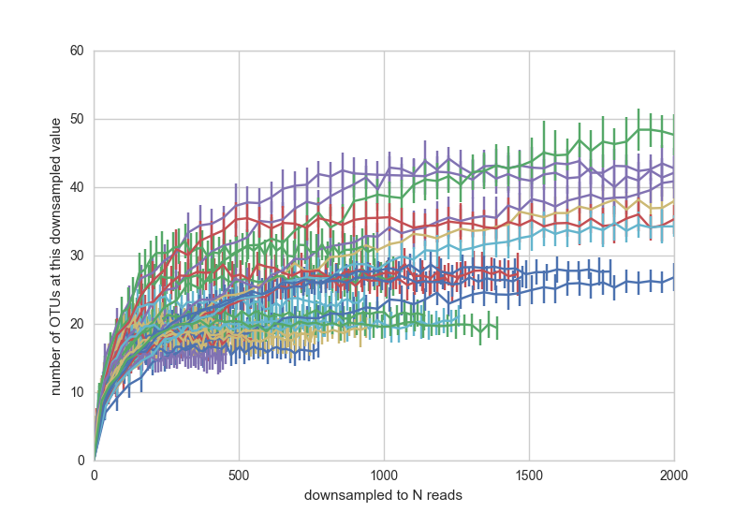
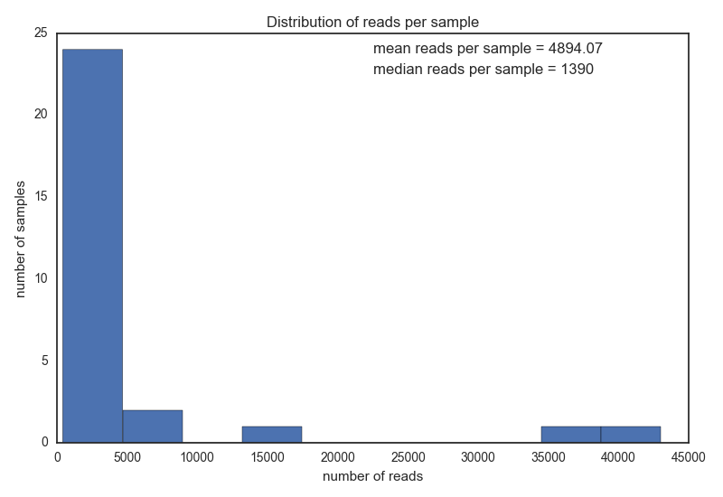
step 3: low reads per sample can be bad but can also be okay

Slide 37
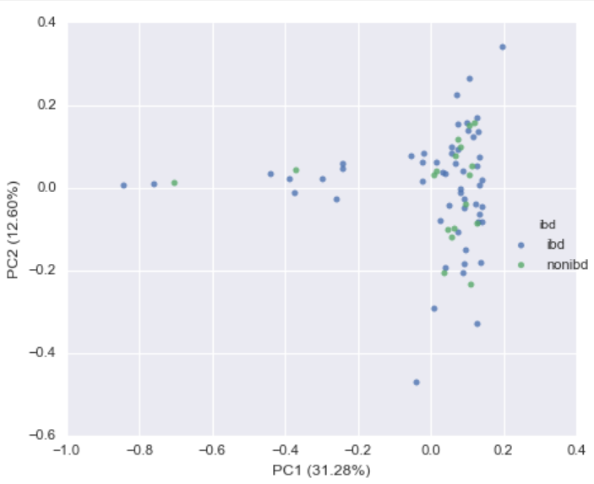
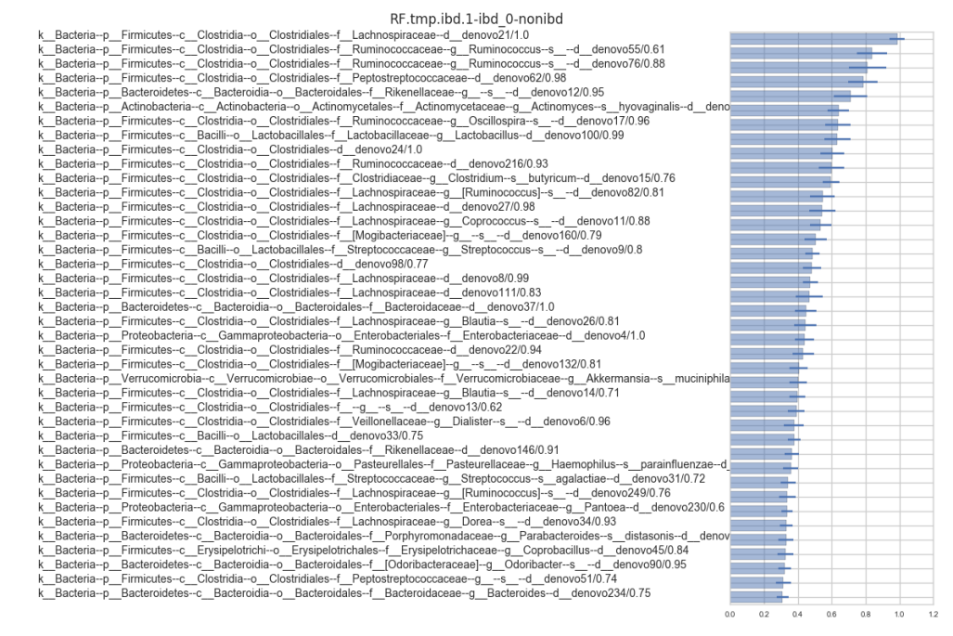
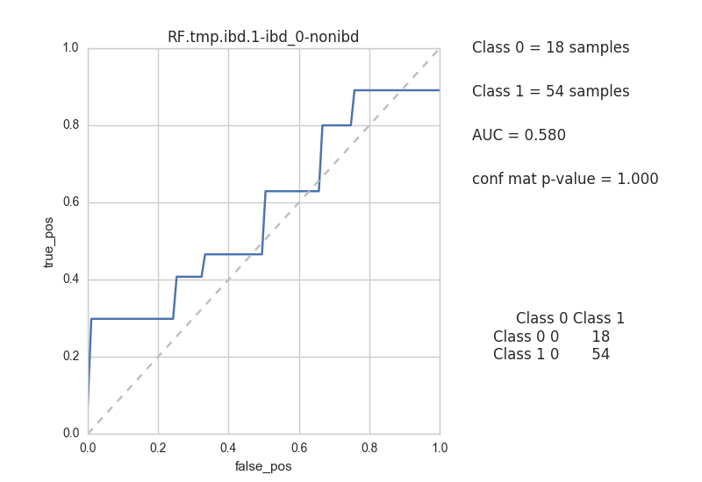
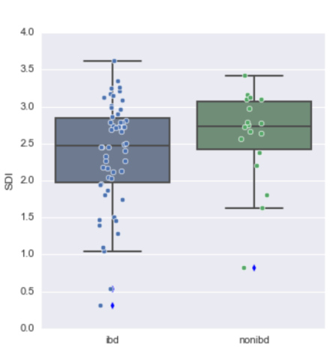
step 3: some places to start with analysis
alpha diversity
PCA
univariate comparisons
basic classifiers

Slide 38
“4” “easy” “steps” for 16S data
0. figure out what data you have
your eyes and your brain
1. pre-process data
AWS pipeline
2. build OTU table
AWS pipeline
3. analyze
your eyes and your brain
raw data
MAGIC
derep data
derep data
MAGIC
OTU table

Slide 39
using the pipeline is easy and looking inside the black box is also easy
code currently on AWS and private github
Master.py calls raw2otu.py
reads in summary_file.txt for file locations, parameter settings, etc
raw2otu.py does most of its work in the preprocessing_16S.py module
many functions are wrappers to either usearch functions or Alm lab scripts

Slide 40
there’s a dropbox folder from 20.106 with problem sets and sample data
play around with the files
look at what input and output files look like
figure out the syntax
don’t be limited by the code given
some steps are missing in instructions (i.e. length and quality trim)
you can also play around with parameters
https://www.dropbox.com/sh/enyftm9ut2r74ry/AAAZejnQlhUydVNsrCnWgrr-a?dl=0

Slide 41
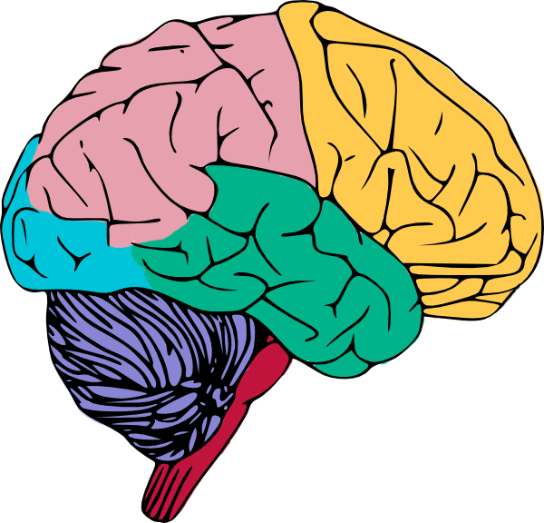

thanks!
raw data
MAGIC
derep data
derep data
MAGIC
OTU table

