Slide 1

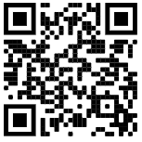
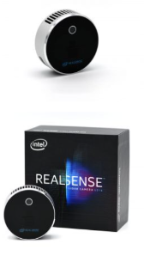
Intel® RealsensE™
Distance & Object Detection
lidar-camera-l515
Autonomous robots - Professor Boaz Ben Moshe
Ariel University
Written by Saar Barel, Almog Reuveny, Ishay Levy.

Slide 2
Content
Distance & Object Detection
Introduce RealSense l515 Camera
What is a Depth camera?
How can this data be used?
How we detect the distance?
How we detect the objects?
Distance detection with Depth Camera - Pycharm
Code - Pycharm
Project result - Screenshots
Project result - YouTube Video
Identify and Measure precisely Objects distance - Pycharm
Code - Pycharm
Project result - Screenshots
Project result - YouTube Video

Slide 3
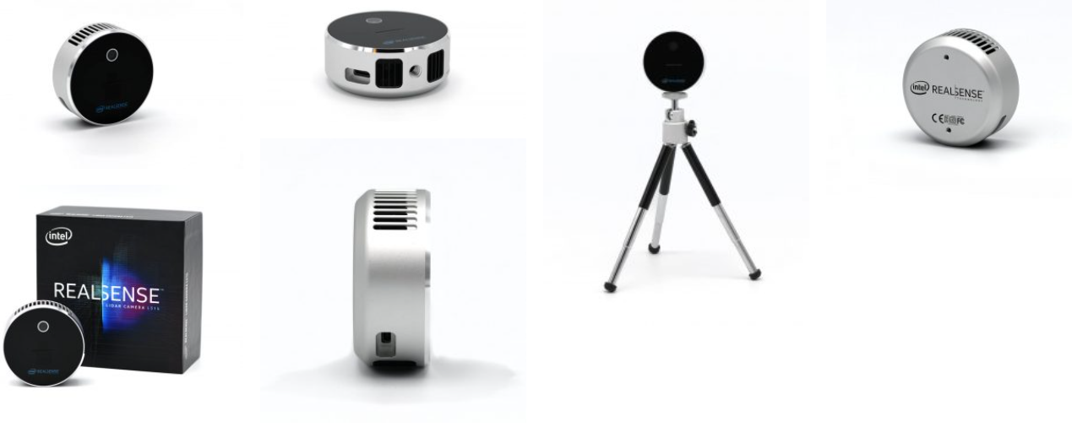
RealSense
lidar-camera-l515
Depth technology: LiDAR
Depth frame rate: 30 fps
Depth output resolution:Up to 1024 × 768
RGB frame resolution: 1920 × 1080
RGB frame rate: 30 fps
This is not an operation that can be done with a simple webcam because it does not provide depth information, you need a camera with an infrared sensor or other dedicated technology for distance measurement.

Slide 4
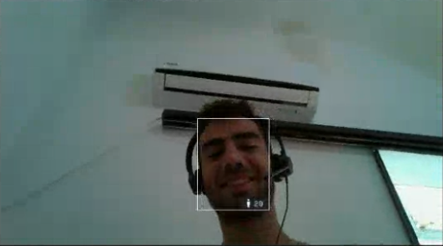
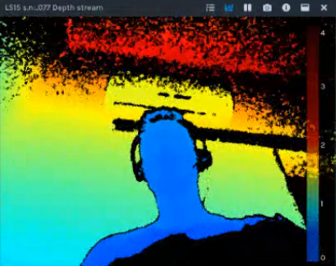
WHAT IS DEPTH?
Color Image from a Color Camera:
Each PIXEL has a Color (Red-Green-Blue) Value
Depth Image from a Depth Camera:
Each PIXEL has a Depth (distance from camera) Value
The Depth Map conveys the distance information between points on an object's surface and the camera

Slide 5
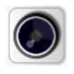
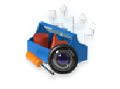





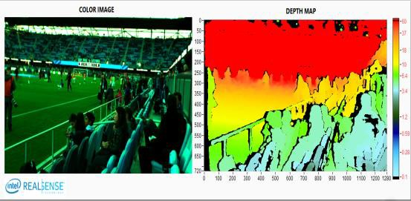
HOW CAN THIS DATA BE USED?
Sense and Capture
Visualize & Process
Integrate into Applications & Products
SDK Tools for prototyping
Samples Codes & APIs for applications
Design & Validation
Intelligence from depth information
Distance Detection
Object Detection
Deep Learning (MR-CNN model)
Raw Depth Map
Enhanced Depth perception makes robots/drones smarter devices and applications across multiple

Slide 6
How we detect the distance?
Depth frame - contains pixels: Each pixel has an array that consists of the distance from the pixel to the object that the camera is aimed at.
The distance that appears on the screen is the calculated distance from Depth frame to point / mouse / object
There are parts that the camera does not pick up and is wrong because it needs to be assigned filtering code to the code. In addition, the camera's prediction is damaged when there is a reflection of light on it.

Slide 7
How we detect the objects?
We are using R-CNN training model:
Picture the object several times, in several positions, in different shapes and sizes‏
We used the MakeSense.AI website: the website allows you to take the photos we took and draw the shape of the object under a certain label (polygons,rects and more)
We used a trained model and added our object to it - the model's training was done through an open source in google colab notebook
We added the trained model to our code - each identified object is painted with a different color, with its own label, and with its own shape. In addition, the distance from the object is displayed on the screen

Slide 8
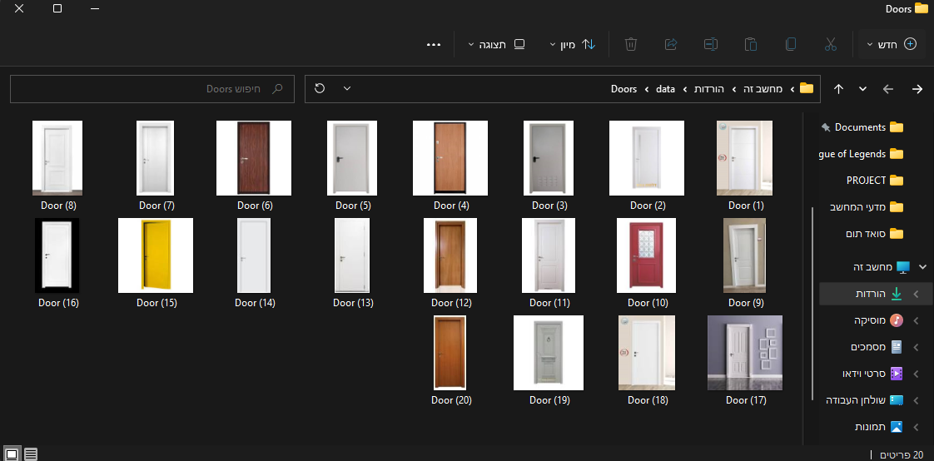
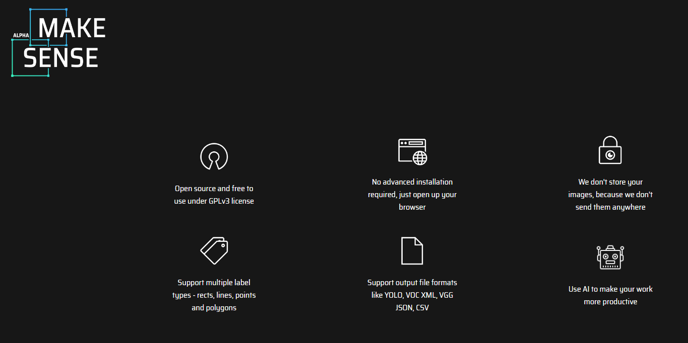
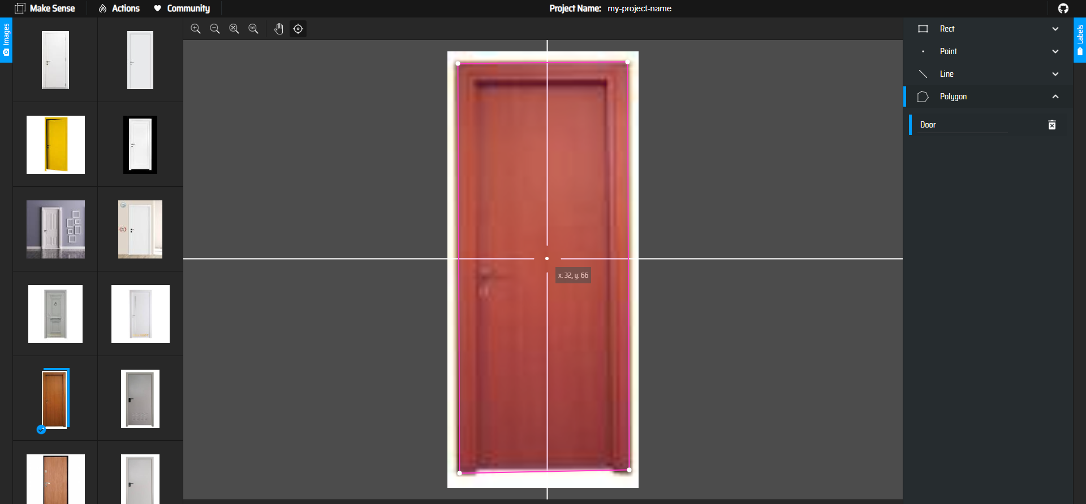
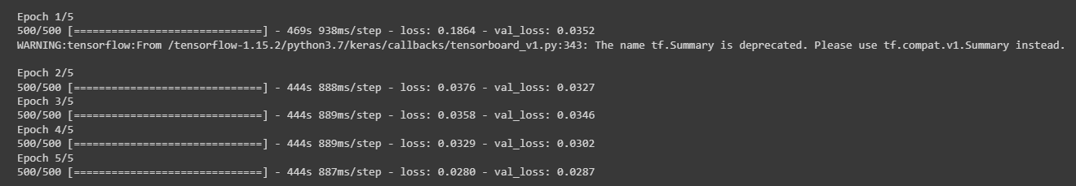
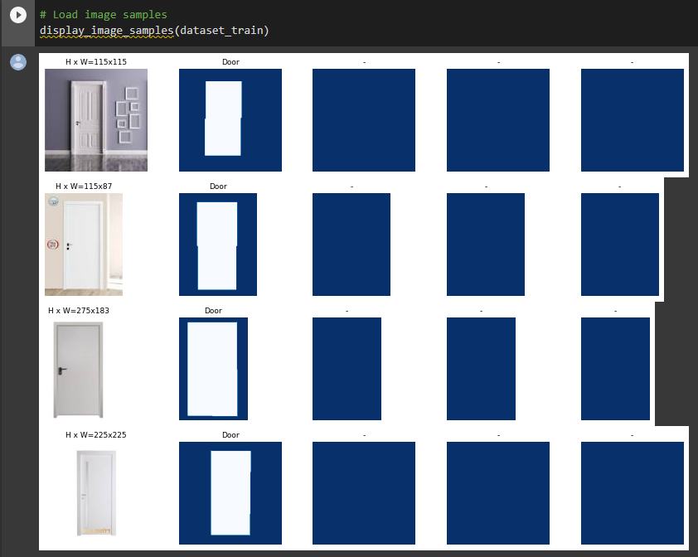
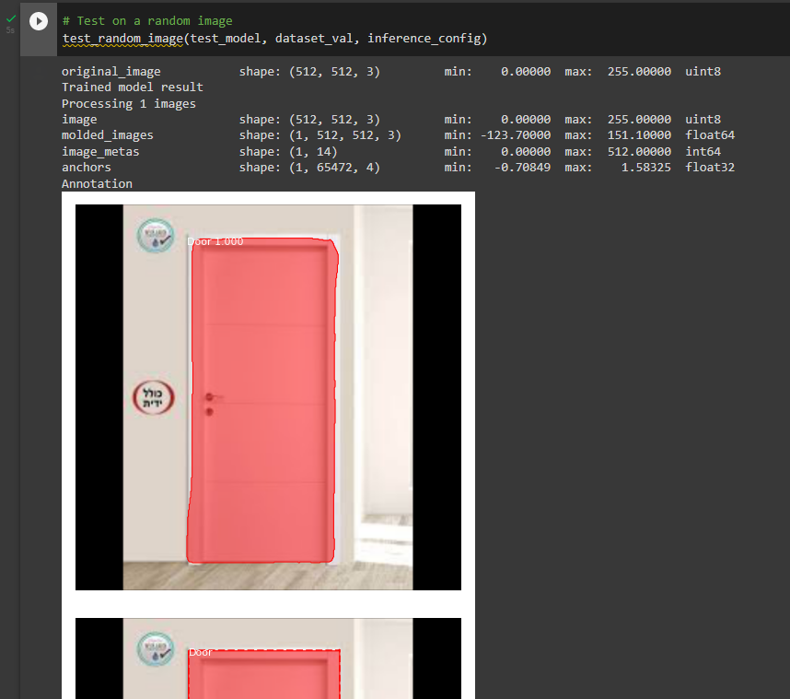

Slide 9

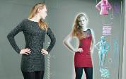


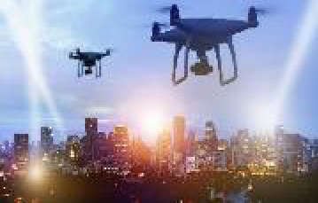
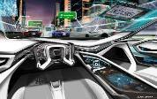
Market Focus
Mobile Phones
Robotics
Broad Market
Virtual Reality
Drones
Autonomous Driving

Slide 10
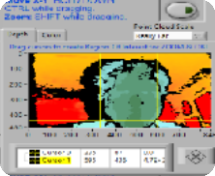





Intel® RealSense™ SDK 2.0 – Tools
Intel® RealSense™
Depth Quality Test
Debug Tools
Viewer
tool for Intel®
RealSense™ camera
Capture, View and Manipulate Depth Streams
Test Setup with camera position and target
Control settings– resolution, gain, exposure, distance to target, error etc.
Data Collection
Playback/Record
FW logger
Terminal access
Camera Enumeration
3D PointCloud
Presets, Filtering, Optical Power
Calculate z-accuracy,
standard deviation
https://github.com/IntelRealSense
* Other names and brands may be claimed as the property of others

Slide 11
In this presentation we will present 2 parts of codes:
Distance detection with Depth Camera - Pycharm
Get the frames from the depth camera.
Distance detection on mouseover.
Distance detection on Fixed point.
Identify and Measure precisely Objects distance - Pycharm
Get the frames from the depth camera.
Detect object with AI.
using openCV to Identify Certain objects.
Distance detection from objects.

Slide 12
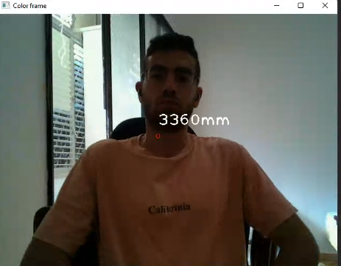
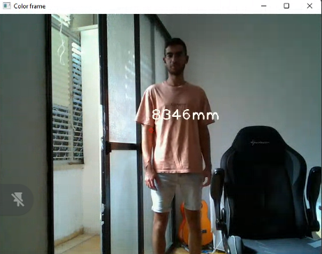
Distance detection with Depth Camera - Pycharm
Distance detection on Fixed point.
‹#›

Slide 13
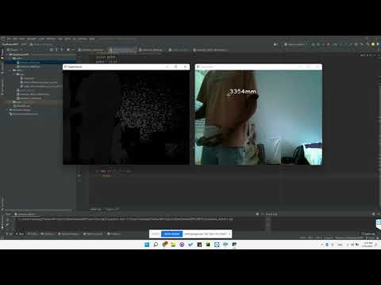
Distance detection with Depth Camera - Pycharm
Distance detection on mouseover.
‹#›

Slide 14
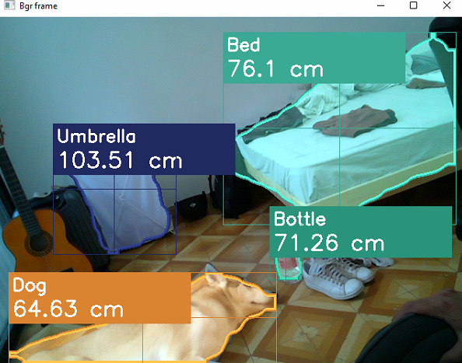
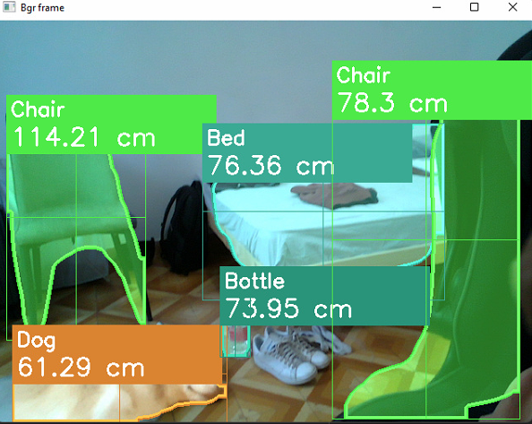
Identify and Measure precisely Objects distance - Pycharm
‹#›

Slide 15
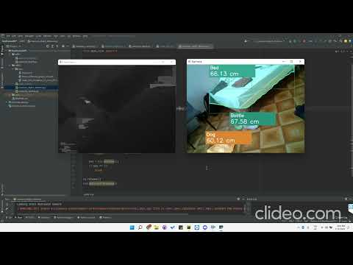
Identify and Measure precisely Objects distance - Pycharm
‹#›

