Slide 1

Weather Risk
Intelligence Agent
System architecture and
repository overview
Almog Salman
AI Engineer Candidate
3 November 2026

Slide 2

Run the live agent
Python 3.11+, repository dependencies, a Groq key and internet access
01
02
03
Install
Start
Open
From the repository root:
python -m pip install -r requirements.txt
Run the command below from the repository root.
Enter the Groq key at the hidden prompt, then open the browser address below.
python scripts/start_live.py --port 8793
Default: Groq / openai/gpt-oss-20b. Keep the terminal open; Ctrl+C stops the server.
Open in browser: http://127.0.0.1:8793
https://github.com/almogs87/hub_weather_agent

Slide 3
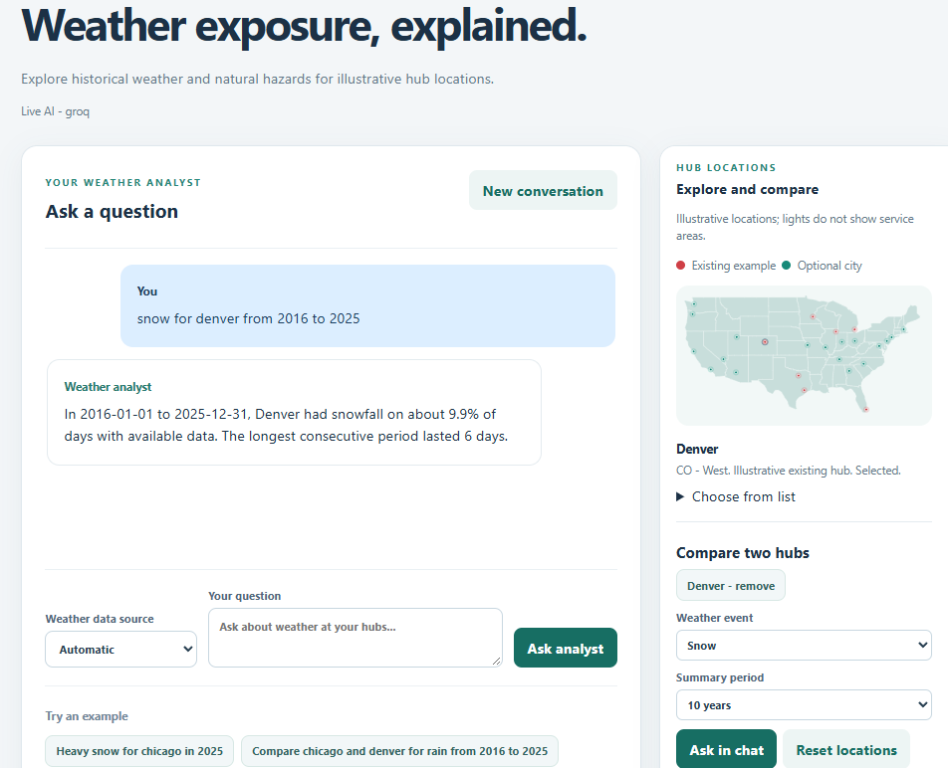
The live agent interface
A sample Denver snowfall question and the hub comparison panel
◉
Ask in chat
Type a question or select an example.
⇄
Explore hubs
Choose locations and a weather event to compare.
Captured example; values depend on the source and period.

Slide 4
Groq free-tier limits
Published reference values for openai/gpt-oss-20b
◷
▤
✦
Σ
30 / min
1,000 / day
8,000 / min
200,000 / day
Requests per minute
Requests per day
Tokens per minute
Tokens per day
Account and project limits can differ. Shared usage counts; a token cap may be reached first. HTTP 429 means wait for the reset or retry time.
Check exact limits in Groq Console. Source: console.groq.com/docs/rate-limits · checked 3 Nov 2026

Slide 5
System architecture
The model selects an analysis; Python validates and computes it
◉
⇄
◇
⚙
Browser
→
Local API
→
Service
→
Python engines
Chat and map
JSON requests
Validate intent
Analysis and replay
✦
☁
▤
Groq / OpenAI
Public data
Storage
Structured plan
ERA5, NOAA, FEMA
SQLite and cache

Slide 6
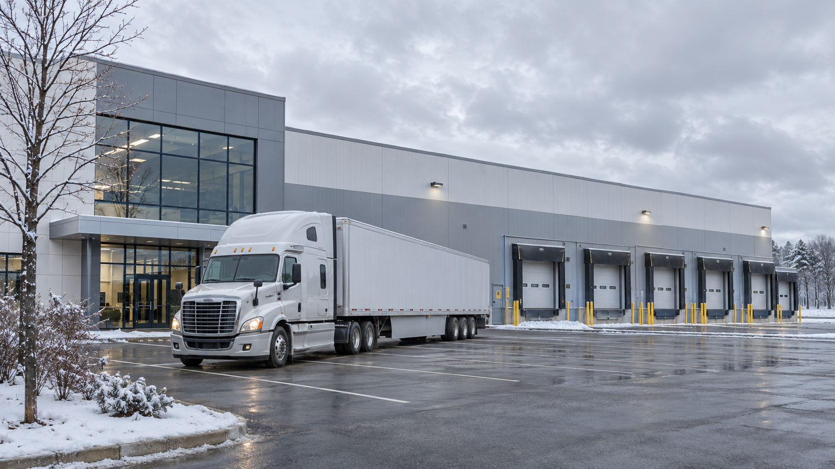
Request and data flow
A typical chat request
1
Question and context
Browser sends a message and conversation ID.
2
Structured plan
The provider returns a schema-validated intent.
3
Data and calculation
Python selects sources, computes metrics and assembles an explanation.
4
Answer and evidence
The browser receives results, limitations and provenance.

Slide 7
Public data sources
Each source answers a different part of the question
☁ Open-Meteo ERA5
▤ NOAA GHCN-Daily
Gridded historical reanalysis
Station observations and fallback
open-meteo.com/en/docs/historical-weather-api
ncei.noaa.gov/products/land-based-station/
global-historical-climatology-network-daily
⚑ NOAA Storm Events
◇ FEMA National Risk Index
County and state event reports
County-level hazard screening
ncei.noaa.gov/stormevents/
fema.gov/sites/default/files/documents/
fema_national-risk-index_technical-documentation.pdf

Slide 8
Problem and mitigation
When the planning index cannot score a requested hazard
!
✓
Problem
Mitigation
Comparable frequency or severity data may be missing for a two-hub event comparison.
Compare available FEMA county expected annual loss scores separately for supported hazards.
FEMA scores require matching dataset versions and available scores. They describe relative county loss, not facility shutdown probability.

Slide 9
Current limits and future improvements
Priorities for a more reliable decision tool
CURRENT LIMITS
FUTURE VERSION
• Illustrative hubs and assumed recovery
• County data does not establish facility shutdowns
• Expanded live and interface checks remain pending
• Calibrate using real facilities, closures and losses
• Add facility hazard and transport evidence
• Expand live evaluation and test uncertainty
For deployment: add authentication, production serving, monitoring and multi-user storage.

