Slide 1
Regression as an Optimization Problem

Slide 2
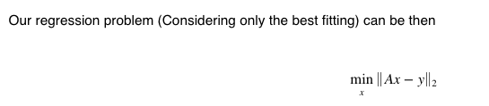
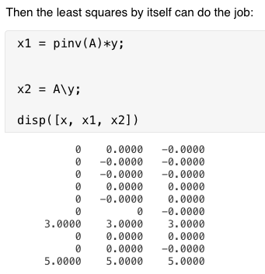
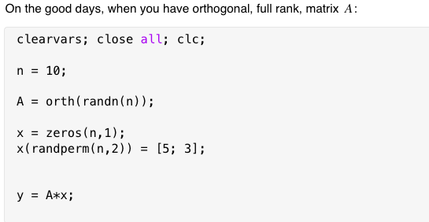

Slide 3
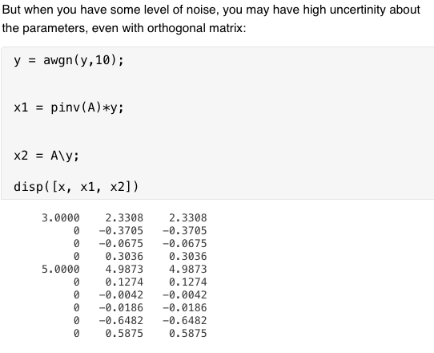
Why?
Optimization_1D_Example

Slide 4





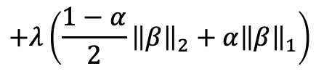
Ridge
$$+λ\left(\frac{1−α}{2}{\left\|β\right\|}_{2}+α{\left\|β\right\|}_{1}\right)$$
Elastic Net
LASSO
What is the big-picture?

Slide 5

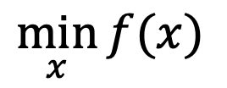
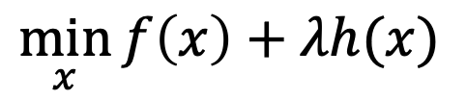
General Optimization Problem:
$$\min_{x}{f(x)}$$
Subject to:
$$h\left(x\right)=0$$
Using Lagrange multiplier:
$$\min_{x}{f\left(x\right)+λh(x)}$$
Optimization Code

Slide 6

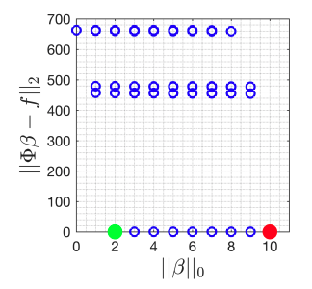
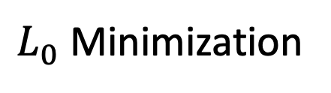
$L_{0}$ Minimization

Slide 7

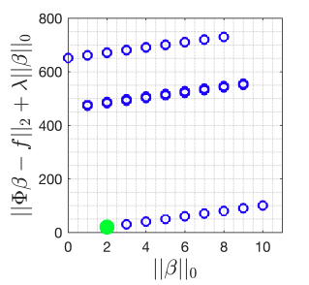
$L_{0}$ Minimization

Slide 8

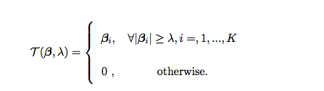


$$Hard−Thresold$$

