Slide 1
On Some Sparse Regression Methods

Slide 2

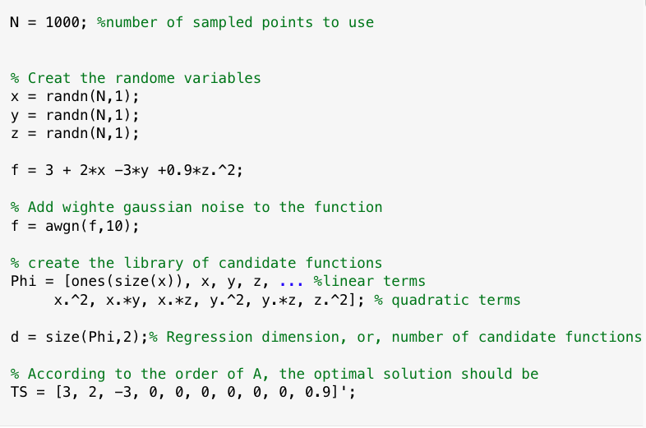

Slide 3
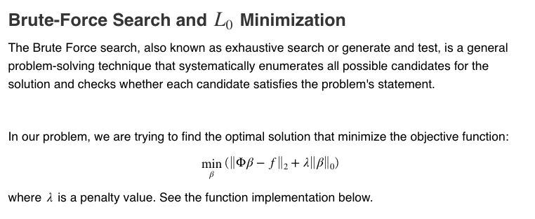





$$λ=0$$
$$λ=100$$
Can we decide on
$λ_{max}$?

Slide 4

Better fitting
Lower dimension
Which one to choose?

Slide 5
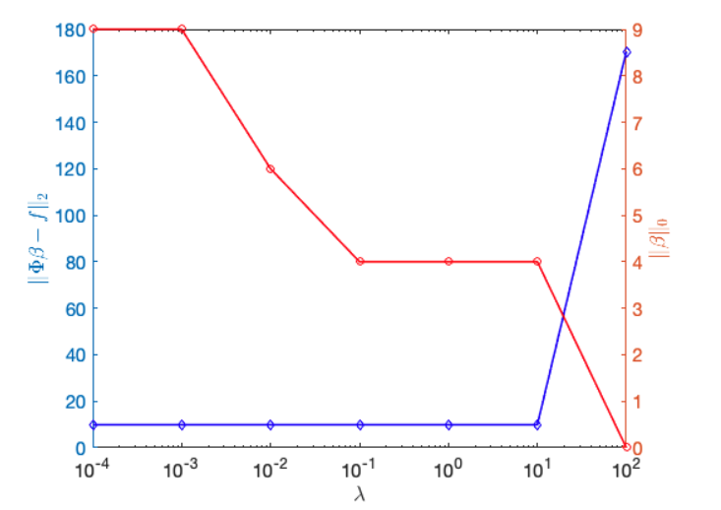

Slide 6
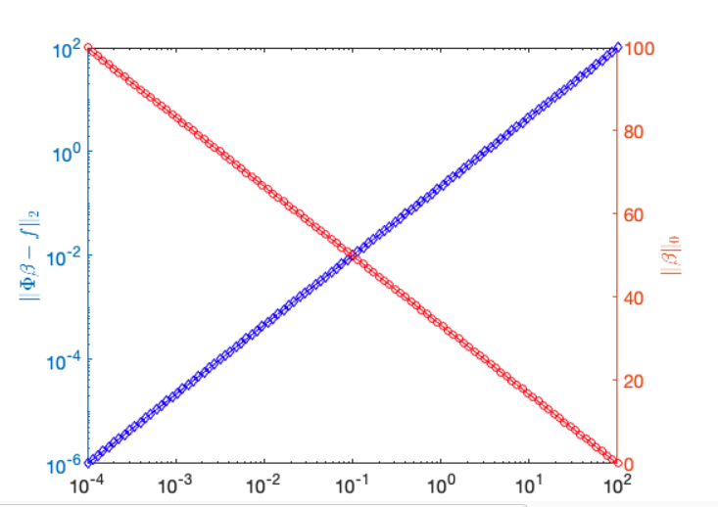
?

Slide 7
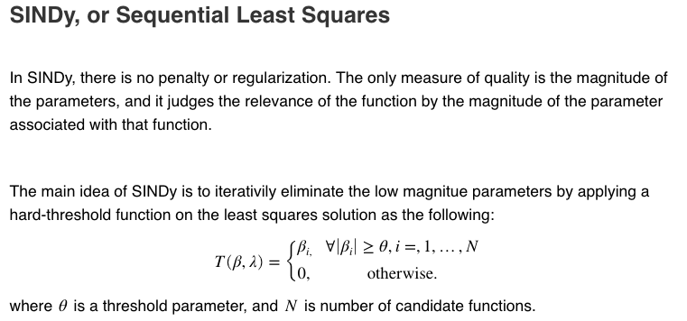

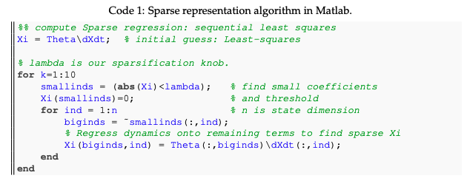

Slide 8
1997
2005
2005
2011

Slide 11
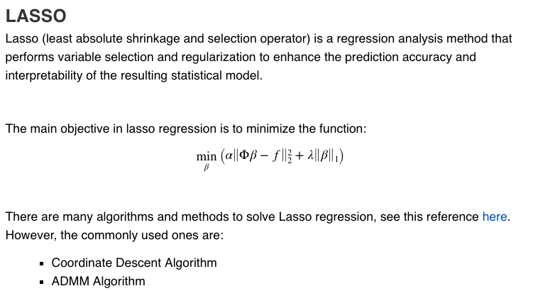

Slide 12
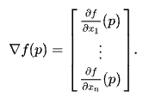
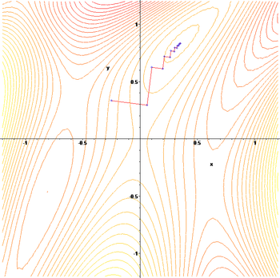
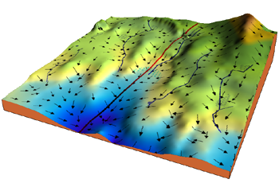

Gradient Descent:
$$x_{n+1}=x_{n}−γ∇f(x_{n})$$

Slide 13
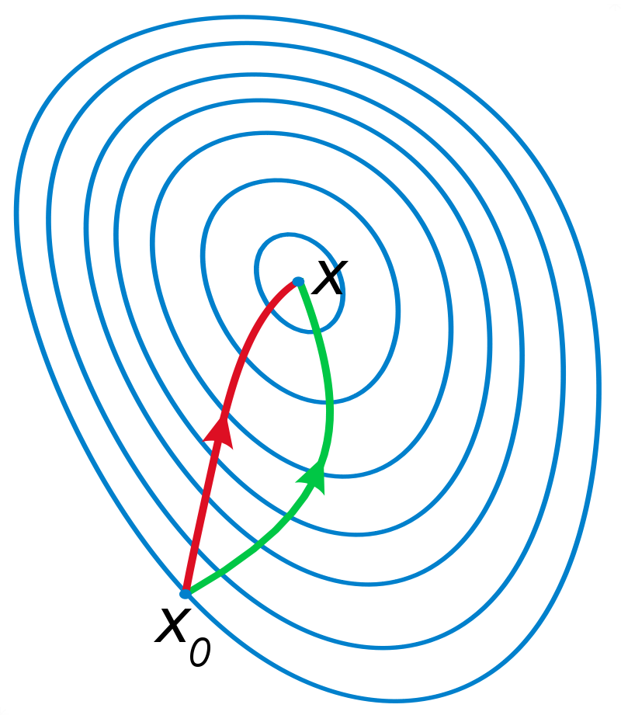
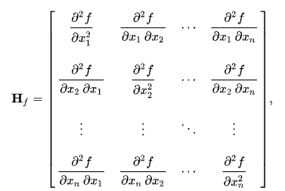


Newton’s Method:
$$x_{n+1}=x_{n}−γH_{f}^{−1}(x_{n})∇f(x_{n})$$
Why has it limited employment in ML?

Slide 14


Coordinate Descent Algorithm
$$x_{n+1}=x_{n}−γ∇f(x_{n})$$
But, for 1-dimension at a time
$$x_{n+1}=x_{n}−γ{\left[∇f\left(x_{n}\right)\right]}_{i}e_{i}$$

Slide 15
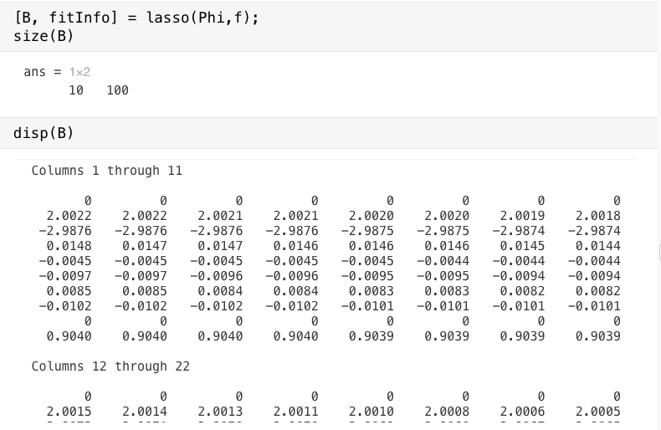

Slide 16

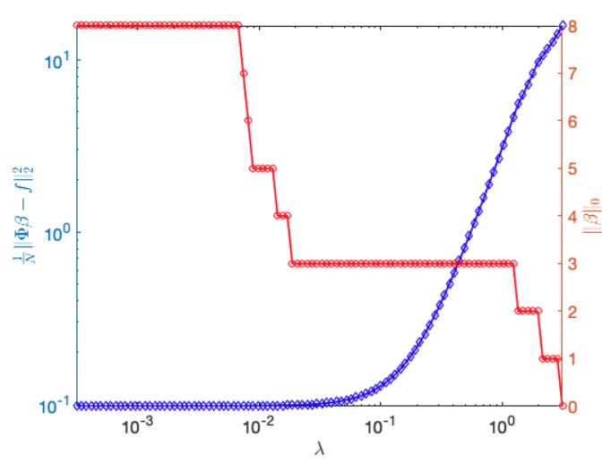

Slide 17


Slide 18

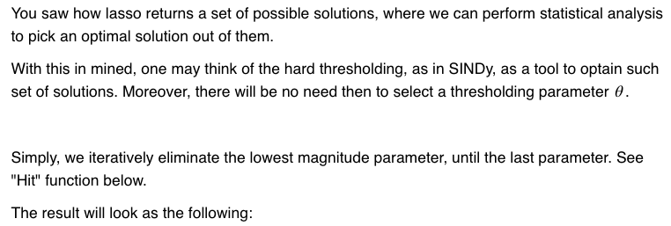
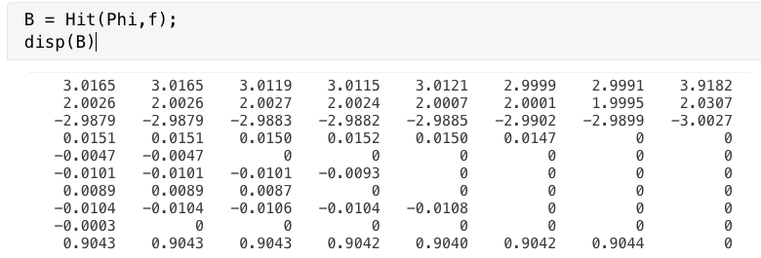

Slide 19
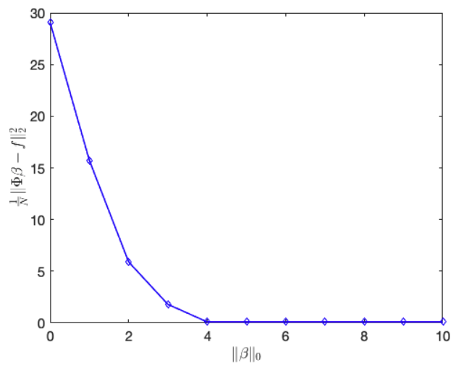

Slide 20
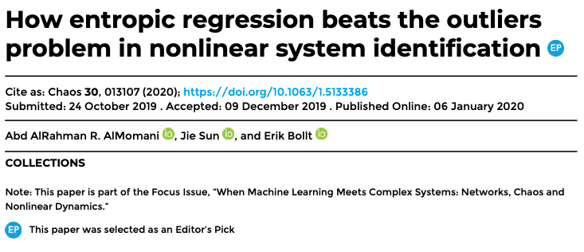
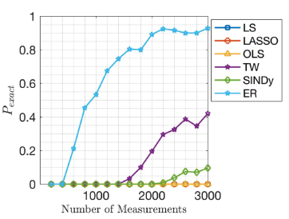
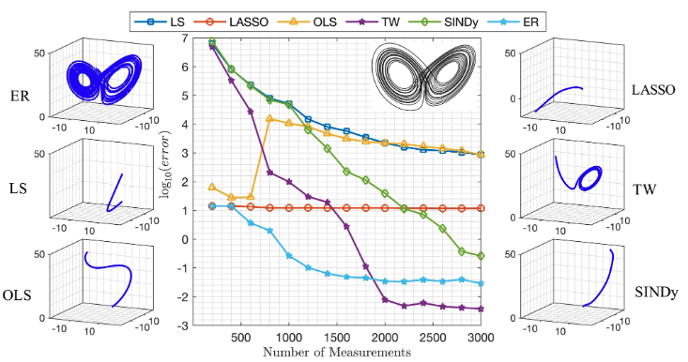
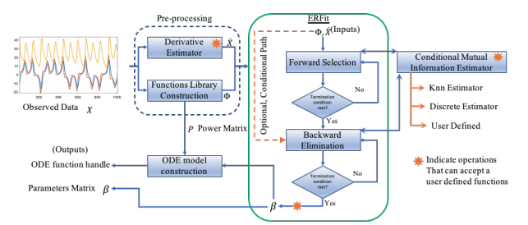

Slide 21

