Slide 1

v
Introduction to Programming
Full Stack Web Development
By Alain Moratalla
Alain Moratalla

Slide 2
Front-End Development
Back-End Development
Client side
Server side
Full Stack Web Development

Slide 3









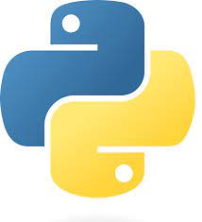





Front-End
Back-End
Client side
Server side
HTML5
CSS3
JavaScript
Node.js
php
ASP.NET Core
React
Angular
Vue
Python
JAVA
GO
SASS
Bootstrap
Tailwind

Slide 4
How does the web work?
What stack should I use?
Why should these things matter to me?
Where should I start?

Slide 5
