Slide 1
Creating Knowledge Bases from Text
Alon Halevy
Joint work with Dan Iter, Wang-Chiew Tan + RIT Team
February 9, 2018 -- KBCOM

Slide 2

R.I.T. and Messy Data
Big Gorilla (https://www.biggorilla.org/)
Open-source data integration and preparation in Python
FrameIt: the topic of this talk
Koko, an information extraction language: query regex + dependency tree structure
Find entities that are described by the word "delicious" and have an associated action of eat/eating/eaten/ate/drink…
I drank some coffee, which was delicious, and also ate some pie

Slide 3
Definition: Knowledge Base Construction
Input: a corpus of many short texts, such as:
Descriptions of happy moments
Product/hotel reviews
Open-ended survey answers, transcripts of conversations
Output:
A set of frames that model some fraction of the texts
An extractor (i.e., SRL) for every frame

Slide 4
Problem Setting
Apriori, while the user understands the domain, but she doesn’t know what’s in the corpus.
→ System must support exploration and iteration.
There is no attempt to cover all the corpus. Just enough to extract enough of the value.
→ best effort scenario. User decides when to stop.

Slide 5
Outline
Background: technology for happiness
HappyDB
The FrameIt System

Slide 6
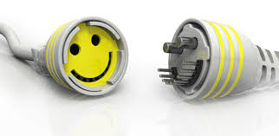
Technology for happiness
Key question:
Can we develop technology that makes us happier?
Positive Psychology
Natural Language Processing
Data management

Slide 7

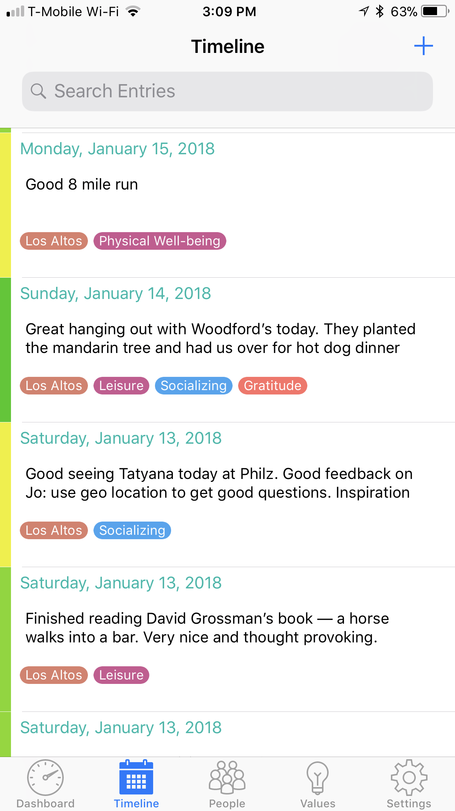
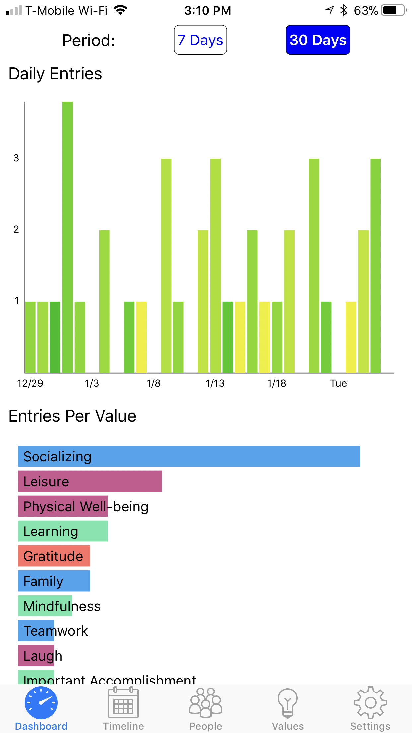
Jo(urnaling) App
Users journal their significant daily moments.
App maps them to user’s values (socializing, learning, family, etc)
User can reflect.
Ultimately: Jo should provide insights and advice.
Jo: the Smart Journal (iOS)
Notes:
In addition to being easy to use, app should have the fun factor.

Slide 8
HappyDB
HappyDB: A Corpus of 100,000 Crowdsourced Happy Moments. LREC ‘18.
Collected 100,000 happy moments by crowdsourcing.
Publicly available at https://rebrand.ly/happydb
“I went to the park with the kids. The weather was perfect!”
“I quit smoking cigarette since the tax increase of this year here in California. I am hoping to keep it up and improve my health.”
“I had dinner with my mom”
“A few weeks ago I received a letter from the President of my University letting me know that I've received tenure and promotion to Associate Professor.”

Slide 9
Why Create Structure?
We want to know what’s in HappyDB.
Create an “ontology” of happy moments that will enable Jo to provide:
Intelligent replies
Activity suggestions
Better insights into people’s activities

Slide 10
Structure = Frames
A frame has a name and a set of attributes
Frames are user-defined. FrameNet and PropBank are “frame snippets” for our purposes.
Different from information extraction: looking for a set of triples.
No need to fill every slot.
Example frame:
Had_meal
Participant:
Meal type:
With whom:
Instance of a frame:
Had_meal
Participant: I
Meal type: breakfast
With whom: my mom

Slide 11
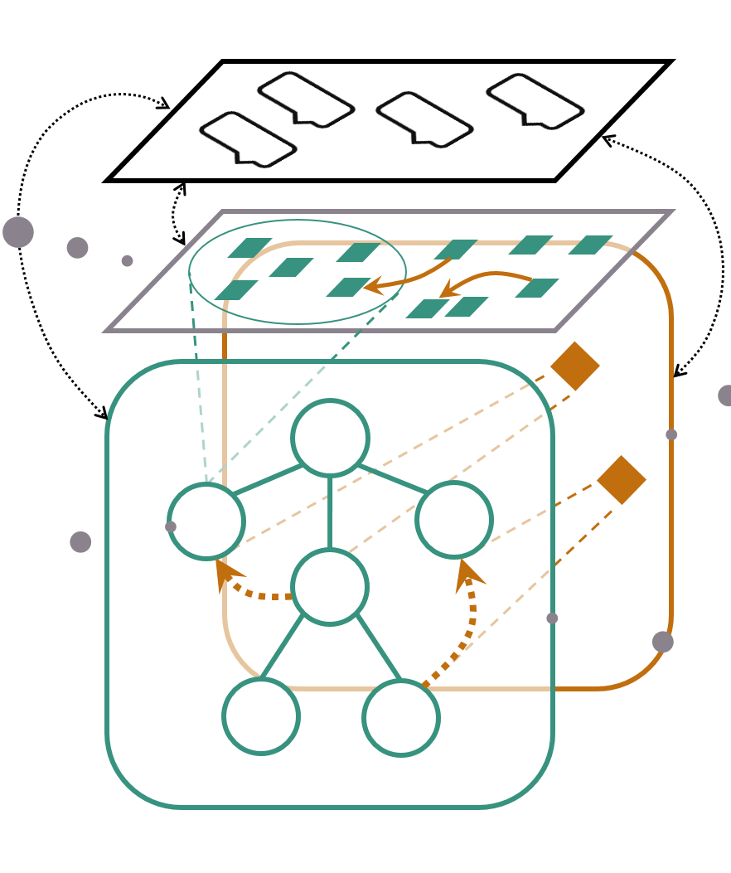



The FrameIt System
Query
HappyNet
What types of meals do friends tend to have together?
HappyDB
frames
Text corpus
operations
You: “I had lunch with
my mom.”
Bot: “What did you
have for lunch?
results
Provides a higher-level of abstraction of the underlying corpus.
user

Slide 12



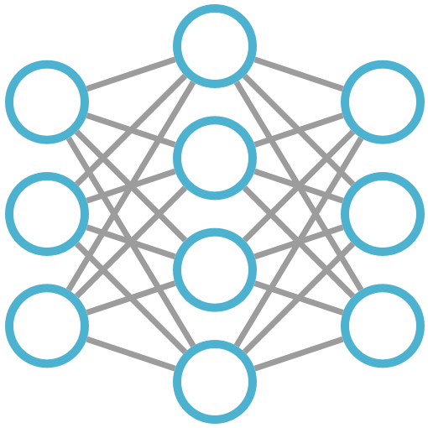
FrameIt Workflow
Explore the corpus
Train SRL
Define frames

Slide 13
The Tasks Supported while Exploring the Corpus
Discover topics for frames (meals, promotions, …)
Show random sentence
Show most frequently occurring words/lemmas
Show all sentences containing a word/lemma
Decide on level of granularity:
Eating a meal, or also preparing a meal?
Getting a promotion, or being congratulated for it?

Slide 14
Find Nearest Moments
“I had dinner with my mom.”
“I had breakfast with my daughter.”
“I had breakfast with my girlfriend.”
“I had breakfast with my kids.”
“I had dinner with my Dad.”
“I had lunch with my husband.”
“I ate my breakfast with my wife today.”
“I had dinner with my mother.”
“I made dinner with my mom.”
“I had dinner with my aunt.”
“I had dinner with my grandmother.”
“I had dinner with my mom and girlfriend.”
“ I had lunch with my family.”
“I had dinner with my wife.”
“I went to lunch with my mom.”
“I had lunch with my cousin.”
“I had lunch with my wife today.”
“I had a nice lunch with my grandmother.”
“I had a really nice dinner with my mom.”
I had dinner with my mom.
Candidate frame:
Have meal
Participant:
Meal type:
With whom:
When:

Slide 15
Leverage FrameNet (using Semaphor)
What are the most common FrameNet frames triggered by a set of sentences?
Food | 3,933
Social_even | 2,867
Calendric_unit | 2,800
Personal_relationship | 2,684
Possession | 2,327
Ingestion | 2,182
Desirability | 1,324
Chemical-sense_description | 1,130
Measure_duration | 839
Getting | 816
Apply_heat | 748

Slide 16
A Closer Look: The Words Triggering the Frames
Possession
[(had, 1659), (have, 234), (having, 120)]
Ingestions
[(ate, 889), (eat, 381), (eating, 172)]
Causation
[(made, 1052), (Making, 36), (Made, 30)]
Apply_heat
[(cooked, 405), (cook, 111), (baked, 65)]

Slide 17
Leverage FrameNet (using Semaphor)
What are the most common FrameNet frames triggered by a set of sentences?
(Food, 3933),
(Social_event, 2867),
(Calendric_unit, 2800),
(Personal_relationship, 2684),
(Possession, 2327),
(Ingestion, 2182),

Slide 18
The Tasks Supported while Exploring the Corpus (2/2)
3. Which slots to define for the frame?
Scope of slots (including holiday meals? coffee?)
4. Create lists or dictionaries for slot values (or at least give the system good hints about them)
Use WordNet to expand terms: (NELL is also an option)
Dinner → lunch, brunch, breakfast, Seder, …
Mom → dad, sister, brother, cousin, fiance, …

Slide 19

Training SRL Models
Training needs to fit in with FrameIt workflow.
Bootstrapping with Weak Supervision
Refinement with Active Learning

Slide 20
Evaluation of FrameIt
Mostly work in progress.
Corpora: HappyDB, TripAdvisor hotel reviews, ANES 2008 presidential election survey.
We’re able to quickly create frames that cover a large fraction of the corpus
The SRL models have high accuracy after relatively short active learning feedback.

Slide 21
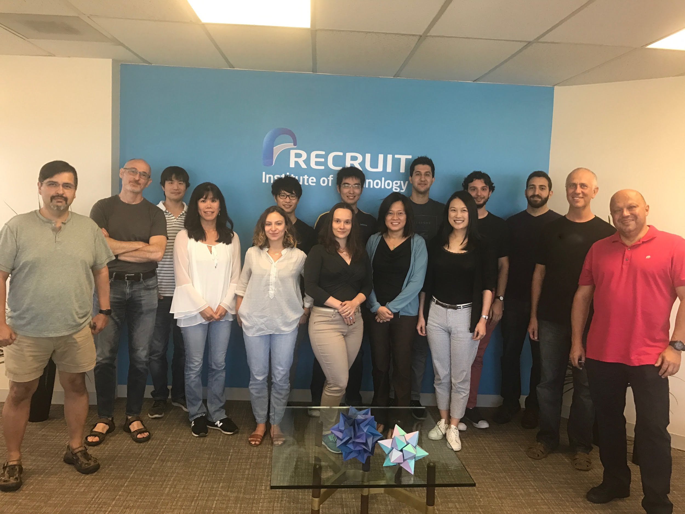
We are hiring! (And New Name Coming Soon!)
Software Engineers.
Research Scientists.
Internships (Summer and Spring)
http://www.recruit.ai
Natural Language Processing, Data Management and Integration, Data Mining, Machine Learning, Knowledge Representation, Bot interfaces, Crowdsourcing, and Visualization.

Slide 22
Extra Slides

