Slide 1
Democratizing Data Science Natural Language Interface to Data
Xifeng Yan
with Izzedin Gur, Semih Yavuz, Yi Ding, Yu Su
Computer Science
University of California at Santa Barbara

Slide 2

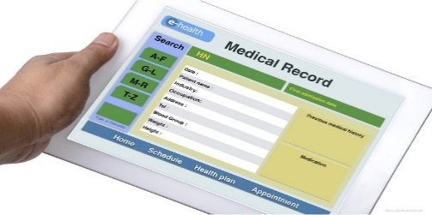

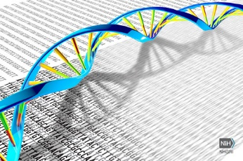

Growing Gap between Human and Data
What disease does the patient have?
(EMR) Similar patients?
(Literature) New findings?
(Gene sequence) Suspicious mutations?
… …
Ad-hoc information needs for on-demand decision making
Massive, heterogeneous data
86.9% adoption (NEHRS 2015)
27M+ papers, >1M new/year (PubMed)
$1000 gene sequencing
24x7 monitoring

Slide 3
Data Science
Foundation
Data Science
Numerical Linear Algebra
Optimization
Stochastic Methods
Discrete Mathematics and Algorithms
Introduction to Statistical Inference
Databases and SQL
Machine Learning
Data Mining
Scientific Programming
Specialization
Data Analysis with Python
Parallel Computing
Distributed Algorithms and Optimization
Data Driven Medicine
Modern Statistics for Modern Biology
Representations and Algorithms for Computational Molecular Biology

Slide 4

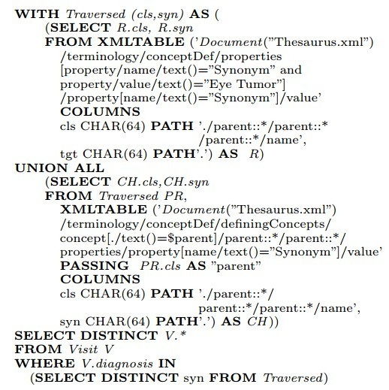

Come On
“find all patients diagnosed with eye tumor”
Asking a doctor to write this?
Execution time in mins
Coding in hours
Finding coders in weeks?
“Semantic queries by example”,
Lipyeow Lim et al., EDBT 2014
Notes:
Asking a non CS Scientist to write something like this is day dreaming

Slide 5
What To Do?
Democratize
Data Science

Slide 6



How can NLP/AI Bridge the Gap?
Insights
Discoveries
Solutions
Bottleneck #2: Access
Bottleneck #3: Reasoning
Bottleneck #1: Knowledge

Slide 7
Natural Language Interface Is The Key
Natural Language Query on Knowledge Graph
NLI on Relational Data
NLI on Everything
Knowledge Graph Construction

Slide 8
Sequence to SQL (SPARQL)
Column Headers | First Name | Last Name | Gender | Age | Salary | Country
Sample Record | Dennis | Wright | Male | 34 | 112,751 | Philippines
Q: What is the average age for male employees
A: 44.69
Q: How old are male employees in Philippines?
A: 6196.18
Q: What is the average age for male employees whose salary is great than 100K?
A: show average of male employees age grouped by salary
query examples from: http://kueri.me/demo

Slide 9
What Is the Issue?
NLP: We are working on NLI on Databases
DB : It is not new. Can you guarantee the correctness?
NLP: No.
DB : What is your accuracy on WikiSQL [Zhong 2017]?
NLP: 68%.
DB : It is low!
NLP: We can improve it 2% per published paper.
DB : Given a question, how can a user know if the answer is correct or not?
NLP: There is 68% chance for the answer to be correct.
DB : Forget about it!
NLP: But at least the user can look at the generated SQL statement?

Slide 10
Some Thoughts
Two Conclusions
In a short period, likely we are not able to break the accuracy barrier, anything close to 100%
If we ask a user to check the correctness by reading SQL, we already fail
Can we still make a dent?
Start with simple queries
Leverage human intelligence
Explain SQL in natural language
Standardize query benchmark
Set up am agenda

Slide 11
Level of Driving Automation vs Level of NLIDB
Level | Driving Automation* | NLIDB
Level 0 |  | SQL
Level 1 | Hands on | Schema-aware, simple question
Level 2 | Hands off | Schema-aware, sequential simple questions
Level 3 | Eyes off | Schema-free, sequential simple questions
Level 4 | Mind off | Schema-free, composite questions + some assistance
Level 5 | Steering wheel optional | Any Question + no assistance
*: from https://en.wikipedia.org/wiki/Autonomous_car

Slide 12
Some Progress From Peers
Simple Dataset: WikiSQL Data [Zhong 2017]
There are a few negative comments on the simplicity of the task
But come on, if you think this dataset or query is too simple, show me a query engine with 100% accuracy
Sequence2SQL: e.g., Seq2SQL [Zhong 2017], SQLNet[Xu 2017], [Wang 2017], etc.
Break query to small sequential simple queries. e.g. [Iyyer 2017][Saha 2018]
SQL Statement translated back to natural language question: e.g., [Deutch 2017]

Slide 13
SQLNet (Dawn Song’s group)
Year | Award | Category | Nominee
1986 | Tony Award | Best Musical | Best Musical
1986 | Tony Award | Best Direction of a Musical | Bob Fosse
Question:
Which award has the category of the best direction of a musical?
SELECT award
WHERE category = best direction of a musical
Correct SQL:
SQLNet:
SELECT award
WHERE category = the best direction award a musical

Slide 14
Why Not Use Table Cells?
You are “cheating.” :(
Do you mean you can achieve 100% accuracy if you use table cell information?
Models | Dev(where) | Test(where)
Seq2SQL | 62.1% | 60.2%
SQLNET (Seq2set + CA + WE) | 74.1% | 71.9%
SQLMaster (Baseline) | 77.2% | 77.1%
SQLMaster | 86.2% | 86.1%
SQLMaster (WindowBased) | 87.4% | 87.1%
SQLMaster (TreeBased) | 88.6% | 88.1%
SQLMaster (Upper Bound) | 92.1% | 91.4%

Slide 15
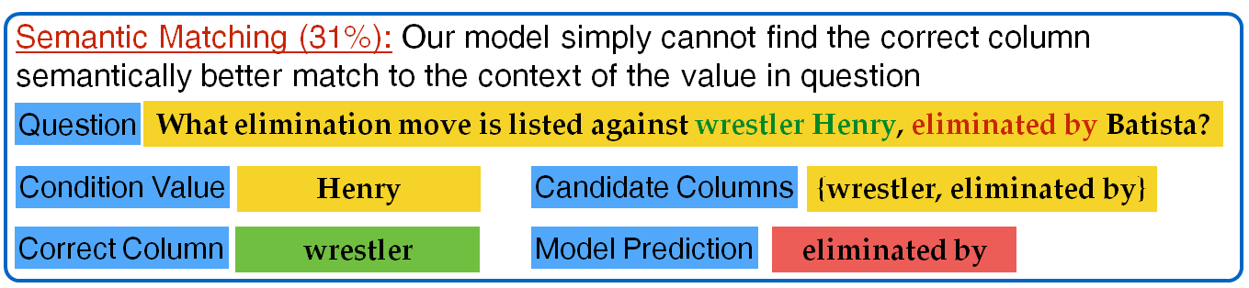
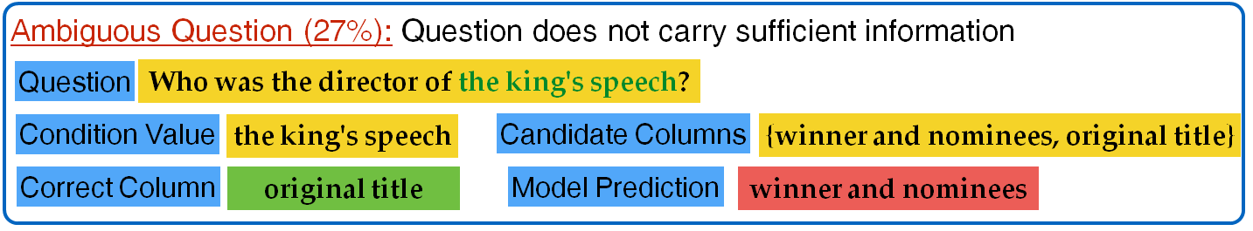
Error Analysis

Slide 16
Error Analysis (cont.)
Missing/Extra Value (25%): Missing (or extra) condition value that occurs (or does not occur) as value of a condition in where statement
Sparsity (13%): Candidate column name appears too rarely (less than 5 times) in the training data.
Wrong labeling (4%): Generated (paraphrased) question for SQL query by AMT worker is wrong.

Slide 17
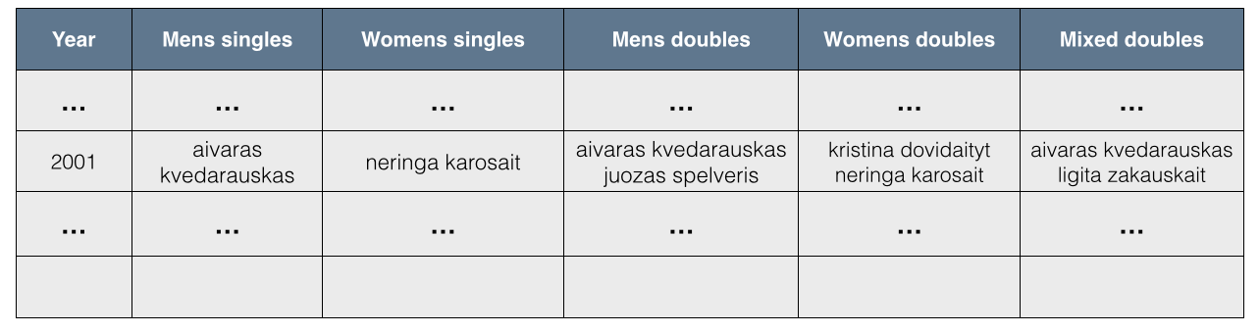
Human and Machine Intelligence Integration
Asking a computer to completely understand the above table is hard. It is like to ask a 4 year old kid without knowledge about tennis to understand this table
However the query issuer likely understands the table
The machine can raise questions and interact with the query issuer

Slide 18
Make the Question Simpler
Notes:
Dataset: 600 imperative queries using IMDB, YELP and Geoquery datasets from 22 non-engineering students.

Slide 19
Explain SQL in Natural Language
Column Headers | First Name | Last Name | Gender | Age | Salary | Country
Sample Record | Dennis | Wright | Male | 34 | 112,751 | Philippines
Q: What is the average age for male employees whose salary is great than 100K?
A: Salary : average of male employees age
59,481 : 57.30
110,062 : 57.30
A: show average of male employees age grouped by salary
Query example from: http://kueri.me/demo
Notes:
Dataset: 600 imperative queries using IMDB, YELP and Geoquery datasets from 22 non-engineering students.

Slide 20
Standardize Query Benchmarks
Level 1: Schema-aware, simple question
Level 2: Schema-aware, sequential simple questions
Level 3: Schema-free, sequential simple questions
Level 4, 5: Composite questions
WikiSQL [Zhong 2017] can be adapted as query benchmark for Level 1
SequentialQA [Iyyer 2017] good for Level 3
Level 4, 5: WebQuestions[Berant 2013], WikiTableQuestions [Pasupat 2015], GraphQuestions [Yu 2017]
We need to characterize the complexity of questions so that we can better understand the QA behavior

Slide 21
Recap
The first step to democratize data science is to let people freely access their data without knowing programming language
In order to make it happen, start with simple queries first. Make it work
Move up the ladder solidly
Leverage human intelligence

