Slide 1


Brand identity system
Competent, quiet infrastructure for the Maldivian business owner.
Simple enough for an owner who has never used an ERP. Built so the same business never has to leave it.
record · join · course
Original identity developed from the product brief after category-collision research. No competitor artwork is reproduced.
v1.0 · 24 AUG 2026

Slide 2
RATIONALE
Start from the operating truth, not a SaaS aesthetic.
WHO
PROMISE
FEEL
Owners with 3–30 staff
Start simple. Never outgrow the record.
Quiet infrastructure
Paper, WhatsApp and spreadsheets today
Phone use on the job floor, slipway or workshop
English may be a second language
Warmth, not whimsy.
Precision, not coldness.
Amber does the warming; everything else gets out of the way.
QuickBooks-level approachability
Odoo-level room to grow
Maldives-first defaults and Thaana-ready UI

Slide 3
RESEARCH + ORIGINALITY
Research was used to avoid the category, not imitate it.
Reference audit
Deliberately avoided
Implementation research
Public brand material reviewed for collision risk and category conventions:
cubes / hexagons
node networks
literal stars
integration arrows as the logo
document/search symbols
purple-blue “AI SaaS” gradients
WCAG 2.2 contrast thresholds
Noto Sans Thaana availability and OFL licensing
RTL handling via semantic lang="dv" dir="rtl"
one-colour reproduction at favicon / engraving sizes
Odoo
Xero
Sage
Zoho
QuickBooks / Intuit
Originality note
The chosen symbol was drawn from the brief’s record + join + navigation logic. Visual research reduces collision risk; it does not replace formal trademark clearance.
Research sources are listed at the end of the deck and in docs/research-notes.md.

Slide 4
DESIGN PRINCIPLES
Five rules that govern every brand decision.
01
Owner-first
Understandable at a glance on a phone.
02
One record
Separate operations visibly resolve into one system.
03
Action discipline
Amber means “do this next,” not “look at us.”
04
Maldives-first
MVR, Thaana, weak-signal realities, local business tone.
05
Room to grow
The identity must still fit when the product becomes much larger.

Slide 5
MARK EXPLORATION
Four original territories. One survives the brief.
Record enclosure
Literal navigation
Connected nodes
Confluence / Course
Rejected: too close to generic document/search territory.
Rejected: “starq” already invites a star. A literal one is too easy.
Rejected: says “tech network,” not “owner’s operating record.”
Chosen: three operational lines become one forward course.
CHOSEN

Slide 6

LOGOMARK
Confluence / Course
RECORD
Three horizontal entries — customers, work, stock, money, or any other operational stream.
JOIN
The lines resolve into one bend: the product’s core promise of one operational record.
COURSE
The final stroke exits on a heading — navigation without a literal compass or star.
One colour · rounded stroke · no fine details · survives 16px, engraving and poor reproduction.

Slide 7



WORDMARK + LOCKUPS
The case shift is the wordmark’s only trick.
Always one word: lowercase starq + uppercase ERP.
Horizontal lockup — primary external use.
Never StarqERP · Starq ERP · STARQ ERP · Starq-ERP · STARQERP.
Stacked — square placements.
House wordmark — product family.

Slide 8

HOUSE ARCHITECTURE
Build a family, not a collection of unrelated logos.
starqERP
operating system
HOUSE
starqPay
payments product
Starq Dynamics
Service brand. Related to the house, but not forced into the product-lockup construction.
starq[Product]
future product pattern
Suffix case is product-specific. The starq prefix stays lowercase and visually stable.

Slide 9
COLOUR SYSTEM · DARK
Dark stays primary — and stays essentially unchanged.
Background
Sidebar
#0A1018 · oklch(17% .02 258)
#050911 · oklch(14% .02 258)
Card
Foreground
#111923 · oklch(21% .024 258)
#E7ECF0 · oklch(94% .008 247)
Muted fg
Accent
#8F9AA4 · oklch(68% .02 250)
#E09036 · oklch(72% .14 65)
Primary
Destructive
#7FBEF3 · oklch(78% .10 245)
#F94144 · oklch(65% .22 25)
KEPT
The existing dark UI palette, radius (.75rem), and “one filled amber action” rule remain the foundation.

Slide 10
COLOUR SYSTEM · LIGHT
Light is rebalanced, not simply inverted.
Background
Sidebar
#F6F8FA · quiet neutral canvas
#EEF2F6 · slightly separated navigation
Card
Foreground
#FFFFFF · true surface white
#111A24 · blue-biased near-black
Muted fg
Border
#5F6C78 · AA-readable secondary text
#D8DEE6 · physical edge without heaviness
Accent
Primary
#E09036 · same action amber
#2563A8 · darkened blue for light-theme contrast
CHANGED
Only the light set was redesigned. Amber remains stable; blue is darkened where text/icon contrast requires it.

Slide 11
SEMANTIC + DATA COLOUR
Action colour and meaning colour never compete.
ACTION
one filled control
Chart palette
Theme-specific so lines remain visible on both canvases. Never rely on hue alone: add markers / line styles beyond three series.
MONEY IN
positive flow / success
DARK
MONEY OUT
cost / destructive
DUE / WARNING
status amber — separate token
LIGHT
INFORMATION
neutral information
Red and green remain semantic colours; they are not paired as the only two chart series. Data colours use blue / orange / teal / violet / ochre.

Slide 12
ACCESSIBILITY
Core combinations clear WCAG AA.
4.5:1
3:1
normal text minimum
large text / non-text UI target
Dark foreground / background
Dark muted / background
Dark text / amber CTA
Aa
Aa
Aa
16.05:1
6.66:1
7.46:1
Light foreground / background
Light muted / background
White / light primary blue
Aa
Aa
Aa
16.48:1
5.05:1
6.12:1
W3C WCAG 2.2 is the threshold source; exact ratios are recorded in the reusable guidelines.

Slide 13
TYPE SYSTEM · LATIN
Keep the product’s type voice.
Lexend
Manrope
Fira Code
Headings + figures · 500 / 600 / 700
UI + body · 400 / 500 / 600 / 700
Identifiers · references · technical values
Scale
12px
helper
14px
dense UI
16px
body
20px
section
24px
page
30px
product H1
40px
marketing H2
56px
marketing H1
Money: tabular lining figures. Product H1: Lexend 600, 30px / 1.875rem, tracking −0.75px. Do not replace the system with Inter.

Slide 14
TYPE SYSTEM · DHIVEHI / RTL
Maldives-first means the brand can set Thaana properly.
Noto Sans Thaana
Implementation
Primary Thaana face · multiple weights · SIL Open Font License
Set lang="dv" dir="rtl" on the smallest correct content container
Do not flip the entire application or mirror the starqERP logo
Isolate MVR, dates and IDs as LTR runs inside RTL sentences
Thaana line-height ≈ 1.7; no forced Latin letter-spacing
Mirror directional icons only when the meaning is directional
ދިވެހި ބަސް · ވިޔަފާރި · ފައިސާ
MVR 4,800 · INV-1042
Noto Sans Thaana was chosen for web availability, weight range and predictable licensing — not because a Latin font “almost works.”

Slide 15
ICONOGRAPHY
Functional line icons; colour only when meaning requires it.
dashboard
customers
jobs
inventory
procurement
money
accounting
alerts
Rules
24px grid · 1.8px stroke · round caps and joins
Optical corner radius ≈ 2px
Monochrome by default
Semantic colour allowed only when adjacent text repeats the meaning
Never use colour alone to communicate state

Slide 16
VOICE
Plain, specific, accountable.
1
Say what happened
2
Name the record
Lead with the event, not a mood.
Invoice, job, item, bill, supplier.
3
Money is exact
4
Problems include the next action
No playful copy around loss or debt.
Tell the user what they can do now.
5
Short first, detail second
6
AI stays accountable
Phone-first comprehension.
Say what the system noticed; never fake certainty.
Never
Oops · awesome · magic · effortless · revolutionary · game-changing · disrupt · synergy · “AI-powered” as the headline · unverified certified / approved / compliant language

Slide 17
VOICE REWRITES · 1/2
Before → after: make the record do the talking.
Nothing here yet.
→
No invoices yet. Create an invoice when you bill a customer.
Oops! Something went wrong.
→
Invoice couldn’t be saved. Check your connection and try again.
Success!
→
Payment of MVR 2,450 recorded.
Payment overdue!!!
→
Invoice INV-1042 is 6 days overdue. MVR 4,800 remains due.
Are you sure?
→
Delete purchase order PO-018? This can’t be undone.

Slide 18
VOICE REWRITES · 2/2
Before → after: specific beats “friendly.”
Invalid amount.
→
Enter an amount greater than MVR 0.00.
Low stock.
→
Primer Grey has 2 cans left. Reorder level: 5.
AI found something!
→
3 supplier bills may be duplicates. Review them before posting.
Done.
→
Job J-0248 marked complete.
Connection error.
→
Connection lost. This page may be out of date. Reconnect to refresh.

Slide 19
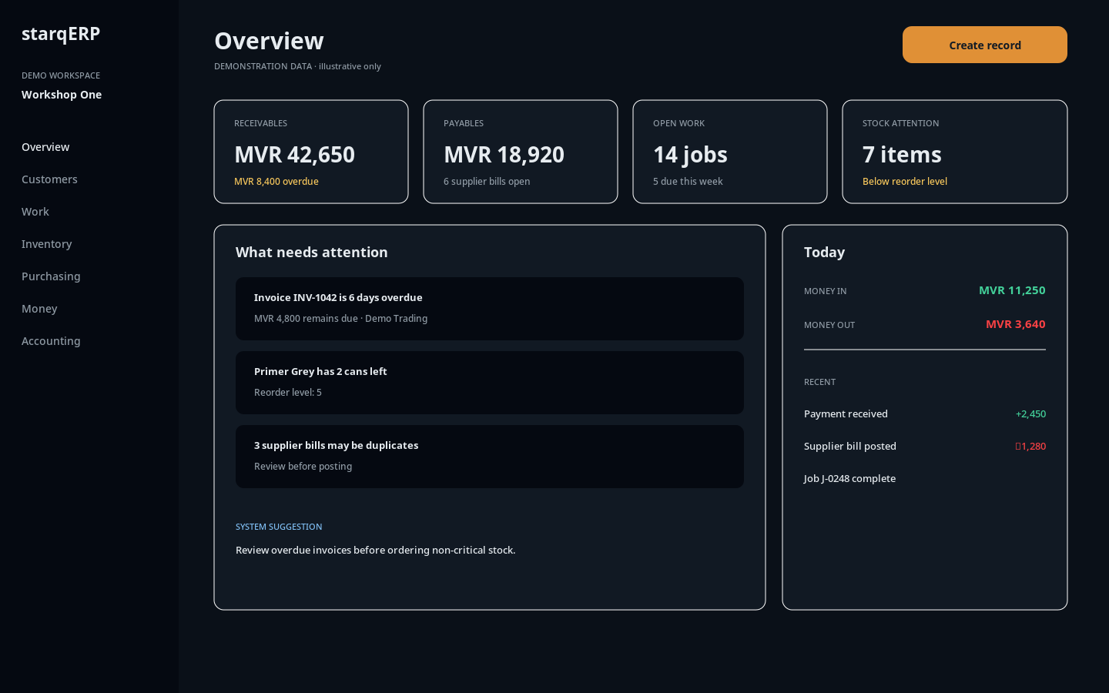
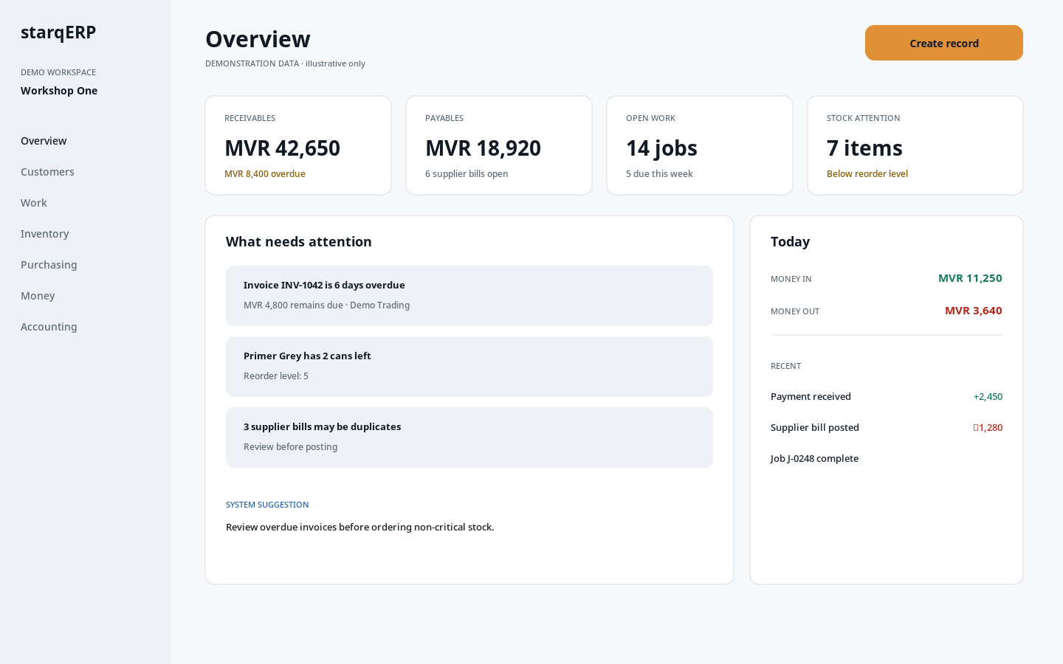
APPLICATION · DASHBOARD
The identity belongs inside the product, not on top of it.
DARK · PRIMARY
LIGHT · SECONDARY
One amber action. Semantic status colours stay separate.
Same hierarchy; stronger blue and darker text carry contrast.

Slide 20
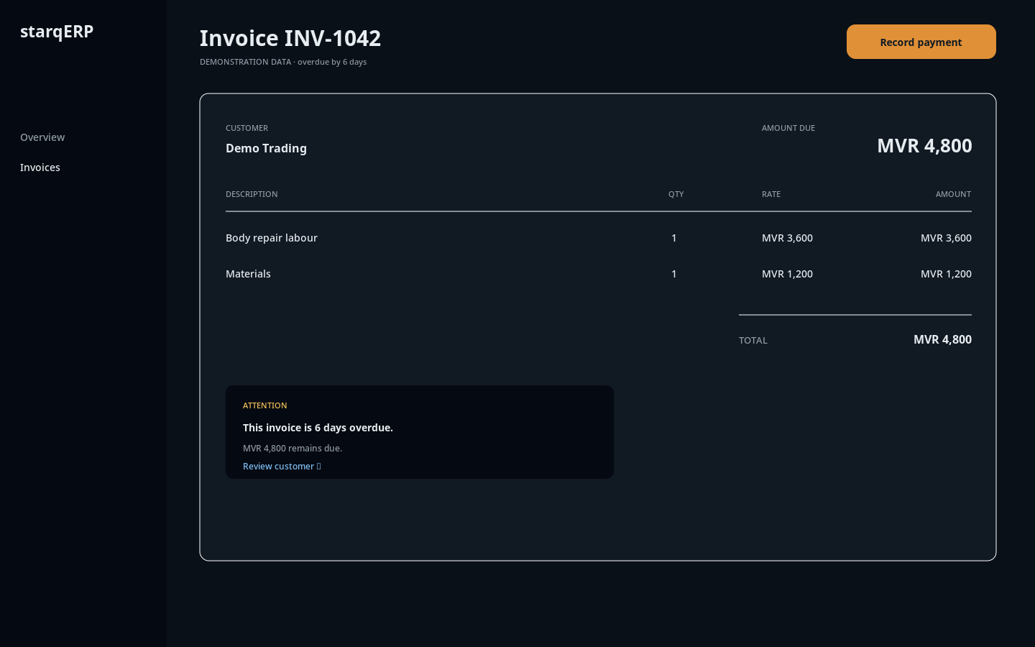
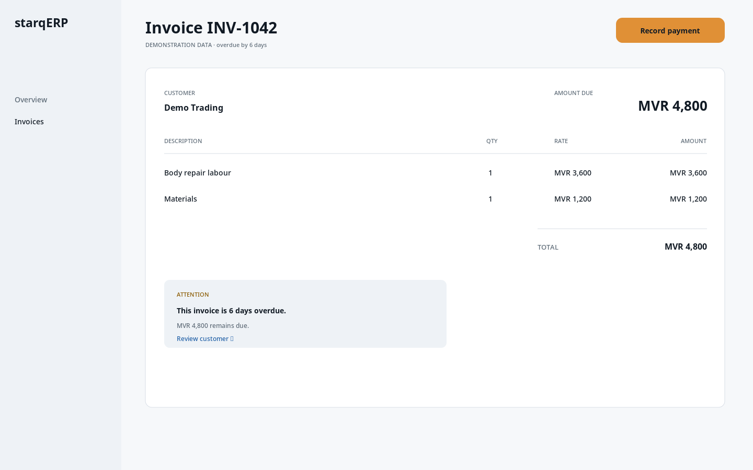
APPLICATION · DETAIL SCREEN
Detail screens stay calm when the data gets serious.
Demonstration data only. No tax, compliance or third-party integration claims are shown.
The system highlights what needs attention, but the data remains the visual protagonist.

Slide 21
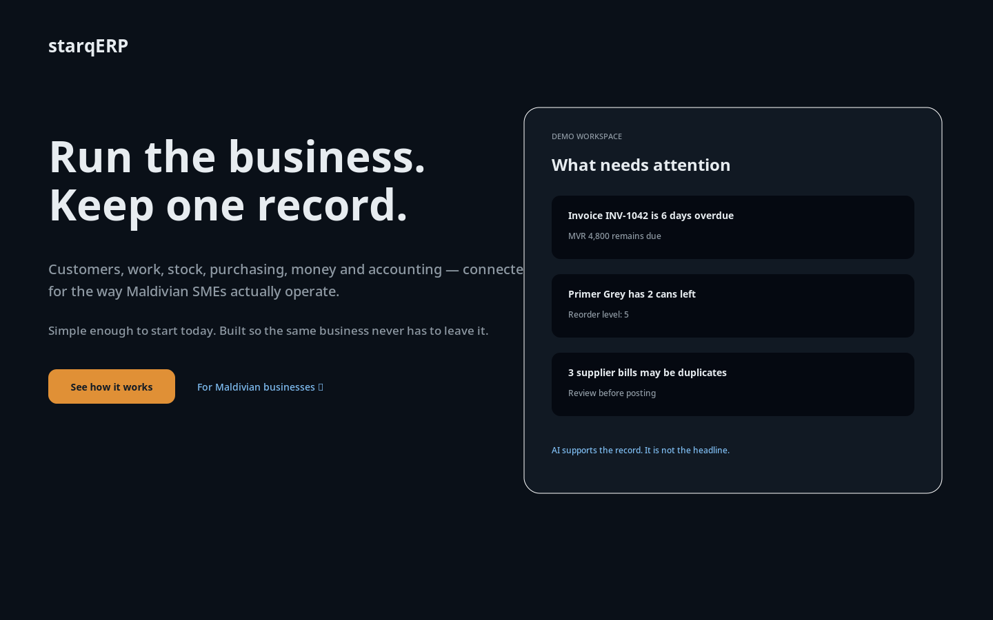
APPLICATION · LANDING PAGE
Lead with what the business does — not “AI-powered.”
Hero logic
Outcome first: run the business, keep one record
Maldives specificity without flag-waving
Product proof shown as operational attention, not abstract AI
Exactly one filled amber CTA
No 3D glass / gradient decoration

Slide 22



APPLICATION · APP ICON
One mark, optically tuned down to 16px.
16px
32px
180px
512px
The icon stays monochrome on the deep product background. Amber is not added as decoration, preserving its action meaning inside the UI.

Slide 23
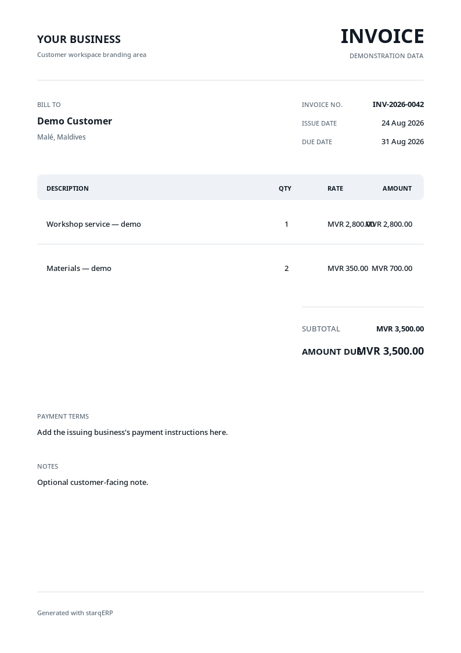
APPLICATION · INVOICE
The customer’s brand leads; starqERP signs quietly.
Invoice rules
Customer workspace logo/name owns the header
starqERP appears quietly in the footer
No GST line, percentage, TIN or compliance badge
MVR uses tabular figures
No “audited,” “certified” or “approved” framing
Template uses clearly marked demonstration data
Reusable source is included as HTML plus SVG/PNG preview so it can move into the product without being redrawn.

Slide 24
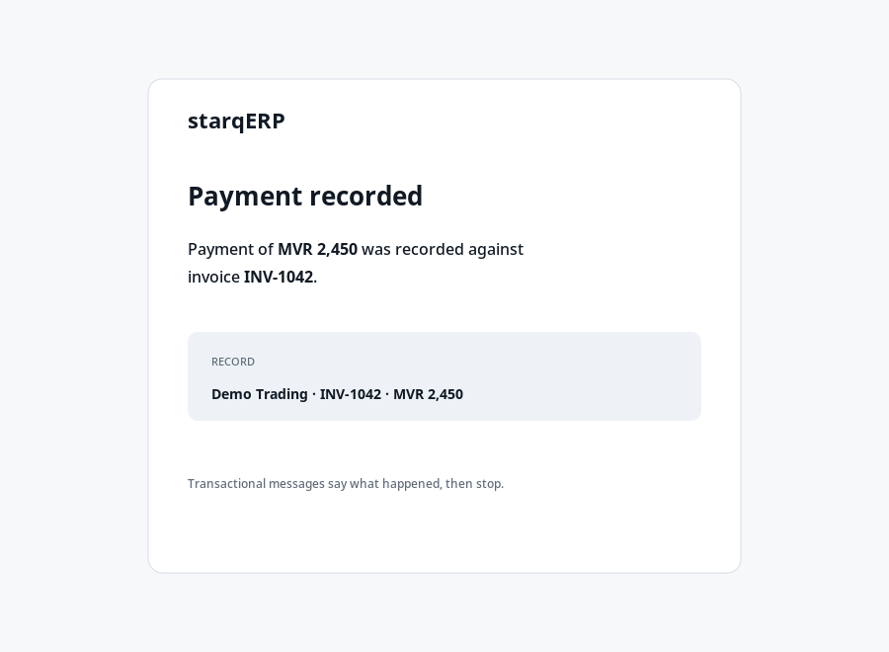
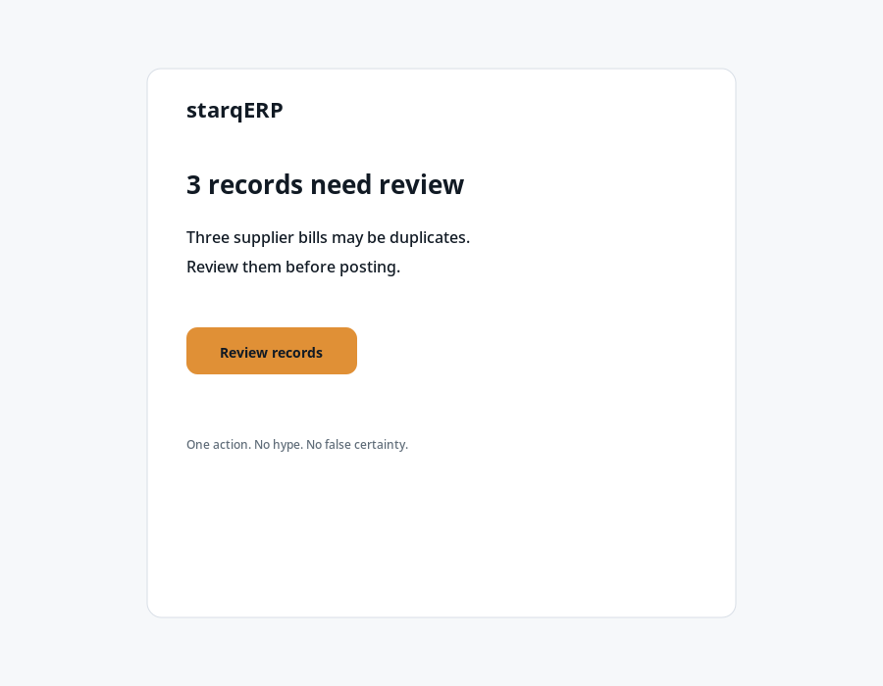

APPLICATIONS · EMAIL + PHYSICAL
The same voice survives inbox and workshop.
Workshop sticker
Monochrome mark. Amber is a supporting line, not the logo fill.
Transactional
Notification
Confirms the record. No celebratory fluff.
One issue, one action, cautious AI language.
Physical rule: the mark must still work when a local printer gives you one colour and mediocre registration.

Slide 25
GUIDELINES · SIZE + CLEAR SPACE
Give the mark room. Do not “improve” it locally.
Never
Standard mark
24px digital · 8mm print
split or recapitalise starqERP
make ERP amber just because it is the suffix
put the mark inside a cube / badge / hexagon
add gradients, glow, bevel or 3D
stretch or rotate the lockup
put a customer logo in global product chrome
Micro mark
16px digital only
Horizontal lockup
112px digital · 28mm print
Clear space = ½ mark width on every side.
Embroidery / engraving
use one-colour master; no effects

Slide 26
GUIDELINES · CO-BRANDING
Customer branding is content; starqERP branding is infrastructure.
IN PRODUCT
ON CUSTOMER DOCUMENTS
starqERP
YOUR BUSINESS
Global chrome carries the product identity.
Customer identity leads.
Demo Business
Generated with starqERP
Workspace name / customer logo may appear only inside the customer’s own workspace context.
Small footer attribution only. Do not compete with the issuer.

Slide 27
REUSABLE HANDOFF
This is a working kit, not just a moodboard.
LOGOS
ICONS
TOKENS
Outlined SVG masters
SVG + PNG
CSS + JSON
Wordmark · house mark · horizontal / stacked lockups · one-colour marks
16 / 32 / 180 / 512 app icon exports · line icon samples
Dark / light / semantic / chart values · type families · radius
TEMPLATES
GUIDES
Reusable source
Markdown
Invoice HTML · landing hero HTML · transactional + notification email
Brand rules · voice · research notes · Thaana / RTL implementation
Source of truth: use the SVG / CSS / JSON / HTML files. The slides explain the system; they are not the production asset.

Slide 28
APPENDIX
Research sources + originality boundary.
Odoo
Official brand assets — odoo.com/page/brand-assets
Xero
Branding / naming and media asset guidance — developer.xero.com / xero.com
Sage
Digital newsroom brand resources — sage.com
Zoho
Branding kit + partner brand guidelines — zoho.com
Intuit
Trademark guidance — intuit.com/legal/trademark
W3C
WCAG 2.2 contrast guidance — w3.org/WAI/WCAG22/Understanding/contrast-minimum
Google / Noto
Noto Sans Thaana specimen + Noto Thaana OFL repository
NOT TRADEMARK CLEARANCE
The mark is original work for this brief and was category-audited for obvious collisions. Formal trademark clearance remains a separate legal step before registration or high-cost rollout.

