Slide 1

JOB MARKET ANALYSIS
PRDA-04 — Data Science Job Market Analysis
Course:
Certified Data Analyst (CDA)
Organization:
DataMites
Tools Used:
MySQL | Python | Pandas | Power BI
Dataset:
742 Job Postings | 42 Features
Presented by:
ALMUBEEN I

Slide 2

Why Analyze the Job Market?
Understand Data Science job demand
Compare salaries across locations
Identify leading companies and industries
Analyze technical skill requirements
Study education and seniority patterns
Build an interactive Power BI dashboard

Slide 3
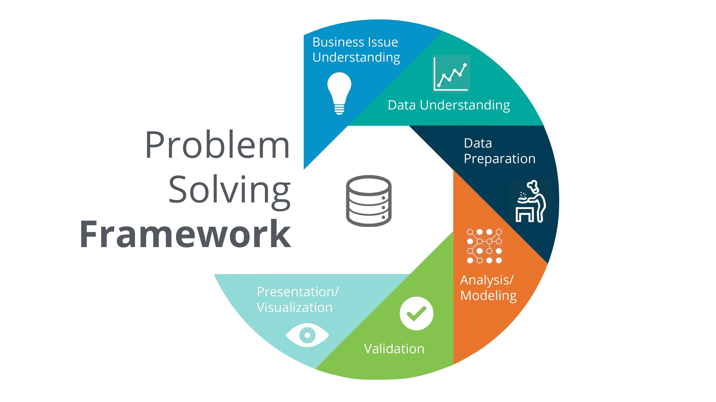
PROBLEM & OBJECTIVES
Raw job-posting data contains many variables, making key market
patterns difficult to identify.
Job Demand → Locations, companies, industries
Salary → Location, title, education, seniority
Skills → Most requested technical skills
Insights → Identify useful market patterns
Dashboard → Interactive Power BI analysis

Slide 4

DATASET
742
Job Postings
42
Features
Data Science
Job Market
$K
$K → Salary Unit (Thousands of Dollars)
-1
Unavailable value
Major Features
Job Information | Salary | Company | Location | Industry | Skills | Education | Seniority

Slide 5
TOOLS & TECHNOLOGIES
TOOLS USED
  MySQL
    Database querying and structured analysis
  Python
    Data extraction and analysis
  Pandas
    Data cleaning and transformation
  Power BI
  Interactive visualization and dashboard development

Slide 6
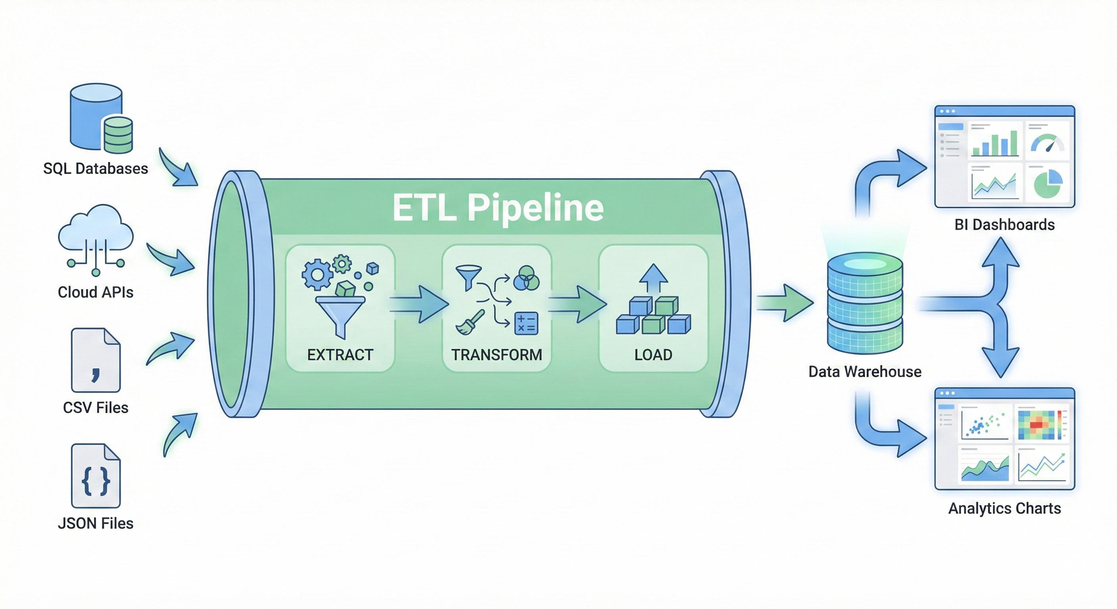
DATA CLEANING
Checked data types and structure
Identified unavailable values
Excluded unavailable salary values from calculations
Prepared categorical and skill fields

Slide 7
SQL-BASED DATA ANALYSIS
Database Analysis
  Retrieved and analyzed 742 job postings from MySQL
  Examined 42 data features across the job-market dataset
  Analyzed job demand by location
  Compared salary ranges and average salaries
  Identified leading industries and hiring companies
  Analyzed popular job titles and required skills
  Evaluated education and seniority patterns
  Performed data-quality checks for missing and unavailable values

Slide 8

PYTHON & PANDAS ANALYSIS
MySQL → Python → Pandas → Analysis → Charts
Extracted job-market data
Performed data cleaning
Conducted exploratory data analysis
Generated analytical tables
Created visualizations

Slide 9
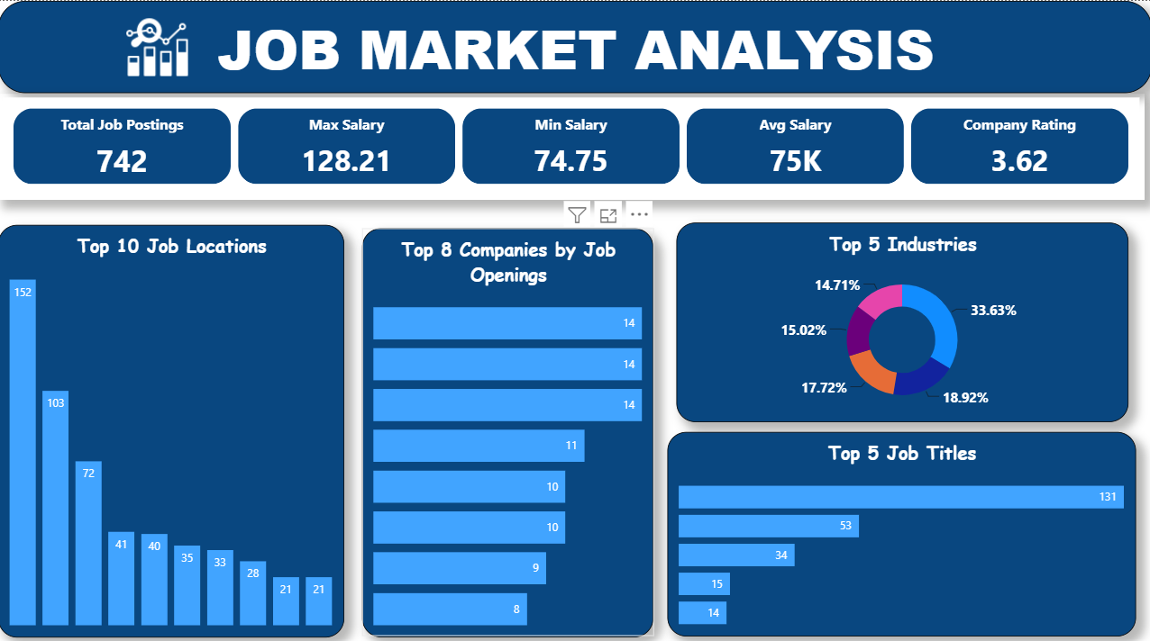
POWER BI — JOB MARKET OVERVIEW
Key Metrics
  742
  Job Postings
  $128.21K
    Maximum Salary
  $74.75K
  Minimum Salary
  $75K
  Average Salary
  3.62
  Company Rating

Slide 10
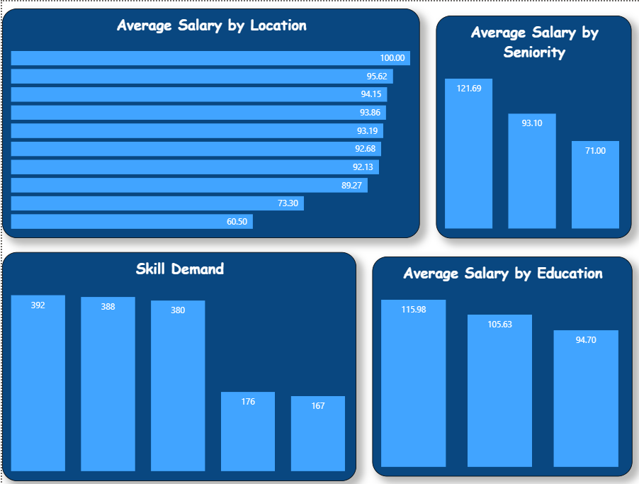
POWER BI — SALARY & SKILLS ANALYSIS
Analysis Covered
  Average Salary by Location
  Skill Demand
  Salary by Education
  Salary by Seniority

Slide 11
KEY INSIGHTS
Job Demand
California (CA) has the highest number of job postings, with 152 postings.
Skill Demand
Python — 392 postings
Excel — 388 postings
SQL — 380 postings
Cloud & Big Data
AWS — 176 postings
Spark — 167 postings
Salary
Salary varies across locations, education and seniority levels.

Slide 12

RECOMMENDATIONS
For Job Seekers
  Build Strong Technical Skills
  Python + SQL + Excel
  Develop Cloud Skills
  AWS
  Learn Big Data Technologies
  Spark
  Consider Location
  Compare job demand and salaries across locations
For Employers
  Clearly define required skills
  Monitor market salary levels
  Develop internal talent

Slide 13
CONCLUSION
Raw Data
↓
MySQL
↓
Python + Pandas
↓
Power BI
↓
Actionable Insights
“Data becomes valuable when analysis turns it into meaningful decisions.”

Slide 14
THANK YOU

