Slide 1
Class Overview

Slide 2
Agenda
Class Overview
  First Night
  Teaching Staff
  What the course covers
  Course Coverage FAQs

Slide 3
Agenda
Class Overview …
  House Rules
  Use of AI
  Grading
  Development Hardware & Tools
  Some more FAQs

Slide 4
First Night
Class Overview
Assignment 01 Overview
ASP NET Web API REST Introduction
Microsoft Foundry Part 1

Slide 5
Class Overview- Teaching Staff
Who
  Instructor
    Joseph Ficara
  Head TA
    Jonathan Franck
  TAs
    Max Eringros
    Jessica Pratt
    Nancy Forero
    Gustavo Varo

Slide 6
Class Overview - Coverage
In depth coverage
  Key Microsoft Azure PaaS offerings
Essentials
  Microsoft Azure Serverless
  .NET 10
    Web API & MVC, Middleware, Entity Framework
  VNETs
  CICD

Slide 7
Class Overview - Coverage
The Fundamentals
  REST
    Scalable REST Services
  Security (Authentication & Authorization)
  Multi-tenancy
  Architectural Patterns
    Cache-Aside
    Pushback, Throttling
    Retry & Circuit breaker
    Command and Query Responsibility Segregation
    And more…
Notes:
Cache-Aside: https://docs.microsoft.com/en-us/azure/architecture/patterns/cache-aside
Materialized View: https://docs.microsoft.com/en-us/azure/architecture/patterns/materialized-view
Throttling: https://docs.microsoft.com/en-us/azure/architecture/patterns/throttling
Notification and Pull: A Joe Pattern
And More: https://docs.microsoft.com/en-us/azure/architecture/patterns/ Additional select topics from Microsoft’s azure architecture patters may be covered based on time and interest

Slide 8
Class Overview - Coverage
The Fundamentals …
  Azure AI – Open AI
    What is offered in Azure
      Focus on Azure AI Foundry
    Microsoft Agent Framework
      Integrating AI into your Applications
      AI Orchestration & Agents, Plugins, Prompts & Plans
    LLM Overview
    Prompt Engineering
    Embedding
    Fine Tuning
    Best practices & Considerations
Notes:
Cache-Aside: https://docs.microsoft.com/en-us/azure/architecture/patterns/cache-aside
Materialized View: https://docs.microsoft.com/en-us/azure/architecture/patterns/materialized-view
Throttling: https://docs.microsoft.com/en-us/azure/architecture/patterns/throttling
Notification and Pull: A Joe Pattern
And More: https://docs.microsoft.com/en-us/azure/architecture/patterns/ Additional select topics from Microsoft’s azure architecture patters may be covered based on time and interest

Slide 9
Class Overview - Coverage
The Fundamentals …
  AI an essential tool for software development
    GitHub Copilot Fundamentals
    Techniques for get better results
    Interactive and async Agent mode
    Remember you own the code
Notes:
Cache-Aside: https://docs.microsoft.com/en-us/azure/architecture/patterns/cache-aside
Materialized View: https://docs.microsoft.com/en-us/azure/architecture/patterns/materialized-view
Throttling: https://docs.microsoft.com/en-us/azure/architecture/patterns/throttling
Notification and Pull: A Joe Pattern
And More: https://docs.microsoft.com/en-us/azure/architecture/patterns/ Additional select topics from Microsoft’s azure architecture patters may be covered based on time and interest

Slide 10
Class Overview - Coverage
How?
  Lectures
  Sections
  Course Work
    Homework assignments
  Microsoft Teams
    Place to ask async questions
  Reading material

Slide 11
Course Coverage FAQ
Can I be successful if ?
  I know Java, C++
    Some other OO language
Yes, if you are a quick study
  You should be able to pickup C# easily
  Teaching staff is well versed in C#
    We can and want to help you!
  In Section we will cover fundamentals of C#

Slide 12
Course Coverage FAQ
Will this class teach me …
  Azure (IaaS) Infrastructure as a Service ?
    No
  Azure (PaaS) Platform as a Service services ?
    YES! (Many but not all…)
  Azure Serverless
    YES! Logic Apps and Azure Functions
  How to
    Build cloud native applications that run in Azure’s cloud ?
      YES!

Slide 13
Course Coverage

Slide 14
Class Overview – House Rules
House Rules
  Silence all noise making devices:
    Cell phones, Laptop, tablet, etc.
    Still rocking a pager ?
      Good for you, but please silence it
We are remote
  Turn on your camera for a better experience!
Ask questions!

Slide 15
Class Overview - Use of AI
GitHub Copilot is encouraged
  As a learning and development tool for all assignments
  Not required
All Copilot usage must be
  Clearly acknowledged and cited in your projectnotes.md file
  Include instruction files, skills, AGENTS.md, prompts, and any MCP servers used, basically everything and anything you provided to the AI for context, constraints and instruction.
Students are responsible for evaluating
  The accuracy & appropriateness of Copilot-generated output

Slide 16
Class Overview - Use of AI
Students must
  Fully understand & be able to explain
    Any code generated by Copilot, TAs may ask
The course teaches
  Effective & responsible use of
    AI Assisted development, focus on GitHub Copilot
  Using AI to
    Improve software development
    Improve your understanding & increase your skill set

Slide 17
Class Overview - Use of AI
Can I use AI to
  Develop the assignment
    Yes
  To develop the extra credit
    Yes
  To build tests
    Yes
Must I understand code that is generated
  Yes

Slide 18
Class Overview - Use of AI
Can I use AI coding tools besides GitHub Copilot
  No
Do I have to pay for GitHub Copilot
  Should be able to get an education grant
  Apply to GitHub Education as a student - GitHub Docs
    Only degree students receive Harvard domain emails which may affect eligibility
Can I use my company GitHub account
  No
Can I provide the assignment to AI
and have AI build the whole thing?
  No, you must decompose the assignment yourself and learn AI assisted development techniques presented in class to achieve the desired result if you use AI assisted development.

Slide 19
Class Overview - Grading
Students registered for Graduate Credit
  Required to complete one extra credit option
  The selected option
    Must be from the assignment's listed extra credit options
    Is included in the base grade calculation
    Cannot increase the assignment score above 100%
  If the required extra credit option is not completed
    A point deduction will be applied
    Deduction equals point value of lowest-value extra credit option
  Additional extra credit options
    May be completed from the assignment's listed options
    Can be used to earn a score above 100%

Slide 20
Class Overview - Grading
Assignments
  Lowest assignment grade is dropped
  Upload to canvas by 5:00 PM EST date due
    1.5 Points deducted per day late
    Assignments more than 14 days late
      Receive a grade of 0%
  Extra points
    1 Point per day early up to 5 points max
  See syllabus for more details

Slide 21
Class Overview - Grading
Assignments …
Accepted submission – Canvas Website
Students' responsibility
  Complete assignment & submit it to canvas
    5:00 PM EST on due date
No excuses accepted …
  Corrupted Zip file, Computer Crashed
  My clock was off
  The internet was broken
  My mouse ate it
  Still late!

Slide 22
Class Overview - Grading
Assignments …
A TA is assigned to grade your assignment
  Assignments are posted in Microsoft Teams
    Under the assignment channel
    Grading TA changes for each assignment
No resubmits!
  Unless requested by your grading TA
    If resubmit is required by a TA?
      All early submission extra credit points are forfeit

Slide 23
Class Overview - Grading
Evaluation (How you are graded)
  Homework is 100% of your final grade
    There are 7 assignments
    The assignment with lowest grade is dropped
    Student can skip a single assignment
      Skipped assignment receives a score of zero
        Is considered lowest grade and dropped
        Uses up the lowest grade dropped benefit

Slide 24
Class Overview
Assignments …
Students are not permitted to make coursework
  Open source
Students must keep all course work private
  Repositories used for assignments must be private
  Exceptions
    Prospective employer
    Showcase during section when permitted
      TAs will coordinate section showcase sessions
Students are not permitted to share
  Any course material, slides, videos, course work

Slide 25
Grading

Slide 26
Class Overview - Logistics
Connectivity Requirements
  Internet Access
  Email
  Your favorite internet browser

Slide 27
Class Overview - Logistics
Sections
  Thursday from 5:30 to 6:30 PM EST
    Student Q&A & supplemental content
    Recorded
Instructor office hours
  Typically, Saturday or Sunday 1-1.5 Hours
    Day & Time posted on Teams and Canvas
    Student Q&A & supplemental content
    Recorded

Slide 28
Class Overview - Logistics
Class Website
  https://canvas.harvard.edu/courses/166214
  Your Harvard Key Credentials
    Login Name & Password

Slide 29
Class Website
https://canvas.harvard.edu/courses/166214

Slide 30
Development Tools & Environment
Software & Hardware
  Windows 11 Professional, Mac or Linux
  Visual Studio 2026 - Windows
    Community, Pro or Enterprise with latest updates
    See hardware/software requirements here
    Download Visual Studio 2026 Community here
Visual Studio Code - Mac, Linux
  You can download VS Code it here
Microsoft software is free for educational use
Most Azure Resources are also “free”
  Students are provided Azure $100.00
    We will use several free services

Slide 31
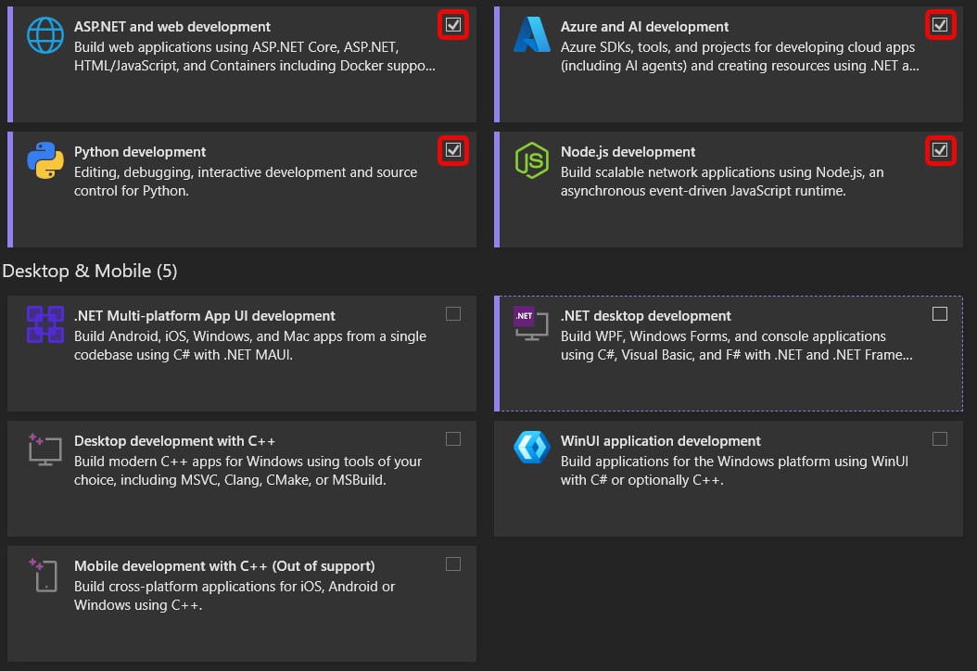
Development Tools & Environment
Visual Studio 2026 Install Selection

Slide 32
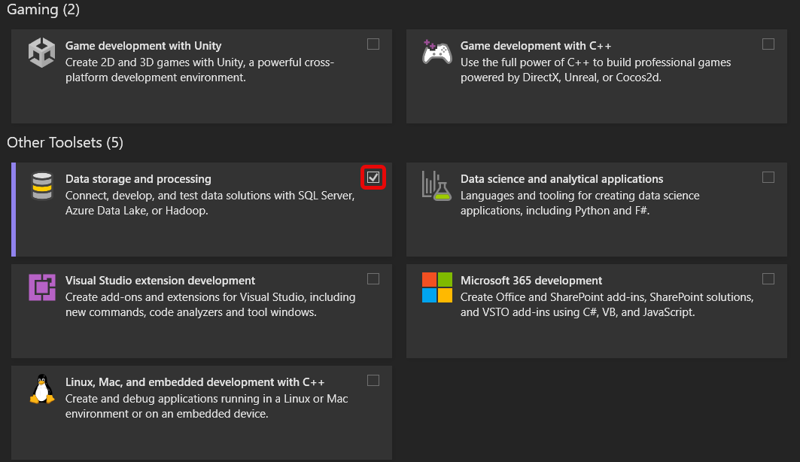
Development Tools & Environment
Visual Studio 2026 Install Selection
Note: You may not see the Data storage and processing option in Visual Studio 2026. I do see it in my installation, but I have multiple versions and editions of Visual Studio installed, so this may be due to cached or carried-over components, even though Visual Studio 2026 Community is selected.
This option is not required for the course. You will be fine without it. For SQL-related work, we will use SQL Server Management Studio (SSMS) or Visual Studio Code with the SQL extension, which fully cover what you’ll need.

Slide 33
Development Tools & Environment

Slide 34
Class Overview – FAQ
I am new to Azure and all this …
  What do I have to setup how do I do it?
    See the welcome letter
      Welcome Letter
    See the setup video
      Microsoft Account, Azure & Teams Setup Video

Slide 35
Class Overview – FAQ
How long do assignments take to complete?
  Median student
    Spends between 15 to 20 hours on each assignment.
What is submitted?
  See details provided in each assignment
    Don't submit the binary
    Required AI Attribution
      See assignment and syllabus
    Ensure projectnotes.md is submitted
      With required information
        See assignment and syllabus

Slide 36
Class Overview – FAQ
What assistance is available for students
  Unfamiliar with the technology stack?
    Several sections include lectures on C# and .NET
    Weekly instructor office hours
    Sample is code provided
      In every lecture pack
      Instructor Office Hours & Section supplemental content
    Async Q&A regarding lectures and assignments
      Take place on Microsoft Teams

Slide 37
Class Overview – FAQ
What assistance is available for students unfamiliar with the technology stack ..
Should I use GitHub for my source code?
  YES, and keep it private
    You can share it with your Instructor / TA if/when needed for assistance
    Assignment submission only happens through Canvas not GitHub
Microsoft Teams Assignment Channel
  Post your question in the assignment channel
  Don't include assignment source code
  Do include context
    Challenge you are facing
    Error messages
    What you have tried so far
  Other students and TAs can help you
Don't use email

Slide 38
Class Overview – FAQ
What assistance is available for students unfamiliar with the technology stack ..
Limited availability for TA 1:1 sessions
  Request to your grading TA or Jonathan Franck
    To schedule a time that works for you both
    TAs Need 2-3 days notice
    ½ Hour sessions
  First come first serve
    Always post your question
      In Teams Assignment channel first
  TA's schedule may be full
    Alternatives
      Microsoft Teams async Q&A
      Section
      Instructor office hours

Slide 39
Class Overview – FAQ
How long before my assignment is graded
  Typically, 2 weeks from date it was turned in
Make sure your service is working in Azure
  TAs will try to restart it, once
  If they can't get it working, they will reach out
    Respond in 24 hours or less
      If they don't hear from you, they will grade as is, working or not
How do I get my assignment's grade?
  Check canvas grading,
    Reach out to grading TA via Microsoft Teams
      To check on progress if not gradated within 2 weeks

Slide 40


Class Overview – FAQ
OS/Software Can it be used ? |  | Support Available ?
macOS | Yes | Yes
Linux | Yes | No
Windows 11, 10 | Yes | Yes
Windows 7, 8, 8.1 | No | No
Visual Studio for Mac | No | No
Visual Studio Code | Yes, Required for Bicep | Yes
Visual Studio 2022 | No | No
Visual Studio 2026 | Yes | No
JetBrains Rider | Yes | No

Slide 41
Class Overview – FAQ
Mac Tip
  To run Windows on a Mac
    Use: Parallels or VMWare Fusion or Bootcamp
      We recommend Parallels if using a Mac
        Academic version available for $39.95
          http://www.onthehub.com/parallels/
JetBrains Rider License
  They offer a free license
    See Free Educational Licenses

Slide 42
Class Overview – FAQ
Do I need an Azure account
  Yes – See welcome letter for instructions
  I already have an Azure account can I use it?
    No
      We need to have full admin rights to your account
  Can I add to my existing Azure account
    No, Use a new Microsoft account
      Don’t use any special characters in email address
        [A-Za-z0-9] Keep email address small and simple
      See: https://account.microsoft.com/account
          Use a Private / Incognito tab to do so

Slide 43
Class Overview – FAQ
Will I be charged for my Azure account?
  When using academic subscription
    No
  What happens when I exceed my limit
    You will be unable to access paid resources
    We won't be able to grade your assignment
    Use free resources as instructed
    If I want to pay how much will it cost me?
      Depends on usage
      Billed monthly

Slide 44
Class Overview – FAQ
Can I use the Azure simulator?
  Sometimes
    For available services during your development
      Not all Azure services have simulations
  Must deploy finished solution to Azure cloud
    Grading is against your Azure cloud deployment
  Recommendation
    Use Azure Cloud and remote debugging

Slide 45
Class Overview

