Slide 1
Stopping Card Fraud Before It Costs Us
What we can catch, what it saves, and what we must decide
BUSINESS DECK | For executives and risk owners
Allen Mendiola
Pillar 5 Capstone | Finance Domain | 21 September 2026

Slide 2
The problem in plain terms
• When a stolen card is used, we refund the customer and absorb the loss.
• Fraud is rare - about 5.7 in every 1,000 payments - which makes it hard to spot.
• But we cannot simply block anything suspicious:
– every block costs staff time to review
– and a wrongly blocked customer is a customer standing at a till, embarrassed
• So this is a balancing act, not a detection problem.
• In the period we tested, fraud was worth $3,186,624.
The question is not 'can we catch fraud'. It is 'how much are we willing to pay to catch it'.

Slide 3
What the system delivers
Measured on transactions it had never seen
88%
of fraud caught
56%
of alerts are real fraud
$554,950
net benefit in the period
1,798
alerts to review
• Out of 1,145 frauds, the system caught 1,009 and missed 136.
• Fraud value blocked: $599,445. Cost of reviews and customer goodwill: $44,495.
Roughly $13 of value protected for every $1 spent running it.

Slide 4
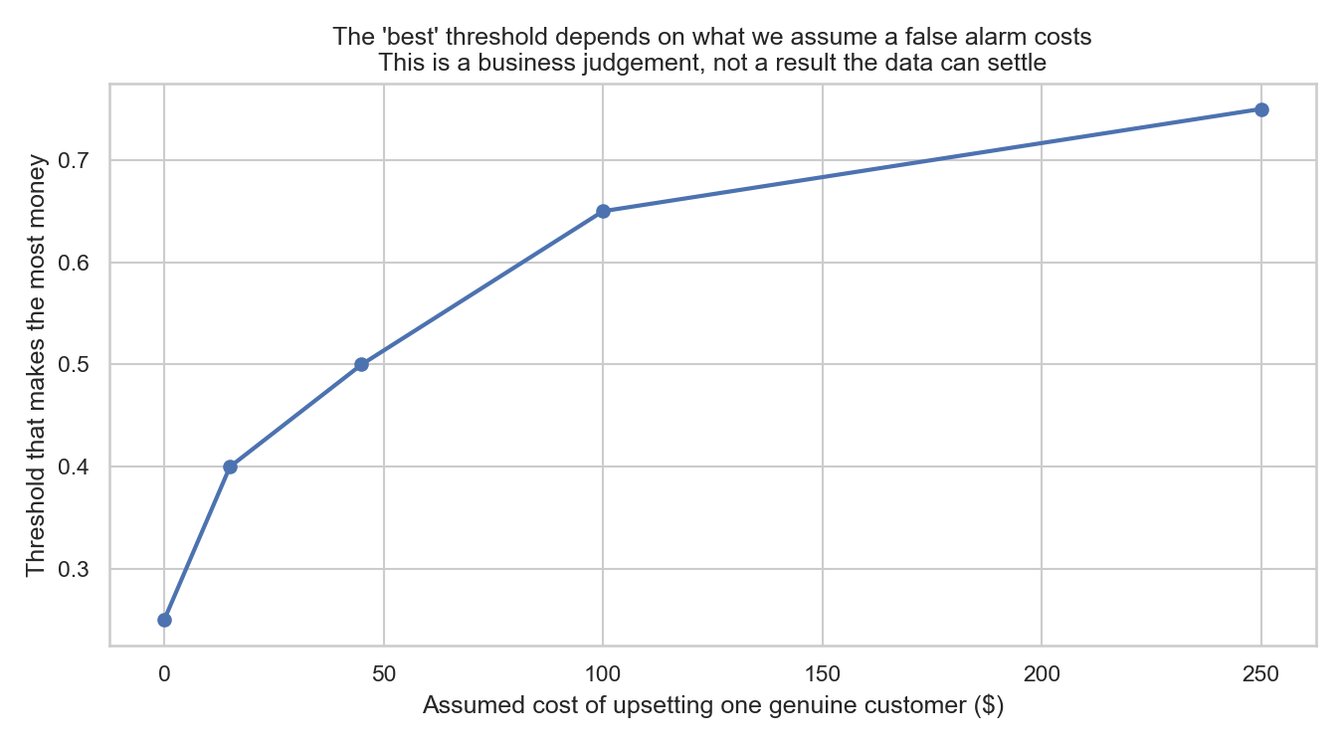
There is a dial, and someone must set it
Catch more fraud, or annoy fewer customers. Not both.
• Turn the dial one way:
– catch nearly all fraud, but block far more innocent customers
• Turn it the other way:
– almost every alert is genuine, but more fraud slips through
• Where it should sit depends on what we think a wrongly blocked customer costs us.
• That is a judgement for this room, not for the data team.
Our recommendation assumes a wrongly blocked customer costs $45. Challenge that number.

Slide 5
Two ways to run it
 | Maximum value | Within current team capacity
Alerts to review | 1,798 | 1,132
Fraud caught | 1,009 (88%) | 891 (78%)
Alerts that are real fraud | 56% | 79%
Net benefit | $554,950 | $529,875
• The capacity option catches less fraud but needs no extra headcount.
• The difference between them is a staffing decision, not a technical one.
Both options are profitable. Choose based on how many reviewers we are willing to fund.

Slide 6
A risk we must not discover later
The system does not protect every customer group equally
• We deliberately never told the model anyone's gender or job.
• That is necessary, but it turns out not to be sufficient - the model infers them indirectly from spending patterns. What we measured:
– F customers have 86% of their fraud caught, against 91% for M
– Rural customers are the worst protected of all, at 86%
– on the standard 80% legal test, city size scores 0.60 and age 0.73 - both fail
• We can close most of the age gap, at the cost of 313 extra reviews.
Regulators increasingly ask for exactly this evidence. We have it, before being asked.

Slide 7
What could go wrong
• These results come from SIMULATED data. Real performance will be lower.
– Nothing should go live before a shadow run against real transactions.
• Fraud adapts. A model trained on last year decays - budget for monthly retraining.
• Alerts must go to people, not straight to automatic blocking.
• Customers need a route to challenge a block and have it reversed.
• Watch for the feedback loop: flagging one group more creates more evidence
– against that group, which teaches the next model to flag them even harder.
Monitor fairness alongside accuracy from day one, not after the first complaint.

Slide 8
What we are asking you to decide
• 1. Approve a shadow run against real transactions, scoring but not blocking.
• 2. Set the dial: confirm what a wrongly blocked customer is worth to us.
• 3. Choose the staffing level - maximum value, or current team capacity.
• 4. Decide how much we will pay to close the fairness gap, and record that decision.
• 5. Fund monthly retraining as an operating cost, not a project.
$554,950
estimated benefit per test period
88%
of fraud stopped
The technology works. The remaining decisions are ours, and they are about values and money.

