Slide 1
Detecting Fraudulent Card Transactions
An end-to-end machine learning lifecycle, from framing to fairness
TECHNICAL DECK | For data scientists and engineers
Allen Mendiola
Pillar 5 Capstone | Finance Domain | 21 September 2026

Slide 2
The problem and why it is hard
Binary classification on 1,048,575 transactions
• Goal: decide whether a card payment is fraudulent, at the moment it is attempted.
• Supervised binary classification. Target: is_fraud.
• Only 6,006 of 1,048,575 transactions are fraud - 0.573% of the data.
– One fraud for roughly every 172 genuine payments.
• This rarity drives every decision that follows.
– Accuracy becomes useless - predicting 'genuine' always scores 99.45%.
– PR-AUC and recall are the honest metrics here.
Headline metric: PR-AUC. Random baseline is 0.0055, so there is a long way to climb.

Slide 3
The data, and two problems found in it
Sparkov simulated transactions, 2019-01-01 to 2020-03-10
• Chosen because it keeps gender, date of birth, job and city size.
– The better-known ULB dataset is anonymised to V1-V28, which would make both SHAP and the fairness audit meaningless.
• Problem 1: the file has exactly 1,048,575 rows - Excel's row limit.
– Roughly 248,000 transactions were lost before publication.
• Problem 2: birth dates used 2-digit years, so '1/19/62' was read as 2062.
– 358,189 rows (34.2%) produced customers born in the future, with NEGATIVE ages.
– Caught only because a cluster reported an average age of minus 41.
The age bug would have silently corrupted the age fairness audit while appearing to work.

Slide 4
Feature engineering
13 engineered features from 22 raw columns
• amt_vs_card_avg - payment size against what that card normally spends.
• distance_km - haversine distance from the customer's home to the shop.
• is_night, hour - fraud rate at night is 1.84% against 0.12% by day.
• age - computed from date of birth, after the century fix.
• Leakage control: card averages and merchant frequencies are fitted on TRAIN only.
• Split is chronological, not random - train on the past, test on the future.
• Dropped: name, street, card number, postcode (privacy) and gender, job (protected).
A random split would let the model learn from the future. The split is by date for that reason.

Slide 5
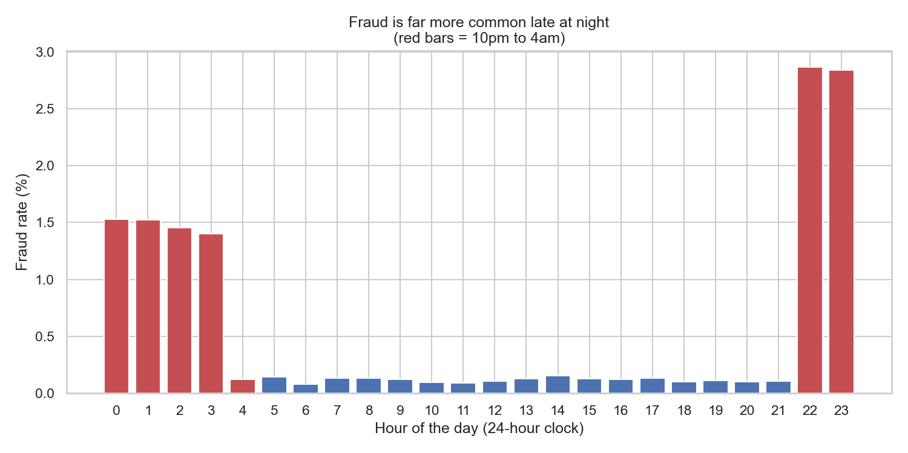
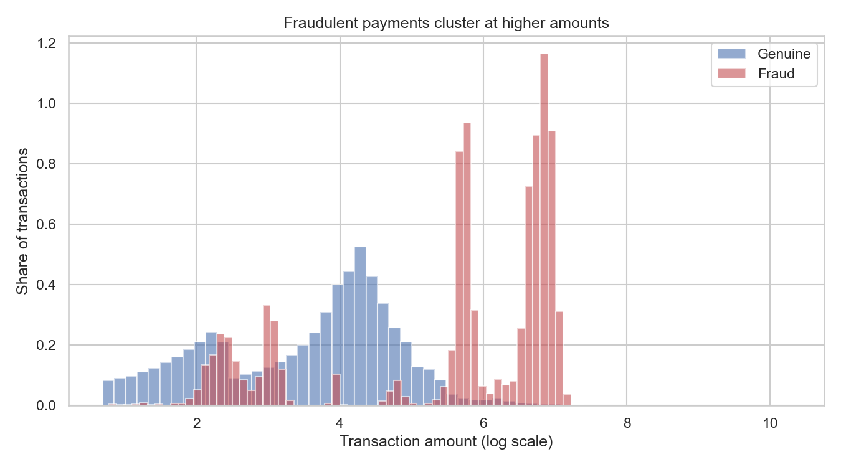
What the data shows
The strongest single pattern is the time of day
Fraud is 16x more likely at night, and averages $526 against $68 for genuine payments.

Slide 6
Seven models compared
All measured on the held-out later time period - and the top scorer is not the one deployed
Model | Precision | Recall | F1 | ROC-AUC | PR-AUC
Neural Network (MLP) | 0.8811 | 0.738 | 0.8032 | 0.9944 | 0.8613
Random Forest | 0.5612 | 0.8812 | 0.6857 | 0.9954 | 0.8605
XGBoost | 0.5402 | 0.8384 | 0.6571 | 0.9947 | 0.8307
Decision Tree | 0.1567 | 0.9712 | 0.2698 | 0.9835 | 0.679
Support Vector Machine | 0.2623 | 0.8044 | 0.3956 | 0.9618 | 0.5087
Logistic Regression | 0.0497 | 0.9013 | 0.0941 | 0.9659 | 0.2377
Isolation Forest (unsupervised) | 0.3195 | 0.4314 | 0.3671 | 0.9297 | 0.2212
• ROC-AUC flatters everything here; PR-AUC separates the models properly.
• Highest PR-AUC: Neural Network (MLP) (0.8613). Deployed: Random Forest (0.8605).
• That 0.0008 gap is noise. Tie broken on explainability - SHAP is exact on trees.
A bank that cannot explain a declined payment cannot deploy the model, whatever its score.

Slide 7
A result that contradicts the textbook
Class weights and SMOTE both LOWERED PR-AUC
Approach | Recall | Precision | PR-AUC
Do nothing | 0.2568 | 0.8424 | 0.4016
Class weights | 0.8952 | 0.0452 | 0.2427
SMOTE oversampling | 0.8934 | 0.0437 | 0.2391
• Recall leaps from 0.26 to 0.90, exactly as advertised.
• But PR-AUC falls, because ranking quality did not improve.
• These methods move the decision boundary; they do not make the model wiser.
• PR-AUC looks across all thresholds, so it sees through the trade.
Better approach: train on the real distribution, then tune the threshold deliberately.

Slide 8
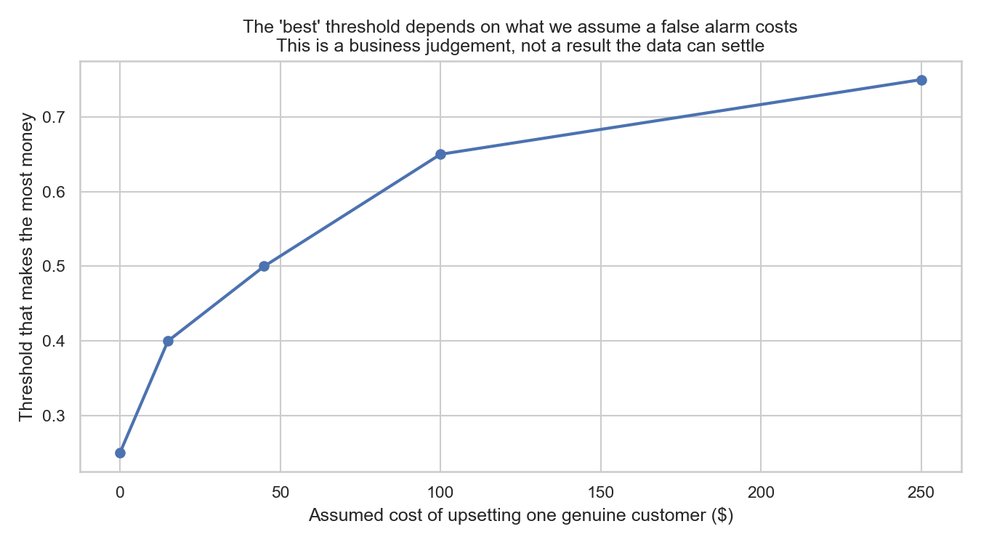
Choosing the threshold with money
0.5 is a convention - and the 'best' answer moves with what we assume
• Each alert costs $5 of analyst time; each FALSE alert costs a further $45 in goodwill.
• Best threshold: 0.50
– 1,798 alerts, 56% of them real fraud
– 1,009 of 1,145 frauds caught (88.1%)
– Net benefit $554,950
• As the assumed goodwill cost rises $0 to $250, the best threshold moves 0.25 to 0.75.
• An earlier version searched from 0.05 and 'won' at 0.05 - the range was too narrow.
This is a business judgement wearing a mathematical costume. Say so out loud.

Slide 9
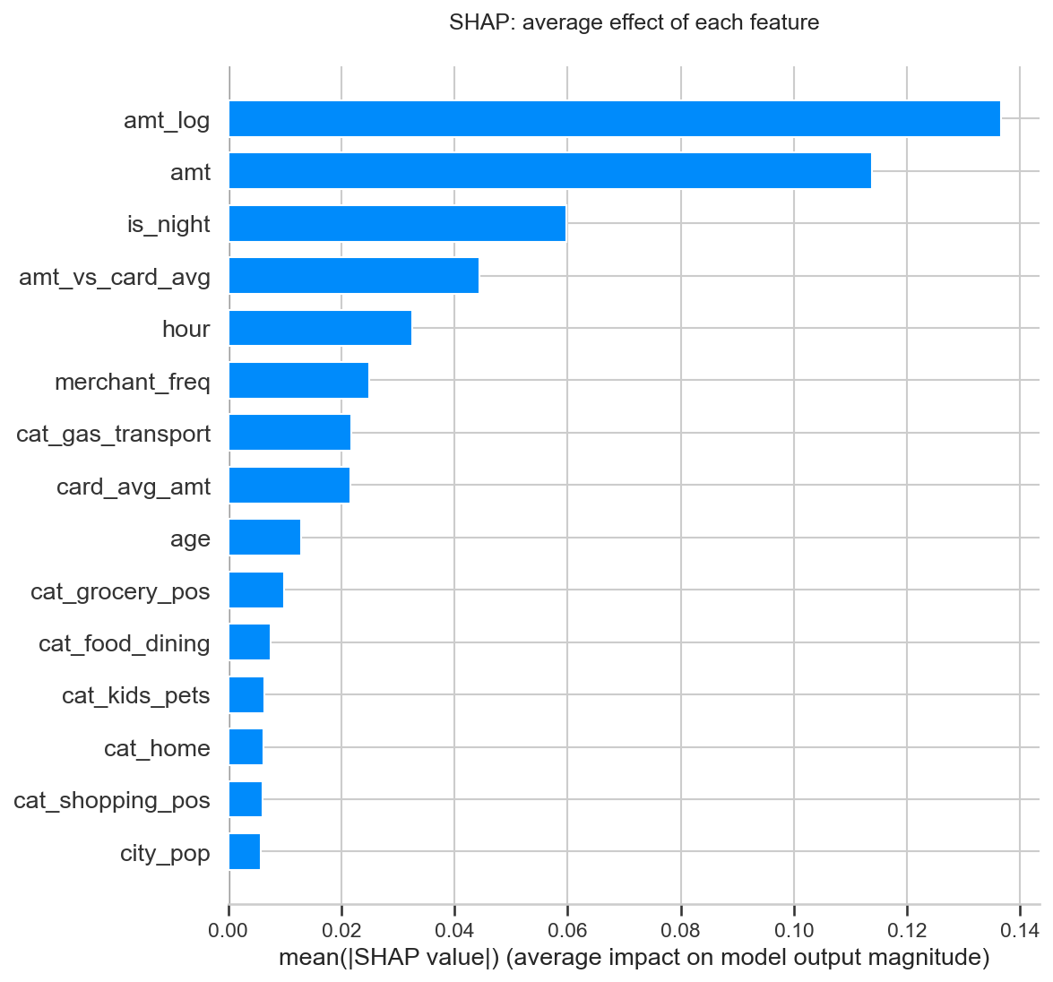
Explaining the model
SHAP, LIME, permutation importance and mutual information
• Top features by SHAP:
– amt_log
– amt
– is_night
– amt_vs_card_avg
– hour
• All behavioural - what was done, not who did it.
• PCA needs 21 of 27 components for 95% of the variance...
– ...but PCA is rejected for the final model: it destroys the explanations.
'40x this card's normal spend, at 2am' is actionable. 'Component 3 was high' is not.

Slide 10
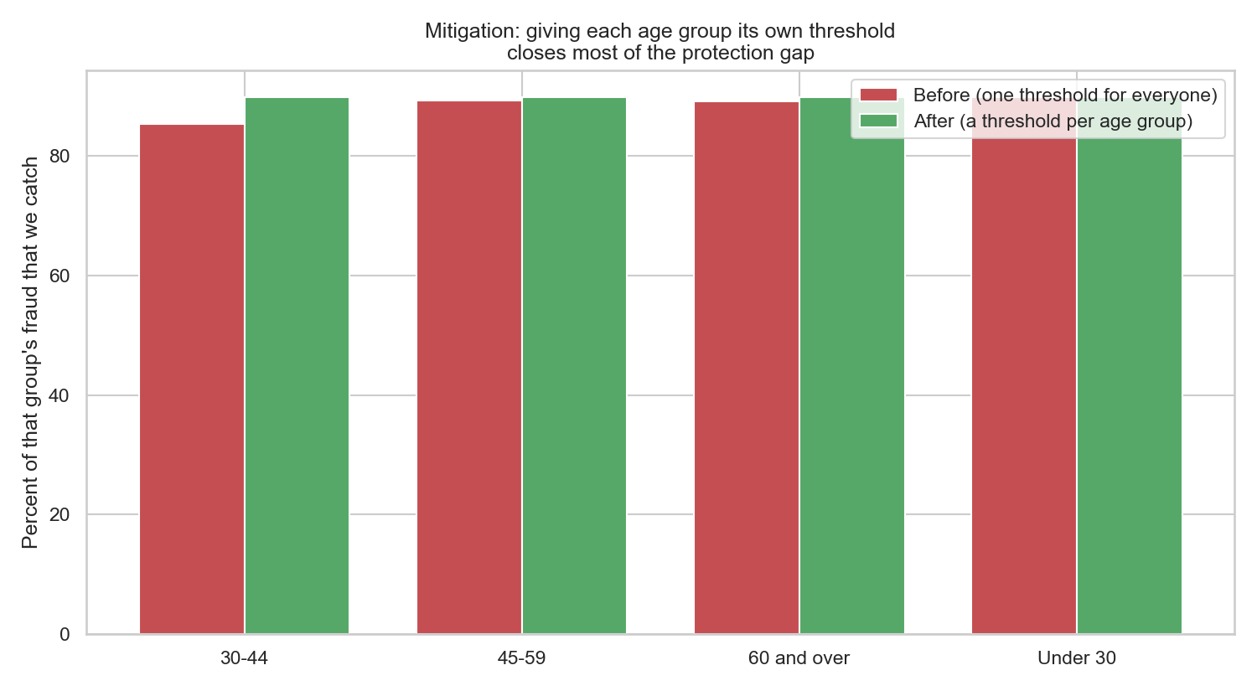
Fairness audit, and what fixing it costs
Gender and job were withheld from the model. Was that enough?
• Gender disparate impact 0.836 (passes); age 0.726 and city size 0.605 both FAIL the 80% rule.
• Worst served: Rural customers, only 85.7% of their fraud caught.
• Protected traits leave fingerprints on category, city size and timing.
• Fix: a separate threshold per age group.
– gap 4.5 -> 0.1 points
– 19 more frauds caught...
– ...but 313 more false alarms to review
• Also considered: reweighting, augmentation, post-processing.
Removing a sensitive column removes your ability to SEE its effect, not the effect itself.

Slide 11
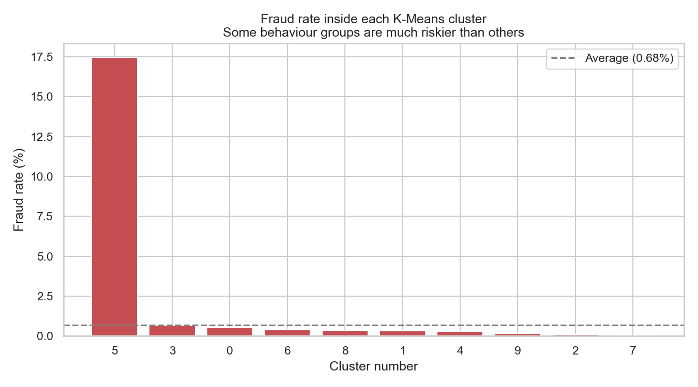
Finding fraud without any labels
Because in a real bank the labels arrive weeks late
• K-Means: best k = 10 (silhouette 0.179)
– Riskiest cluster has a 17.5% fraud rate - 26x the average
• DBSCAN: 1,190 noise points (6.0%)
– Noise is 51x more likely to be fraud than grouped points
• Hierarchical silhouette 0.125, agrees with K-Means but far slower.
'Does not look like anything else' is a powerful fraud signal on its own.

Slide 12
Limitations and what comes next
• The data is SIMULATED. Real fraud adapts; these numbers will not transfer.
• Source file truncated at Excel's row limit, losing ~248,000 transactions.
• No race or ethnicity field exists, so that fairness dimension is untested.
• City size is a weak stand-in for socioeconomic status.
• Next: model each card as a SEQUENCE and apply an LSTM - the formulation that would genuinely justify deep learning, unlike the flat table used here.
• Next: velocity features (payments per hour/day/week), the biggest missing signal.
• Next: adversarial testing against a fraudster who knows the model exists.
Methodology transfers. The specific numbers do not. Validate on real data before trusting any of it.

