Slide 1
Microsoft Azure ML

Slide 2
Azure
Azure is Microsoft’s Cloud Services solution
Dozens of services hosted on over 200 datacenters in 34 countries
Competes with Amazon Web Services (AWS), Google Cloud Platform, Oracle Cloud, etc.

Slide 3
Azure ML, What It Is: One of the Four Components of Microsoft Azure AI
Azure Applied AI Services
Azure Cognitive Services
Azure Machine Learning
AI Infrastructure
Cloud Service for Building, Deploying and Managing Machine Learning Solutions

Slide 4
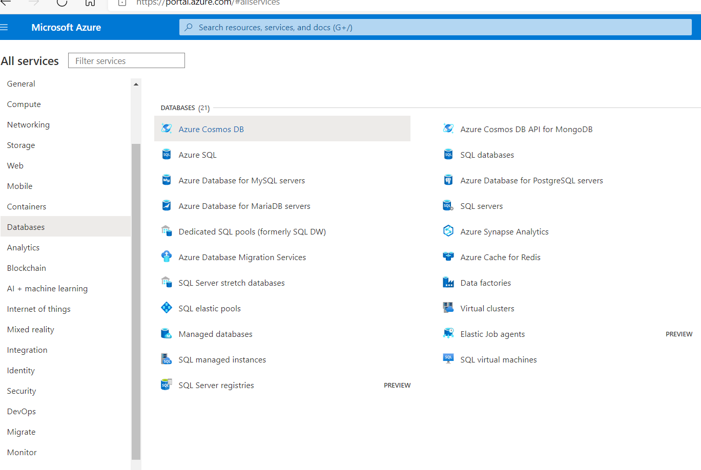
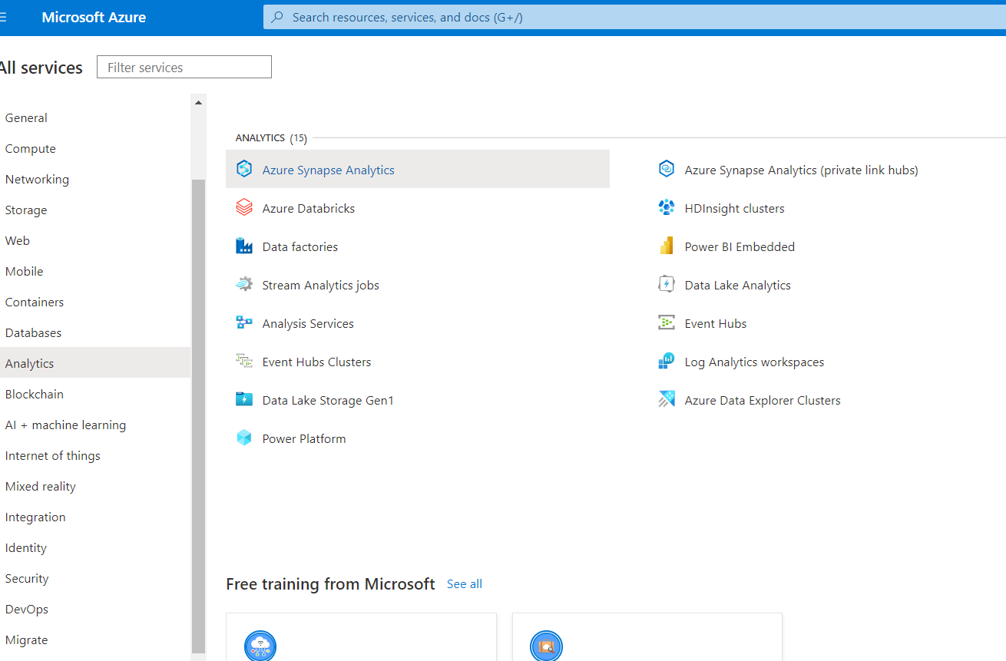
Azure ML, What It is Not: Database Services (21) and Analytic Services (19)

Slide 5
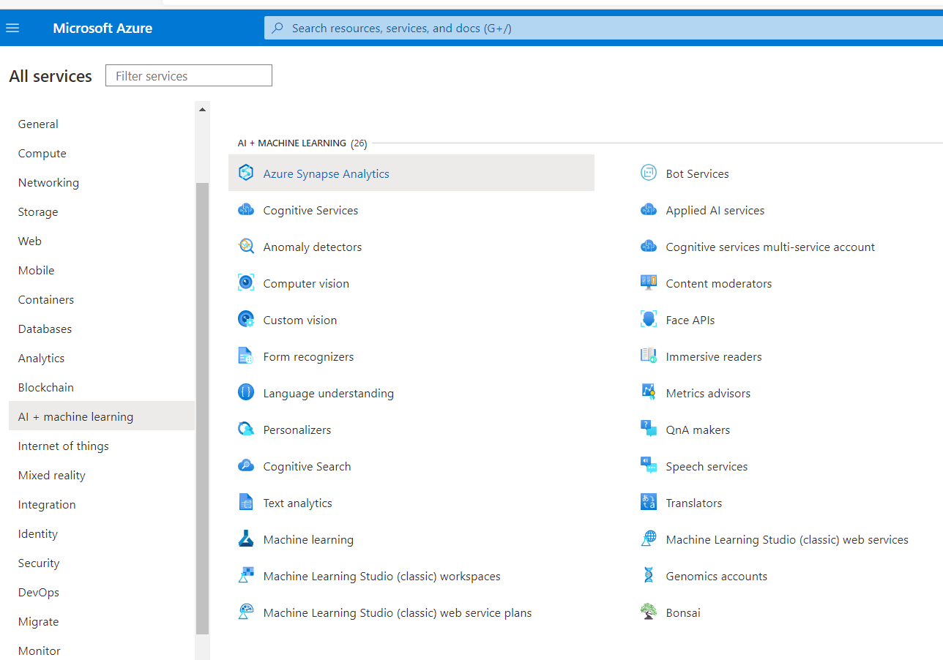
AI and Machine Learning Services (26)

Slide 6
Azure ML is designed to help data scientists and machine learning engineers leverage their existing data processing and model development skills & frameworks.
Productivity enhancement for those who already know what they are doing.

Slide 7
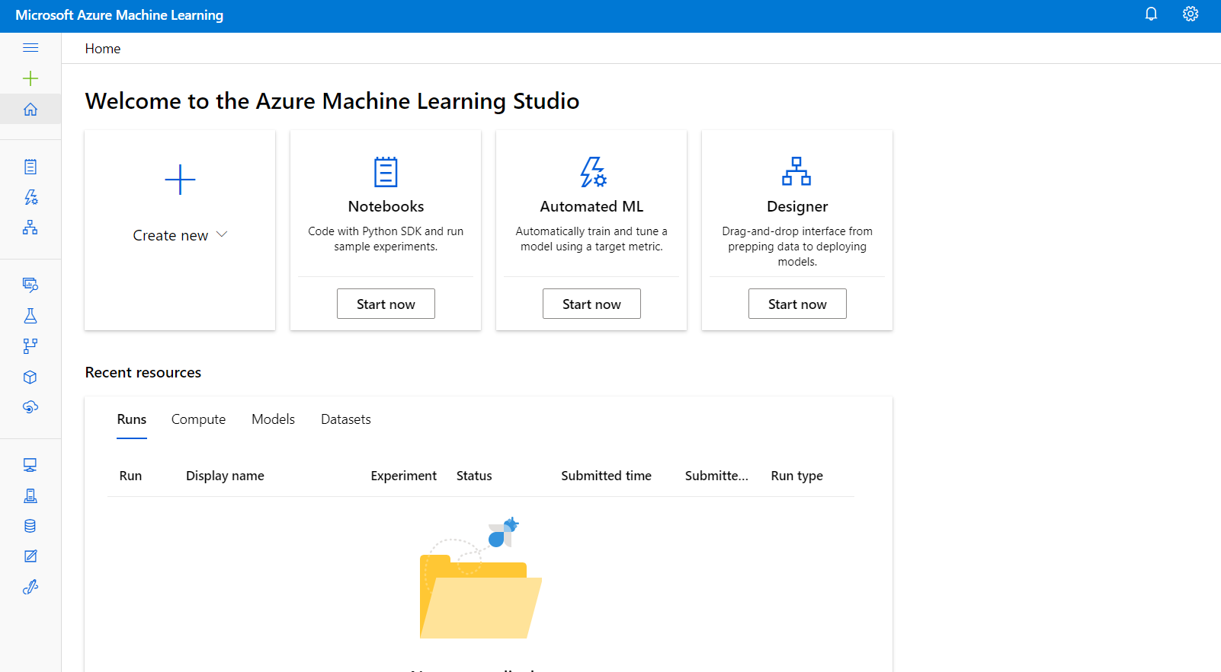
Solutions are Developed in Azure ML Studio - A Web Based IDE

Slide 8
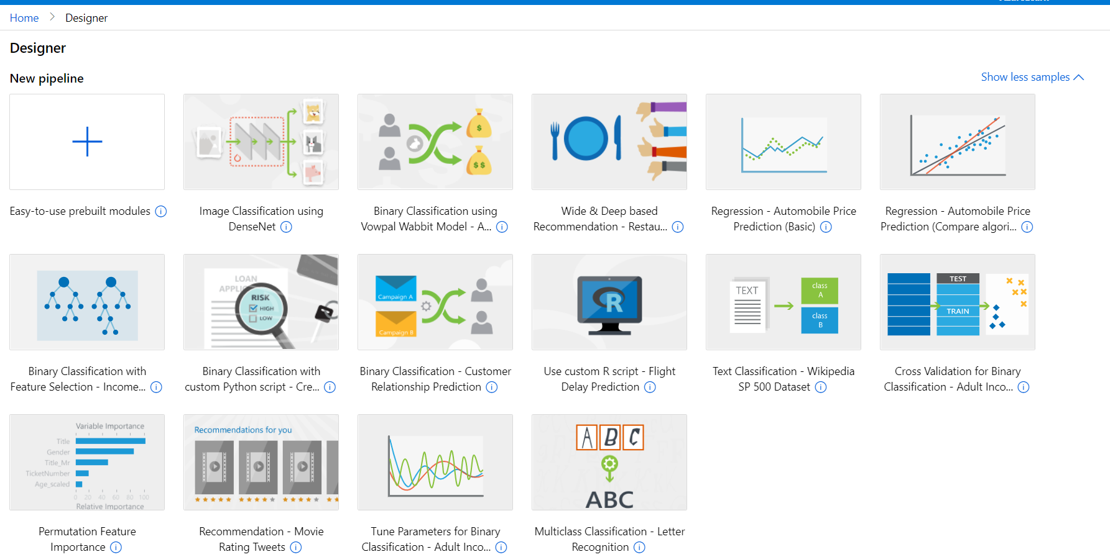
Several Prebuilt Full Examples in Designer

Slide 9
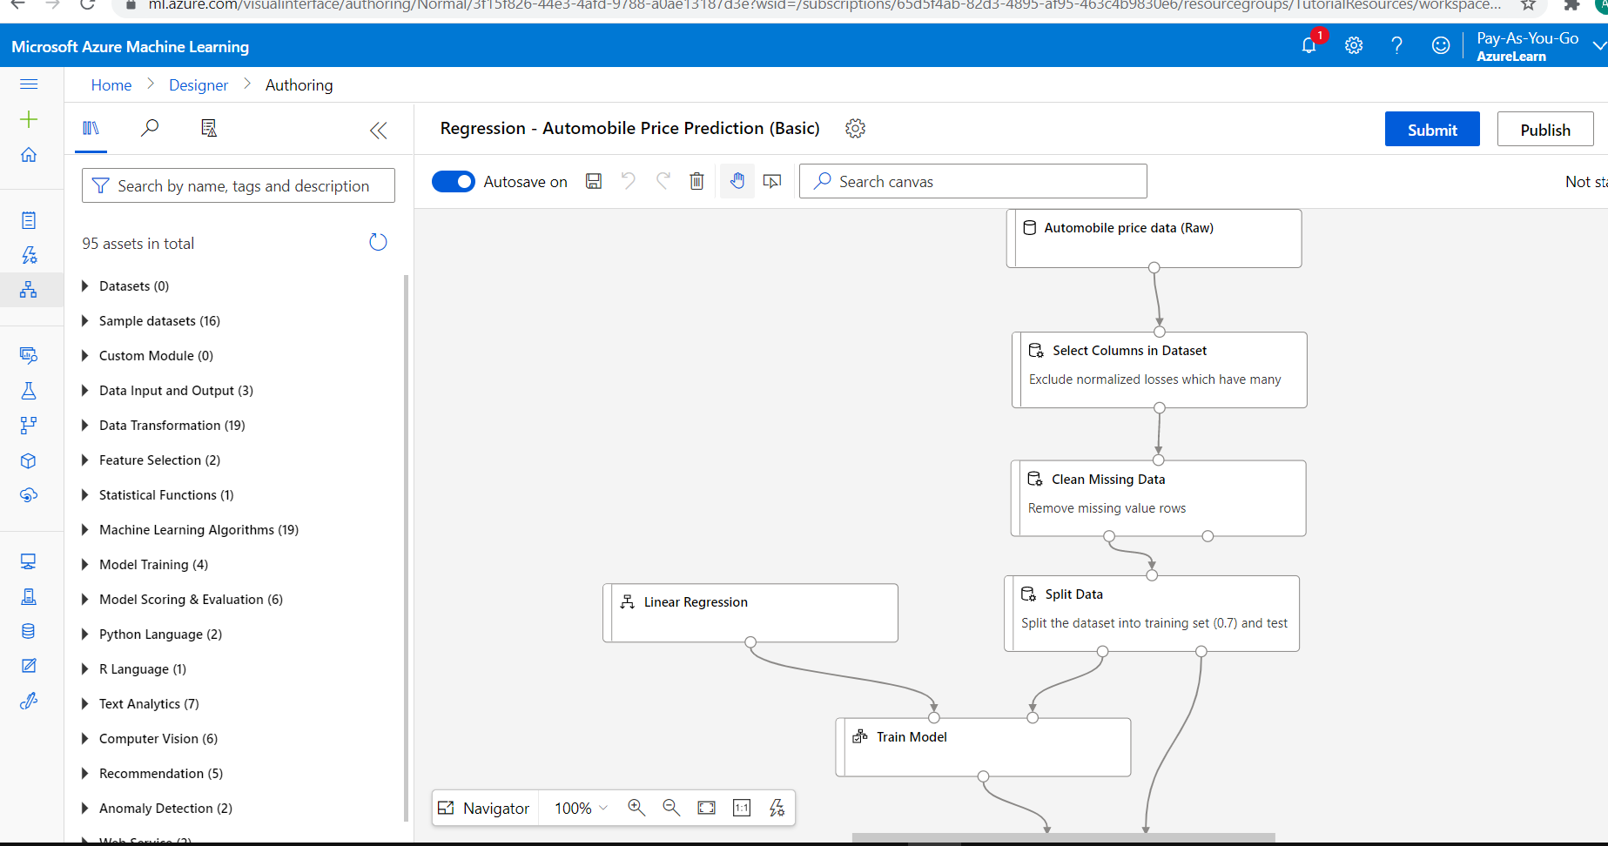
Example: Regression with Automobile Data
Drag and Drop Modules
Connect them
Configure them
Add R or Python code as
needed

Slide 10
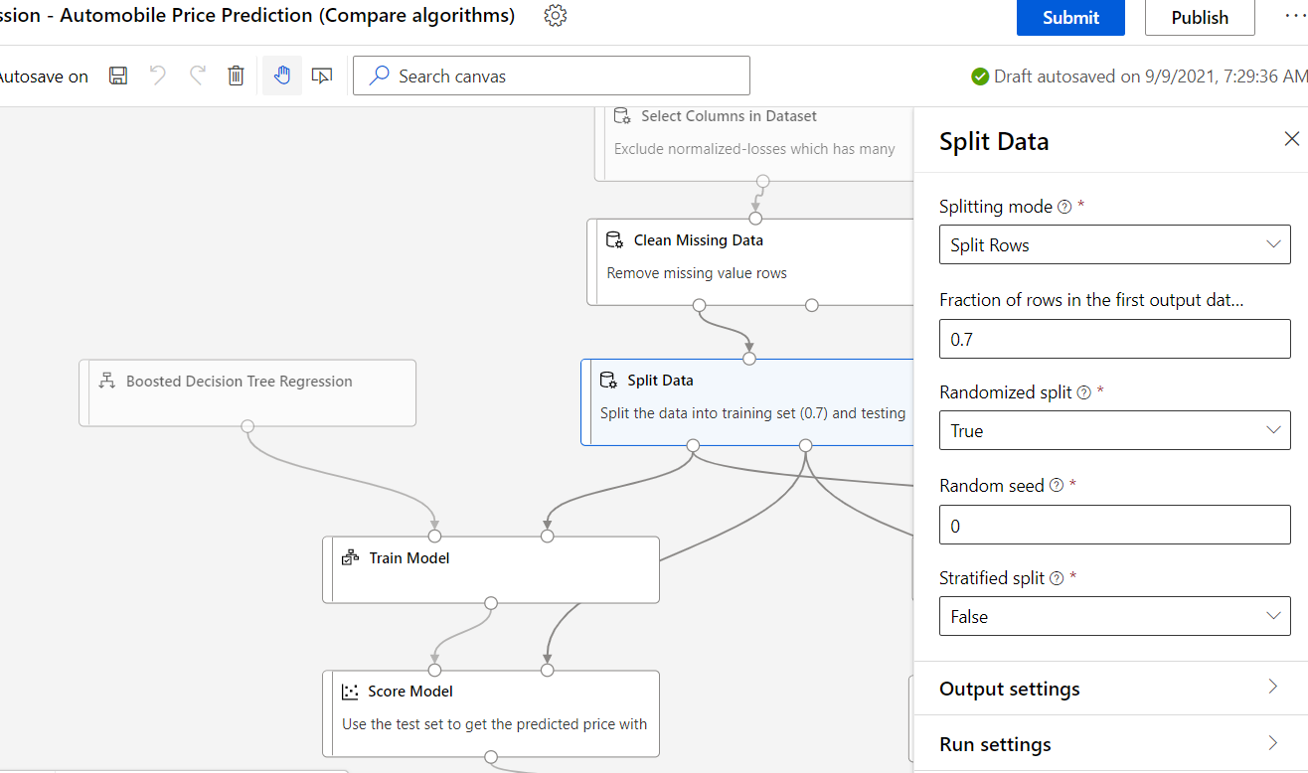
Example: Split Data Module (train and test)

Slide 11
Solutions are Deployed as Web Services
Call like a function from all sorts of other systems
Prebuilt Docker images*
Monitor with “Application Insights”
Deploy encrypted inferencing service
Profile the service to determine resource utilization
*Docker is a set of platform as a service products that use OS-level virtualization
to deliver software in packages called containers. Containers are isolated from
one another and bundle their own software, libraries and configuration files.

Slide 12
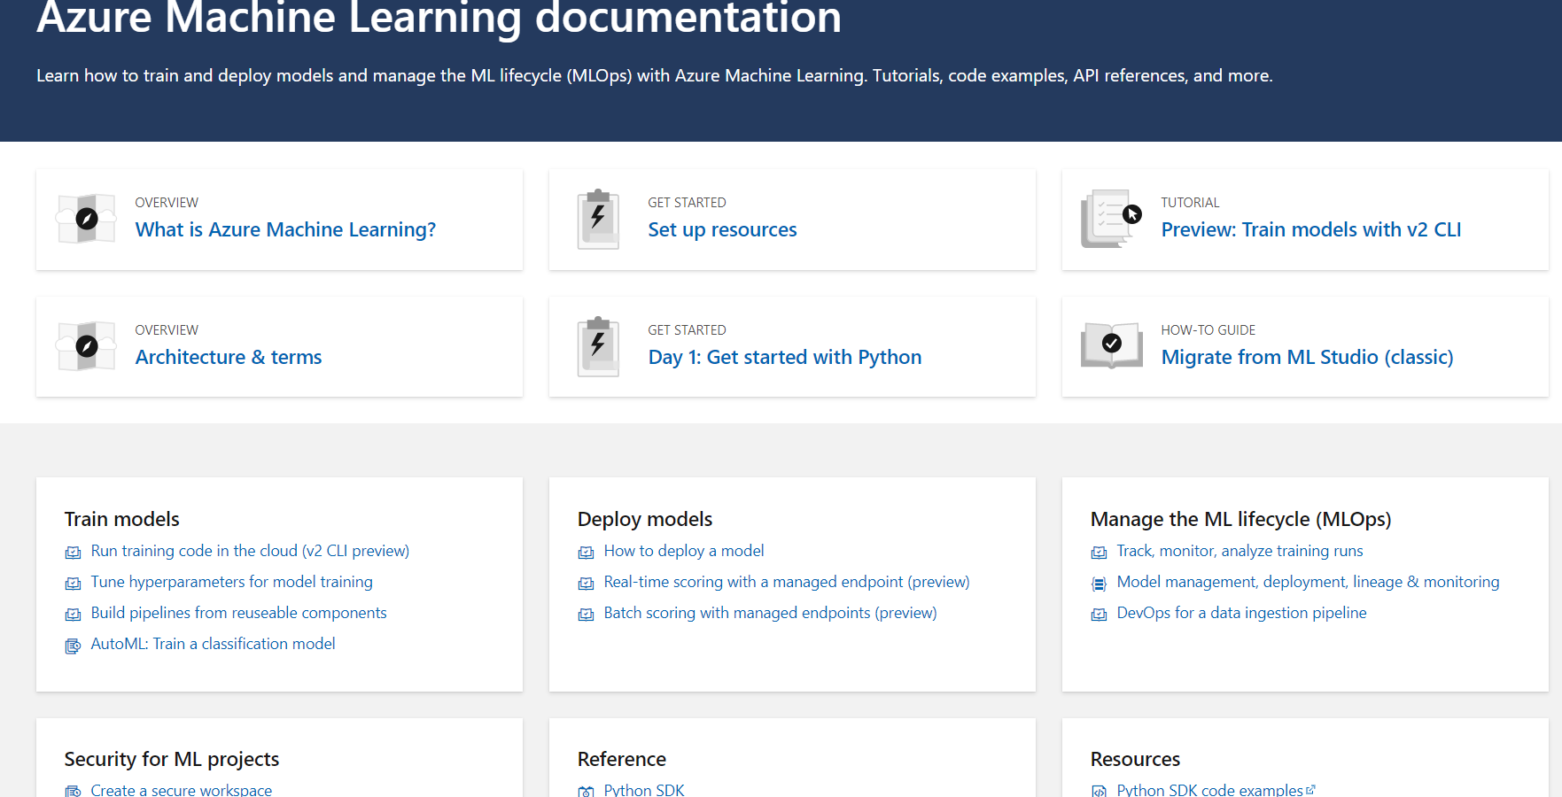
Get Started Here: https://docs.microsoft.com/en-us/azure/machine-learning/

Slide 13
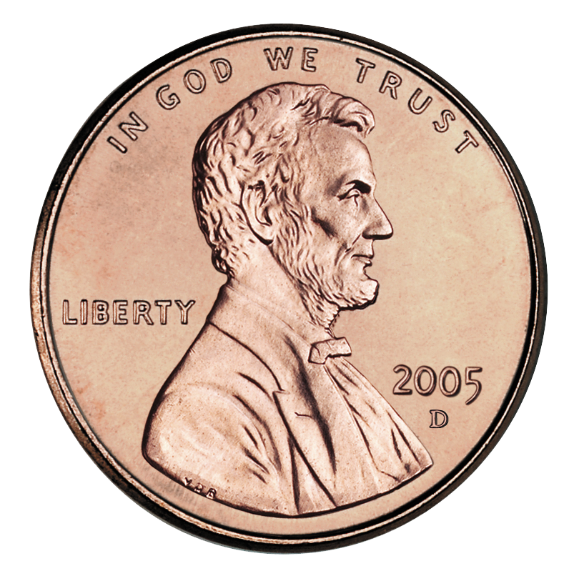
Just my opinion, my “two cents”

Slide 14


Learn How to Use These First

Slide 15
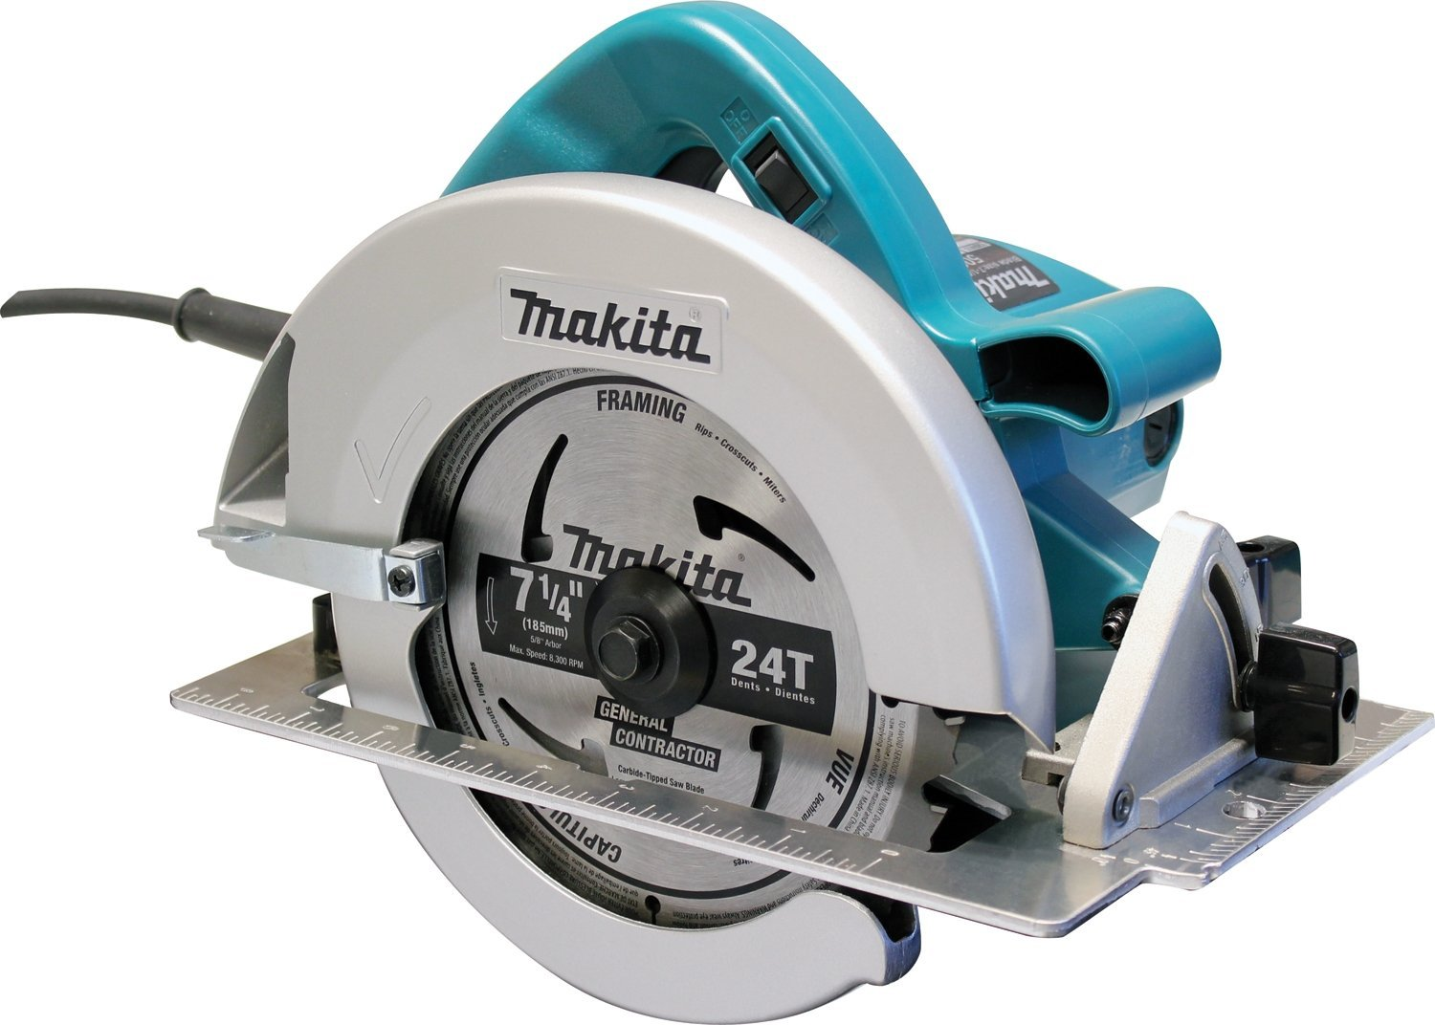

Then Learn How to Use These

