Slide 1


Aneesh antony – Self Introductory
Using HTML, CSS and JavaScript

Slide 2
Navigation Bar
Options:
Logo
List Menu
Home
About
Skills
Achievements
Contact

Slide 3

Logo
“Resume”
A self-referential link inside <div> tag.

Slide 4
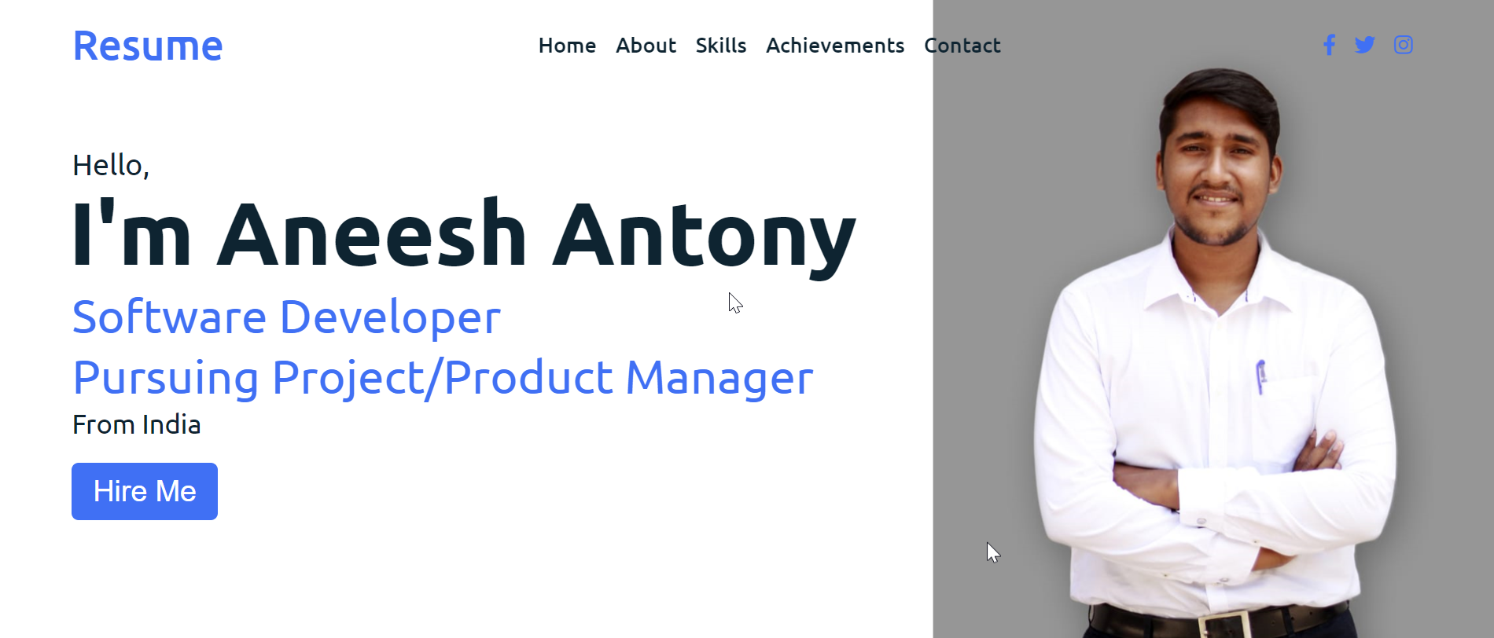
home
Menu-Bar navigation link.
On-click shows the Title name and sub-title with a dashing photo as background

Slide 5
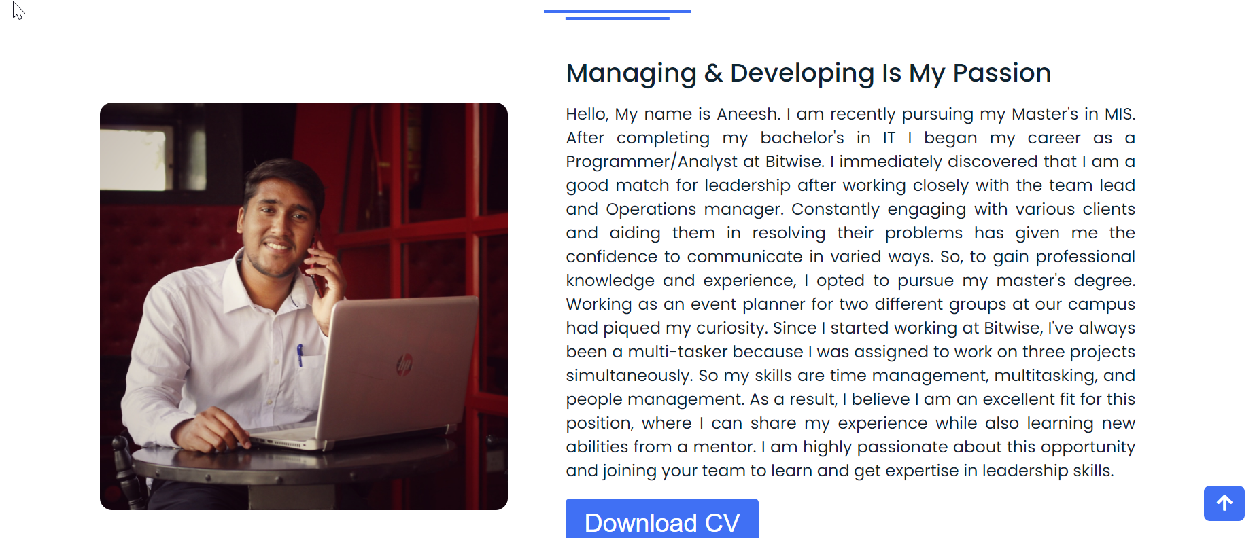
about
About me… explains my strong programming language and the various tools I previously worked on.
The page is divided into two columns. On the left is a self-photo and on the right side is small work experience with a ‘Download CV’ button [which will download my CV on the system]

Slide 6
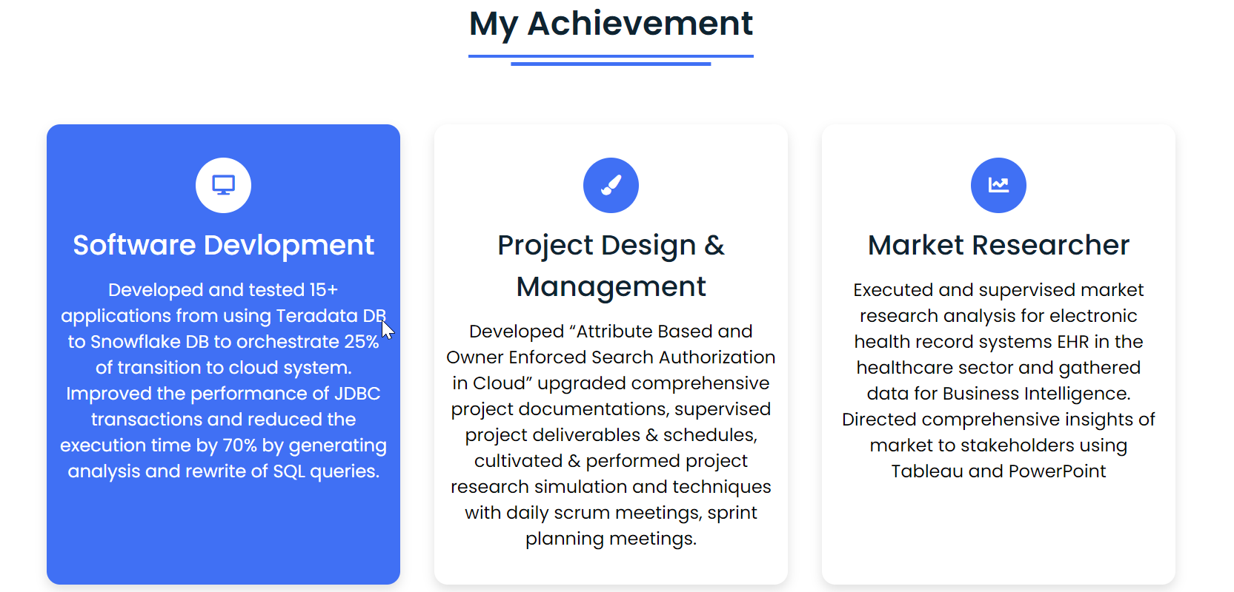
Achievements
This section explains my grip over various achievement along with a few references from work and academic experience.

Slide 7
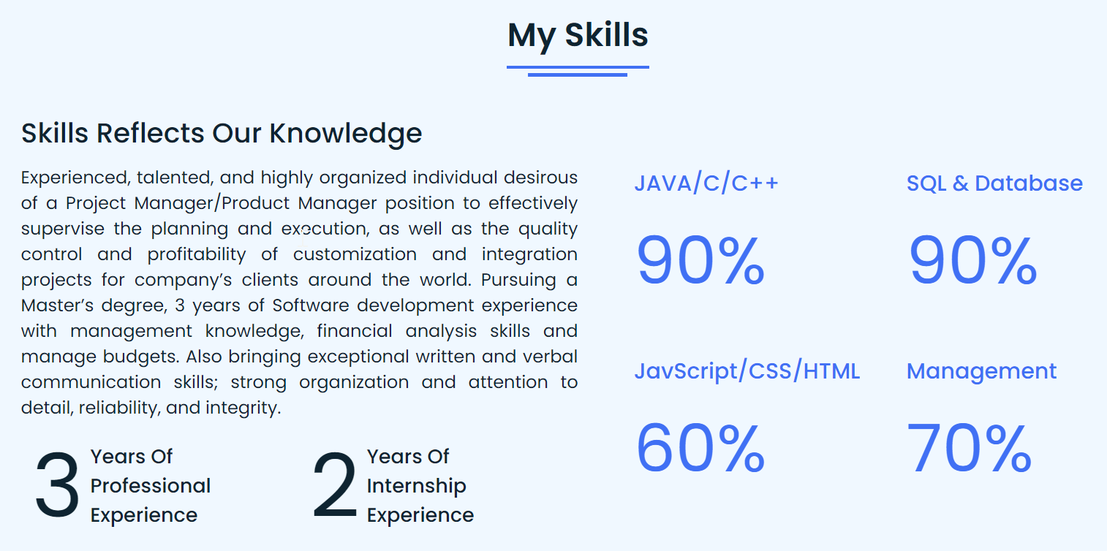
Skills
This section explains my grip over various programming languages along with a few references from work and academic experience.
On the right side – there’s a nice bar chart that gives an idea about my proficiency in different programming languages.

Slide 8
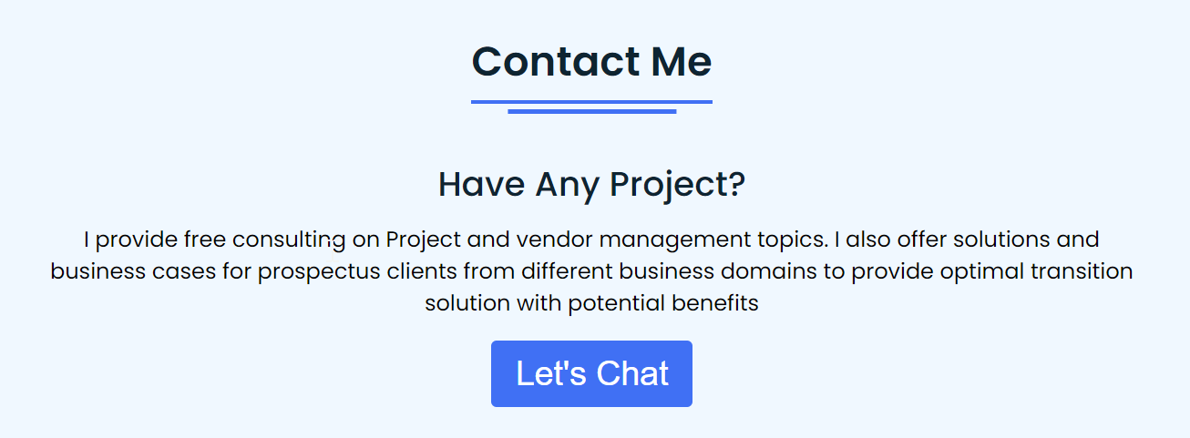
Contact
Closing the home page with a get-in touch button: directly sending an email.

