Slide 1
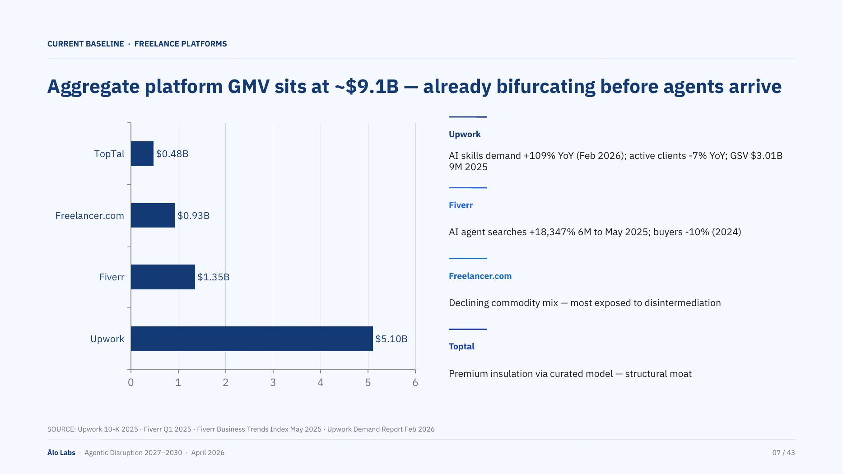
MINOR
Title is ~95 characters on a single line. Risks wrapping or truncation at smaller display sizes.
POLISH
MAJOR
"TopTal" in the bar chart Y-axis vs "Toptal" in the annotation panel — inconsistent capitalisation on the same slide.
Annotation panel lists Upwork first (top), but the bar chart shows Upwork last (bottom). Reversed ordering forces cognitive re-mapping.
MINOR
No X-axis title label. The "$B" unit is implied by bar labels but absent from the axis itself.
Agentic Disruption · Slide 7 / 43

Slide 2
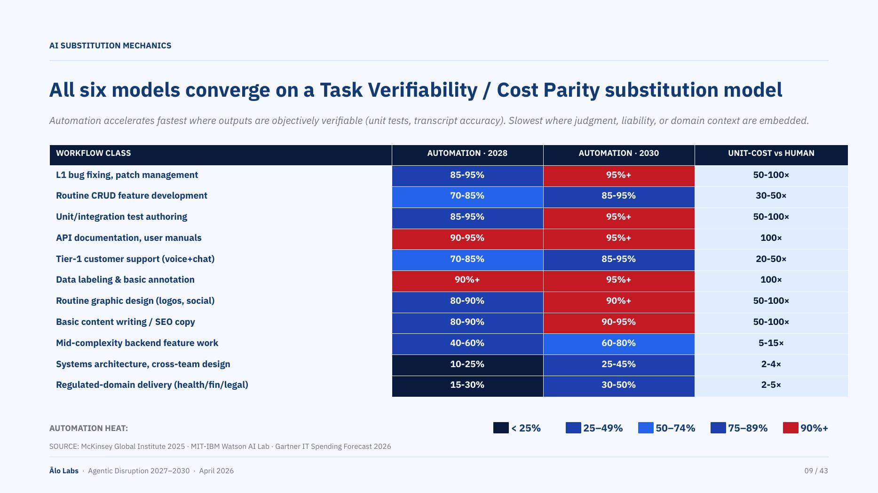
MINOR
Italic subtitle is ~11 pt. Likely illegible at a standard 10–15 ft projection distance.
POLISH
MINOR
Table row height ~22 px for 11 rows. Increasing to ~26 px would improve scan legibility without layout changes.
Source citation sits only ~6 pt below the legend bar. At projection distance it reads as part of the legend.
MINOR
Dark (<25%) cells in AUTOMATION·2028 column blend with the adjacent navy row-label background — column boundary is visually ambiguous.
Agentic Disruption · Slide 9 / 43

Slide 3
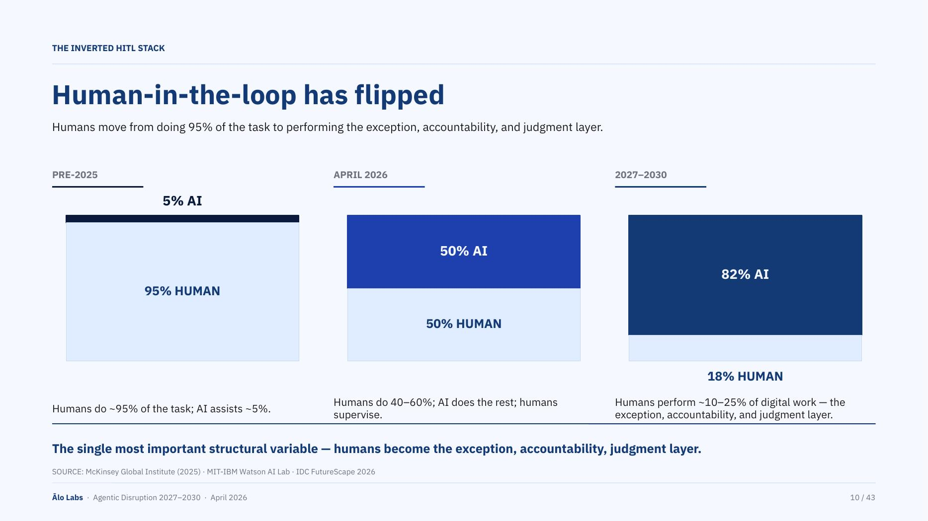
MAJOR
MINOR
PRE-2025 "5% AI" bar is ~4 px thin — its label floats above the bar rather than sitting inside it, breaking the stacked-bar metaphor.
"18% HUMAN" (2027–2030) is orphaned text floating below the bar area rather than inside the thin human segment.
MINOR
POLISH
No Y-axis (0–100%) is shown. Precise split values require mental calculation from the in-bar labels.
Descriptive text below each era column is ~12 pt. Consider 13 pt for comfortable projection legibility.
Agentic Disruption · Slide 10 / 43

