Slide 1
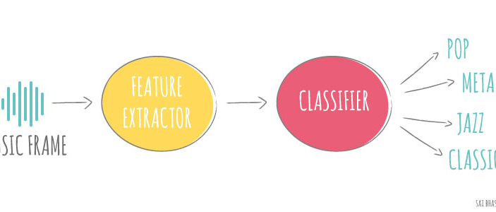

Music Classification
Chilton Nguyen

Slide 2
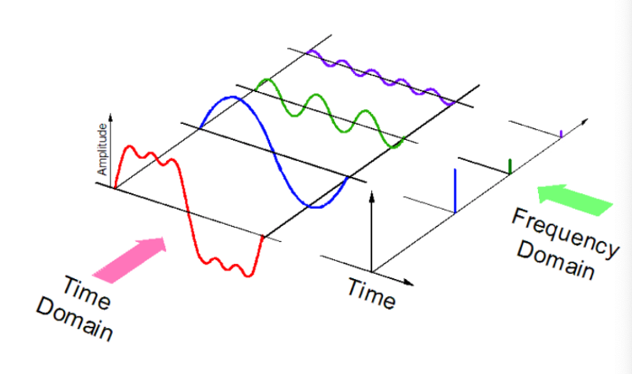
What feature extraction?
Audio is expressed as a function of Amplitude and Time.
Mel-Frequency Cepstral Coefficients (MFCC) calculation is the best choice, extracted from the cepstral domain.
Notes:
So, this is popular feature that you would see being used in any machine learning experiment involving audio files.
need to compute logarithm of the mel filter bank energies after FFT and only then apply DCT. The number of energies of filter banks should be about 20 or 40, after DCT you should get 20 or 40 numbers and take first 13.
decorrelate energy different in mel bands
Spectral Centroid
Spectral Rolloff
chroma
rmse
rolloff
zcr
harmony
perceptr
tempo
MFCC (20) — Mel-Frequency Cepstral Coefficients
https://viblo.asia/p/feature-extraction-mfcc-cho-xu-ly-tieng-noi-4dbZN2xmZYM
https://towardsdatascience.com/cnns-for-audio-classification-6244954665ab
https://stackoverflow.com/questions/13810873/mfcc-13-coefficients
https://dothanhblog.wordpress.com/2020/08/26/mel-frequency-cepstral-coefficient-mfcc-trong-asr-automatic-speech-recognition/
https://itzone.com.vn/en/article/feature-extraction-mfcc-for-speech-processing/
https://towardsdatascience.com/music-genre-classification-with-python-c714d032f0d8
http://practicalcryptography.com/miscellaneous/machine-learning/guide-mel-frequency-cepstral-coefficients-mfccs/

Slide 3
Working GTZAN Dataset
10 genres, each 100 audio files (.wav) of 30 seconds.
=> 1000 training samples
Extract the first 13 coefficients of MFCC as they represent the envelope of spectra.
Utilize library "librosa"
Output: a matrix of 13 * n dimensional.
Where n depends on the total duration of the audio.
Notes:
So assuming you used the default sample rate (sr=22050), the output of your mfcc function makes sense:
output length = (seconds) * (sample rate) / (hop_length)
(X) * (22050) / (512) = 129 samples
public dataset for evaluation in machine listening research for music genre recognition (MGR).

Slide 4

Increase Data
30s audio is split into 10 samples of 3 seconds.
1000 audios become 10,000 samples of 3 seconds.
Increase dataset sample size.

Slide 5
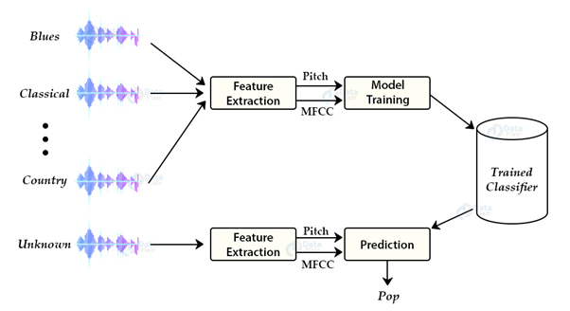
Working with Model
Notes:
CNN layers takes input primarily in 3D shape, so we need to prepare the dataset in the form and for that, I have used np.newaxis function which adds a column/layer in the data
https://librosa.org/doc/main/generated/librosa.stft.html#librosa.stft
https://www.researchgate.net/figure/Short-time-Fourier-transform-STFT-overview_fig1_346243843
https://stackoverflow.com/questions/37963042/python-librosa-what-is-the-default-frame-size-used-to-compute-the-mfcc-feature
Convolution network
Spectrogram/MFCC= image
Long Short Term Memory
Time, frequency = x ,y
Amplitude = pixel value
130 times window * 13 coeficient *1 depth (1 channel)
Batch normalization is a technique for training very deep neural networks that standardizes the inputs to a layer for each mini-batch

Slide 6
Future works
Suggest a similar songs based on my own database
Generation a new song like input.

Slide 7
Questions and Answers?

Slide 8

Thank you all, instructors, TAs and my classmates for making cool class

