Slide 1
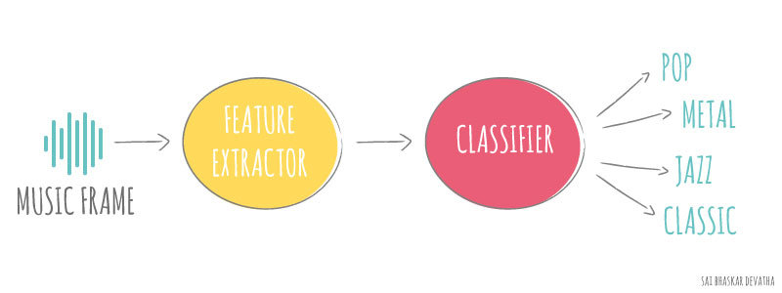

Music Classification
Chilton Nguyen

Slide 2
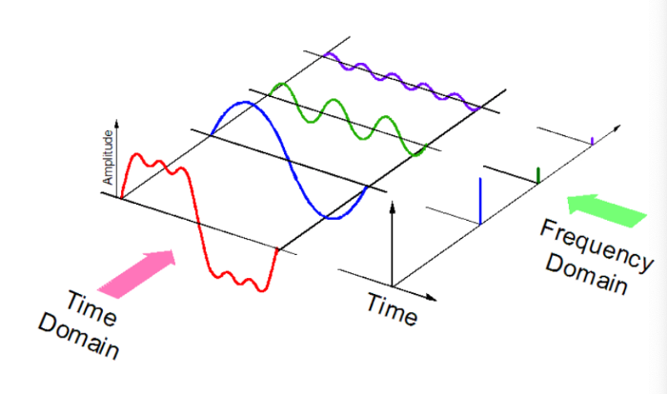
MFCC features?
Sound is represented in the form of an audio signal having parameters such as frequency, bandwidth, etc. A typical audio signal can be expressed as a function of Amplitude and Time.
MFCC calculation is the best results obtained were from the cepstral domain.
Notes:
So, this is popular feature that you would see being used in any machine learning experiment involving audio files.
need to compute logarithm of the mel filter bank energies after FFT and only then apply DCT. The number of energies of filter banks should be about 20 or 40, after DCT you should get 20 or 40 numbers and take first 13.
decorrelate energy different in mel bands
Spectral Centroid
Spectral Rolloff
chroma
rmse
rolloff
zcr
harmony
perceptr
tempo
MFCC (20) — Mel-Frequency Cepstral Coefficients
https://viblo.asia/p/feature-extraction-mfcc-cho-xu-ly-tieng-noi-4dbZN2xmZYM
https://towardsdatascience.com/cnns-for-audio-classification-6244954665ab
https://stackoverflow.com/questions/13810873/mfcc-13-coefficients
https://dothanhblog.wordpress.com/2020/08/26/mel-frequency-cepstral-coefficient-mfcc-trong-asr-automatic-speech-recognition/
https://itzone.com.vn/en/article/feature-extraction-mfcc-for-speech-processing/
https://towardsdatascience.com/music-genre-classification-with-python-c714d032f0d8
http://practicalcryptography.com/miscellaneous/machine-learning/guide-mel-frequency-cepstral-coefficients-mfccs/

Slide 3
Working GTZAN Dataset
Each genre comprises 100 audio files (.wav) of 30 seconds each that means I have 1000 training examples and if I keep 20% of them for validation then just 800 training examples. I chose to extract MFCC from the audio files as the feature.
For MFCC feature, the first 13 coefficients of MFCC are taken as features as they represent the envelope of spectra.
librosa.feature.mfcc function of “librosa”.
The output will be a matrix of 13 * n dimensional vector. Where n depends on the total duration of the audio: 13 (100*sec).
Notes:
So assuming you used the default sample rate (sr=22050), the output of your mfcc function makes sense:
output length = (seconds) * (sample rate) / (hop_length)
(X) * (22050) / (512) = 129 samples
public dataset for evaluation in machine listening research for music genre recognition (MGR).

Slide 4
Increase Data
DURATION = 30 Which the one file, split into 10 samples and collected feature for 3 second.
This means that one samples nearly 3 seconds. Now my training examples have become tenfold etc... each genre has 1000 training examples and total training examples are 10,000.
Increased my dataset, and this will be helpful for a deep learning model because it always requires m
Increase based on dataset not based on features.

Slide 5
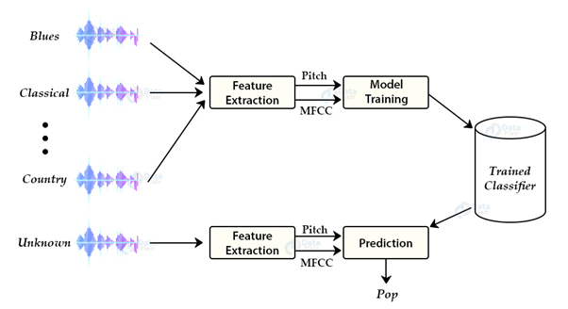
Working with Model
Notes:
CNN layers takes input primarily in 3D shape, so we need to prepare the dataset in the form and for that, I have used np.newaxis function which adds a column/layer in the data
https://librosa.org/doc/main/generated/librosa.stft.html#librosa.stft
https://www.researchgate.net/figure/Short-time-Fourier-transform-STFT-overview_fig1_346243843
https://stackoverflow.com/questions/37963042/python-librosa-what-is-the-default-frame-size-used-to-compute-the-mfcc-feature
Convolution network
Spectrogram/MFCC= image
Long Short Term Memory
Time, frequency = x ,y
Amplitude = pixel value
130 times window * 13 coeficient *1 depth (1 channel)
Batch normalization is a technique for training very deep neural networks that standardizes the inputs to a layer for each mini-batch

Slide 6
Future works
Suggest Song with feature vector (build a data storage of songs)
Generation a song with related input songs.

Slide 7
Questions and Answers?

Slide 8

Thank you all, instructors, TAs and my classmates for making cool class

Slide 9
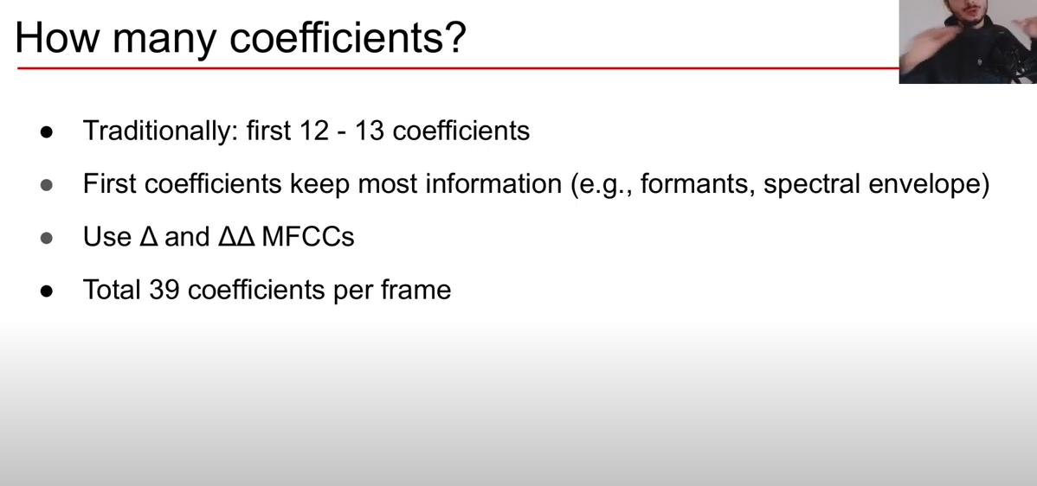
Notes:
https://www.youtube.com/watch?v=4_SH2nfbQZ8

Slide 10
MFCC feature
MFCC: cuts the audio signal string into equally short (25ms) and overlaps (10ms). Each of these audio clips is transformed, calculated to obtain 39 features.
Each list of 39 features has high independence, low noise, small enough to ensure computation, enough information to ensure quality for recognition algorithms.
Notes:
mel-frequency-cepstral-coefficient

