Slide 1
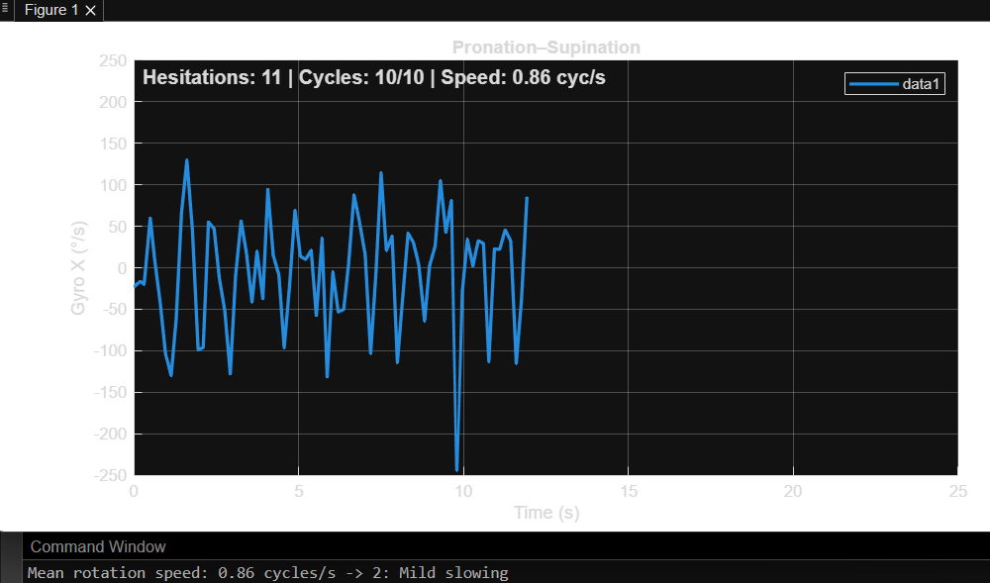
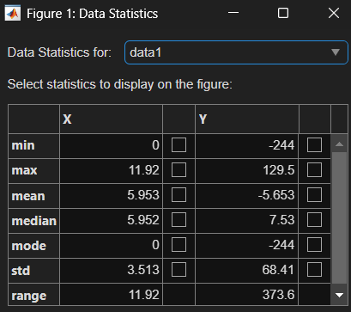
Pronation/Supination Test (Inertial Movement Unit)

Slide 2
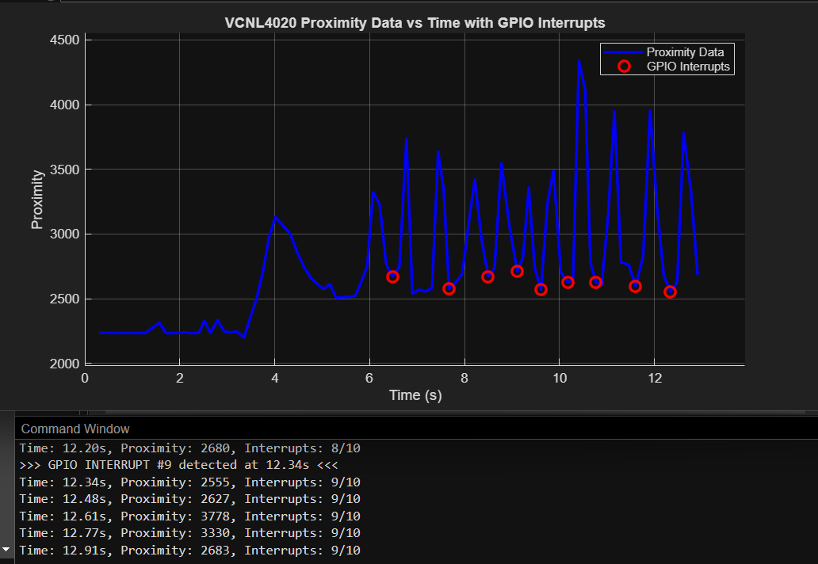
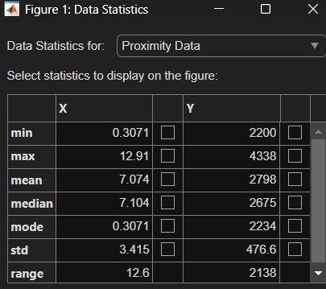
Finger Tap and Hand Movement Test (Capacitive Touch and Proximity Sensor)

