Slide 1
Predicting Accident Severity

Slide 2
Background/Problem
35,000 people die from automobile accidents each year (CDC)
75 billion dollars in medical/productivity costs each year (CDC)
Approximately 22 percent of all accidents are weather-related (Federal Highway Administration)
Of interest to: emergency services, the Federal Highway Administration, driving related companies such as Uber, Lyft, DoorDash, etc.
MAIN OBJECTIVE: address this problem by predicting what factors determine the severity of accidents to provide avenues for possible solutions.

Slide 3
Data - Description
Seattle, Washington
collected between the years of 2004-2020
contains 37 attributes
total of 194673 unique reports
Accident Severity is encoded as 1 = Property Damage only, 2 = Injury Collision

Slide 4
Data – Feature Selection
*predictor variables (i.e weather conditions, driver’s state of mind)
resultant collision descriptors (type of collision, number of people/vehicles involved)
INATTENTIONIND (collision due to inattention)
UNDERINFL (collision due to influence of drugs/alcohol)
WEATHER
ROADCOND (road condition)
LIGHTCOND (light condition)
PEDROWNOTGRNT (If pedestrian was given right of way)
SPEEDING
INATTENTIONIND, PEDROWNOTGRNT, and SPEDING all had very few entries (29805, 4667, and 9333 respectively).

Slide 5
Data – Final Features
UNDERINFL
WEATHER
ROADCOND
LIGHTCOND

Slide 6
Data - Cleaning
Encoding:
For UNDERINFL : “N” was replaced with 0, “Y” was replaced with 1.
For WEATHER: 0 = Clear, 1 = mild weather (overcast/cloudy), 2 = severe weather (rain, snow, hail, wind, etc.)
For ROADCOND: 0 = Dry, 1 = Wet/Sandy/Oily, 2 = Icy, snowy, standing water
For LIGHTCOND: 0 = Light, 1 = Medium, 2 = Dark
Any “Unknown” or “Other” values were encoded to NaN values.
Interpolate values to fill the NaN values.

Slide 7
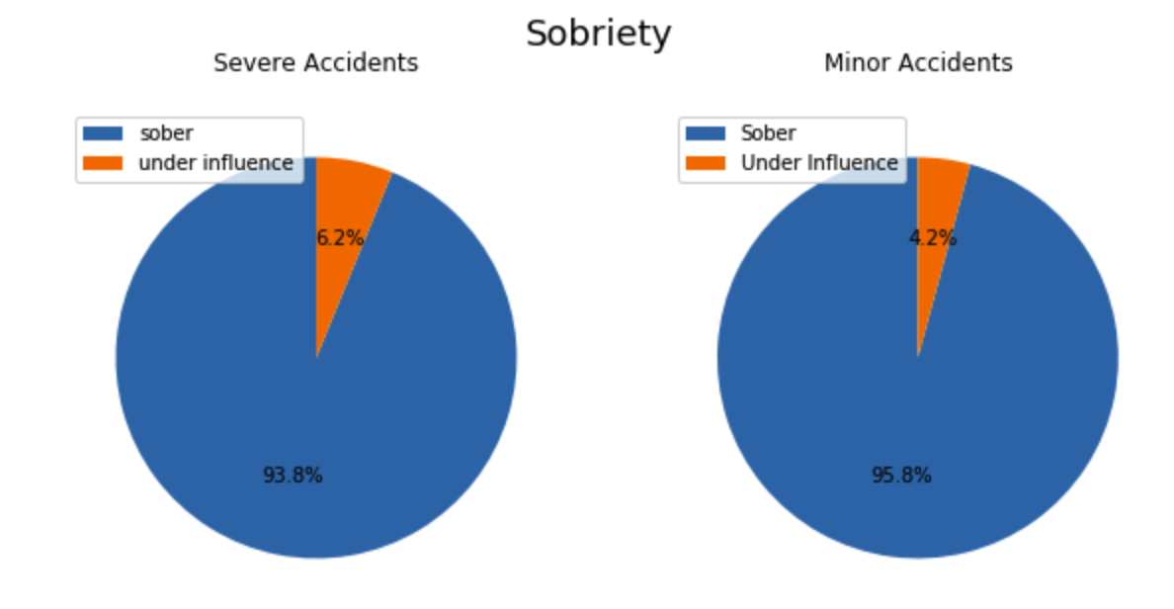
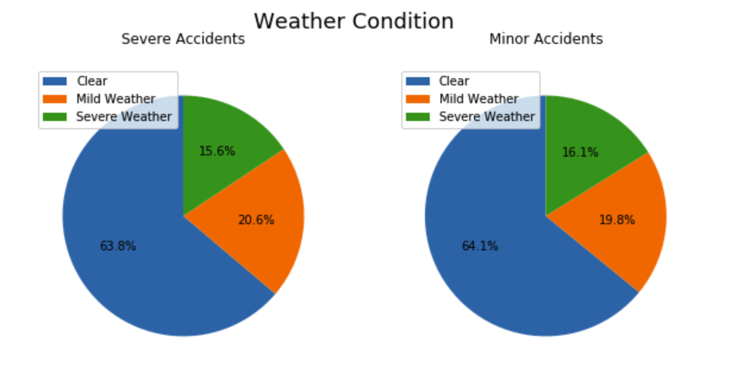
Methodology – Data Exploration
Data split in minor vs. severe accidents

Slide 8
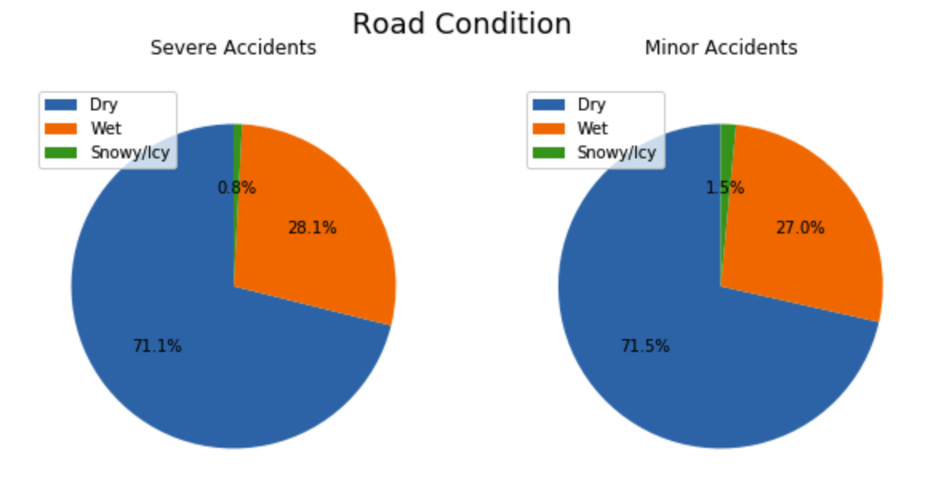
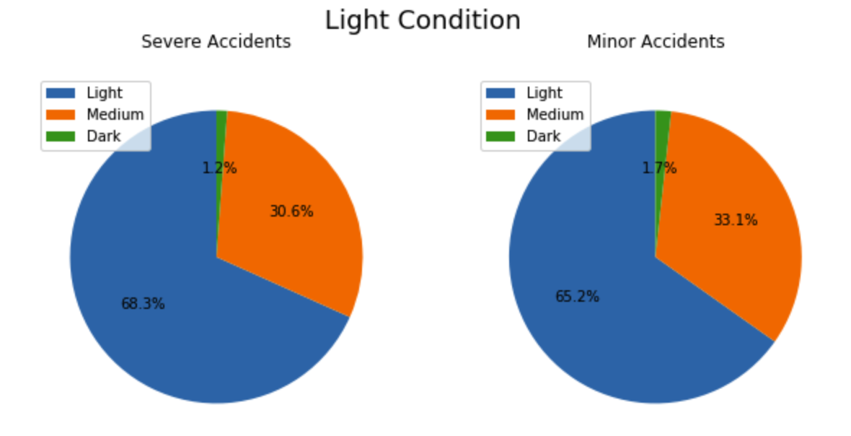
Methodology – Data Exploration
Data split in minor vs. severe accidents

Slide 9
Methodology – Data Exploration
severe accidents contain a higher ratio of drivers under the influence and worse road and weather conditions
Interestingly, severe accidents seem more likely to occur during light conditions.

Slide 10
Methodology – Model Selection
KNN: clusters data into groups by matching a point with the closest neighbor in some multi-dimensional space. It can be used for categorical data
Decision/Classification Tree: go from features/variables as inputs to come to a conclusion/target. It can be used for categorical data.
Logistic Regression: uses logistic function to estimate a binary dependent variable.
** Did not choose SVM since doesn’t work well for large datasets

Slide 11
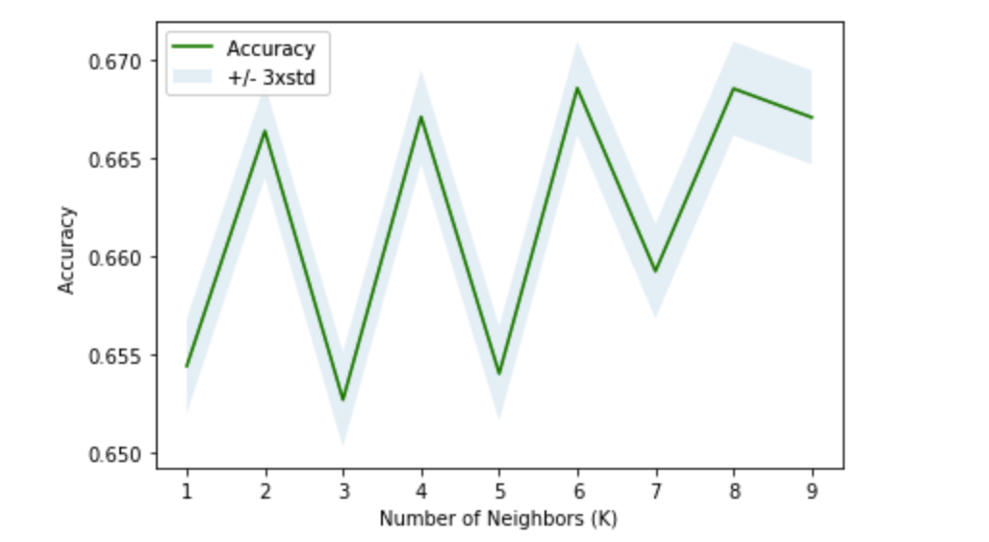
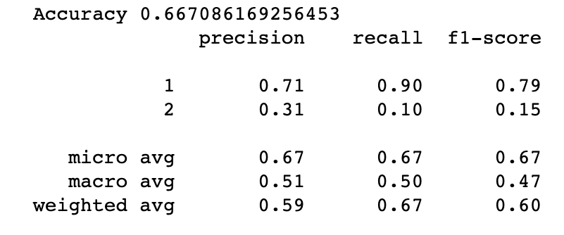
Results - KNN
The data was split into 80% train, 20% test size with a random state value of 4.
Best k value = 6
Accuracy = 0.67

Slide 12
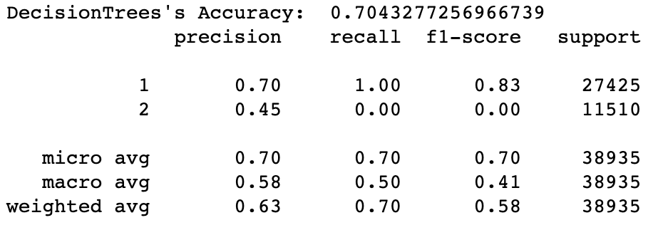
Results – Classification Tree
Accuracy = 0.70

Slide 13
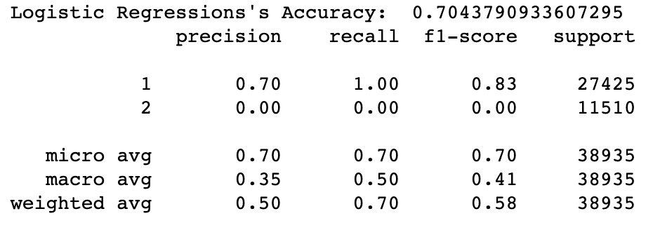
Results – Logistic Regression
Accuracy = 0.70

Slide 14
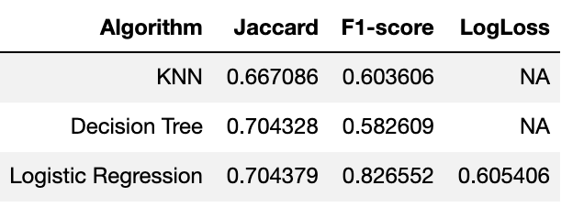
Results – Model Evaluation Summary

Slide 15
Discussion – Jaccard Index
The Jaccard Index is the ratio of correct predicted values to wrongly classified values
A higher jaccard score means a better model (more accurate)
The logistic regression and decision tree model both have the highest jaccard index as compared to KNN.

Slide 16
Discussion – F1-Score
The F1-score is a measure of the balance between the precision and recall of a model.
The higher (closer to 1) value of the F1-score, the better the model.
Using this metric, the logistic regression model is best.

Slide 17
Discussion – Best Model
KNN method is the least accurate of the models
The best model is the logistic regression model, although the decision tree model is close behind.
The models would have performed better if
dataset been more balanced (an equal number of low and high severity accidents).
Complete set of data for the features inattention and speeding, as these likely have a major impact on severity of accidents.

Slide 18
Discussion/Conclusion - Recommendations
Under the influence: I would recommend further delving into the data to see what days of the week and time of the day intoxication accidents occurred. Then during these day/timepoints increase the number of patrol cars out on the roads.
Road and weather conditions: I would recommend developing an app, or potentially an add on to google/apple maps, that takes into consideration the current weather/road conditions to make suggestions/recommendations about when and when not to go out driving (using the logistic regression model that was developed).

