Slide 1
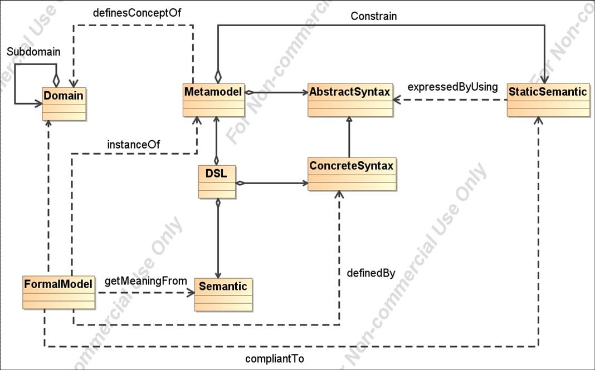
Figure 1: Overview of important concepts associated with the development of DSLs

Slide 2
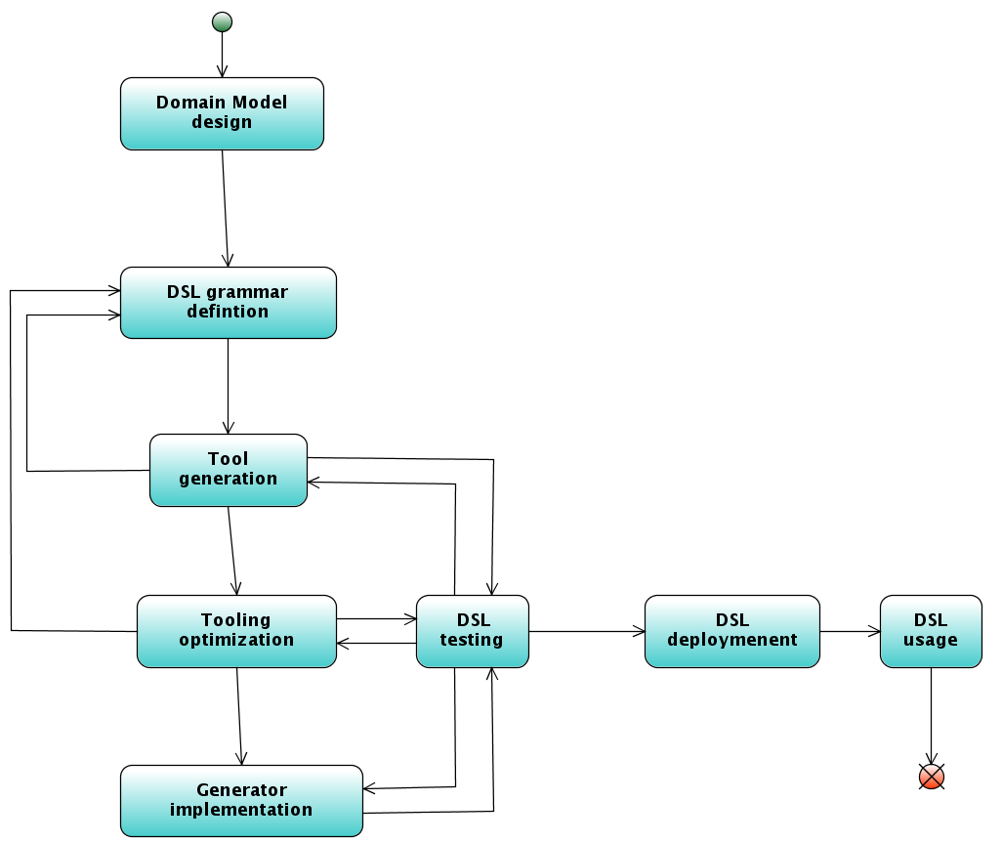
Figure 2: Shows the different steps involved in the development of a DSL with Xtext.

Slide 3
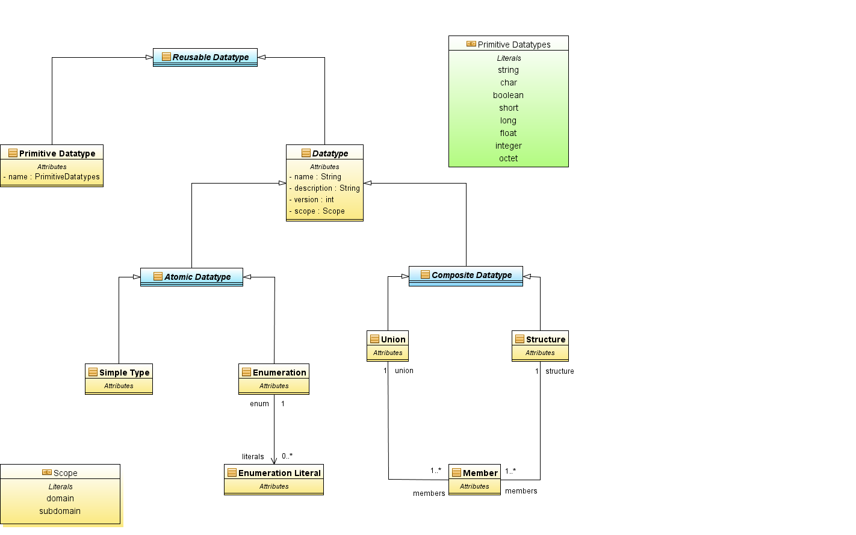
Figure 3: Domain model associated with our DSL

Slide 4
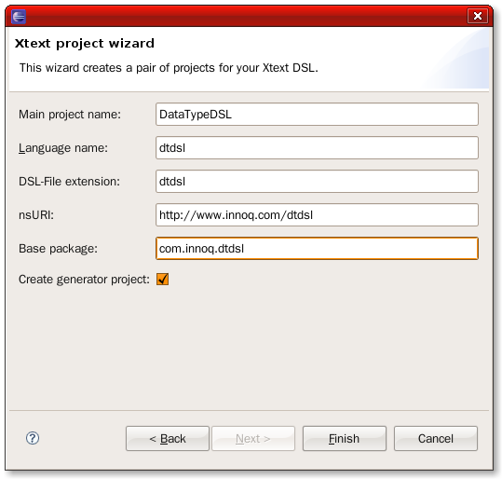
Figure 4: The Xtext project wizard ensures an easy start by setting all the needed stuff.

Slide 5
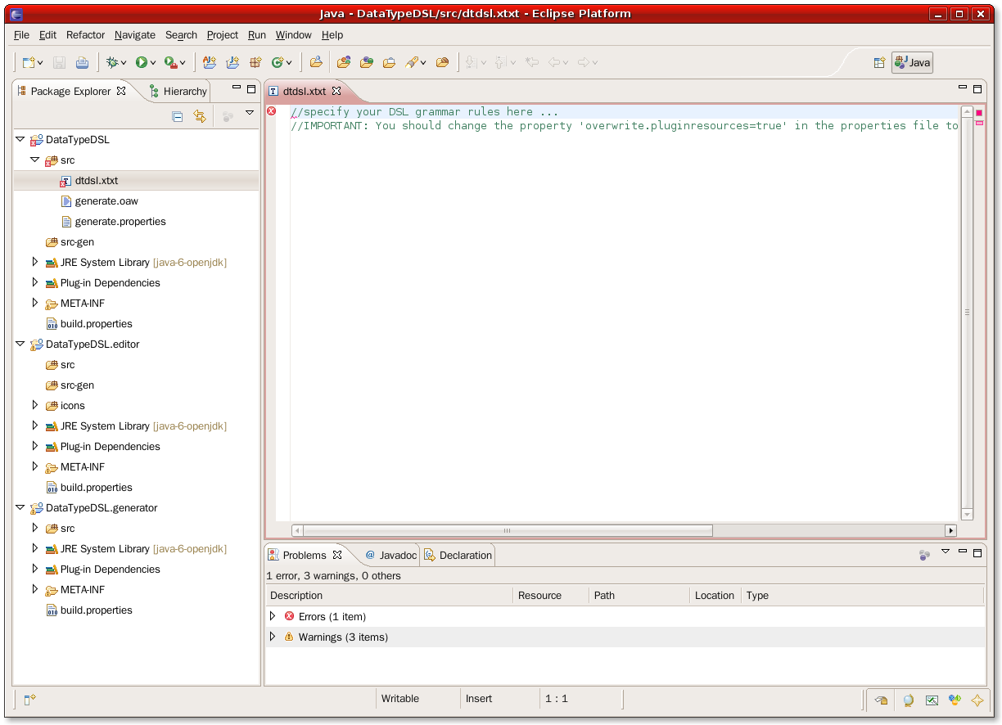
Figure 5: The definition of a textual DSL with Xtext is based on three Eclipse plugin projects: one for the language definition self, one for the language editor and one for the language generator.

Slide 6
Xtext grammar
format
ANTLR grammar config file
mydsl.xtext
mydsl.g
Lexer Rules
Parser Rules
Program written
With the DSL
InputStream
Lexer
TokenStream
Parser
Parser
Tree
ANTLR-parser
Figure 6: from the Xtext grammar generates Xtext an ANTLR grammar config file used by an ANTLR-parser.

Slide 7
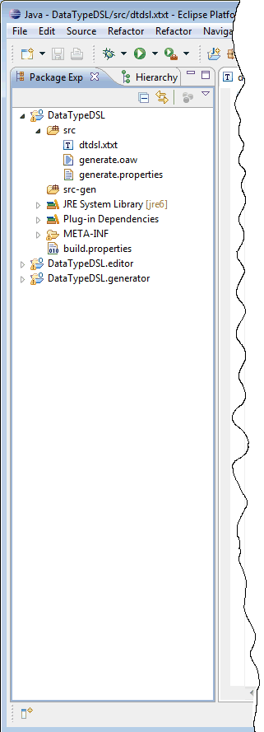
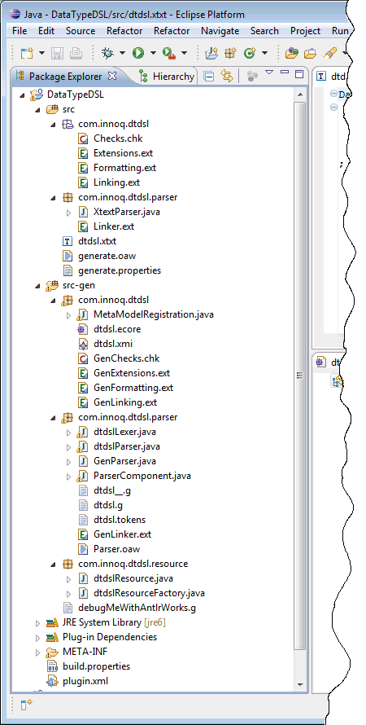
Validation rules (constrains) used by the parser and the editor for the syntax validation.
Definition of general extensions for the domain model. It inherits generated extensions from GenExtensions. You can overwrite or spezialize them here.
Definition of the standard serialization for resources.
For more sophisticated linking semantic. You can add your logic or overwritte the generated com.innoq.dtdsl.GenLinking linking extensions.
Abstract Syntax Tree (AST) of the DSL generated from the grammar.
Generated part of the package com.innoq.dtdsl
Java Lexer generated by ANTLR
Java Parser generated by ANTLR
Generated ANTLR-grammar file
a)
b)

Slide 8
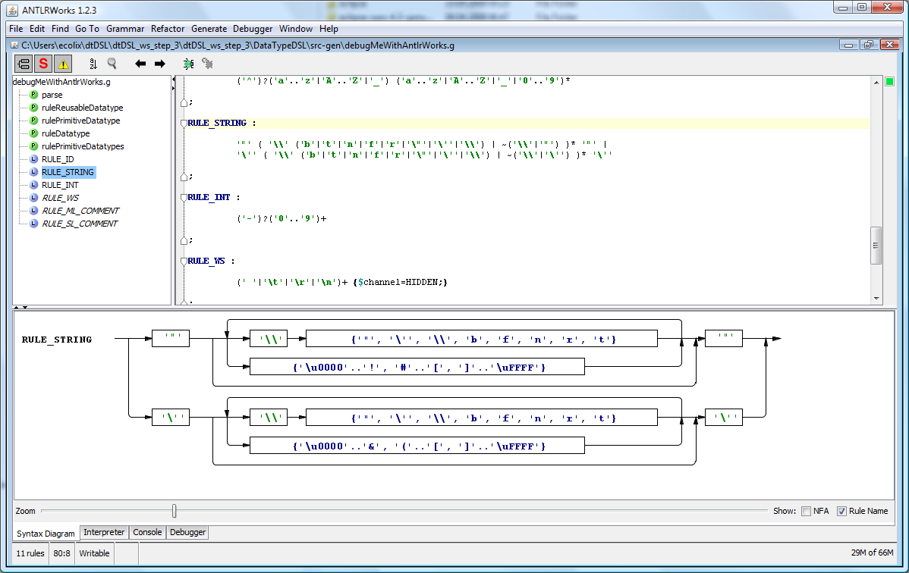

Slide 16

oAW
A short introduction
“Language development has
never been so easy”

Slide 17
Agenda
Important Definitions
Xtext DSL classifications
Xtext overall process
design time : setting the DSL tooling
runtime : programming using the DSL
Xtext grammar
Sources:
“Modellgetriebene Softwareentwicklung” Thomas Stahl, Markus Völter, Sven Efftingen, Arno Haase
“Textual DSLs with oAW Xtext”, Bernd Kolb & Markus Völter
openArchitectureWare User Guide version 4.3

Slide 18

Important Definitions
Notes:
Domäne = Wissensgebiet oder begrenzten Interessen
Domänen können sowohl technisch als auch fachlich sein.
Es gibt in MDSD architekturzentriert Domänen: Viewpoint der Software Architektur
Wir wollen den Inhalt einer Domäne formal beschreiben. Diese formalisierte Beschreibung einer Domäne nennt man Metamodell.
Ein Metamodell umfasst die abstrakt Syntax und die statische Semantik.
Die Metamodellelemente und ihre Beziehungen untereinander bezeichnet man auch als abstrakte Syntax.
Die konkrete Syntax beschreibt wie die tatsächlichen Quelltext bzw. Diagramme aussehen.
Die Modelle werden in einer konkreten Syntax beschrieben, und es gibt einen „Parser“ oder „Instantiator“, der diese konkrete Syntax einliest und entsprechende Instanzen der abstrakten Syntax-Klassen erzeugt. Die weitere Verarbeitung erfolgt dann auf Basis dieses Objektnetztes.
Die statische Semantik einer Sprache legt Bedingungen fest, die ein Modell erfühlen muss, damit er „wohlgeform“ ist. Diese Bedingungen (auch Constraints genannt) werden gegen die abstrakte Syntax definiert, sind also von ihr abhängig. Das entspricht im Prinzip jede Fehlermeldung die ein Compiler ausgibt: „variable müssen deklariert werden“, casting errror, …
Eine Domänespezifische Sprache ist nichts anderes als eine Programmiersprache für eine Domäne. Sie besteht im Kern aus einem Metamodell mit dazugehöriger abstrakt Syntax und Constrains sowie einer konkreten Syntax.
Dazu muss noch einer klar definierte Semantik kommen, dh eine Definition, was welche Sprachelemente bedeuten sollen.
Ein formales Modell ist ein Programm, das in einer DSL geschrieben ist. Formal betont noch einmal, dass ein solches Programm automatisiert in ausführbaren Code überführt werden kann, sein es mit Hilfe eines Interpreters, sei es mit Hilfe von Codegenerierung.

Slide 19
Xtext DSL Classification
Xtext enables the design of
external (versus internal like Ruby)
textual ( versus graphical )‏
DSLs

Slide 20
Xtext overall process‏
Based on an EBNF grammar Xtext generates
ANTLR3‐based parser (ANTLR = ANother Tool for Language Recognition)‏
EMF‐based AST-metamodel
Eclipse editor with
syntax highlighting
code completion
customizable outline
code folding
real‐time constraint checking

Slide 21
Xtext overall process
design-time:
setting of the
DSL tooling
Xtext grammar editor
Lexer Rules
Parser Rules
EBNF-like grammar

Slide 22
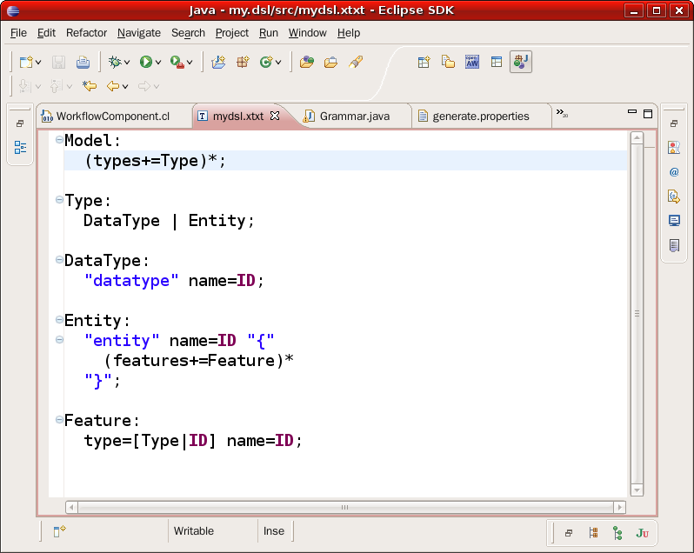
Xtext overall process
design-time:
setting of the
DSL tooling
Xtext grammar editor
Lexer Rules
Parser Rules
EBNF-like grammar
Grammar is defined in an EBNF‐like format in the Xtext editor.
The editor provides code completion and constraint checking for the grammars themselves

Slide 23
Xtext overall process
design-time:
setting of the
DSL tooling
Xtext grammar editor
Lexer Rules
Parser Rules
EBNF-like grammar
Xtext generator
ANTLR
parser

Slide 24
Xtext overall process
design-time:
setting of the
DSL tooling
Xtext grammar editor
Lexer Rules
Parser Rules
EBNF-like grammar
Xtext generator
ANTLR
parser
Xtext grammar
format
ANTLR grammar config file
mydsl.xtext
mydsl.g
Lexer Rules
Parser Rules
Program written
With the DSL
InputStream
Lexer
TokenStream
Parser
Parser
Tree
ANTLR-parser

Slide 25
Xtext overall process
design-time:
setting of the
DSL tooling
Xtext grammar editor
Lexer Rules
Parser Rules
EBNF-like grammar
Xtext generator
DSL
editor
ANTLR
parser

Slide 26
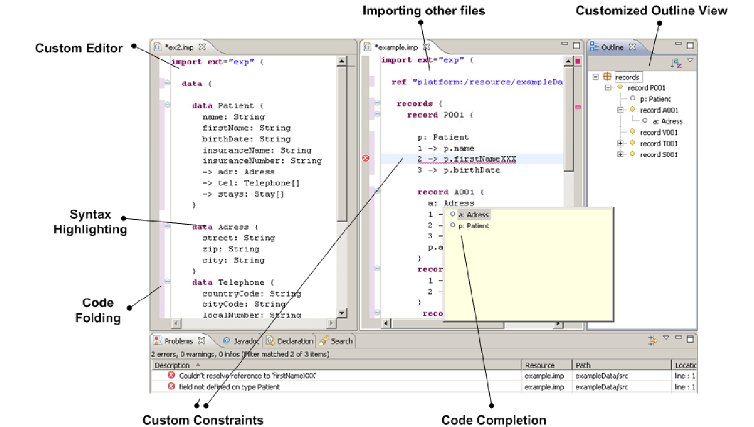
Xtext overall process
design-time:
setting of the
DSL tooling
Xtext grammar editor
Lexer Rules
Parser Rules
EBNF-like grammar
Xtext generator
DSL
editor
ANTLR
parser
Eclipse editor with
syntax highlighting
code completion
customizable outline
code folding
real‐time constraint checking

Slide 27
Xtext overall process
design-time:
setting of the
DSL tooling
Xtext grammar editor
Lexer Rules
Parser Rules
EBNF-like grammar
Xtext generator
DSL
editor
ANTLR
parser
EMF‐based
AST-metamodel

Slide 28
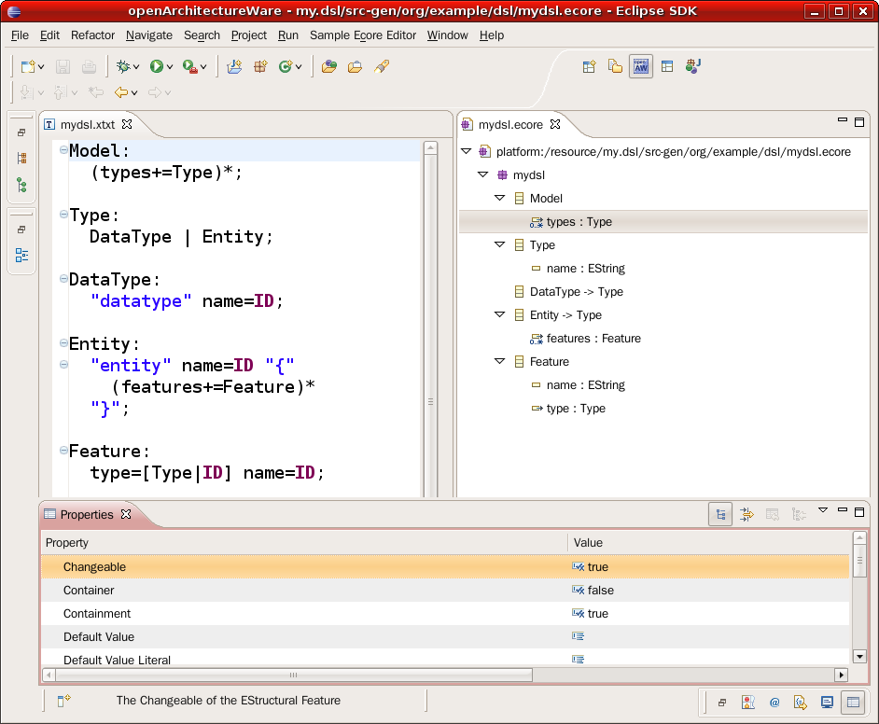
Xtext overall process

Slide 29
Xtext overall process
design-time:
setting of the
DSL tooling
Xtext grammar editor
Lexer Rules
Parser Rules
EBNF-like grammar
Xtext generator
The node types
of the AST
correpsond
to metamodel
entities
DSL
editor
ANTLR
parser
EMF‐based
AST-metamodel
Transformation
no whitespace,
reified nodes,
often binary tree
...
DSL instance
(text file)‏
parser tree
Abstact
Syntax
Tree
(ecore file)‏
runtime:
programing
with the
DSL
The Xtext generator builds an EMF meta model from the grammar.
The generated parser then instantiates the metamodel from a model.
Processing Xtext models is based on this meta model: all existing EMF tooling is suitable for processing.
Any EMF
M2M / M2T
transformations
PSM
Code
artefacts

Slide 30
Xtext overall process (2/3)‏
.xtxt
(Grammar)‏
Language project
Constrains
Manual
optional
.ecore File
(Metamodel)‏
Manual,
required
.properties
(Configuration)‏
generated
Antlr Parser
Editor
Plugin
incl. Defaults for
Navigation,
Outline,
Code completion
Icons
Xtext
Generator
Navigation
Code
Completion
Outline
Editor project

Slide 31
The Xtext Grammar
Similar to an Extended Backus-Naur-Form (EBNF)
Describe the concrete syntax as well as the abstract syntax (metamodel)
The Xtext editor provides code completion and constraint checking for the grammars themselves

Slide 32
The Xtext Grammar
Model:
(types+=Type)*;
Type:
DataType | Entity;
DataType:
"datatype" name=ID;
Entity:
"entity" name=ID "{"
(features+=Feature)*
"}";
Feature:
type=[Type|ID] name=ID;
A grammar file = list of Rules
Rules start with their name followed by ”:” and ending with “;”
The rule definition is a list of tokens

Slide 33
The Xtext Grammar
Entity is both the name of the rule and the name of the metatype corresponding to this rule
Keyword tokens : “entity”, “{“, “}”
Assignment 1(name=ID)
name = property of the metatype
Build-in token ID (a lexer rule)
Assignment 2 (features+=Feature)+
( )+ : one or more features
Points to an other rule (Feature)
+= list of Feature
Model:
(types+=Type)*;
Type:
DataType | Entity;
DataType:
"datatype" name=ID;
Entity:
"entity" name=ID "{"
(features+=Feature)*
"}";
Feature:
type=[Type|ID] name=ID
(description=STRING)?;

Slide 34
Parser and Lexer Rules
Type (Parser) Rules
For each rule Xtext creates a class in the metamodel
Each rule property results in a property of the metaclass
Lexer Rules (return value = String)
Keyword tokens defined with string literal syntax
Build-in Lexer Types
The ID token
('^')?('a'..'z'|'A'..'Z'|'_') ('a'..'z'|'A'..'Z'|'_'|'0'..'9')*
The STRING token
The INT token
The URI token
Single and multi-line Comments
// this a single line comment
/* this is a multiline comment */

Slide 35
Type Rules
A type rule is mapped to a metaclass in the metamodel
may contain keywords (using string literal syntax)‏
It also contains properties which will result in properties of the respective metaclass
The property type is derived from the called rule
There are different kinds of
properties
= single assign
+= (multiple assign/add)‏
?= (boolean assign)‏
There are different property
cardinalities
? (0..1)‏
* (0..n)‏
+ (1 n)‏
nothing (1..1)‏

Slide 36
Reference Rule
Linking ?
Parsers construct parse tree not graphs
no crossreferences possible
usually solved by using a third task: the linking
Xtext solution
specification of the linking within the grammar
By default the ID is used as reference
Model:
(types+=Type)*;
Type:
DataType | Entity;
DataType:
"datatype" name=ID;
Entity:
"entity" name=ID "{"
(features+=Feature)*
"}";
Feature:
type=[Type|ID] name=ID;

Slide 37
Abstract Type Rules (metatype (multi-) inheritance)
A Type rule can be abstract
collection of OR-ed alternatives
mapped to an abstract metaclass
The OR-ed alternative become concrete subclasses
Multiple inheritance : the same rule can be or-ed in several abstract rules.
Model:
(types+=Type)*;
Type:
DataType | Entity;
DataType:
"datatype" name=ID;
Entity:
"entity" name=ID "{"
(features+=Feature)*
"}";
Feature:
type=[Type|ID] name=ID;

Slide 38
Enum Rules
Definition of a limited set of defined alternative
map to an Enum in the metatmodel
Enum keyword
List of enum litteral
enum litteral has a token name and a string representation
Model:
(types+=Type)*;
Type:
DataType | Entity;
DataType:
"datatype" name=ID;
Entity:
"entity" name=ID "{"
(features+=Feature)*
"}";
Feature:
type=[Type|ID] name=ID;
Enum PrimitivType:
Str=„string“| Int=„int“

Slide 39
Questions ?

