Slide 1
Figure 1
PIM
level
PIM
abstraction
Relational
model
OO
model
JAXR
model
PSM
level
Vertical M2M transformation
Horizontal M2M transformation

Slide 2
JAXR
Reader
M2M
transformation
Generator
Workflow runner

Slide 3
Input
JAXR Metamodel
Output
Ecore Metamodel
conforms
uses
uses
conforms
Xtend M2M transformation
JAXR → Ecore
Model JAXR
Model Ecore

Slide 4
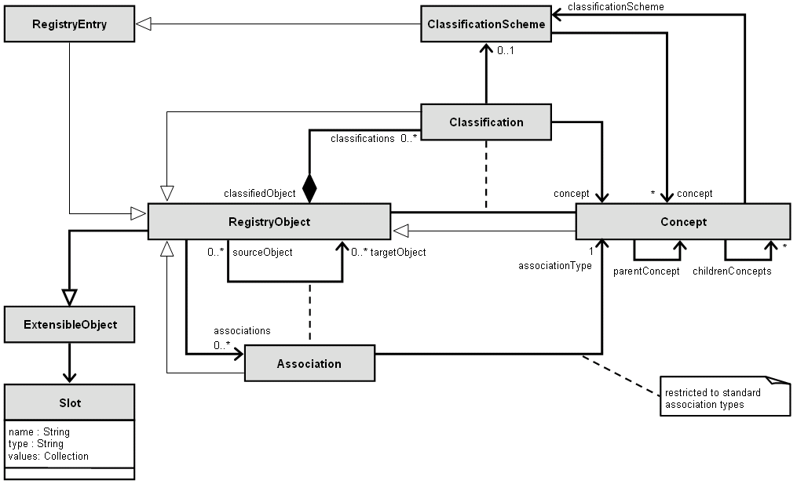

Slide 5
Figure 1
logical model
(UML)
JET templates
Design time
JET templates
manual
implementation as technical model
JET Emitter
EMF (generation)
POJO
SOA
Repository
Access
Layer
M2M from
JAXR to
Ecore
POJO
instance
Generator
M2M from
PIM to PSM
Service
& DT
artifacts
Service
Implementation
Classes
POJO
instance
Service/DT
Implementation
Classes
JAXR
Runtime
call generate(id,type)
Configuration file

Slide 6
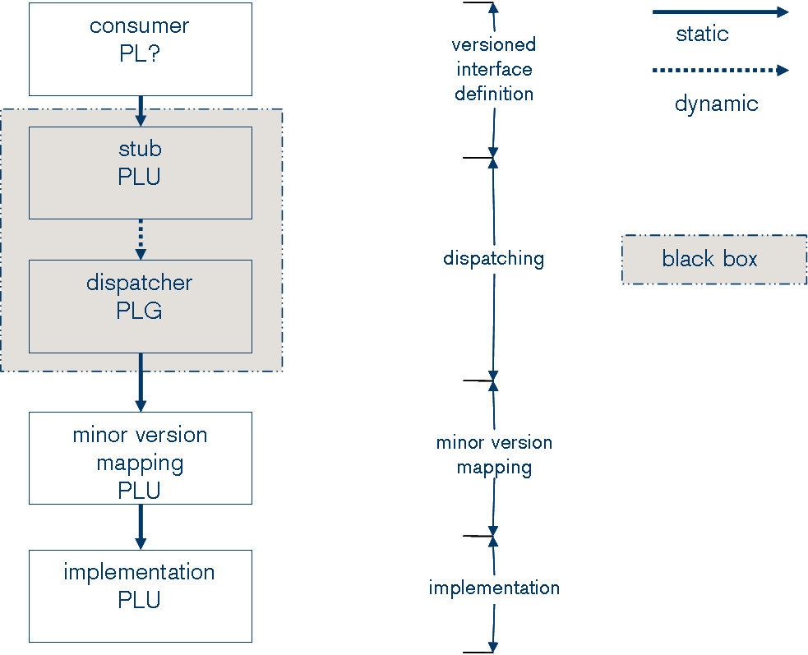
PL1 Service Model
Source: DiMA Standard and Guidelines

Slide 7
PL1 Service Model – Example
Consumer
xxxx10BE
xxxx11BE
Consumer
getCustomer_1_0
Consumer
getCustomer_1_1
xxxx10BE
xxxx10PE
xxxx11BE
xxxx11PE
Stub
getCustomer_1_0
xxxx10B
Stub
ping_1_0
xxxx10P
Stub
getCustomer_1_1
xxxx10B
Stub
ping_1_1
xxxx10P
Stub
Dispatcher
getCustomer_1_*
ping_1_*
xxxx1#E
xxxx1#EE
Dispatcher
xxxx10ME
xxxx11ME
Mapper
IF type
xxxx10BT
Mapper
getCustomer_1_0 <->
getCustomer_1_1
xxxx10M
Mapper
getCustomer_1_1 <->
getCustomer_1_1
xxxx10M
IF type
xxxx11BT
CS_B
init input
xxxx11BI
Implementation
xxxx1#IE
init output
xxxx11BI
CIF_B
Implementation
getCustomer_1_1
xxxx1#I
def const
xxxx11BC

Slide 8
M2C
M2M
Complexity
M2M is economically justified
delta betwenn Input and output model
Input
model
Output
model
Input
model
Output
model

Slide 9
Recommendation: M2M or not?
Standard MDA
focus on full code generation
IFMS
Data Model
M2M
IFMS
PSM
M2C
IFMS
Running
Application
A logical model
For the management
Of various Interfaces Types
Takes target
Platform into account
Runs on a specific
Platform/Environment
Ex: CentraSite
Zoom into Model
MDA Variant
focus on dedicated code generation
IFMS
Data Model
Code Generator
PSI
Ex: PL1 Mainframe
Artifacts

Slide 10
Recommendation: M2M or not?
In the current version of the Generator we already do a M2M
  JAXR → POJO
  no tooling support
  POJO → Code is simple enough (no need of additional M2M here)
If the interface to the IFMS/CentraSite changes in the future, we might consider a real M2M
M2M
POJO
instance
IFMS
(CentraSite)
Access
Layer
Generator
generate()
JAXR

