Slide 1
TSFRESH – Time Series FeatuRe Extraction Scalable Hypothesis tests
Eason Chiang

Slide 2
Agenda
TSFRESH introduction (Feature Extraction)
TSFRESH validation result in paper
UCR Time Series Classification Archive:
85 train/ test data sets for different subjects
iPRODICT: production data of steel billets industry
TSFRESH python package trial run

Slide 3
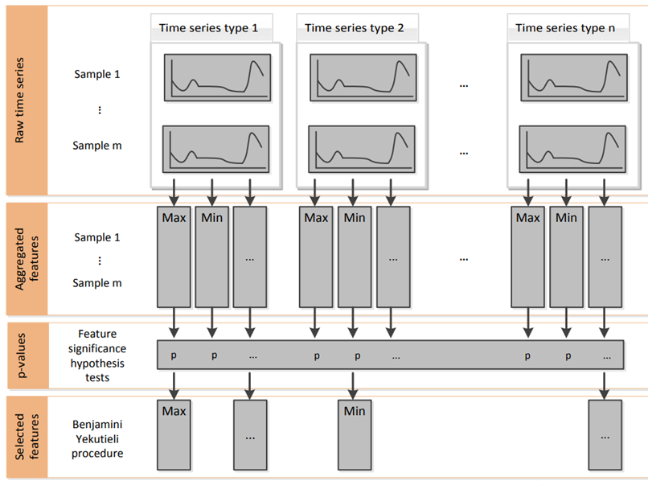
TSFRESH
Time Series FeatuRe Extraction based on Scalable Hypothesis tests

Slide 4
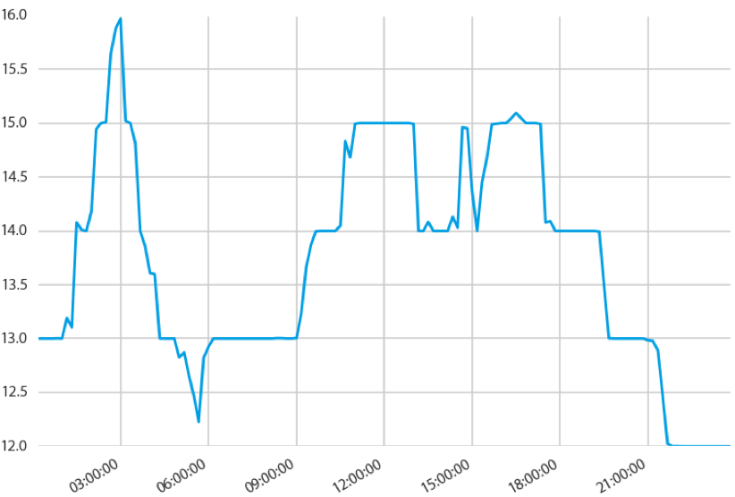
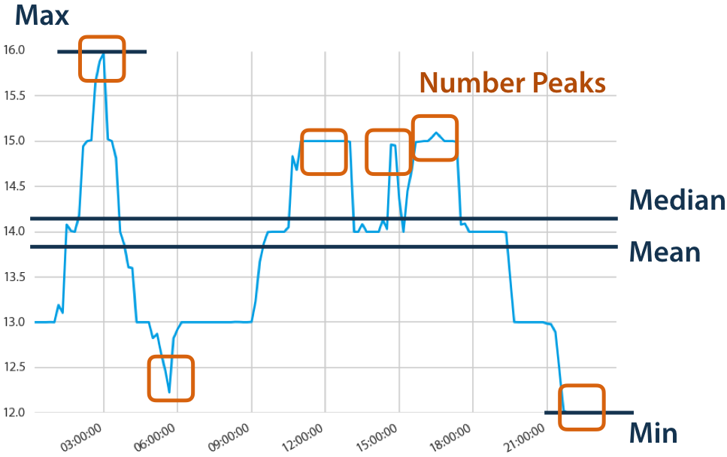
Aggregation Features
Temporally annotated data
Temporally invariant information (e.g. the manufacturer of a device)
Temporally variant information, which change irregularly (e.g. process states)
Temporally variant information with regularly updated values (e.g. sensor measurements)
This paper only exemplified some measurable characteristics of time series to be the features such as Max, Min, Mean, Median, and so on.
Comprehensive collections of time series feature mappings are discussed by Fulcher and Jones [2014] and Nun et al. [2015]. Fulcher and Jones [2014]. Propose to use more than 9000 features from 1000 different feature generating algorithms.

Slide 5

Feature significance test (1/2)
Singular statistical test checking the hypotheses
The result of each hypothesis test H^{φ}₀ is a so-called p-value p_{φ}, which quantifies the probability that feature X_{φ} is not relevant for predicting Y. (X_{φ} vs. Y)
Based on the vector (p₁, . . . , p_{nφ} )^{T} of all hypothesis tests, a multiple testing approach will select the relevant features
Different statistical test ↔ codomains of target / feature
檢定兩個變數間 (X_{φ} vs. Y) 是否存在關聯性
得到每一組的 P-value

Slide 6
Feature significance test (2/2)
Based on nonparametric hypothesis tests, do not make any assumptions about the distribution of the variables, which ensures robustness of the procedure.
Fisher’s Exact test: both the target and feature are binary
Kolmogorov-Smirnov test (binary feature):
Kolmogorov-Smirnov test (binary target):
Kendal rank test:
 | Target – Binary | Target – Non-Binary
Feature – Binary | Fisher’s Exact test | Kolmogorov-Smirnov test (Binary Feature/ Continuous Feature)
Feature – Non-Binary | Kolmogorov-Smirnov test (Binary Target) | Kendal rank test

Slide 7
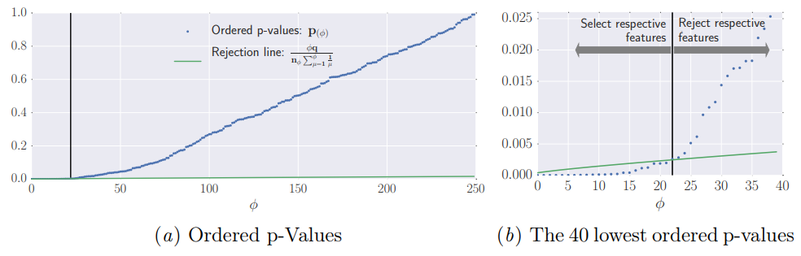

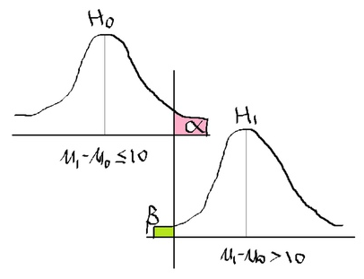
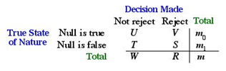
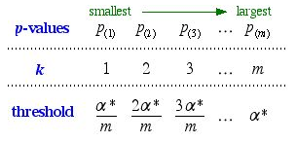

Benjamini-Yekutieli Procedure
n_{φ} is the number of all null hypotheses and
q is the FDR level the procedure controls.
It will reject all hypotheses belonging to p-values that have a lower value than the p-value at the intersection, see the left side of Fig. 2(b).
Notes:
http://www.unc.edu/courses/2007spring/biol/145/001/docs/lectures/Nov12.html

Slide 8
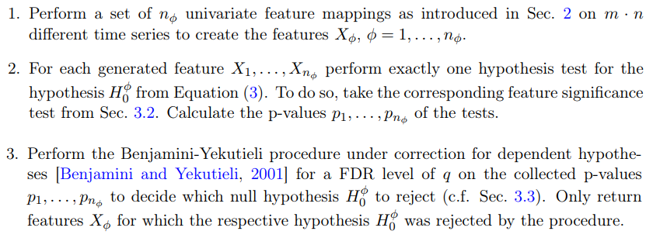
Proposed Feature Extraction Algorithm: FRESH
FRESH: FeatuRe Extration based on Scalable Hypothesis tests for parameter

Slide 9
TSFRESH evaluation result (1/2)
Use UCR data sets (31 two-class data) and iPRODICT data (steel billets).
Adopt several Feature Extraction algorithms (FULL_X, FRESH, LDA, Boruta, FRESH_PCAa, FRESH_PCAb) to evaluate classifiers performance.
Time Series Feature Extraction Algorithms:
DTW_NN: a nearest neighbor search under the Dynamic Time Warping, is reported to reach the highest accuracy rates among other time series classifiers
FRESH_PCAa: (PCA after) features are found relevant by FRESH, and then use PCA to process (step3+ use PCA)
FRESH_PCAb: (PCA before) take principal components instead of the original features as input (step2 use PCA)
LDA: the 1st proposed automatically extract features from time series.
Boruta: considers interactions between features.
Data
FRESH
PCAb
PCAa
Average Accuracy
UCR Data
(31 data sets)
Feature Extraction
Evaluation Classifiers
FRESH_PCAa
FRESH_PCAb
FRESH
LDA
FULL_X
Boruta
NN
SVM
RFC (Random Forest Classifier)
ABC (AdaBoost Classifier)
LR (Logistic Regression)
Highest Accuracy Classifier # (xx/155)
Notes:
https://github.com/blue-yonder/tsfresh/blob/master/notebooks/robot_failure_example.ipynb
Figure 3: Average pipeline runtime of time series classification concerning the nonlinear dynamics of a dissipative soliton [Liehr, 2013, p. 164]. The curves of all methods except DTW_NN lay on top of each other.
Figure 4: Average feature extraction runtime during ten feature selection runs for 10,000 samples of different amounts of simulated feature mappings (the curves of FRESH and FRESH_PCAa are overlapping)

Slide 10
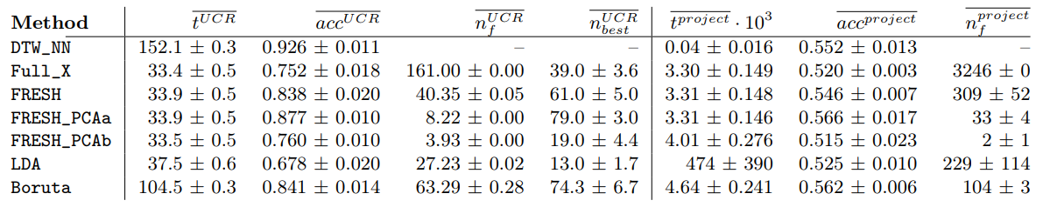
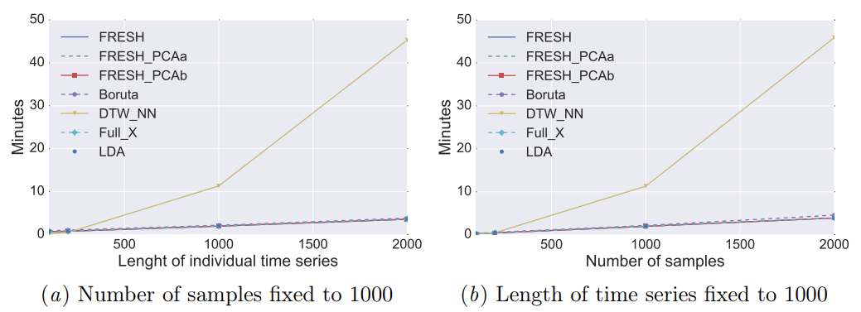
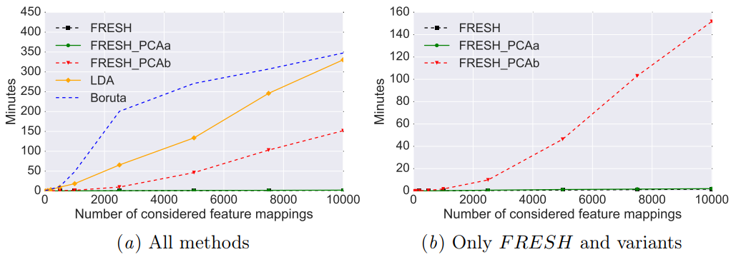
TSFRESH validation result (2/2)
t: Average pipeline runtime including feature extraction, training of a classifier and predicting.
acc: Average accuracy from 31 UCR data sets
n_{f}: Number of features are extracted
n_{best}: Best classifier number count in total 155 combinations (31 * 5)
Conclusion: FRESH_PCAa has good result on either accuracy or performance.
No. 1
No. 2
No. 3
Notes:
https://github.com/blue-yonder/tsfresh/blob/master/notebooks/robot_failure_example.ipynb

Slide 11

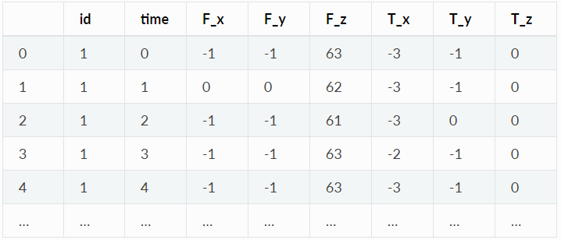
TSFRESH python package trial run
TSFRESH Robot Failure Example (http://archive.ics.uci.edu/ml/datasets/Robot+Execution+Failures)
This dataset contains force (力) and torque (扭矩) measurements on a robot after failure detection
Data contains 88 robots (id 1-88), each has 6 sensors (a-f)
Each sensor collects 14 time points.
For this, tsfresh comes into place. It allows us to automatically extract over 1200 features from those 6 different time series.
88 X (6 X 14) ➔TSFRESH➔ 88 X 4764 ➔ 88 X 622
id | result
1 | True
2 | True
3 | False
… | …
88 | False
Notes:
https://github.com/blue-yonder/tsfresh/blob/master/notebooks/robot_failure_example.ipynb
https://github.com/blue-yonder/tsfresh/blob/master/notebooks/robot_failure_example.ipynb

Slide 12
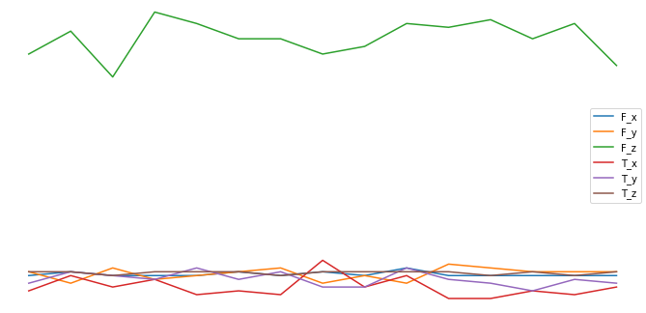
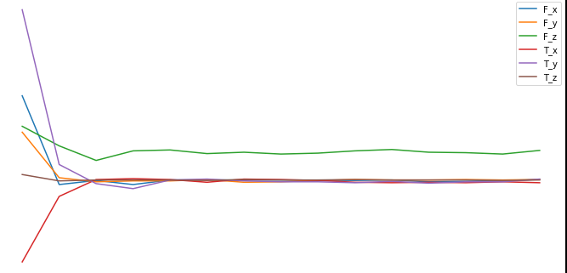
Difference between success and failure
Success example (id=3)
Failure example (id=20)

Slide 13
ComprehensiveFCParameters
'abs_energy‘
'absolute_sum_of_changes': None,
'agg_autocorrelation': [{'f_agg': 'mean'},
'agg_linear_trend': [{'attr': 'rvalue', 'chunk_len': 5, 'f_agg': 'max'},
'approximate_entropy': [{'m': 2, 'r': 0.1},
'ar_coefficient': [{'coeff': 0, 'k': 10},
'augmented_dickey_fuller': [{'attr': 'teststat'},
'autocorrelation': [{'lag': 0},
'binned_entropy': [{'max_bins': 10}],
'change_quantiles': [{'f_agg': 'mean', 'isabs': False, 'qh': 0.2, 'ql': 0.0},
'cid_ce': [{'normalize': True}, {'normalize': False}],
'count_above_mean': None,
'count_below_mean': None,
'cwt_coefficients': [{'coeff': 0, 'w': 2, 'widths': (2, 5, 10, 20)},
'energy_ratio_by_chunks': [{'num_segments': 10, 'segment_focus': 0},
'fft_aggregated': [{'aggtype': 'centroid'},
'fft_coefficient': [{'attr': 'real', 'coeff': 0},
'first_location_of_maximum': None,
'first_location_of_minimum': None,
'friedrich_coefficients': [{'coeff': 0, 'm': 3, 'r': 30},
'has_duplicate': None,
'has_duplicate_max': None,
'has_duplicate_min': None,
'index_mass_quantile': [{'q': 0.1},
'kurtosis': None,
'large_standard_deviation': [{'r': 0.05},
'last_location_of_maximum': None,
'last_location_of_minimum': None,
'length': None,
'linear_trend': [{'attr': 'pvalue'},
'longest_strike_above_mean': None,
'longest_strike_below_mean': None,
'max_langevin_fixed_point': [{'m': 3, 'r': 30}],
'maximum': None,
'mean': None,
'mean_abs_change': None,
'mean_change': None,
'mean_second_derivative_central': None,
'median': None,
'minimum': None,
'number_crossing_m': [{'m': 0}, {'m': -1}, {'m': 1}],
'number_cwt_peaks': [{'n': 1}, {'n': 5}],
'number_peaks': [{'n': 1}, {'n': 3}, {'n': 5}, {'n': 10}, {'n': 50}],
'partial_autocorrelation': [{'lag': 0},
'percentage_of_reoccurring_datapoints_to_all_datapoints': None,
'percentage_of_reoccurring_values_to_all_values': None,
'quantile': [{'q': 0.1},
'range_count': [{'max': 1, 'min': -1}],
'ratio_beyond_r_sigma': [{'r': 0.5},
'ratio_value_number_to_time_series_length': None,
'sample_entropy': None,
'skewness': None,
'spkt_welch_density': [{'coeff': 2}, {'coeff': 5}, {'coeff': 8}],
'standard_deviation': None,
'sum_of_reoccurring_data_points': None,
'sum_of_reoccurring_values': None,
'sum_values': None,
'symmetry_looking': [{'r': 0.0},
‘time_reversal_asymmetry_statistic': [{'lag': 1}, {'lag': 2}, {'lag': 3}],
'value_count': [{'value': 0},
‘variance': None,
'variance_larger_than_standard_deviation': None}

Slide 14
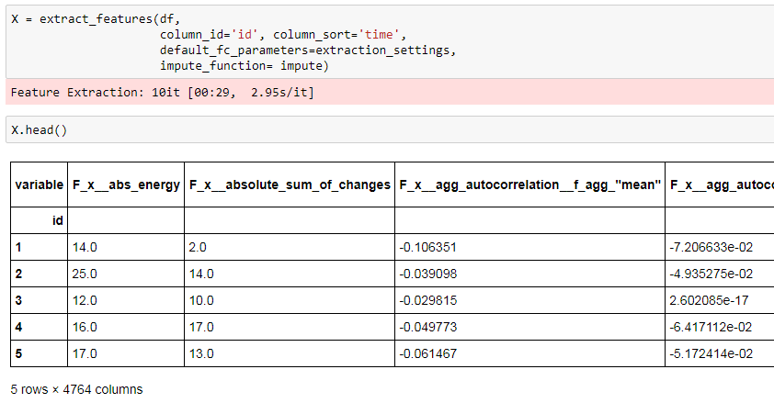
After extract_features

Slide 15
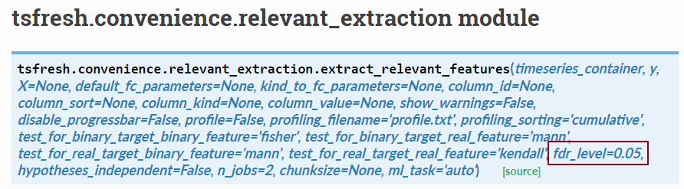
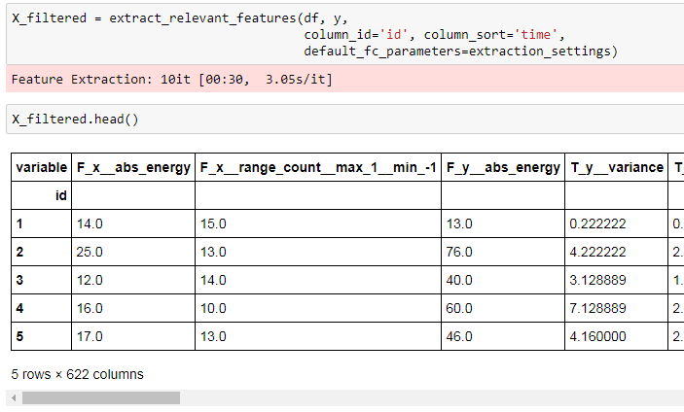
After extract_relevant_features

Slide 16
Backup

Slide 17
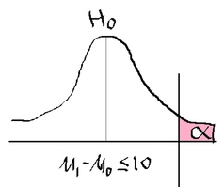
多重檢定問題 (1/3)
計算在虛無假設（null hypothesis）下檢定統計量出現與觀察值相同或更極端之值的機率，稱為 p 值。
p 值越小，我們越傾向於否定虛無假設。
當 p 值小於給定的門檻 α ，稱為顯著水準（significance level），我們拒絕虛無假設，並稱 檢定結果顯著。
當虛無假設為真時，仍有可能因所得 p 值小於給定的 α ，而獲致 拒絕虛無假設 的 錯誤結論，這種錯誤稱為型一錯誤（type I error）。
單一檢定時，犯 型一錯誤 的機率等於給定的顯著水準 α。
不犯錯機率 = 0.95

Slide 18
多重檢定問題 (2/3)
當同時進行多個檢定時，犯型一錯誤之機率會增加。
以同時進行兩個檢定為例，當兩個虛無假設為真且 α＝0.05 時，個別檢定 不犯型一錯誤的機率為 0.95。
若兩個檢定獨立，則同時不犯型一錯誤之機率為 0.95² = 0.9025 。
因此，至少一個檢定犯型一錯誤的機率為 1 − 0.9025 = 0.0975 。
檢定個數越多，犯型一錯誤之機率就越高。
這個現 象被稱為多重檢定問題（multiple testing problem）。
不犯錯機率 = 0.95
同時都不犯錯 = 0.95²
至少一個犯錯 = 1- 0.95²
越多就越容易犯型一錯誤
不犯錯機率 = 0.95

Slide 19


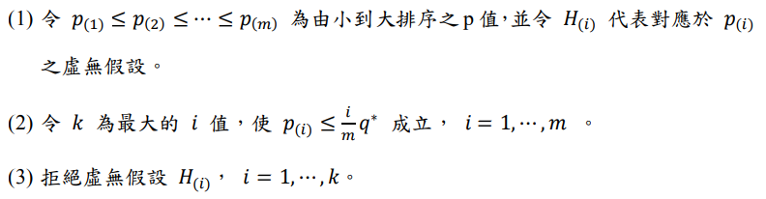

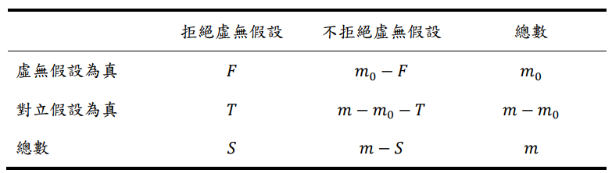
多重檢定問題 (3/3)
一種度量 型一錯誤 程度的方法，是考慮顯著結果中型一錯誤的比例，FDR (False Discovery Rate) 是以 之期望值做為度量：
令 𝑝₁, 𝑝₂, … , 𝑝_{𝑚} 為 𝑚 個檢定所得之 p 值。
給定一個門檻 𝑞∗ ，執行以下程序可使 FDR ≤ 𝑞 ∗：

Slide 20
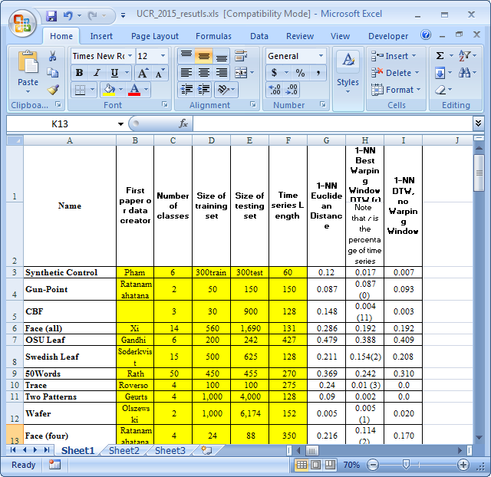



UCR Time Series Classification Archive

