Slide 1


Wavelet-Based Diffusion Model for Enhanced Inference Speed in Image Super-Resolution
Master of Science in Engineering in Computer Science
Thesis Advisor
Prof. Danilo Comminiello
Co-Advisor
Dr. Luigi Sigillo
Candidate: Lorenzo Aloisi
ID number: 1836344

Slide 2
Introduction
Diffusion models have become SotA for high-fidelity image generation and have been introduced in Image Super-Resolution (SR3)
Slow training and inference speeds
Several approaches have tried to smooth out Diffusion Models’ drawbacks for unconditional image generation (DDGAN).
Wavelet-Based Diffusion Model for Enhanced Inference Speed in Image Super-Resolution
Pagina <number>

Slide 3
Introduction (cont.)
Problem:
  Scarcity of approaches addressing speed limitations in Diffusion Models for Image Super-Resolution
Solution:
  Discrete wavelet transform (DWT) for dimensionality reduction
  Integration of Diffusion and GANs for accelerated inference
Wavelet-Based Diffusion Model for Enhanced Inference Speed in Image Super-Resolution
Pagina <number>

Slide 4
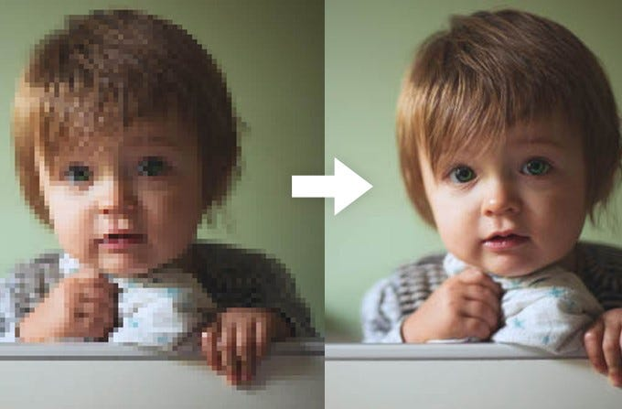
Single Image Super-Resolution (SISR)
SISR involves reconstructing a high-resolution (HR) image from a low-resolution (LR) observation
Challenge: a specific low-resolution input can correspond to various high-resolution possibilities
Widespread use in medical imaging, satellite imaging, and security application
Wavelet-Based Diffusion Model for Enhanced Inference Speed in Image Super-Resolution
Pagina <number>

Slide 5
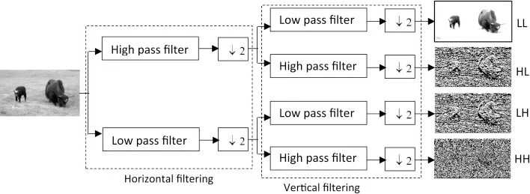
Wavelet transform
Used for decomposing a signal into components with different frequency bands
Signals are passed through two filters and then decomposed into high frequency and low frequency components
Wavelet-Based Diffusion Model for Enhanced Inference Speed in Image Super-Resolution
Pagina <number>

Slide 6
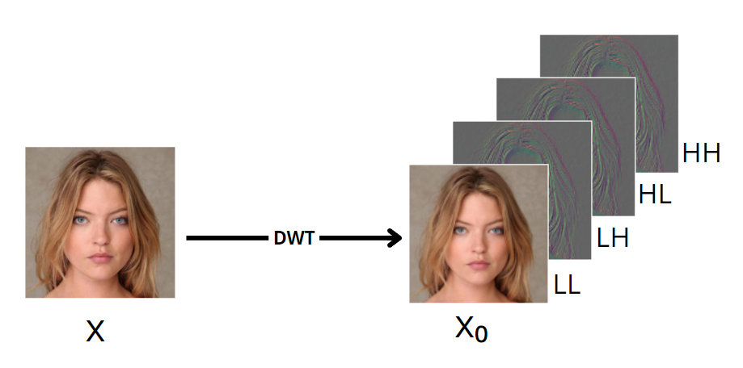
Wavelet transform (cont.)
Discrete wavelet transform (DWT) is used for discrete signals, such as digital images
Dimensionality reduction for efficient sampling
Leveraging high-frequency information enhances generated image detail
Wavelet-Based Diffusion Model for Enhanced Inference Speed in Image Super-Resolution
Pagina <number>

Slide 7
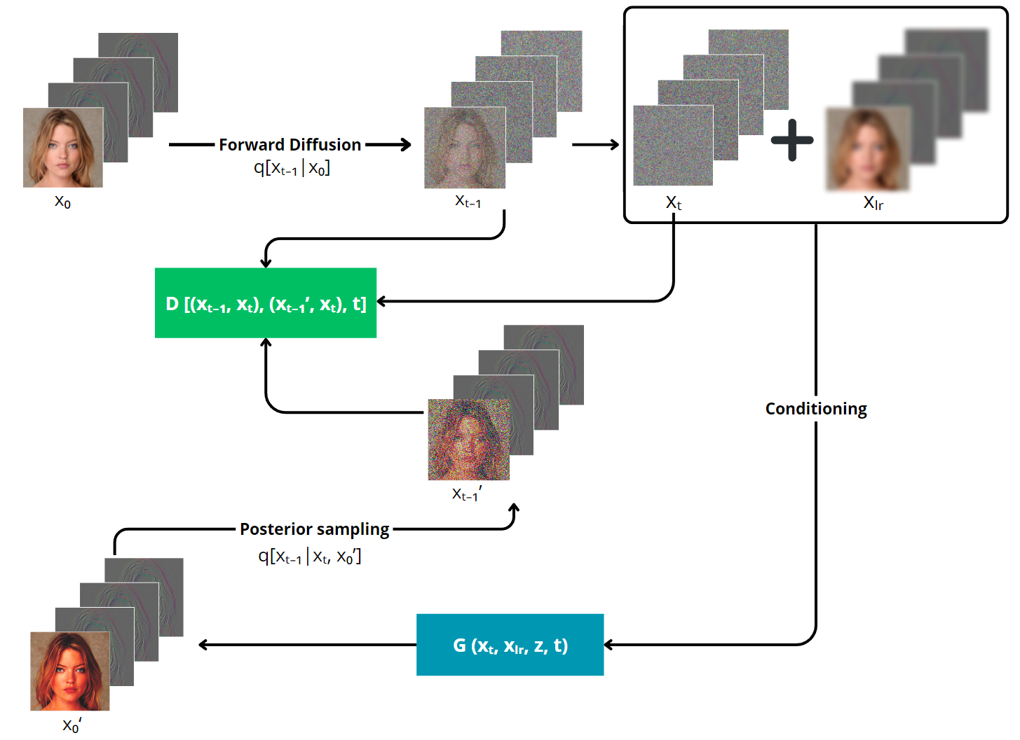
Proposed method architecture
Wavelet-Based Diffusion Model for Enhanced Inference Speed in Image Super-Resolution
Pagina <number>

Slide 8
Training objectives
Given pure noise and low-res image as conditioning inputs, G produces an unperturbed prediction of the target image
G acquires the perturbed sample through known posterior distribution
D performs judgement between real and fake pairs
Wavelet-Based Diffusion Model for Enhanced Inference Speed in Image Super-Resolution
Pagina <number>

Slide 9
Training objectives (cont.)
Formulated to match data produced by G and the regular posterior distribution
Adversarial min-max loss function
Wavelet-Based Diffusion Model for Enhanced Inference Speed in Image Super-Resolution
Pagina <number>

Slide 10
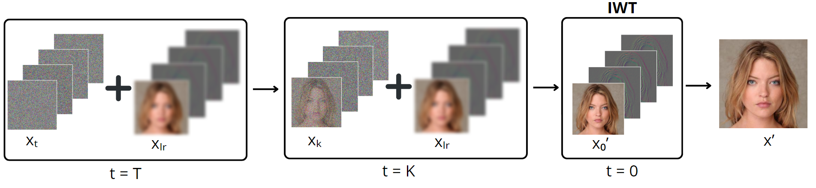
Conditional backward diffusion
Given pure noise and low-res image as conditioning inputs
At each step of the process, the model is responsible of producing a less noisy sample
After T steps, the clean sample is used to reconstruct the super-resoluted image through IWT
Wavelet-Based Diffusion Model for Enhanced Inference Speed in Image Super-Resolution
Pagina <number>

Slide 11
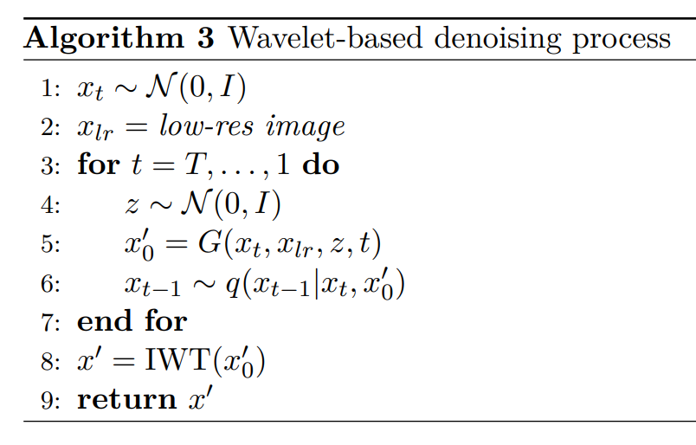
Conditional backward diffusion (cont.)
Backward diffusion is modelled using the GAN generator:
GAN architecture allows us to do bigger steps in the diffusion process
Wavelet-Based Diffusion Model for Enhanced Inference Speed in Image Super-Resolution
Pagina <number>

Slide 12
Training details
Baseline: Super-Resolution via Repeated Refinement (SR3)
Both models trained in similar conditions (25k iteration steps)
Training done on a single 15 GB NVIDIA Tesla T4 GPU (Google Colab)
8x magnification factor (16x16 → 128x128)
Wavelet-Based Diffusion Model for Enhanced Inference Speed in Image Super-Resolution
Pagina <number>

Slide 13
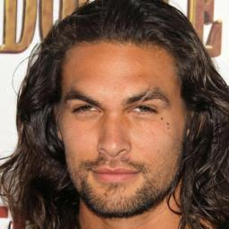
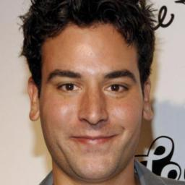
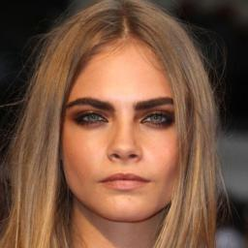




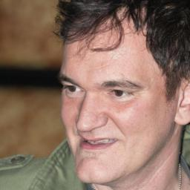
Dataset: CelebA-HQ
30.000 celebrity images
Resized to obtain 16x16 low-res images and 128x128 high-res images
Wavelet-Based Diffusion Model for Enhanced Inference Speed in Image Super-Resolution
Pagina <number>

Slide 14






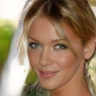
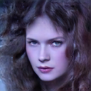
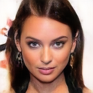
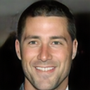

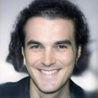
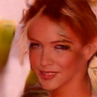
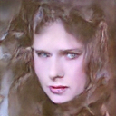
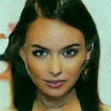
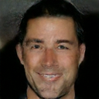
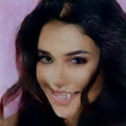
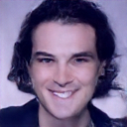
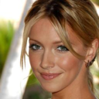


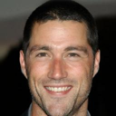


(some) Graphic results
LR
Ours
SR3
HR
Wavelet-Based Diffusion Model for Enhanced Inference Speed in Image Super-Resolution
Pagina <number>

Slide 15
Quantitative results
PSNR: quality of a reconstructed image by comparing it to the original
FID: model’s proficiency in generating realistic images
Metric | Ours | SR3
# of parameters (↓) | 57M | 98M
PSNR [dB] (↑) | 23.53 | 14.65
SSIM [dB] (↑) | 0.69 | 0.42
FID [dB] (↓) | 48.3 | 99.4
Inference time [s] (↓) | 0.12 | 60.3
SSIM: content and structural preservation between the generated image and the original
Wavelet-Based Diffusion Model for Enhanced Inference Speed in Image Super-Resolution
Pagina <number>

Slide 16
Conclusions
Introduction of a novel Wavelet-based Diffusion model that outperformed current ISR SotA
Significant reduction in inference time highlighting viability of our model in real-time applications
Early experimentation with wavelet transforms into diffusion models, contributing to the groundwork for future research
Wavelet-Based Diffusion Model for Enhanced Inference Speed in Image Super-Resolution
Pagina <number>

Slide 17

Thank you!
Wavelet-Based Diffusion Model for Enhanced Inference Speed in Image Super-Resolution
Pagina <number>

