Slide 1
CISSP Certified - The Easy Way
Lessons from a Newly Minted CISSP

Slide 2
Class Overview
8 domains used to be 10
This makes the test more streamlined and I say easier
Less questions per domain
More “real-world” questions- because the domains overlap, the questions tend to be more real-world
ALL the questions, except the Crypto questions, are non-technical – Always remember “how would your CIO answer”

Slide 3
Lesson 1 Security and Risk Management
Confidentiality, integrity, and availability concepts - Know CIA by Heart
Security governance principles – Oversight and ITIL will help you out here
Compliance, Legal and Regulatory Issues – SOX and Regulatory Guidelines – There will be “memorization” questions on the test
Professional ethics – Know the ISC2 code by heart
Security policies, standards, procedures and guidelines – be sure and know how these differ in an organization, what is “suggested” vs. “mandatory”

Slide 4
Lesson 2 Asset Security
Information and asset classification – Know all the layers of public and government data classification i.e. Confidential, private…etc
Ownership (e.g. data owners, system owners) – Quite a few questions on the test concerning “who can change data, who can class it”
Protect privacy
Appropriate retention – a few questions on data destruction
Data security controls – You will see questions regarding shipping and Chain of Custody
Handling requirements (e.g. markings, labels, storage)

Slide 5
Lesson 3 Security Engineering
Engineering processes using secure design principles
Security models, evaluations and capabilities fundamental concepts
Security architectures, designs, and solution elements vulnerabilities
Web-based systems vulnerabilities – Know sql injection vs <script> vs Cross Site
Mobile systems vulnerabilities – Know all the “blue” words. Jacking, smacking, snarfing
Embedded devices and cyber-physical systems vulnerabilities
Cryptography – The MOST Questions on the test. Public, Private, Nonrepudiation vs. Plain Confidentiality
Site and facility design secure principles – Know what hills, slopes and entrance design are best
Physical security – Fence, light height, man traps, desk check-in are likely to be on the test

Slide 6
Lesson 4 Communication and Network Security
Secure network architecture design (e.g. IP & non-IP protocols, segmentation) – Firewall and DMZ questions appear on the test
Secure network components
Secure communication channels – Encryption like TLS vs SSL all the way to which way to point Satellite Dishes
Network attacks – Know ping of death, tear drop, and every other DOS attack

Slide 7
Lesson 5 Identity and Access Management
Physical and logical assets control – Bar coding and Inventory tagging
Identification and authentication of people and devices
Identity as a service (e.g. cloud identity) - – Know SAML definition
Third-party identity services (e.g. on premise) – AD Questions and How passwords are stored
Access control attacks – Know brute-force attacks and everyway to log on as someone else
Identity and access provisioning lifecycle (e.g. provisioning review) – This is a memorization exercise

Slide 8
Lesson 6 Security Assessment and Testing
Assessment and test strategies – Know what kind of testing and test cases help security
Security process data (e.g. management and operational controls)
Security control testing
Test outputs (e.g. automated, manual)
Security architectures vulnerabilities

Slide 9
Lesson 7 Security Operations
Investigations support and requirements
Foundational security operations concepts
Resource protection techniques
Incident management – Know the incident management life cycle
Patch and vulnerability management – Know your Patch management life cycle.
Change management processes
Recovery strategies – Know DR sites, Hot, Cold..etc.
Disaster recovery processes and plans
Business continuity planning and exercises – Know the BCP lifecycle, know what steps are not in it
Personnel safety concerns

Slide 10
Lesson 8 Software Development Security
Security in the software development lifecycle – Know the rings and how they work
Development environment security controls
Software security effectiveness – know what stops <Script> and injection attacks
Acquired software security impact – Know shrink-wrap vs. malicious attacks vs. purposeful backdoors

Slide 11
Thank you
On to Lesson 1…

Slide 12
Lesson 1 Security and Risk Management
Confidentiality, integrity, and availability concepts - Know CIA by Heart
Security governance principles – Oversight and ITIL will help you out here
Compliance, Legal and Regulatory Issues – SOX and Regulatory Guidelines – There will be “memorization” questions on the test
Professional ethics – Know the ISC2 code by heart
Security policies, standards, procedures and guidelines – be sure and know how these differ in an organization, what is “suggested” vs. “mandatory”

Slide 13
Confidentiality, Integrity, and Availability
Often times called the Security Triad
Confidentiality: Has everything to do with Encryption
Integrity: Keeping the data from being altered
Availability: Keeping the systems up and available
Real World Resource: https://www.cccure.org/

Slide 14
Confidentiality
Types
Symmetric
Asymmetric
Strength
Bits
PKI – You will only need to know root CAs
Real World Resource: http://www.mindcert.com/category/mind-maps/cissp/

Slide 15
Integrity
The data was not altered in any way
Hashing
MD5
SHA-1
Real World Resource: http://www.mindcert.com/category/mind-maps/cissp/

Slide 16
Availability
The Site and the Servers are always up
Site Level Redundancy
Hot
Cold
Warm
Reciprocal
Raid Level – Know all of these.
https://en.wikipedia.org/wiki/Standard_RAID_levels
http://www.corexchange.com/blog/disaster-recovery-hot-warm-cold-sites-key-differences

Slide 17
GOVERANCE, Legal and Ethics
Spend a weekend and get ITIL Certified
Memorize the ISC2 code of ethics
Protect society, the commonwealth, and the infrastructure
Act honorably, honestly, justly, responsibly, and legally
Provide diligent and competent service to principals
Advance and protect the profession Visit the following site for the complete mind map for law, ethics and regulations:
http://www.mindcert.com/category/mind-maps/cissp/

Slide 18
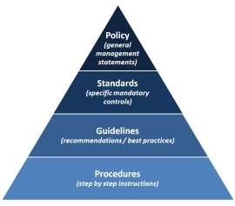
Policies etc.…

Slide 19
Thank you…On to Lesson 2

Slide 20
Lesson 2 Asset Security
Information and asset classification – Know all the layers of public and government data classification i.e. Confidential, private…etc
Ownership (e.g. data owners, system owners) – Quite a few questions on the test concerning “who can change data, who can class it”
Protect privacy
Appropriate retention – a few questions on data destruction
Data security controls – You will see questions regarding shipping and Chain of Custody
Handling requirements (e.g. markings, labels, storage)

Slide 21
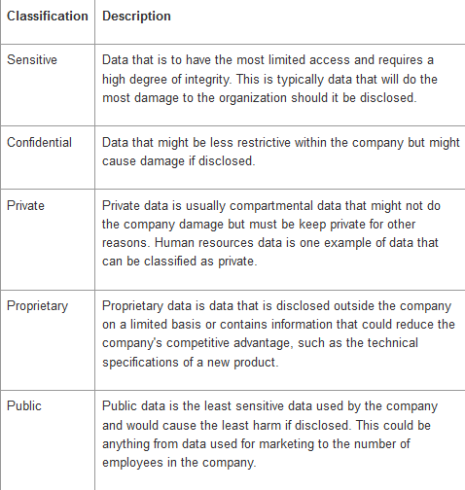
Information Classification - Public

Slide 22
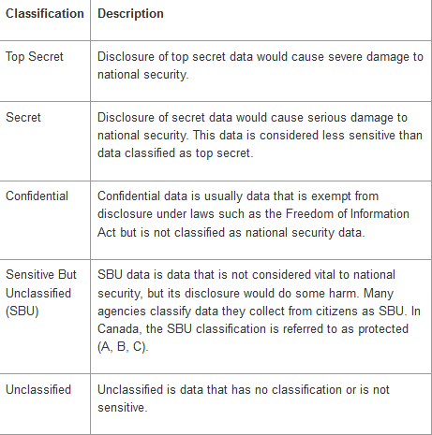
Information Classification - Government

Slide 23
Ownership – Only have to know two
Data owner—Usually a member of senior management. After all, senior management is responsible for the asset and, if it is compromised, can be held responsible. The data owner can delegate some day-to-day duties but cannot delegate total responsibility; senior management is ultimately responsible.
Data custodian—This is usually someone in the IT department. The data custodian does not decide what controls are needed, but he or she does implement controls on behalf of the data owner. Other responsibilities include the day-to-day management of the asset. Controlling access, adding and removing privileges for individual users, and ensuring that the proper controls have been implemented are all part of the data custodian’s daily tasks.

Slide 24
Data Security Controls
Marking, Labeling and Handling
Data Security Controls – Shipping, Chain of Custody
Don’t open boxes
Data Destruction
Tape Backup Security

Slide 25
Thank you…on to Lesson 3

Slide 26
Lesson 3 Security Engineering
Engineering processes using secure design principles
Security models, evaluations and capabilities fundamental concepts
Security architectures, designs, and solution elements vulnerabilities
Web-based systems vulnerabilities – Know sql injection vs <script> vs Cross Site
Mobile systems vulnerabilities – Know all the “blue” words. Jacking, smacking, snarfing
Embedded devices and cyber-physical systems vulnerabilities
Cryptography – The MOST Questions on the test. Public, Private, Nonrepudiation vs. Plain Confidentiality
Site and facility design secure principles – Know what hills, slopes and entrance design are best
Physical security – Fence, light height, man traps, desk check-in are likely to be on the test

Slide 27
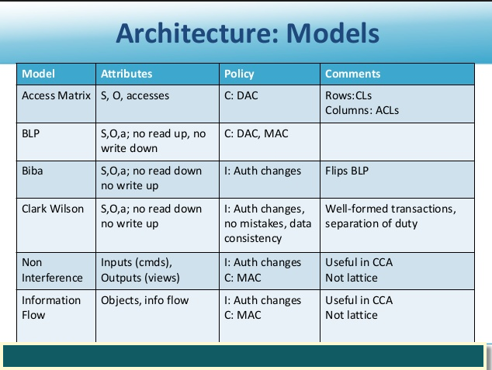
Security Models

Slide 28
Security Models
If the test ask about lattice – Clark Wilson
Bell–LaPadula Model – “Rides Ugly White Donkeys”
Everything else is opposite

Slide 29
Web Based Vulnerabilities
"CSRF is an attack which forces an end user to execute unwanted actions on a web application in which he/she is currently authenticated." – OWASP
Remember when you don’t see <script>, its probably this attack, especially when 2 sites are involved
"Cross-Site Scripting (XSS) attacks are a type of injection, in which malicious scripts are injected into otherwise benign and trusted web sites." - OWASP
Remember when you see <script>
Remember that checking your inputs is the best defense to this or a SQL injection
XSS: http://example.com?variable=a'<script>alert(1)</script>
CSRF: http://example.com/changePassword?userID=1&newPassword=foobar

Slide 30
Mobile System Vulnerabilities
BLUEJACKING Think of it as a high-tech version of ding-dong-ditch, where savvy pranksters push unsolicited messages to engage or annoy other nearby Bluetooth users by taking advantage of a loophole in the technology’s messaging options.
BLUESNARFING More damaging than bluejacking is bluesnarfing. With bluesnarfing, thieves wirelessly connect to some early Bluetooth-enabled mobile devices without the owner’s knowledge to download and/or alter phonebooks, calendars or worse.

Slide 31
Cryptography
Non-Repudiation – Can’t deny it came from you. When you digitally sign a message.
Private key encryption, symmetric, uses the same key for both encryption and decryption (Faster)(DES) – think winzip file with a password
Public key encryption (Slower)(RSA), asymmetric, uses the two keys, private to encrypt, and public to decrypt.

Slide 32
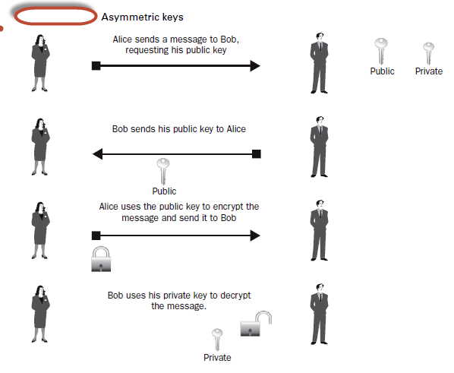
Cryptography

Slide 33
Facility Design Specifications
Remember what locks can be picked and what ones need to be bumped
Remember how high lights need to be
Carefully review the following site for physical security review:
http://www.mindcert.com/category/mind-maps/cissp/

Slide 34
Thank you…On to Lesson 4

Slide 35
Lesson 4 Communication and Network Security
Secure network architecture design (e.g. IP & non-IP protocols, segmentation) – Firewall and DMZ questions appear on the test
Secure network components
Secure communication channels – Encryption like TLS vs SSL all the way to which way to point Satellite Dishes
Network attacks – Know ping of death, tear drop, and every other DOS attack

Slide 36
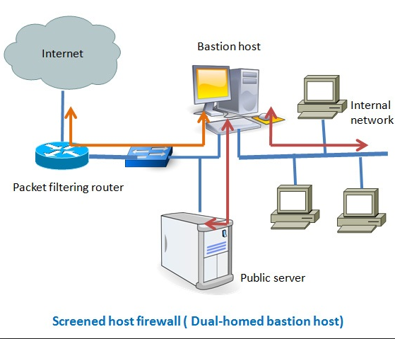
Secure Network Design and Components
Bastion Host
Exposed to the Internet
Hardened – You expect and attack, its your front line
Screened Subnet
A Bastion Host between an internal and an external firewall
MOST SECURE – Any questions asking that
Proxy Server
Can be used outbound or inbound to mask a client’s identity

Slide 37
Secure Network Design and Components
Honeypots
Lure bad people into doing bad things.
Lets you watch them
ONLY ENTICE, not ENTRAP. The difference is that you are not allowed to let them download items with “Enticement”. If you stick a fake payroll file out there, let them download it, then bust them, you have “Entrapped” them. - Remember this

Slide 38
Firewalls
STATELESS
Stateless firewalls watch network traffic, and restrict or block packets based on source and destination addresses or other static values. They are not 'aware' of traffic patterns or data flows. A stateless firewall uses simple rule-sets that do not account for the possibility that a packet might be received by the firewall 'pretending' to be something you asked for.
STATEFUL
Stateful firewalls can watch traffic streams from end to end. They are are aware of communication paths and can implement various IP Security (IPsec) functions such as tunnels and encryption. In technical terms, this means that stateful firewalls can tell what stage a TCP connection is in (open, open sent, synchronized, synchronization acknowledge or established), it can tell if the MTU has changed, whether packets have fragmented etc.
Neither is really superior and there are good arguments for both types of firewalls. Stateless firewalls are typically faster and perform better under heavier traffic loads. Stateful firewalls are better at identifying unauthorized and forged communications.

Slide 39
IDS/IPS
Intrusion Detection System
A device or application that analyzes whole packets, both header and payload, looking for known events. When a known event is detected a log message is generated detailing the event.
Intrusion Prevention System
A device or application that analyzes whole packets, both header and payload, looking for known events. When a known event is detected the packet is rejected.

Slide 40
Secure Communication Channels
There are going to be a few questions on communication channels security.
For Satellite Dish technology , I recommend watching: http://resources.infosecinstitute.com/hacking-satellite-look-up-to-the-sky/
For TLS/SSL, you simply have to remember that TLS is newer than SSL

Slide 41
Network Attacks (DDOS Mostly)
SYN Flood
A SYN flood is a form of denial-of-service attack in which an attacker sends a succession of SYN requests to a target's system in an attempt to consume enough server resources to make the system unresponsive to legitimate traffic.
Fraggle Attack
A Fraggle Attack is a denial-of-service (DoS) attack that involves sending a large amount of spoofed UDP traffic to a router's broadcast address within a network. It is very similar to a Smurf Attack, which uses spoofed ICMP traffic rather than UDP traffic to achieve the same goal.
Land Attack
A LAND Attack is a Layer 4 Denial of Service (DoS) attack in which, the attacker sets the source and destination information of a TCP segment to be the same. A vulnerable machine will crash or freeze due to the packet being repeatedly processed by the TCP stack.
Teardrop Attack
A teardrop attack is a denial-of-service (DoS) attack that involves sending fragmented packets to a target machine. Since the machine receiving such packets cannot reassemble them due to a bug in TCP/IP fragmentation reassembly, the packets overlap one another, crashing the target network device.

Slide 42
Thank you…On to Lesson 5

Slide 43
Lesson 5 Identity and Access Management
Physical and logical assets control – Bar coding and Inventory tagging
Identification and authentication of people and devices
Identity as a service (e.g. cloud identity) - – Know SAML definition
Third-party identity services (e.g. on premise) – AD Questions and How passwords are stored
Access control attacks – Know brute-force attacks and everyway to log on as someone else
Identity and access provisioning lifecycle (e.g. provisioning review) – This is a memorization exercise

Slide 44
Physical and logical assets control – Bar coding and Inventory tagging
RFID, Barcoding and Inventory – represent the ability to prevent theft. This reduces risk. Any questions on this simply point this out and are to be answered like a CTO/CIO would answer. Very long and not technical.

Slide 45
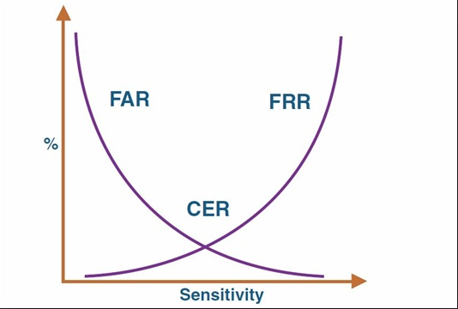
Identification and authentication of people and devices
Know brute force attacks – Best on spreadsheets and their passwords.
Know your Biometrics
https://www.cccure.org/Documents/HISM/039-041.html
Object Reuse
Space on a Disk, allocated and not given back to OS
Tempest Attack and White Noise
Few Questions on the Tempest attack, which is reading a screen at a distance and White Noise, which you can pump down a wire to scramble or mask an attack

Slide 46
SAML and OAUTH
Security Assertion Markup Language (SAML, pronounced sam-el) is an XML-based, open-standard data format for exchanging authentication and authorization data between parties, in particular, between an identity provider and a service provider.
OAuth is an open standard for authorization, commonly used as a way for Internet users to log into third party websites using their Microsoft, Google, Facebook, Twitter, One Network etc. accounts without exposing their password.

Slide 47
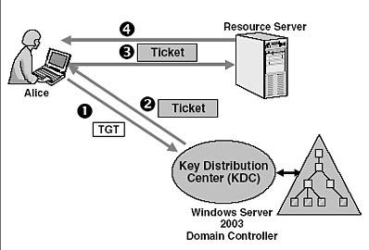
AD Passwords
Active Directory passwords are stored as a hash. For further details, you can review the following link:
http://www.passcape.com/windows_password_recovery_windows_faq
Kerberos
Replay Attacks happen here

Slide 48
Access Controls
Will have to remember all the types of access controls
http://cisspstudy.blogspot.com/2007/05/types-of-access-control.html

Slide 49
Access Control Attacks
Dictionary attacks
These are programs with built in dictionaries. They would use all dictionary words to attempt and find the correct password, in the hope that a user would have used a standard dictionary word.
Brute force
This type of attack is attempting to break the password by trying all possible words, in the alphabet. You can set the software to start from 2 combination letter and keep keep going to 3 combinations, and then 4 and so on. The program would attempt all possible combinations including special keywords. However after 6 or 7 combinations it can take a long time to exhaust all keyword. In fact it is not worth attempting beyond an 8 letter combination as most computers will take a very long time exhausting all possibilities, we are talking weeks, months and years depending on the number of letters and the processing power of the computer.
Spoofed logon screens
The last access control attack is to implement a fake logon screen, and when a user attempts to login, the logon screen will send the username and password to the hacker.
Prevention against authentication and access control attacks
To circumvent these type of attacks, passwords should be long, complex and changed every so often. If the password is used many times a day and protects important information, then it should be changed more often. There should be a strong password policy in place to enforce this, as well as enforcing other measures such as locking users out after so many logon attempts, etc. To circumvent against spoofed logon screens, this can be almost unavoidable if the fake logon screen has already been installed on a computer. The prevention for this attack is to have secure endpoints, where these fake logon screens can not be implemented.

Slide 50
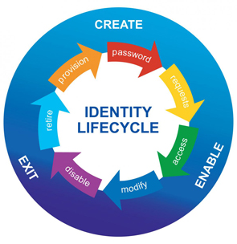
Identity and Access Provisioning Lifecycle

Slide 51
Thank you…On to Lesson 6

Slide 52
Lesson 6 Security Assessment and Testing
Assessment and test strategies – Know what kind of testing and test cases help security
Security process data (e.g. management and operational controls)
Security control testing
Security architectures vulnerabilities

Slide 53
Assessment and test strategies
Pen Test
War Dialing – Bank of Modems
Sniffing – Monitor the Network
Eavesdropping – Listening
Dumpster Diving – Just like it sounds
Social Engineering – Human Manipulation

Slide 54
Security process data
Employment Polices and Practices – Termination process and Background Checks
Roles and Responsibilities – Management sets the standard and verbalizes the policy
Security Awareness Training – Prevents Social Engineering

Slide 55
Security control testing and Vulnerabilities
http://www.mindcert.com/category/mind-maps/cissp/

Slide 56
Thank you…On to Lesson 7

Slide 57
Lesson 7 Security Operations
Investigations support and requirements
Foundational security operations concepts
Resource protection techniques
Incident management – Know the incident management life cycle
Patch and vulnerability management – Know your Patch management life cycle.
Change management processes
Recovery strategies – Know DR sites, Hot, Cold..etc.
Disaster recovery processes and plans
Business continuity planning and exercises – Know the BCP lifecycle, know what steps are not in it
Personnel safety concerns

Slide 58
Foundational security operations concepts
Know your Law - http://www.mindcert.com/category/mind-maps/cissp/

Slide 59
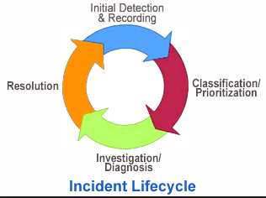
Incident management
Incident management (IcM) is a term describing the activities of an organization to identify, analyze, and correct hazards to prevent a future re-occurrence. These incidents within a structured organization are normally dealt with by either an Incident Response Team (IRT), or an Incident Management Team (IMT).

Slide 60
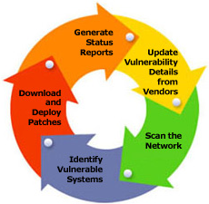
Patch Management
Patch management is an area of systems management that involves acquiring, testing, and installing multiple patches (code changes) to an administered computer system.

Slide 61
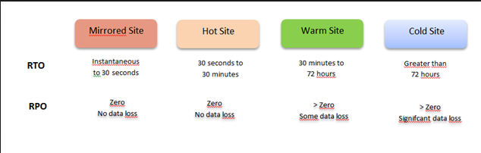
Recovery Strategies
Go over your BCP and DR Mind Map - http://www.mindcert.com/category/mind-maps/cissp/
Know Site Types
Hot
Cold
Warm

Slide 62
RPO and RTO
RPO
The recovery point objective (RPO) is the age of files that must be recovered from backup storage for normal operations to resume if a computer, system, or network goes down as a result of a hardware, program, or communications failure.
RTO
The Recovery Time Objective (RTO) is the duration of time and a service level within which a business process must be restored after a disaster in order to avoid unacceptable consequences associated with a break in continuity.

Slide 63
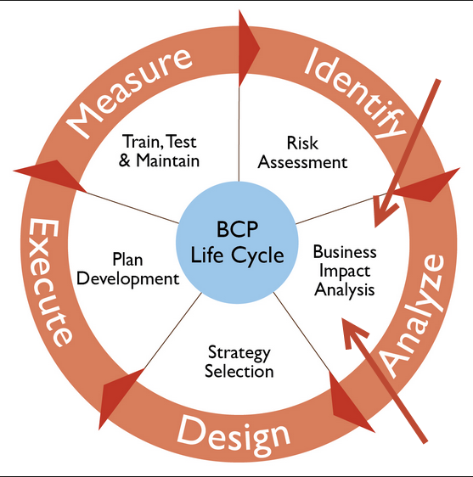
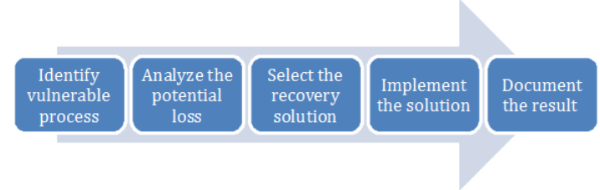
BCP and BIA Lifecycle

Slide 64
Above All…
People are the most important thing in any system!

Slide 65
Thank you…On to Lesson 8

Slide 66
Lesson 8 Software Development Security
Security in the software development lifecycle – Know the rings and how they work
Development environment security controls
Acquired software security impact – Know shrink-wrap vs. malicious attacks vs. purposeful backdoors

Slide 67
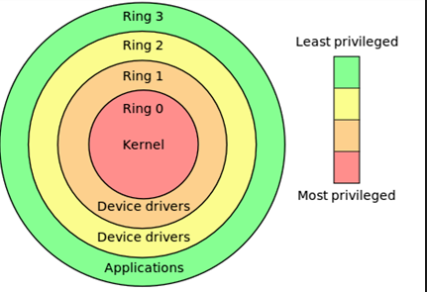
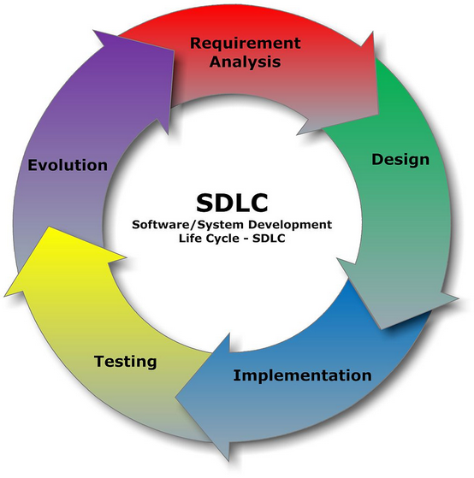
Security and the SDLC
Rings are easy to remember
SDLC is a little harder

Slide 68
Development environment security controls
Know your Software Mind Map - http://www.mindcert.com/category/mind-maps/cissp/

Slide 69
Acquired software security impact
1-Operating system Attacks: attackers always try to search for operating system vulnerabilities and exploits to can attack against operating system some vulnerabilities of operating system are buffer overflow vulnerabilities ,bugs in operating system, unpatched operating system
2-Application-Level Attacks: when a application release must be test it out from it is company in this type of attack a hacker can use buffer overflow, active content, cross-site script, denial of service, SQL injection, session hijacking , phishing
3-Shrink Wrap Code Attacks: in this type of attack a hacker can use the shrink wrap code method to hack into a system you may confuse with this type of attack but when you buy and install an operating system application it comes with tons of sample script so you use the script and can start thinking of attack in a system
4-Misconfiguration Attacks: if your an not a smart administrator so you always make mistake like you forgot to give permission to authorized persons in your organization and when you bring a new device in your organization you just leave it as it’s default so a hacker can use default setting to access the device or you may set the username and password same name of your organization name so a hacker can easy attack to your system

Slide 70
Thank you…On to Summary and Supplemental

Slide 71
In Summary…
Relax – It’s not hard
Take breaks – if you have to take the 6 hours they give you, you are not ready
Answer like a stuffed-shirt, not a super smart engineer
Stay Positive
Eat right, get a good night sleep and pass!

Slide 72
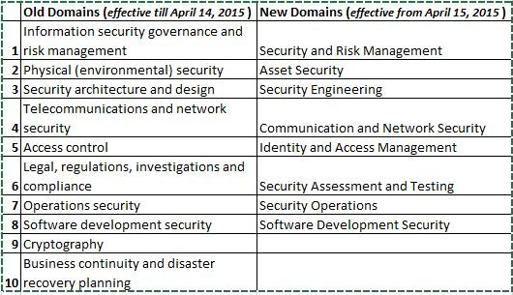
Old Vs New

Slide 73
Supplemental – Calculating EF, SLE, ARO and ALE
Key Terms:
EF – Exposure Factor – The % of value an asset lost due to an incident, represented in a decimal
SLE – Single Loss Expectancy – How much would it cost you if it happened just ONE time?
SLE = Asset Value x Exposure Factor (SLE=AV*EF)
ARO – Annual Rate of Occurrence – How many times does it happen in a year? The exam will try to trip you up and say it occurs every 5 years.
ALE – Annual Loss Expectancy – SLE x ARO – How much you will lose per year.

Slide 74
Supplemental – Calculating EF, SLE, ARO and ALE – Cont.
For example, if forest fires occur about once every five years and present a risk to a building, the ARO is .20 (1/5). If a forest fire is expected to reduce the value of the building by 20% (say from $1,000,000 to $800,000) the exposure factor is .20 (800,000 / 1,000,000)
A lot of math can be involved in a quantitative assessment, but the CISSP exam focuses on the SLE, ALE, and ARO formulas.

Slide 75
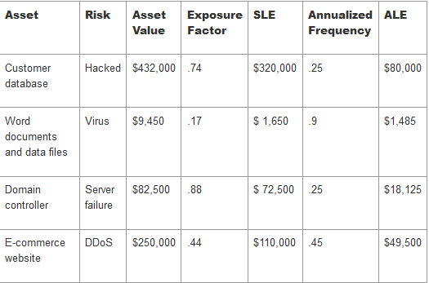
Supplemental – Calculating EF, SLE, ARO and ALE – Cont.

Slide 76
Helpful Study Guides
Sunflower https://www.google.com/url?sa=t&rct=j&q=&esrc=s&source=web&cd=1&ved=0ahUKEwiZ_5rTmZfMAhWiuoMKHev0AIMQFggdMAA&url=http%3A%2F%2Fwww.kilala.nl%2FSysadmin%2FImages%2FCISSP_Summary_V1.1.pdf&usg=AFQjCNE6_ViFnOV8Ea6s9qcpaOcJvSndKQ
Techexams.net
Cccure.org

