Slide 1
Information Security is Must
- by Alok Nath

Slide 2
Incidents
Log 4J
Pegasus spyware
PrintNightmare - Printer Spooler Service
Proxy Logon - Exchange server
Florida Water Utility Hack
Dominos India Database leak

Slide 3

CyberSecurity Fields
Chip Design/Hardware Security
SCADA/IOT Security
Network Security
Vulnerability Management (VM)
Security operations Center (Soc)
Compliance
Application Security/Exploit Dev

Slide 4
CIA Triad
Confidentiality – restrict access to authorized individuals
Integrity – data has not been altered in an unauthorized manner
Availability – information can be accessed and modified by authorized individuals in an appropriate timeframe
Confidentiality
Integrity
Availability

Slide 5
Chip Design/Hardware Security
IISC Banglore - Paid Training
CDAC VLSI - PG Diploma
ARM.com - Paid
Udemy - Subscription based
https://nptel.ac.in/ - Free
https://ocw.mit.edu/ -Free
Digital Integrated Circuits Jan Rabaey - Free
ocw.mit.edu - Free
Notes:
https://ocw.mit.edu/courses/electrical-engineering-and-computer-science/6-374-analysis-and-design-of-digital-integrated-circuits-fall-2003/
Computer Architecture by Hennessy and Patterson
Digital Integrated Circuits Jan Rabaey
https://www.quora.com/How-do-I-build-my-basic-knowledge-for-a-Masters-of-Technology-and-future-in-VLSI-field/answer/Vansh-Lata
https://ocw.mit.edu/courses/electrical-engineering-and-computer-science/6-858-computer-systems-security-fall-2014/video-lectures/
http://www.testbench.in/
http://www.asic-world.com/

Slide 6
SCADA/IOT/ICS Security
SCADA - CDAC Banglore
www.cisa.gov/uscert/ics
https://www.sans.org/cyber-security-courses/ics-scada-cyber-security-essentials/
Notes:
https://www.cisa.gov/uscert/ics/Training-Available-Through-CISA

Slide 7
Network Security
CCNA, CCNP, CCIE Security
Firewall
IDS / IPS
Checkpoint/Cisco/WAF

Slide 8
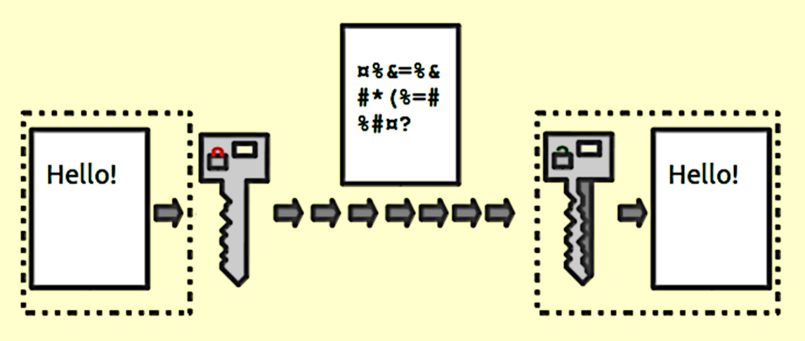
Vulnerability Management
Identify issues and vulnerability
Analyse issue and suggest fix
Suggest solution
CEH

Slide 9
Security operations Centre
Identify issue realtine block remidiate
Alert
SIEM tools

Slide 10
Compliance & Audit
ISO 27001
Policies, governance
Third party risk assessment & Audit
CISM

Slide 11
Application Pen Test
Hardware/software/firmware/application
Red/blue teams
Fuzzing/Exploit Dev - www.corelan.be
Sam Brown CNIT
https://exploit.education/
https://www.vulnhub.com/
C,C++, Java, Python, assembly ASM language
CEH, Offensive security

Slide 12
Growth path
Learning path
Certications
Higher studies MS/Mtech
?? Questions ??

