Slide 1

E-Manual
Asset Management System

Slide 2
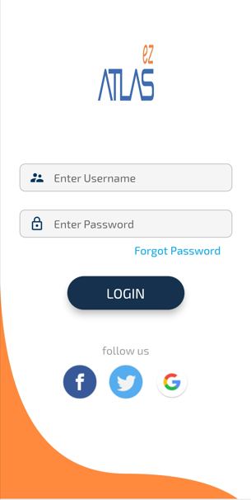
How to login AMS
Enter Your User Name and password

Slide 3
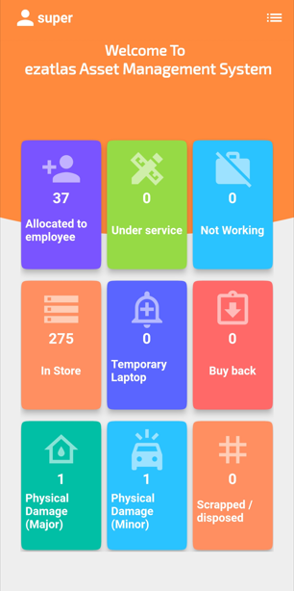
Welcome Screen/Dashboard
Home/Dashboard

Slide 4
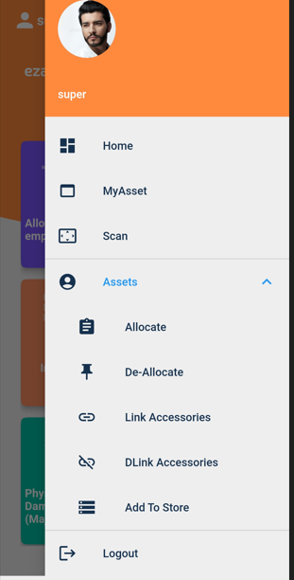
Navigation Bar

Slide 5
How to create Assets ?
Go to Assets
Assets Modules in which we are capturing the invoice of the assets
The we are pushing that assets to our store.
Add to Store by assigning the serial number to the assets.
Once we done all the process we put to use that assets to our employee by allocating them.
There are various tools to capture:
Add to Store
Allocate
De Allocate
Link Accessories
De link Accessories
My Asset
Scanning

Slide 6
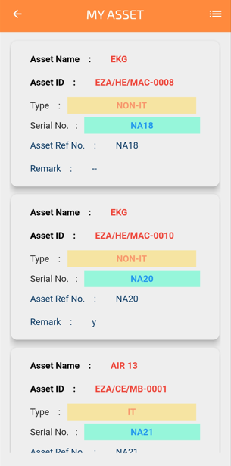
MY Asset.
User login can All check allocated Asset to him in My Asset

Slide 7
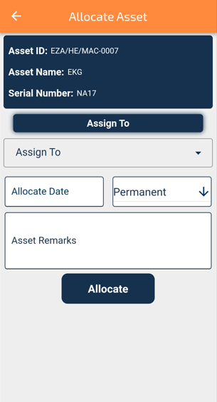
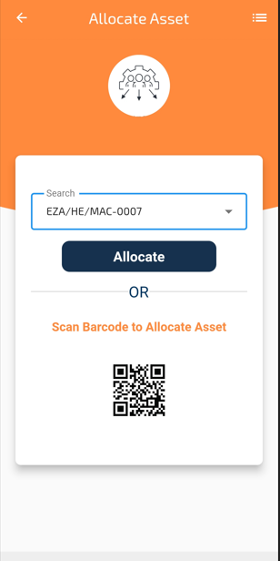
How to create Allocate?
The asset is ready to put in use by allocating to our employee.
Go to Asset
Select Asset Id for Allocate
Select the name of Employee
Tool will automatically capture details of employee
Select Date of Allocation
Tick on box of asset and assign allocation nature i.e. Permanent or Temporary.
Click on Allocate
Email will trigger to employee of this allocation.
After acceptance Asset will allocated

Slide 8
How to create Allocate?
The asset is ready to put in use by allocating to our employee.
Go to Asset
Select Tag Scan Barcode for Allocate Asset
Select the name of Employee
Tool will automatically capture details of employee
Select Date of Allocation
Click on Allocate
Email will trigger to employee of this allocation.
After acceptance Asset will allocated

Slide 9
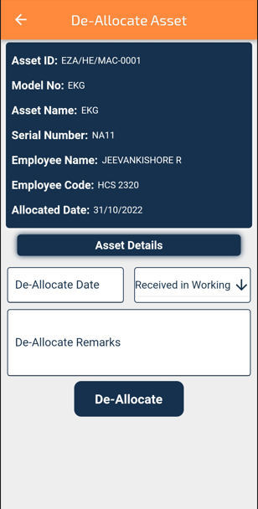
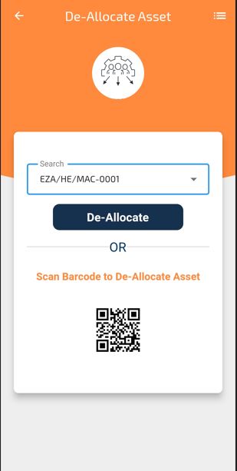
How to create De allocate?
Employee is transferred or Retirement or any such situation.
So we do Deallocation the assets from the employee account.
Go to Asset
Select Asset Id for De allocate
Click on Deallocate
Select the name of Employee
Tick on the box and Enter date of deallocation.
Click on Deallocate
Email will trigger to employee of this deallocation.

Slide 10
How to create De allocate?
Employee is transferred or Retirement or any such situation.
So we do Deallocation the assets from the employee account.
Go to Asset
Select Tag Scan Barcode for De allocate asset
Click on Deallocate
Select the name of Employee
Tick on the box and Enter date of deallocation.
Click on Deallocate
Email will trigger to employee of this deallocation.

Slide 11
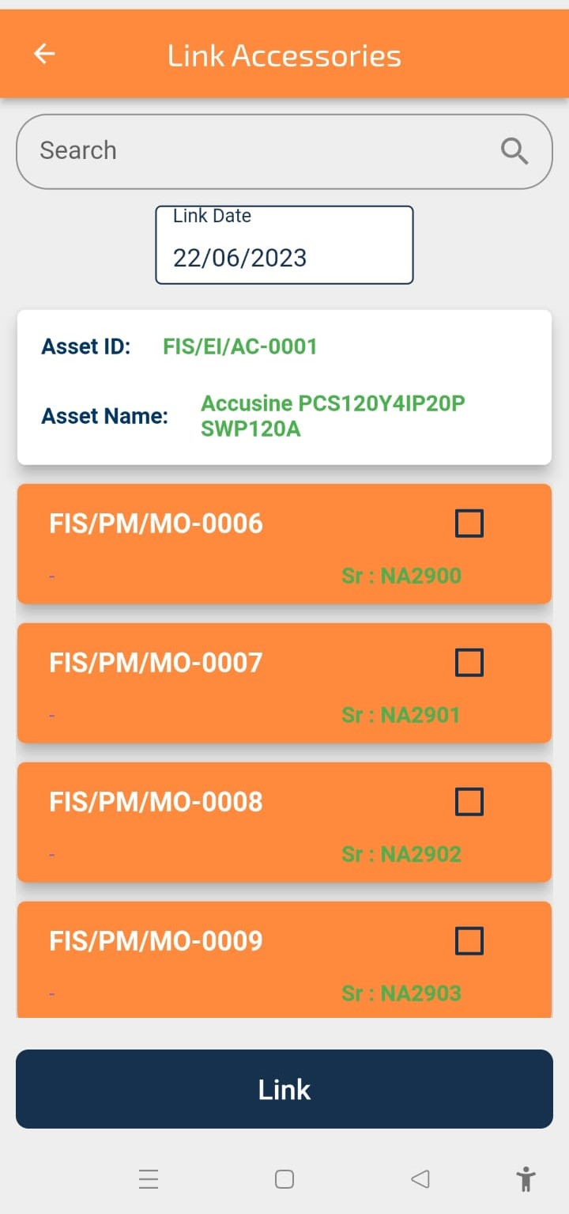
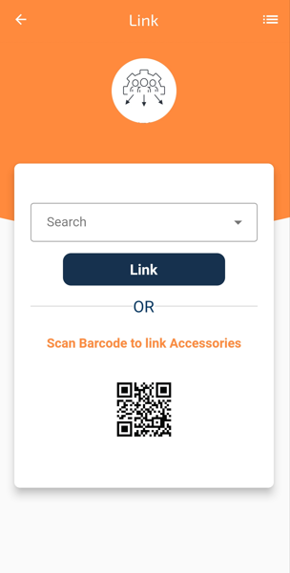
How to Create Link Accessories?
Which some Installation of Software or any External device need to link
Go to Asset
Click on Link Accessories
Select the Asset id from dropdown
Tick on the box against the accessories which is intended to link and Enter date of Link
Click on Link.
Click on Link

Slide 12
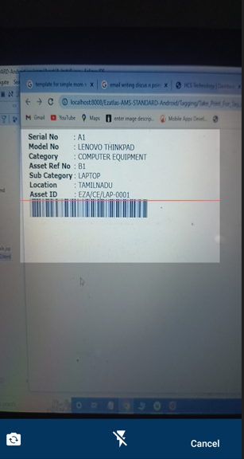
How to Create Link Accessories?
Which some Installation of Software or any External device need to link
Go to Asset
Select Tag Scan Barcode Link Accessories
Select the Asset id from dropdown
Tick on the box against the accessories which is intended to link and Enter date of Link
Click on Link.
Click on link

Slide 13
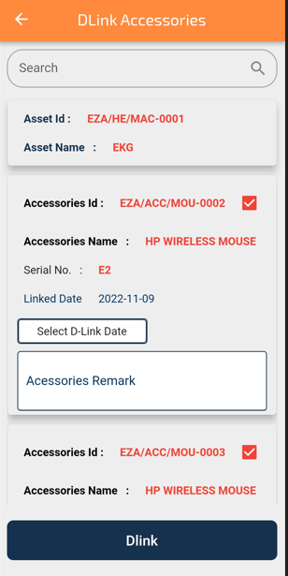
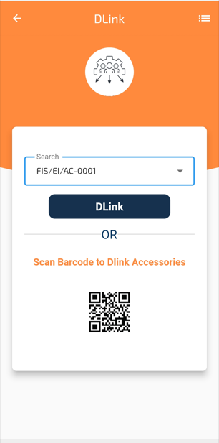
How to Create Delink Accessories ?
Employee is transferred or Retirement or any such situation
So we do Deallocation the assets from the employee account.and Delink Accessories
Go to Asset
Select Asset
Click on Delink
Select the name of Employee
Tick on the box and Enter date of deallocation.
Click on Delink
Email will trigger to employee of this deallocation.
Click on Dlink

Slide 14
How to Create Delink Accessories ?
Employee is transferred or Retirement or any such situation
So we do Deallocation the assets from the employee account.and Delink Accessories
Go to Asset
Select Asset
Click on Delink
Select the name of Employee
Tick on the box and Enter date of deallocation.
Click on Delink
Email will trigger to employee of this deallocation.
Click on Dlink

Slide 15
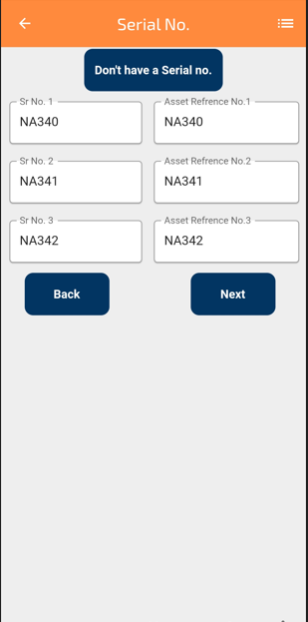
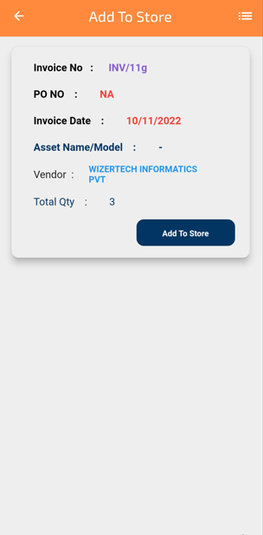
How to create Add store ?
The invoice now our next step to put the Assets to our Store.
Go to Asset
Click on Add to Store
Select the Items and click on Add to Store
Assign Serial Number and Reference Number
Click on Next

Slide 16
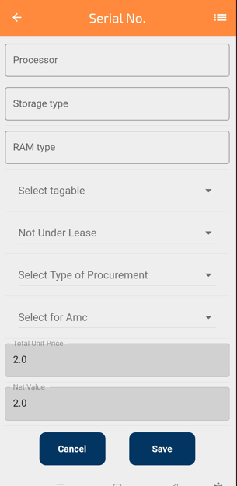
How to create Add store ?
Now, Asset Details page will open, Enter all information with respective part.
Select whether item is Taggable or Not
AMC or Warranty if, Yes, Select Start Date and End Date, so email will trigger before deadline
Select Lease Status and Purchase Mode
Click on Save.

Slide 17
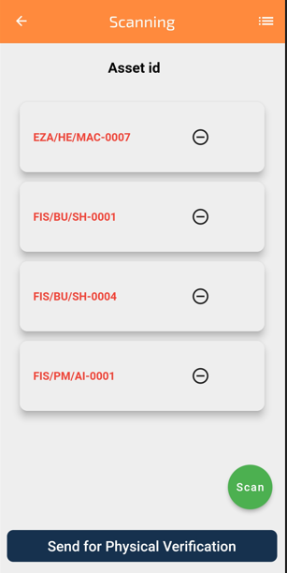
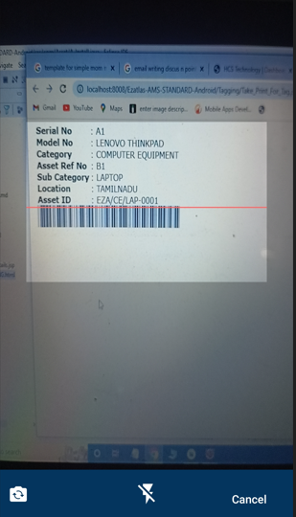
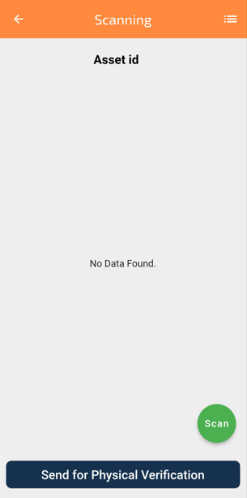
How to do Scanning?
Click on Scan
You get the scan Asset

Slide 18
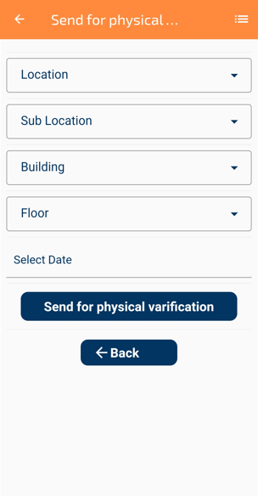
How to do Scanning?
Click on Scanning
You get the scan Asset
Drop down in Location
Drop down in Sub-Location
Drop down in Building
Drop down in Floor
Put the Date
Send for Verification

Slide 19

Thank You
Created by
N:Ramprasad Kulkarni
E: ramprasad@hcstechno.com

