Slide 1
Chapter 1: EDA Report
Capstone Project- Group 6
7 September 2020

Slide 2
1. Sector and Cap size govern the dynamics of a Company

Slide 3
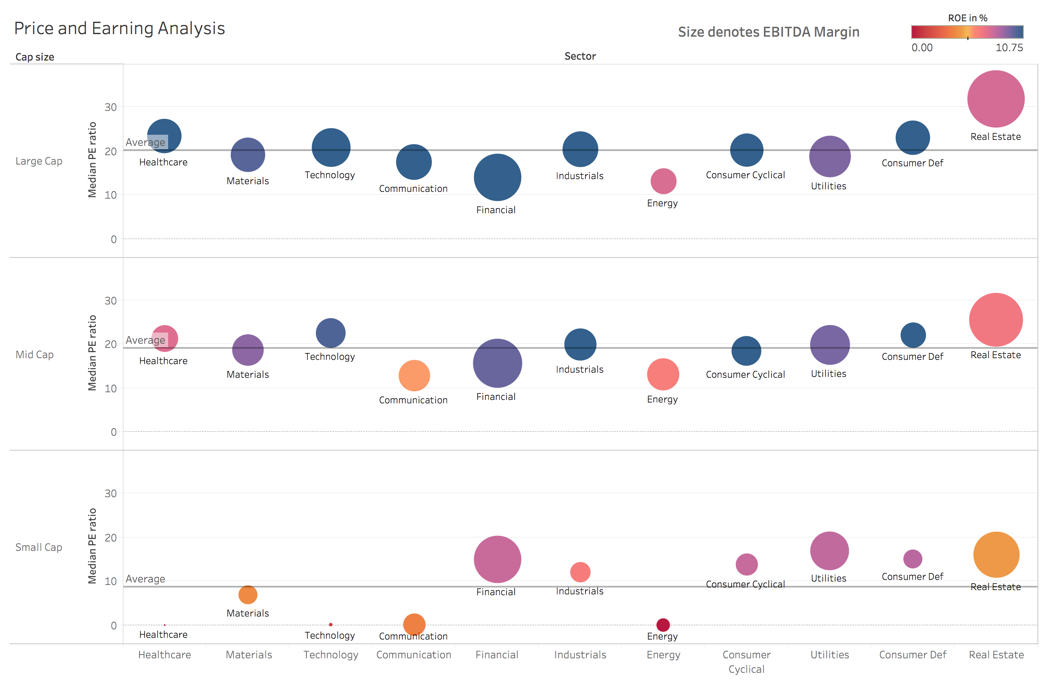
Graph 1

Slide 4
Analysis of Graph 1
Price and Earning Analysis
1. Idea behind making this graph
There are two perspective that is shown in the above graph
Is the sector (across diff cap size) on average profitable ? (Indicated by ROE and EBITDA Margin )
Is the sector (across diff cap size) undervalued or overvalued ? (Indicated by P/E ratio)
2. Inference based on this graph
Large cap stocks
In large cap, majority of sector is blue indicating that Return on equity is high for these stocks. Therefore the investor are also buying these stocks more and driving it’s P/E ratio high in comparison to small cap stocks.
Due to this high ROE on average, These large cap stocks are also refer to as Blue chip stocks
Small cap stocks
Across sectors, there is more variability in the small cap sector . This indicates that the level of uncertainty is more in small companies since there are in the growth stage and still figuring out there business model/niche

Slide 5
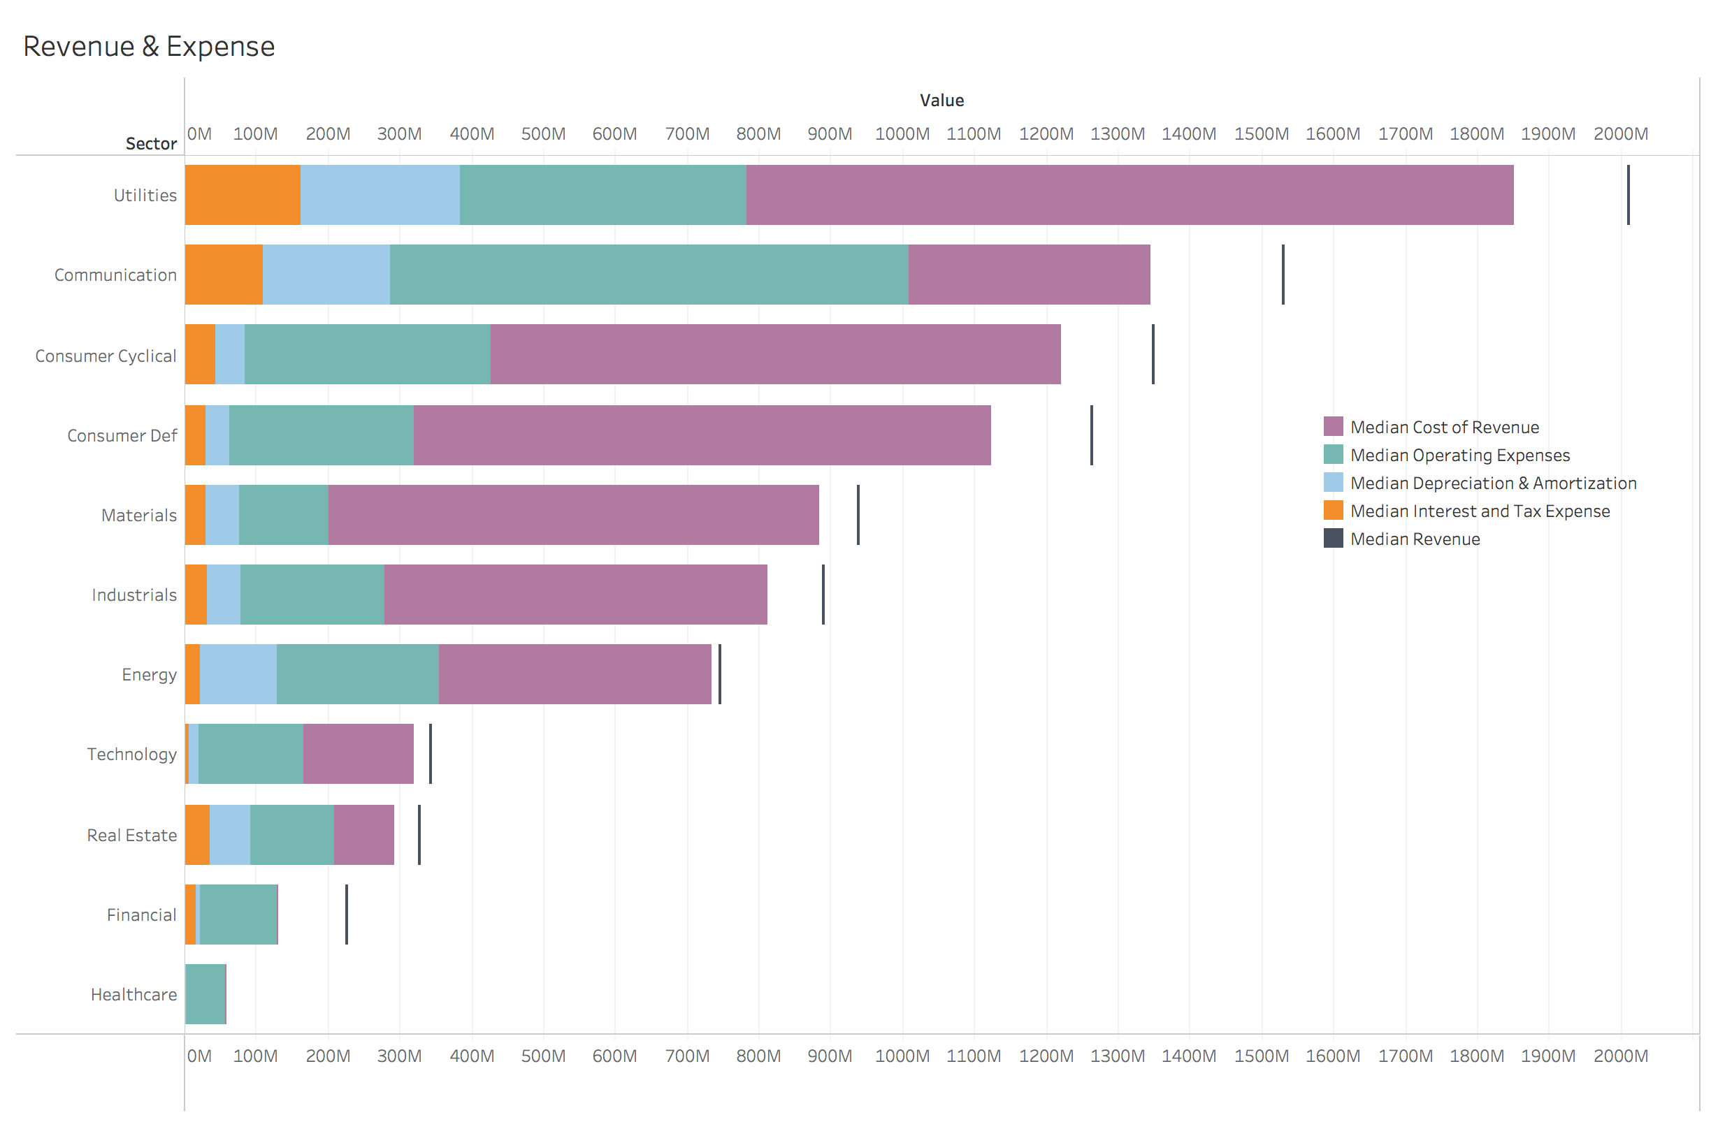
Graph 2

Slide 6
Analysis of Graph 2
Revenue and Expense
1. Idea behind making this graph
There are four major type of expenses
Cost of revenue: represent the direct costs associated with the goods and services the company provides
Operating Expenses: Operating expenses refer to expenditures that are not directly tied to the production of goods or services, such as rent, utilities, office supplies, marketing & R&D
Depreciation and Amortization: Depreciation represents the cost of capital assets on the balance sheet being used over time, and amortization is the similar cost of using intangible assets like goodwill over time.
Interest and Income tax expense: Interest expense relates to the cost of borrowing money.
2. Inference based on this graph
Some sectors are more capital intensive then other. Therefore various metrics like total debt, working capital will be highly sector dependent.
The proportion of different type of expenses varies across the sector due to different dynamics and this could be used as a anomaly detector to figure out the companies that is not following the overall trend of expense in their sector
.

Slide 7
2. Identifying Important discriminating factor

Slide 8
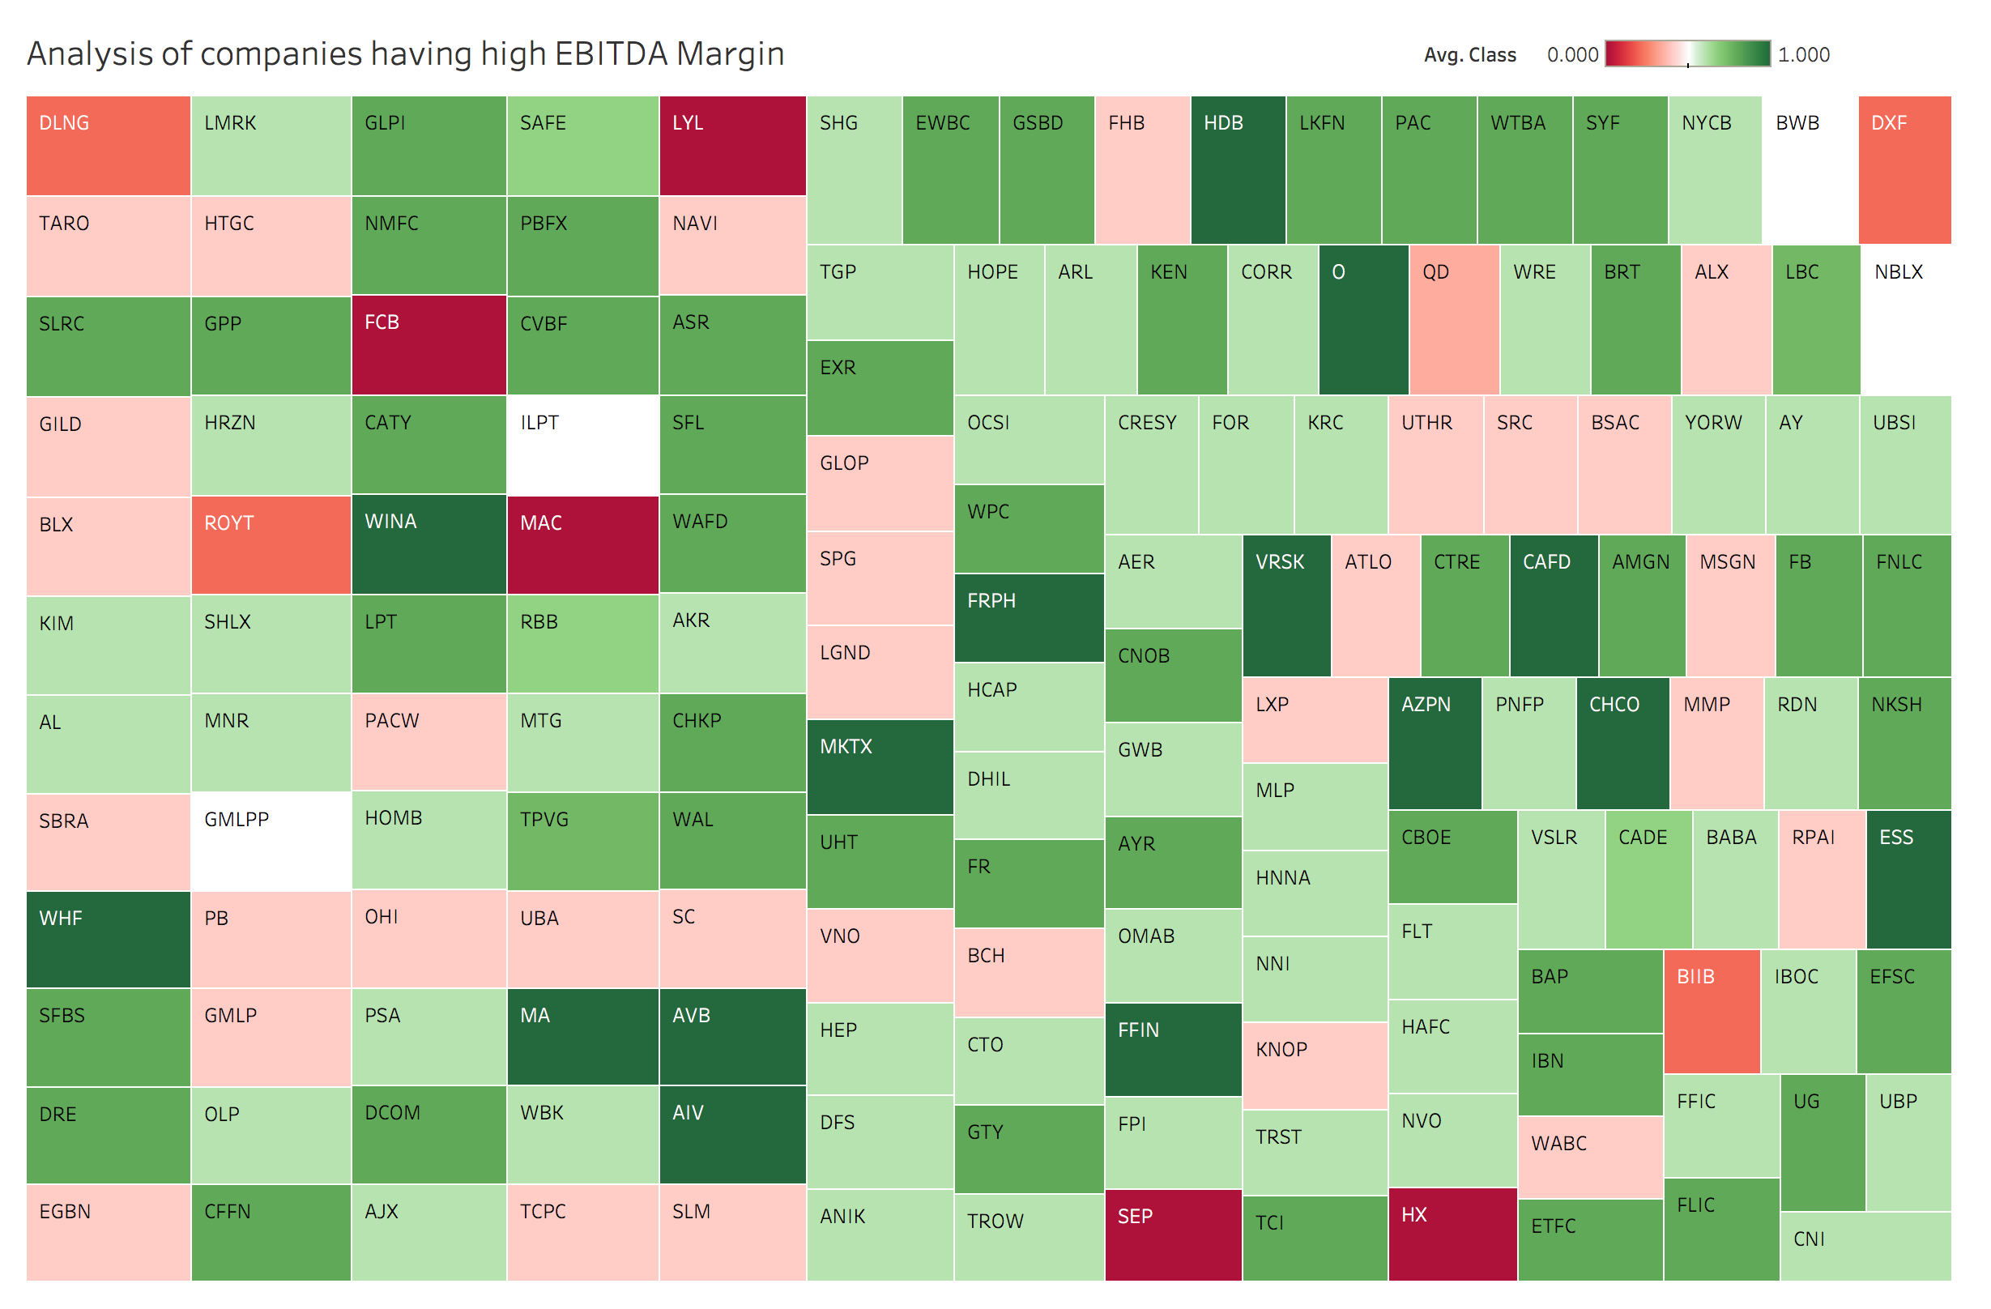
Graph 3
High P/E Ratio (81)
Low current ratio (0.02)
Low current ratio (0.6)
High P/E Ratio (51)
High P/E Ratio (57)

Slide 9
Analysis of Graph 3
Analyzing Companies having high EBITDA Margin
1. Idea behind making this graph
Here we are doing exploratory analysis by seeing only those companies that have high EBITDA Margin (15-60%) .
Intuitively, Mostly the companies belonging here have class 1(green color)
But the idea behind making this graph is to individually analyze the companies which belong to class 0 in spite of having a high EBITDA Margin. In the process of finding the reason why these companies belong to class 0. We would discover other variables that are important along with EBITDA Margin
2. Inference based on this graph
There are two major reason because of which the companies belong to class 0 in spite of having high EBITDA Margin
Low current ratio: The current ratio is a liquidity ratio that measures a company's ability to pay short-term obligations . Low values indicates the weak financial stability due to insufficient cash
High P/E ratio: generally indicates that the stock has become over valued therefore due to market correction, it’s share price has decreased
Note
Class 0: Stocks which share price has decreased in the following year
Class 1: Stocks which share price have increased in the following year
EBITDA: Earnings before interest, taxes, depreciation and amortization

Slide 10
3. Insights based on EDA done till now

Slide 11
Two major Insight based on EDA done till now
1.Based on exploratory data analysis done till now .We conclude that sector and Cap size(Large, mid, small) are important categories that govern the dynamics of a company. Therefore when seeing which factors discriminate between class 0 & 1, we should see it separately for each sector and cap size
2. There are 200+ features in this dataset, We will see the discriminating power across class for the four most important factors
Revenue (Sales) - Indicates if there is demand for the product company is offering
EBITDA- Indicates if business model of the company is profitable
Operating cash flow- Indicates financial stability of the company
Market Capitalization- Indicates how much the market values the company. This indicates current health as well as expectation of future health
These four factors are identified based on the exploratory analysis done till now
So therefore in the next analysis we would see the discriminating power of these factors across class for each sector and cap size.

Slide 12
4. Discriminatory Analysis across Class

Slide 13
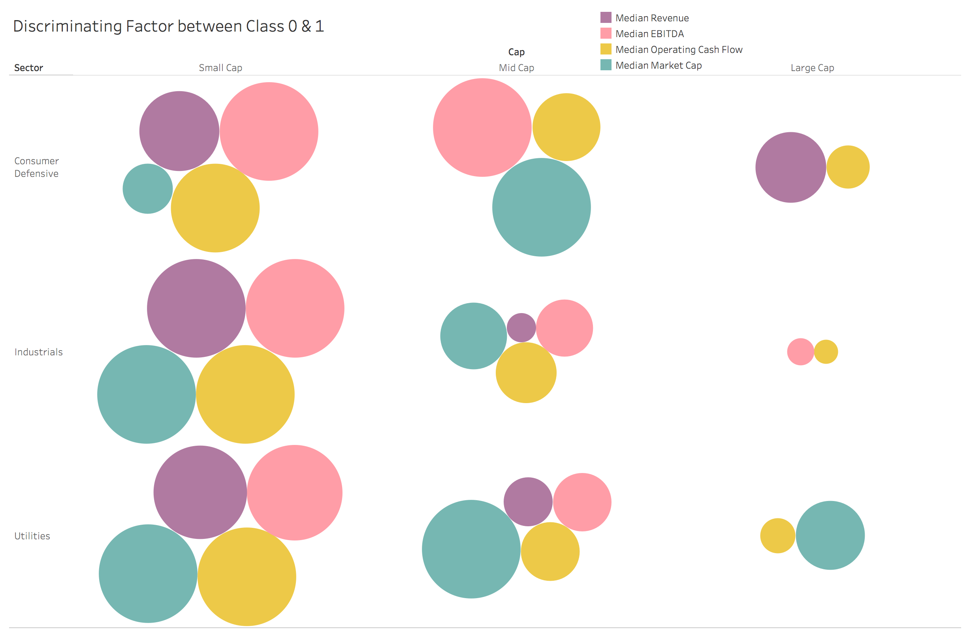
Graph 4.1
Note on how to read the graph
Size denotes the percent difference between class 1 & class 0
Large size show that particular factor is on average bigger for class 1 then class 0
Zero Size shows that particular factor is not bigger for class 1 then class 0
Inference Based on this graph
For these three sector the discriminating power of the factors is more in small cap then large cap

Slide 14
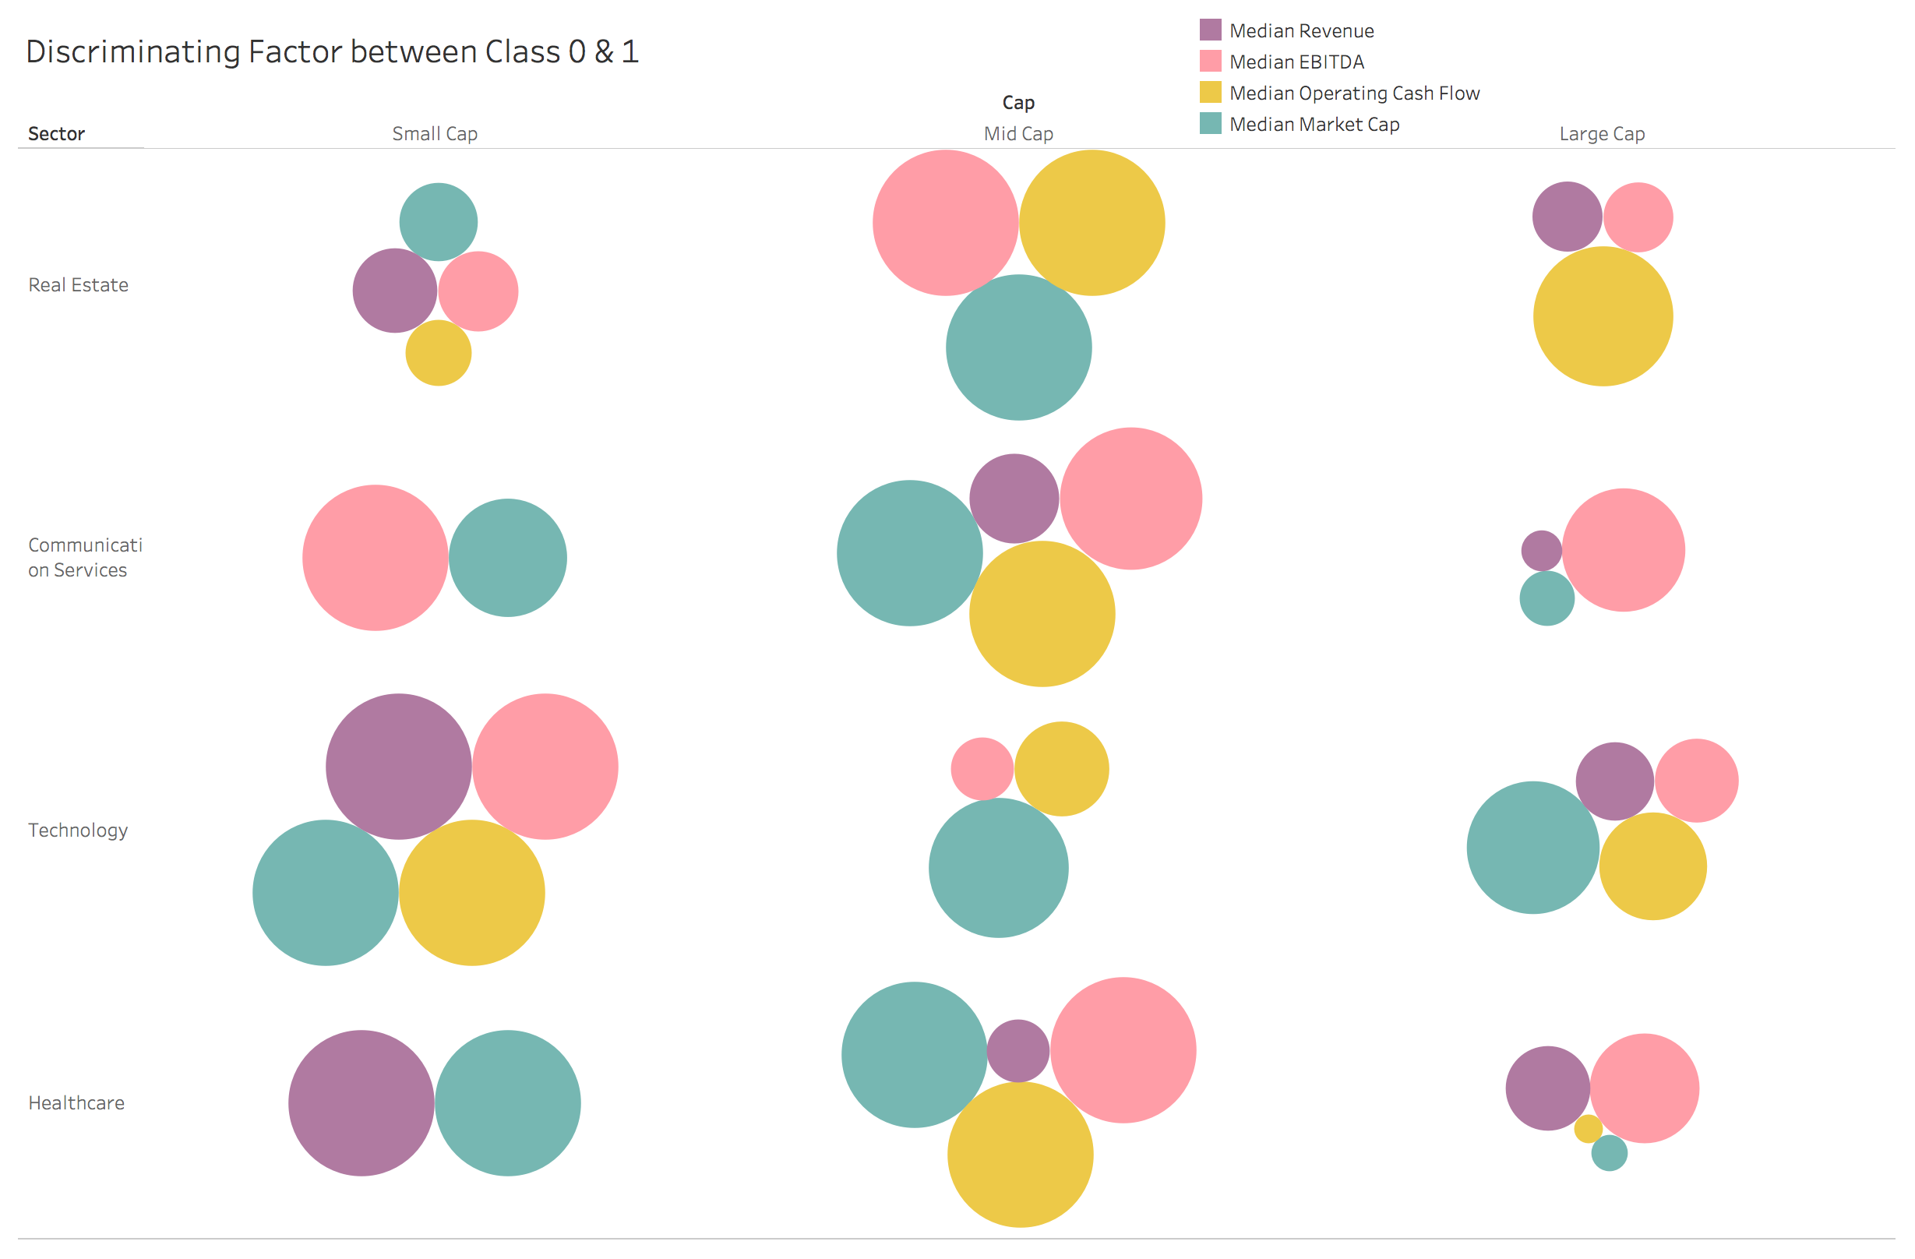
Graph 4.2
Note on how to read the graph
Size denotes the percent difference between class 1 & class 0
Large size show that particular factor is on average bigger for class 1 then class 0
Zero Size shows that particular factor is not bigger for class 1 then class 0
Inference Based on this graph
For Real estate and communication discriminating the classes in mid cap is easier then small/large cap
In technology it is equally easy to discriminate across cap

Slide 15
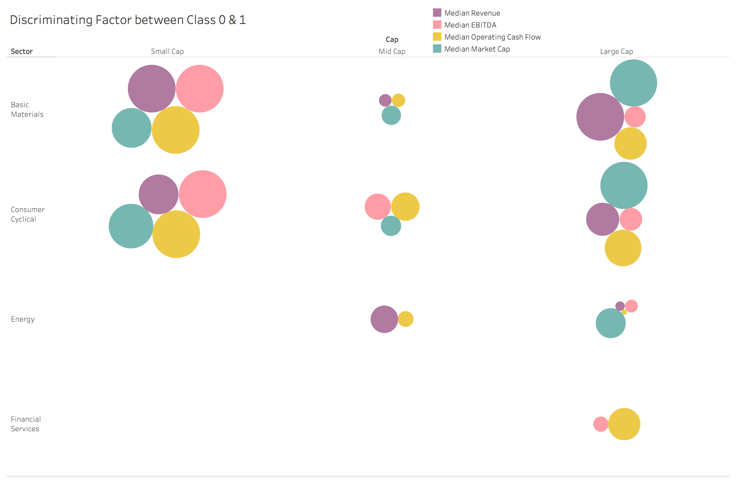
Graph 4.3
Note on how to read the graph
Size denotes the percent difference between class 1 & class 0
Large size show that particular factor is on average bigger for class 1 then class 0
Zero Size shows that particular factor is not bigger for class 1 then class 0
Inference Based on this graph
In Basic materials and Consumer cyclical it is hard to discriminate a mid cap stock
In general the discriminating power is not great in Energy and financial sector

Slide 16
Chapter 2:
Data Pre-Processing
12 September 2020

Slide 17
Data Cleaning

Slide 18
Data Cleaning
Steps followed in Data Cleaning
1. | We remove the unwanted columns that were semantically similar to other columns.We also removed columns which had very low variance. In this process we were able to reduce the no of columns from 225 to 181.
2. | From alpha vantage(https://www.alphavantage.co/) , We webscrapped the missing data. From this site we found 50 columns detail for most of the companies that were missing
3. | For the remaining 131 columns (181-50) we calculated its value based on the exact formula For eg Book Value per Share = (Total asset-total liabilities) / Weighted Average Shs Out (Dil) Total asset, total liabilities and Weighted Average Shs Out (Dil) were given in those 50 columns and accordingly we calculated the Book value per share
4. | Remaining missing values were then imputed with KNN Imputer.
Note 1: In cleaned dataset we are sending the outliers is not removed
Note 2: Finally There are 20,794 rows & 181 columns
Note 3: Data is from 2014-2018

Slide 19
2. Outlier Treatment

Slide 20
Removing outliers using pyOD
What is pyOD?
PyOD is an open-source Python toolbox for performing scalable outlier detection on multivariate data. It provides access to a wide range of outlier detection algorithms, including well established outlier ensembles
How are we using pyOD ?
We would be aggregating the result of seven different outlier detection algorithm in pyOD, So that the outlier detected is more robust to mistakes made by any one algorithm
Outlier fraction of 0.1 is used in each method as a threshold to decide the number of outliers
Angle-based Outlier Detector (ABOD), Cluster-based Local Outlier Factor (CBLOF), Feature Bagging, Histogram-base Outlier Detection (HBOS), Isolation Forest, KNN, Average KNN are the name of seven outlier detection algorithm used
Final result after using it
We have removed 870 companies in which at least 5 out of 7 methods told that the corresponding company is a outlier
The outlier companies removed correspond to approximately 4% of the total companies
2. Replacing the outlier by upper or lower cap
After removing the outliers using the above method , We would be capping all the remaining outlier beyond the 0.1 and 0.9 percentile value with corresponding lower or upper cap

Slide 21
3. Feature Engineering

Slide 22
Statistical Analysis - To identify similar input columns
1.We applied pearson correlation between all the possible combination of numerical input columns
2. From here we identified the pair of input columns which have more than 0.9 correlation
3. Based on this analysis, we were able to remove 25 columns
4. The columns we removed through the above process was in sync with our domain knowledge. for eg we saw high correlation between EBITDA Margin and EBIT Margin
Note: Now we have 154 columns

Slide 23
Feature Selection - To identify least important features
Univariate Feature Selection
1.We compare each feature to the target variable(Class), to see whether there is any statistically significant relationship between them
2. We are using two different univariate feature selection method- f test and mutual information classification test
Recursive feature elimination using models
1.Compared to univariate feature selection, model-based feature selection consider all feature at once, thus can capture interactions.
2. We are using two different models- Logistic Regression and Random Forest Classifier as a recursive feature selector
Note
In each of the 4 methods the top 90 out of 150 columns were selected
To make this robust to the mistake made by any one of the models, We identified the least important column which was not selected by at least 3 out of the 4 methods.
Final result
On combining the result obtained from the above method with domain knowledge, We were able to remove 10 more columns.
Note: Now we have 144 columns

Slide 24
4. Data Transformation

Slide 25
Binning the numerical features
First we identified the columns which denoted growth. There were 15 such columns
These columns were binned at 5 levels
2. One hot encoding the categorical features
Sector were encoded using pd.dummies
3. Scaling & Normalisation
All the numerical features were scaled using Standard Scaler

