Slide 1
Interactive Stock Price Visualization Tool
Submitted by: Alok kumar sah
Lakshya pandya
victor khangembam

Slide 2
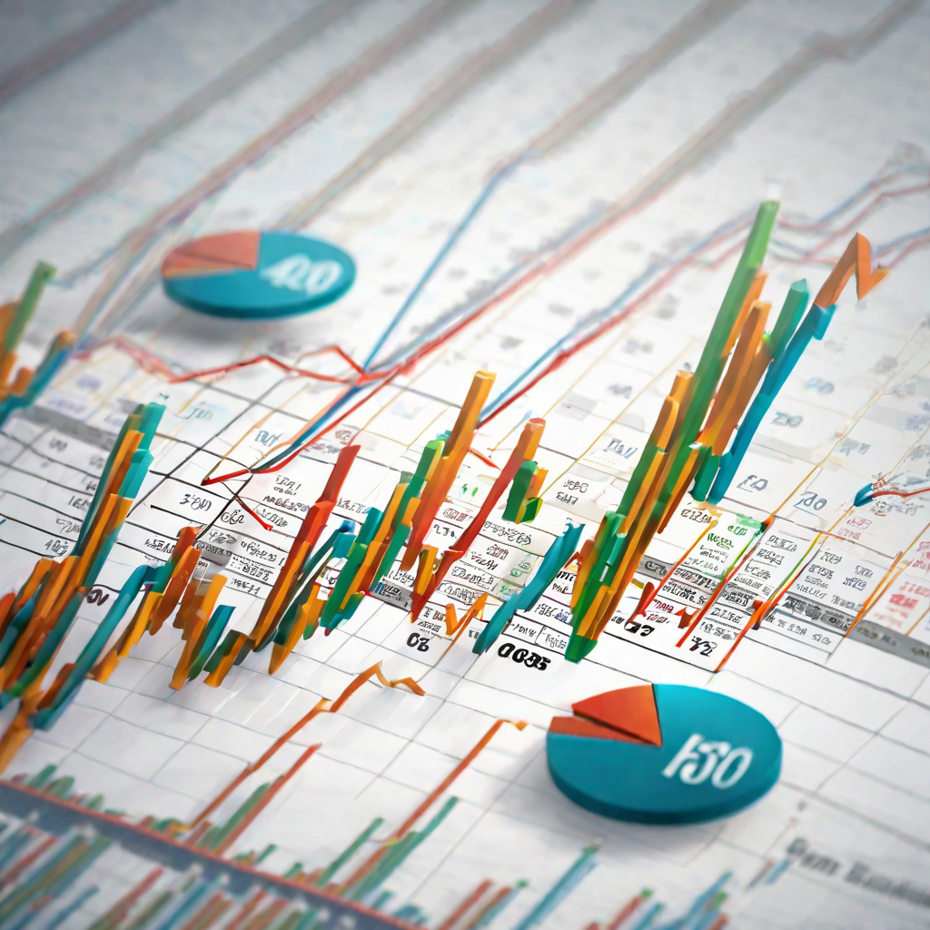
Introduction
This project introduces an interactive and dynamic Python-based tool for visualizing stock prices using Plotly and the Yahoo Finance API. The user interface allows users to select from a range of popular stocks, such as Google, Tesla, Apple, Cisco, and Intel, or input a custom stock name for personalized analysis. Leveraging the capabilities of Plotly, the tool generates visually appealing candlestick charts that represent the stock's open, high, low, and close prices over the past 5 days at hourly intervals.
The tool's functionality extends beyond mere visualization, offering users the flexibility to explore and analyze stock trends. The interactive chart comes equipped with a range slider and a time interval selector, enabling users to zoom in on specific timeframes, from 15 minutes to the entire available data set. This feature empowers investors and enthusiasts to conduct detailed analyses and make well-informed decisions based on historical stock performance.

Slide 3
Problem Statement
The financial landscape, particularly in stock market investments, often presents a challenge for individuals to access and interpret real-time data effectively. Traditional methods of stock analysis may be cumbersome and lack the visual appeal necessary for a comprehensive understanding of market trends. There is a clear need for a user-friendly, interactive tool that seamlessly integrates with reliable financial data sources and provides an intuitive visualization of stock prices.

Slide 4
Requirement Analysis
From the given scenario, we draw the following requirements:
The tool should integrate with the Yahoo Finance API or a similar reliable financial data source to fetch real-time stock price data.
The tool should use Plotly to generate visually appealing candlestick charts that represent the historical open, high, low, and close prices of the selected stock over a specified time period.
Internet connectivity to retrieve the real time stock values using api
Python running environment for the program
We need to configure a stock market value display keeping the following requirements in mind.

Slide 5
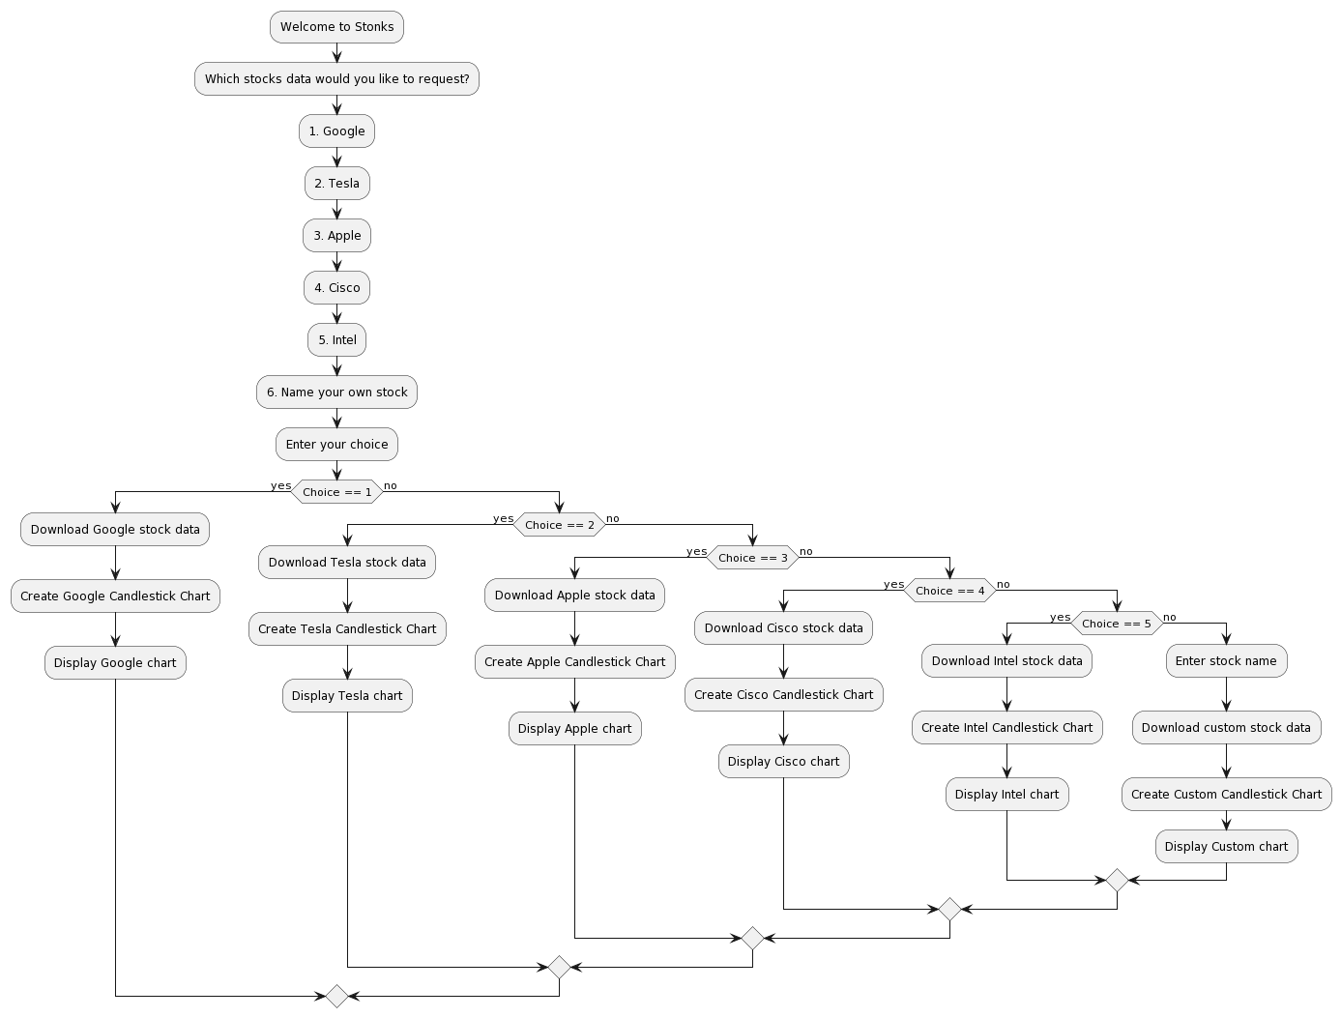
Flowchart

Slide 6
IMPLEMENTATION
import plotly.graph_objs as goh import yfinance as yif print("welcome to Stonks") print("\nWhich stocks data would you like to request?") print("\n1. Google") print("\n2. Tesla") print("\n3. Apple") print("\n4. Cisco") print("\n5. Intel") print("\n6. Name your own stock") ch = input("\nPlease enter your choice.\n") if ch == "1": print(ch) data = yif.download(tickers="GOOG", period="5d", interval="1h", rounding=True) fig = goh.Figure() fig.add_trace( goh.Candlestick(x=data.index, open=data['Open'], high=data['High'], low=data['Low'], close=data['Close'], name='market data')) fig.update_layout(title='Google share price', yaxis_title='Stock Price (Rs)') fig.update_xaxes(rangeslider_visible=True, rangeselector=dict(buttons=list([ dict(count=15, label='15m', step='minute', stepmode='backward'), dict(count=45, label='45m', step='minute', stepmode='backward'), dict(count=1, label='1h', step='hour', stepmode='backward'), dict(count=6, label='6h', step='hour', stepmode='backward'), dict(step='all')]))) fig.show()

Slide 7
elif ch == "2": data = yif.download(tickers="TSLA", period="5d", interval="1h", rounding=True) fig = goh.Figure() fig.add_trace( goh.Candlestick(x=data.index, open=data['Open'], high=data['High'], low=data['Low'], close=data['Close'], name='market data')) fig.update_layout(title='Tesla share price', yaxis_title='Stock Price (USD)') fig.update_xaxes(rangeslider_visible=True, rangeselector=dict(buttons=list([ dict(count=15, label='15m', step='minute', stepmode='backward'), dict(count=45, label='45m', step='minute', stepmode='backward'), dict(count=1, label='1h', step='hour', stepmode='backward'), dict(count=6, label='6h', step='hour', stepmode='backward'), dict(step='all')]))) fig.show() elif ch == "3": data = yif.download(tickers="APPL", period="5d", interval="1h", rounding=True) fig = goh.Figure() fig.add_trace( goh.Candlestick(x=data.index, open=data['Open'], high=data['High'], low=data['Low'], close=data['Close'], name='market data')) fig.update_layout(title='Apple share price', yaxis_title='Stock Price (USD)') fig.update_xaxes(rangeslider_visible=True, rangeselector=dict(buttons=list([

Slide 8
dict(count=15, label='15m', step='minute', stepmode='backward'), dict(count=45, label='45m', step='minute', stepmode='backward'), dict(count=1, label='1h', step='hour', stepmode='backward'), dict(count=6, label='6h', step='hour', stepmode='backward'), dict(step='all')]))) fig.show() elif ch == "5": data = yif.download(tickers="INTC", period="5d", interval="1h", rounding=True) fig = goh.Figure() fig.add_trace( goh.Candlestick(x=data.index, open=data['Open'], high=data['High'], low=data['Low'], close=data['Close'], name='market data')) fig.update_layout(title='Intel share price', yaxis_title='Stock Price (USD)') fig.update_xaxes(rangeslider_visible=True, rangeselector=dict(buttons=list([ dict(count=15, label='15m', step='minute', stepmode='backward'), dict(count=45, label='45m', step='minute', stepmode='backward'), dict(count=1, label='1h', step='hour', stepmode='backward'), dict(count=6, label='6h', step='hour', stepmode='backward'), dict(step='all')]))) fig.show() elif ch == "6": na = input("Enter stock name") data = yif.download(tickers=na, period="5d", interval="1h", rounding=True) fig = goh.Figure() fig.add_trace( goh.Candlestick(x=data.index, open=data['Open'], high=data['High'], low=data['Low'], close=data['Close'], name='market data')) fig.update_layout(title=na+' share price', yaxis_title='Stock Price (Rs)') fig.update_xaxes(rangeslider_visible=True, rangeselector=dict(buttons=list([ dict(count=15, label='15m', step='minute', stepmode='backward'), dict(count=45, label='45m', step='minute', stepmode='backward'), dict(count=1, label='1h', step='hour', stepmode='backward'), dict(count=6, label='6h', step='hour', stepmode='backward'), dict(ste

Slide 9
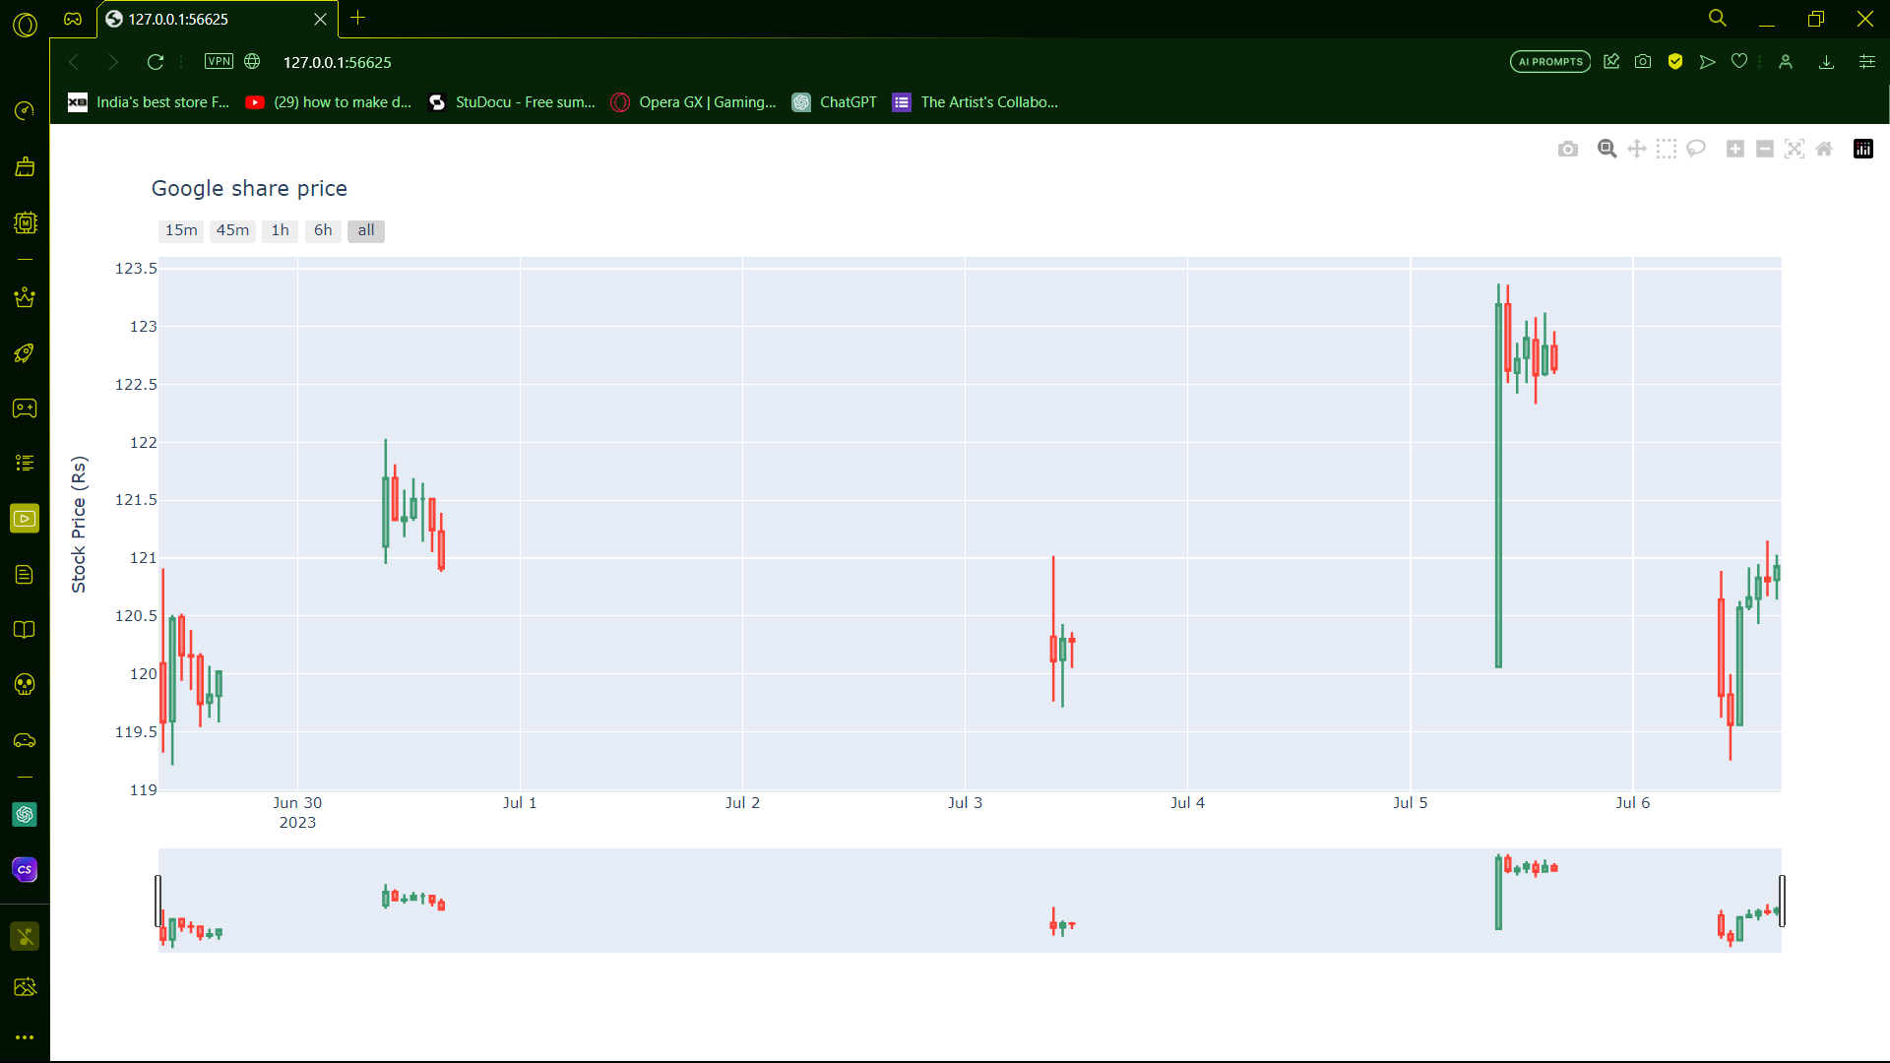
OUTPUT

Slide 10
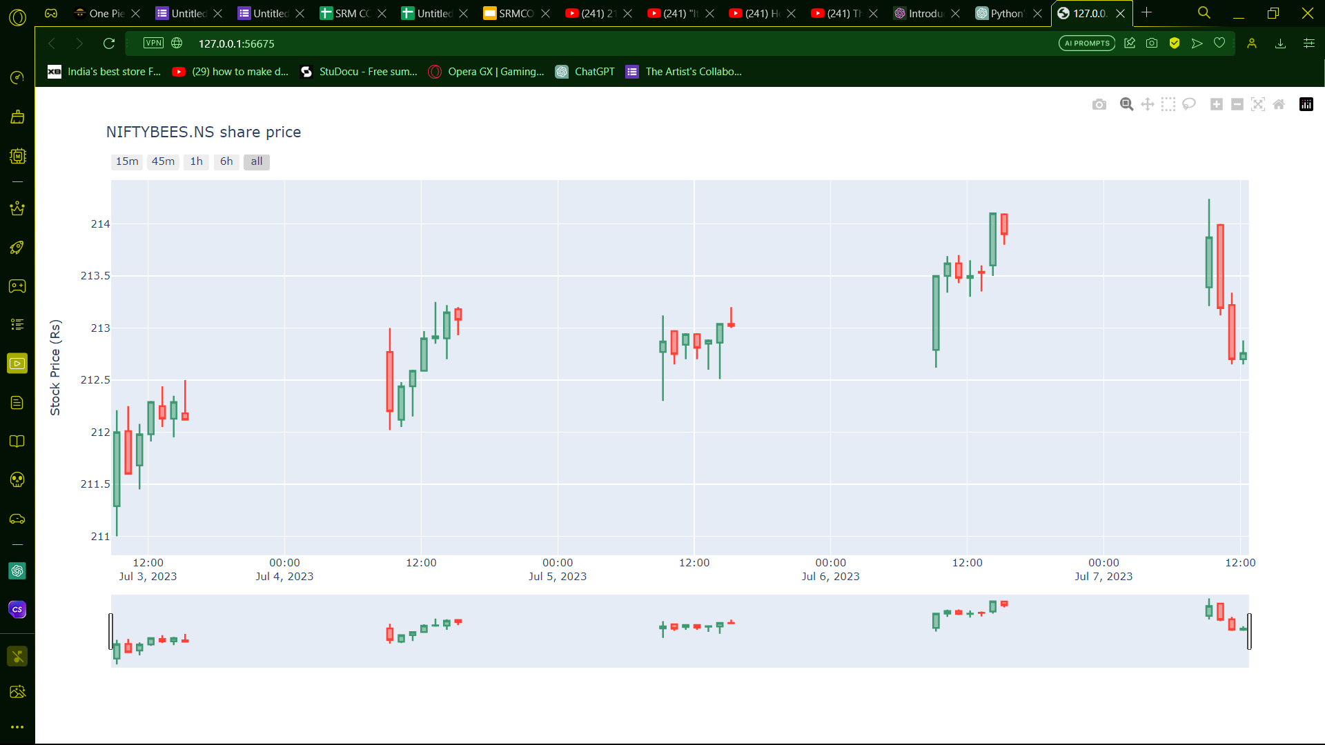

Slide 11
DISCUSSIONS
The project, centered around a stock price visualization tool, has culminated in a robust and user-friendly application that empowers individuals to explore and analyze stock market trends with ease. The implemented features showcase a well-designed interface that enables users to select from popular stocks or input custom stock names, offering a versatile and personalized experience. The flowchart, efficiently represented in PlantUML, vividly illustrates the logical sequence of operations within the tool, providing users with a clear roadmap from stock selection to the visualization of candlestick charts. The integration of real-time data from the Yahoo Finance API ensures the tool's responsiveness, delivering up-to-date insights for informed decision-making. The modular codebase facilitates scalability and future enhancements, demonstrating a forward-looking approach to accommodate evolving user needs and technological advancements in the financial technology landscape. Additionally, the educational component enriches the user experience by providing insights into interpreting candlestick patterns, contributing to users' financial literacy. Overall, the project has successfully achieved its objectives, providing a valuable and educational tool for users to navigate the complexities of stock markets through intuitive and interactive visualizations.

Slide 12
REFERENCES
McKinney, Wes. "Python for Data Analysis: Data Wrangling with Pandas, NumPy, and IPython." O'Reilly Media, 2017.
Plotly Documentation. "Plotly Python Open Source Graphing Library." Available at: https://plotly.com/python/
The Python Software Foundation. "Python 3 Documentation." Available at: https://docs.python.org/3/
The Yahoo Finance API Documentation. "Yahoo Finance API Documentation." Available at: https://rapidapi.com/apidojo/api/yahoo-finance1

