Slide 1
PCOS Dashboard Report
Analysis based on cleaned dataset of 541 women
Focus: Prevalence, metabolic, reproductive, and symptomatic patterns

Slide 2
PCOS Prevalence
PCOS is common among women in reproductive age
Higher incidence found in young adult women (25-34 years)

Slide 3
Age Distribution
Majority fall under Young Adult and Adult groups
Earlier onset suggests need for routine screening

Slide 4
BMI & Body Composition
Many PCOS patients are in overweight/obese category
BMI and metabolic stress linked to PCOS risk

Slide 5
Reproductive Indicators
Higher follicle count observed in PCOS patients
Ultrasound often shows PCO patterns

Slide 6
Symptom Analysis
Common symptoms: Weight gain, Hair loss, Pimples, Skin darkening
Most patients fall into Mild to Moderate severity

Slide 7
Menstrual Health Patterns
Cycle irregularity more common among PCOS patients
Useful for early screening but not sole diagnostic factor

Slide 8
Conclusion
PCOS linked strongly to metabolic and hormonal factors
Early lifestyle changes can improve long-term health

Slide 9
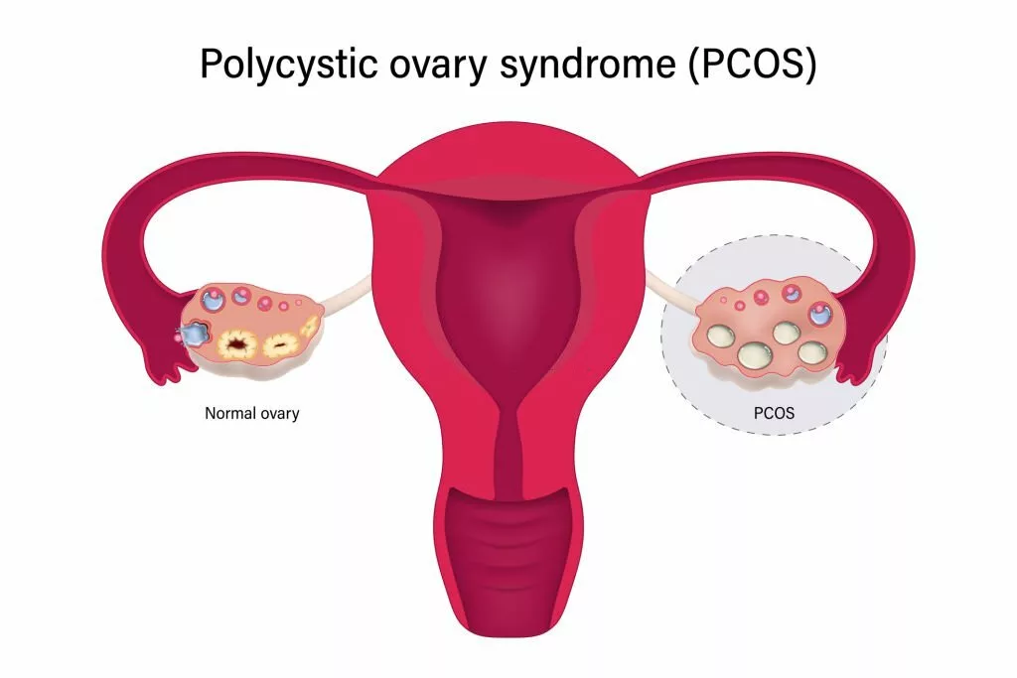

Slide 10
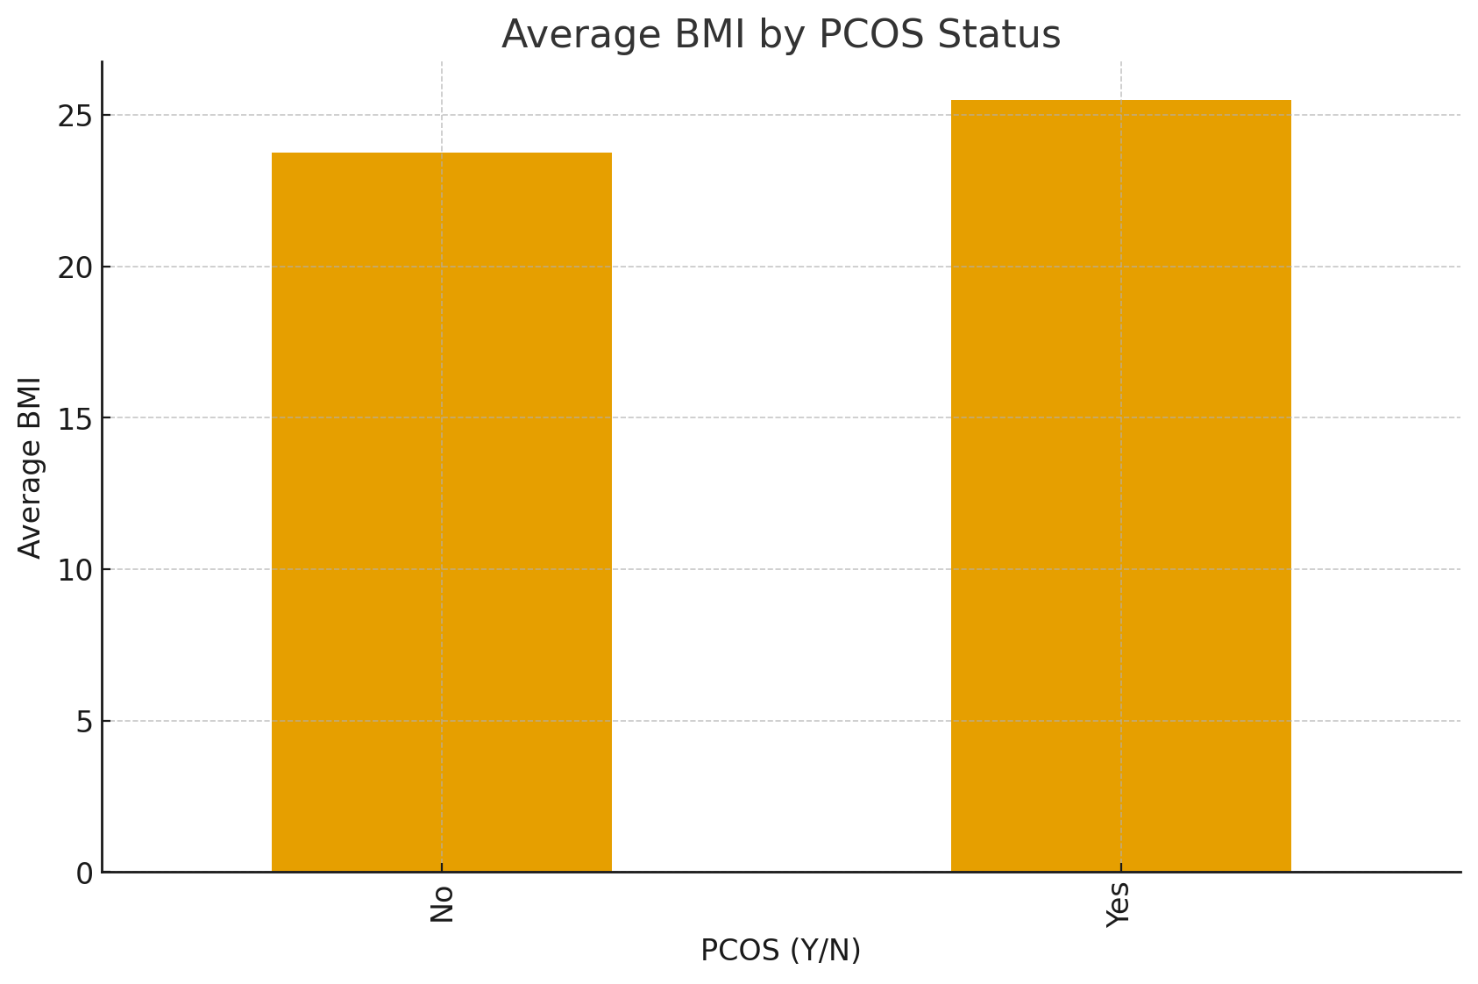
BMI Comparison

Slide 11
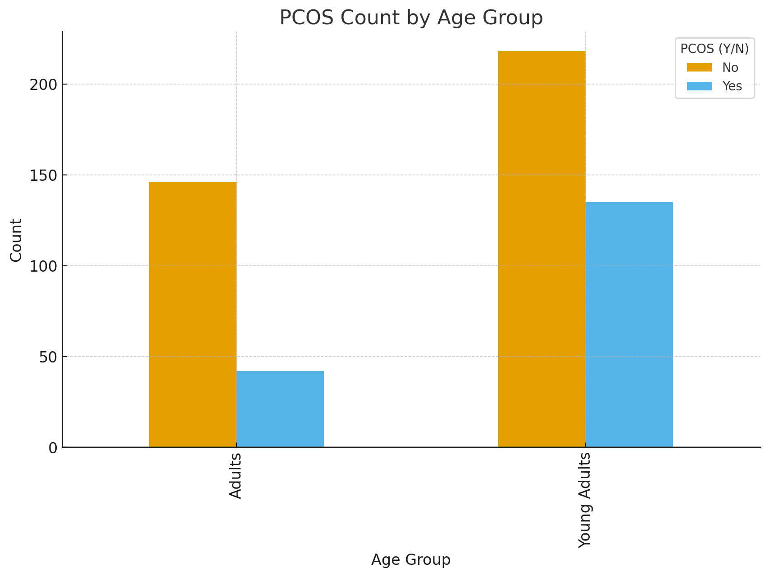
Age Group vs PCOS Presence

Slide 12
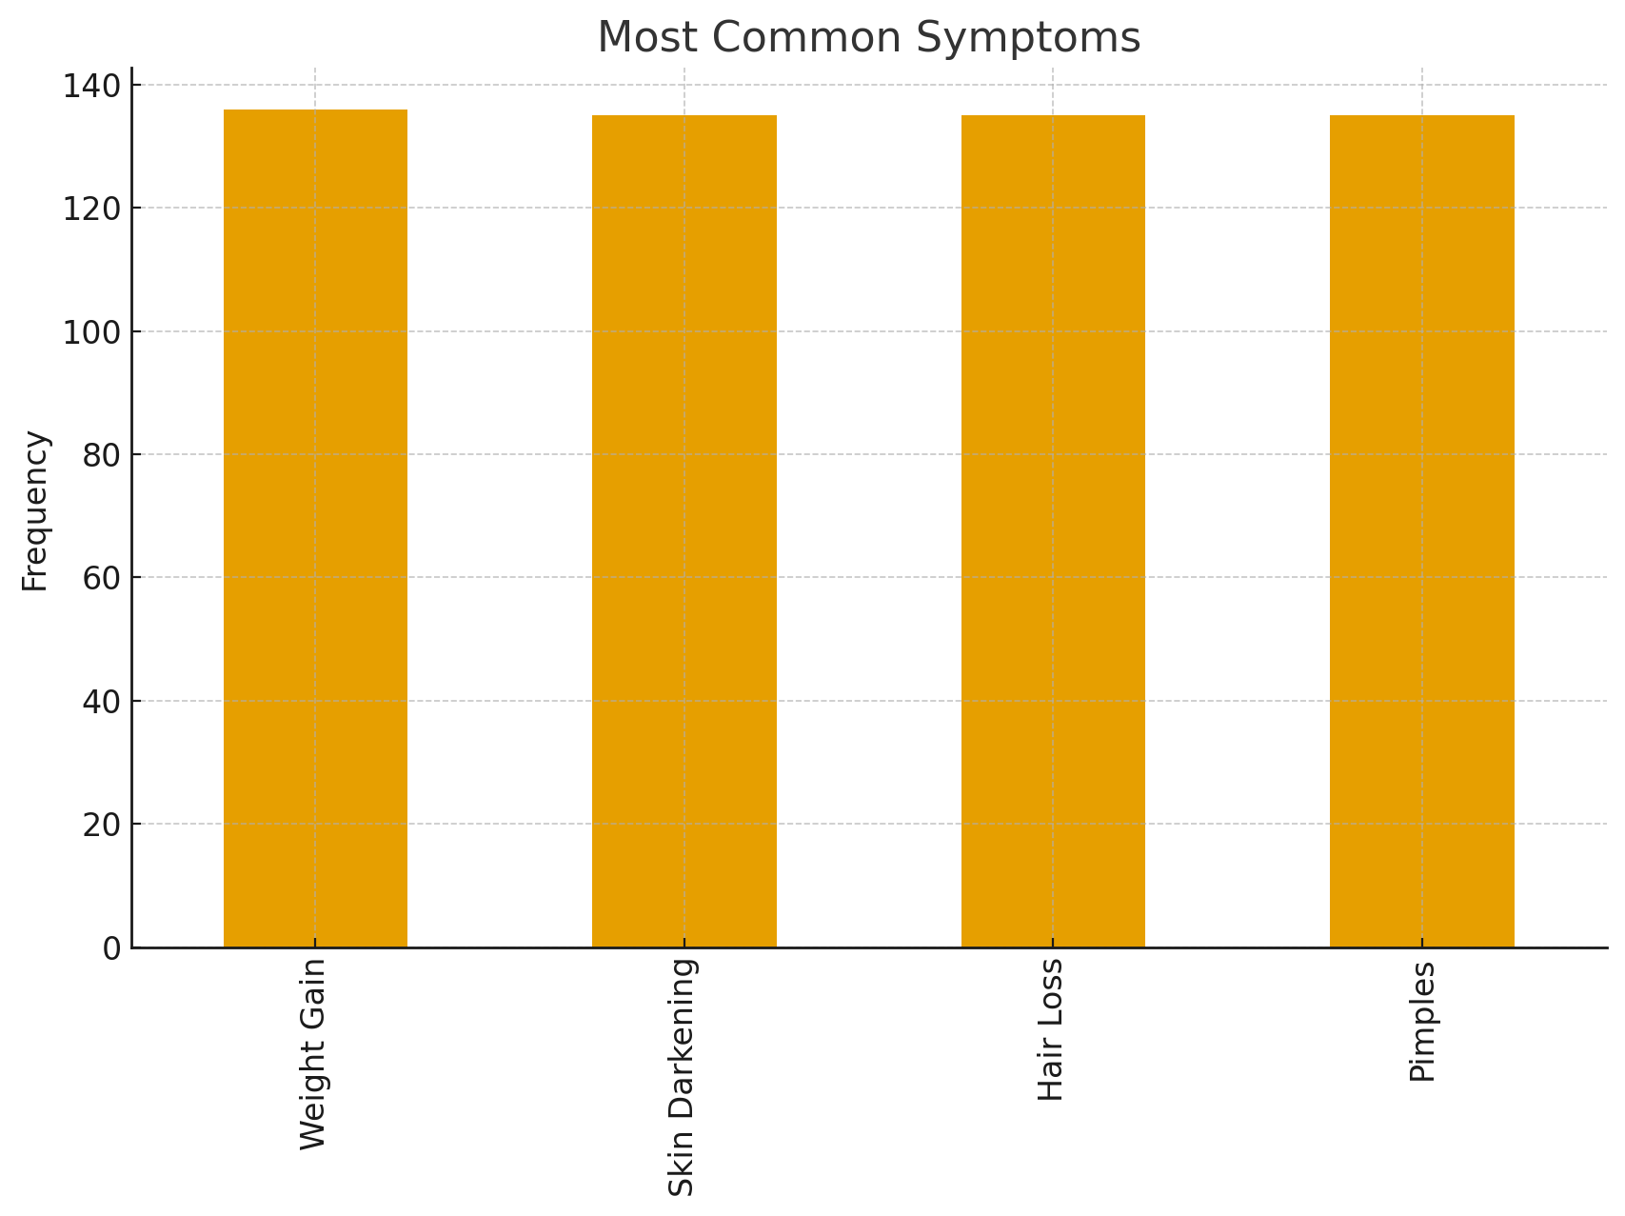
Common Symptoms Distribution

