Slide 1
P-Review

Slide 2
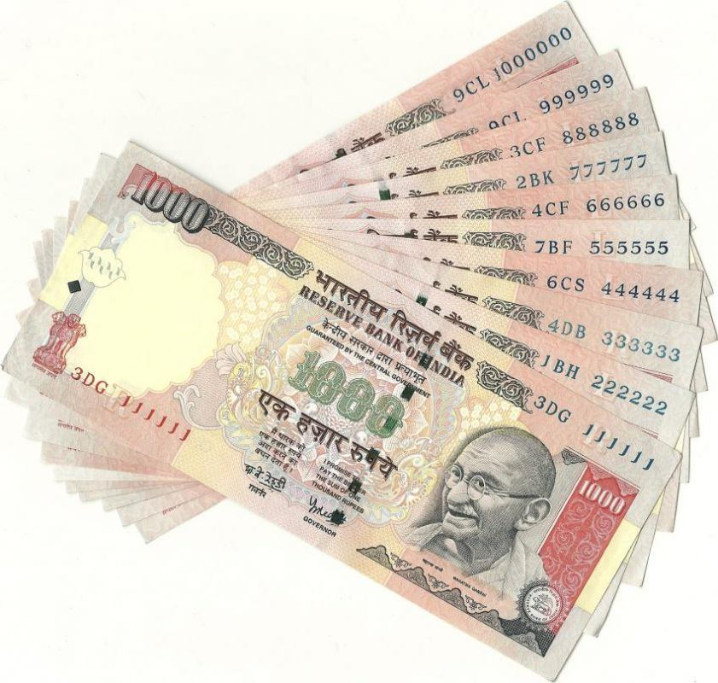
**Please Read the offer document carefully before investing.

Slide 3

Reading the Fine print

Slide 4
Data Gathering
Updating Database
Servicing API
Mobile/Web interface

Slide 5




Tech Stack
API server
Database
Mobile UI
Web UI

Slide 6
Thank You!

