Slide 1
Project Overview
Automation Title: Project 2 - Team Member Data Capture & AI Poetry Generator
Business Goal: Automatically collect team member details via a form, assign a role-based rating, generate a custom 2-line AI poem based on the user’s data, and update results into Airtable.
Tools Used:
- n8n
- Airtable
- Google Gemini (via LangChain)
- AI Agent node in n8n

Slide 2
Workflow Description
1. Trigger: A form is submitted with Name, Looks, and Profession.
2. Store: The data is saved to Airtable.
3. Decision Node: Based on Profession, the workflow assigns a predefined rating.
4. AI Interaction: An AI poem is generated using LangChain and Google Gemini model.
5. Update: The poem and rating are updated back in Airtable.

Slide 3
Node-Level Details
- Form Trigger Node: Captures Name, Looks, Profession (dropdown).
- Airtable (Create): Saves the form data to the 'Condition' table in the 'IT Project Management' base.
- Switch Node (Pathways): Routes flow based on profession.
- "Video Editor" → Rating 5
- "Graphic Designer" → Rating 3
- "Ai Manager" → Rating 1
- Airtable (Update): Saves rating to the same record.
- AI Agent + Gemini: Generates a poem using the fields.
- Airtable (Update Poem): Updates the poem into Airtable record.

Slide 4
Sample Data & Output
Sample Input (Form Submission):
- Name: Alex
- Looks: Smart
- Profession: Ai Manager
Generated Output:
- Rating: 1
- Poem: "Alex looks smart and has a curious brain,
As Ai Manager, they run the data train."

Slide 5
Highlights & Takeaways
- Seamless no-code automation using n8n.
- Integrated OpenAI-style AI capabilities with Google Gemini.
- Practical use of Airtable for structured storage and update.
- Good example of role-based logic, API integration, and AI personalization in workflow design.

Slide 6
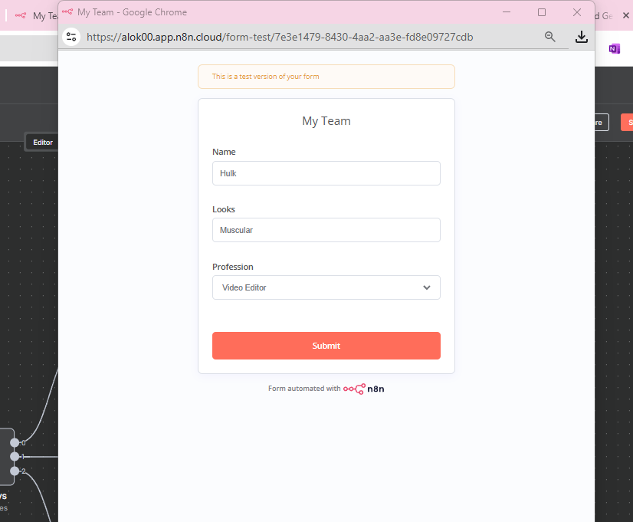
Visual Workflow (Canvas View)

Slide 7
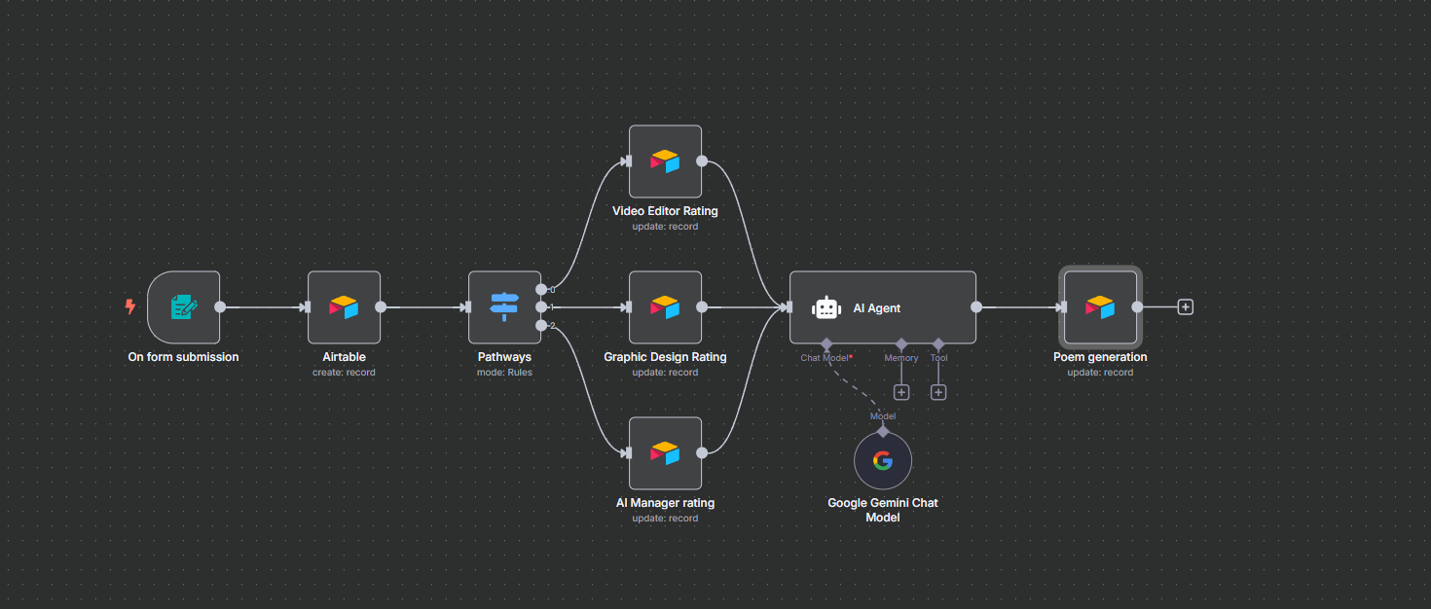
Form View - User Input Interface

Slide 8
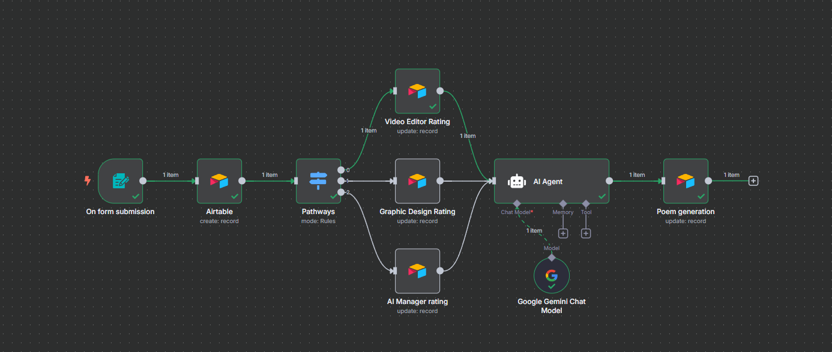
Workflow After Execution

Slide 9
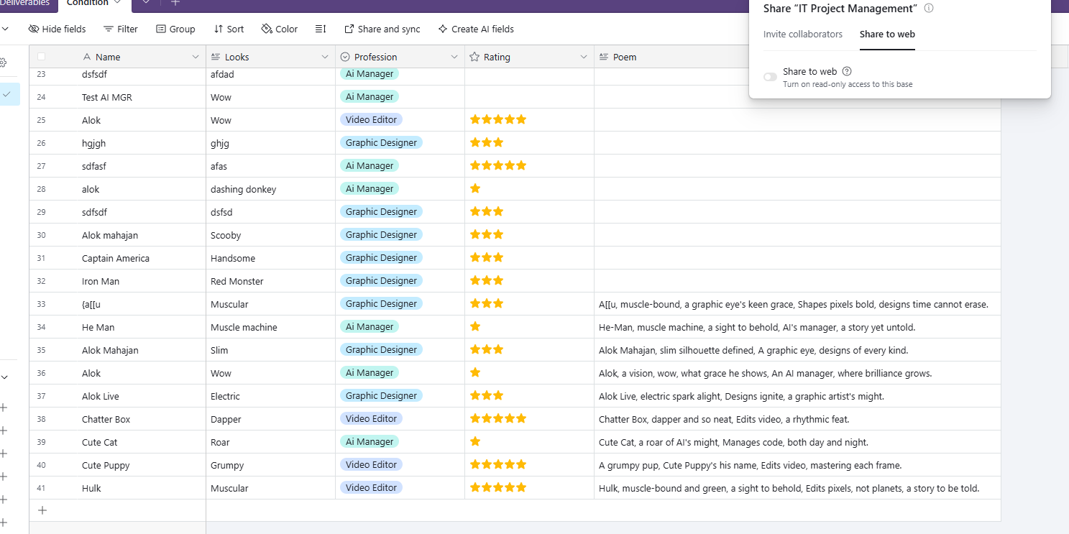
Airtable Output with Poem and Ratings

