Slide 1



Slide 2
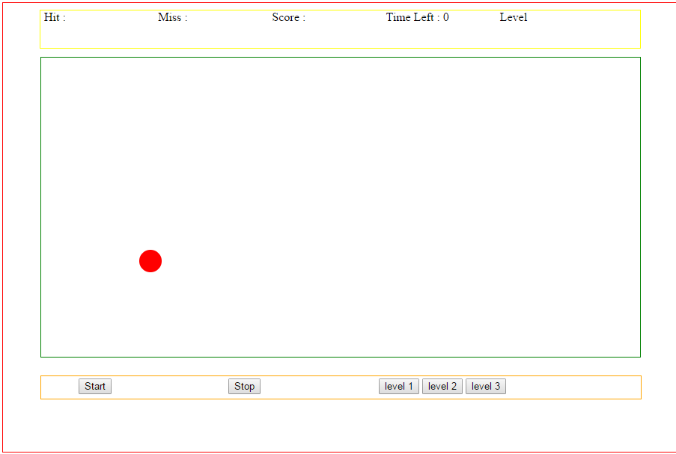
Prerequisites
1) JavaScript
2) Html
Game will look

Slide 3
What All Things Are Required to Develop Game
Learning Canvas in HTML5
1.1) How to draw shapes
1.2) How to animate shape using JavaScript
2) Working with event handling in JavaScript

Slide 4
Understanding Canvas in HTML5
1) Canvas is a Container or an area in webpage where we can draw shapes and animate them using JavaScript.
2) <canvas id="canvas" width="800px" height="400px"></canvas>
3)
<html>
<body>
<div class="wrapper">
<canvas id="canvas" width="400" height="300"></canvas>
</div>
</body>
</html>

Slide 5
How To Draw Shapes in Canvas
1) Getting the Canvas id
var canvas = document.getElementById("canvas");
2) Getting the 2D context of the Canvas
var ctx = canvas.getContext("2d");
3) Drawing shapes in Canvas
Drawing a line in Canvas
ctx.moveTo(0,0); // (x1,y1)
ctx.lineTo(200,100);//(x2,y2)
ctx.stroke();

Slide 6
How To Animate Shape in Canvas using JavaScript
Problem Statement: We will draw a ball and move it horizontally in the canvas
1) Drawing Ball in Canvas
We need to draw an arc to draw a ball
ctx.beginPath(); // to start drawing
ctx. arc(x, y, radius, startAngle, endAngle, counterClockwise); // arc
ctx.fillStyle = "#0095DD"; // giving color
ctx.fill(); // filling the color
ctx.closePath(); // closing the path , when the path begin

Slide 7
How To Animate Shape in Canvas using JavaScript
Problem Statement: We will draw a ball and move it horizontally in the canvas
2) Moving the ball horizontally in Canvas
To Move the ball we need to change the X , Y co-ordinates
Then we have to re-draw the ball every time with new co-ordinates which makes it to move horizontally
We will have a function call setTimeout we need to draw shape with new co-ordinates

Slide 8
How To Animate Shape in Canvas using JavaScript
Problem Statement: We will draw a ball and move it horizontally in the canvas
function drawBall(x,y) {
ctx.save(); // it saves the previous context
ctx.clearRect(x,y,canvaswidth,canvasheight); // clear aways the old shape
//drawing new shape
ctx.beginPath();
ctx.arc(x, y, 10, 0, Math.PI*2);
x=x+1; // increasing x co-ordinate by 1
ctx.fillStyle = "#0095DD";
ctx.fill();
ctx.restore(); // it restores the new shape draw
loopdraw=setTimeout('drawBall('+x+','+y+')',20); // recursive call to the function
}

Slide 9
Building The Setup
We wont dealing much with the design part.
Step 1: Creating the canvas in the html page with some width and height.
<canvas id="canvas" width="800px" height="400px"></canvas>
Step 2: On click of start button , the game starts and on stop , the game stop. Hence creating two JavaScript function.
Step 3: Our first objective will be drawing ball and animating them.
3.1) In our game a ball will have following properties
3.2) {"x":30,"y":40,"r":15,"vx":1,"vy":2,"color":"red","hitcount":1,"misscount":1}
3.3) To draw multiple ball we have to create array of ball with above properties

Slide 10
Building The Setup
Step 4: Understanding and developing the draw function
4.1) function draw(x1,y1){…….}
function draw(x1,y1){
x=x1;
y=y1;
circles[pos].x=x;
circles[pos].y=y;
canvas=document.getElementById('canvas');
var ctx=canvas.getContext('2d');
ctx.save();
ctx.clearRect(0,0,800,400);
ctx.beginPath();
ctx.arc(circles[pos].x,circles[pos].y,circles[pos].r,0,2*Math.PI);
ctx.fillStyle=circles[pos].color;
ctx.fill();
ctx.restore();
4.2) The value of pos will be zero as we will start with first ball from our array

Slide 11

Building The Setup
Step 5: If we observe closely the ball is reflecting back once it hits the container border. In this step we will create the boundary condition to retain the ball within the container
5.1) Understanding the Math's behind
4
1
400px
3
2
800px
5.2) There are total 4 boundary in the above container
5.3) The boundary can be divided into two main category
1) Horizontal Boundary Condition (1 and 3)
2) Vertical Boundary Condition (2 and 4)

Slide 12
Building The Setup
5.4) Formulating the horizontal boundary condition logic
1. If the x-co-ordinate of the ball exceeds the width of the container (3 part of container)
2. If the x-co-ordinate of the ball goes beyond zero.(1 part of container)
3. If any of above two condition are met then reverse the “vx” velocity of the ball
5.5) Formulating the vertical boundary condition logic
1. If the y-co-ordinate of the ball exceeds the height of the container (2 part of container)
2. If the y-co-ordinate of the ball goes beyond zero.(4 part of container)
3. If any of above two condition are met then reverse the “vy” velocity of the ball
Note: vx is horizontal velocity and vy is the vertical velocity of the ball

Slide 13
Building The Setup
5.6) Implementing the boundary condition logic
var circle={"x":30,"y":40,"r":15,"vx":1,"vy":2,"color":"red","hitcount":1,"misscount":1};
// horizontal boundary logic
if( (circle.x+circle.vx+circle.r>800) || ((circle.x-circle.r)+circle.vx<0) )
{
circle.vx=-circle.vx;
}
//vertical boundary logic
if( (circle.y+circle.r+circle.vy<0) || (circle.y-circle.r)+circle.vy>400) )
{
circle.vy=-circle.vy;
}
circle.x=circle.x+circle.vx;
circle.y=circle.y+circle.vy;

Slide 14
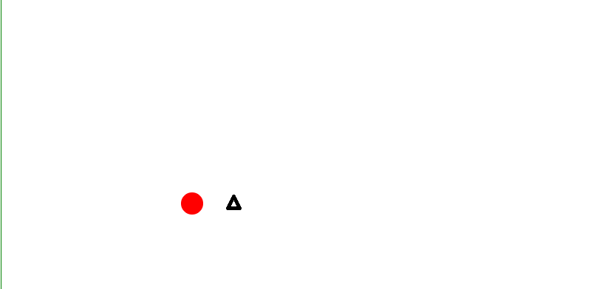
Building The Setup
Step 6 : Registering events using JavaScript
In this step we will calculate how to trigger on click event on ball and to find weather the ball has been hit or not.
1) Calculating the position of the on-click event, means finding the on-click current X,Y co-ordinates where it has been triggered
Ball’s position
Mouse event
X,Y
X1,Y1
2) The objective is to find the (X1, Y1) , co-ordinates of the event fired

Slide 15
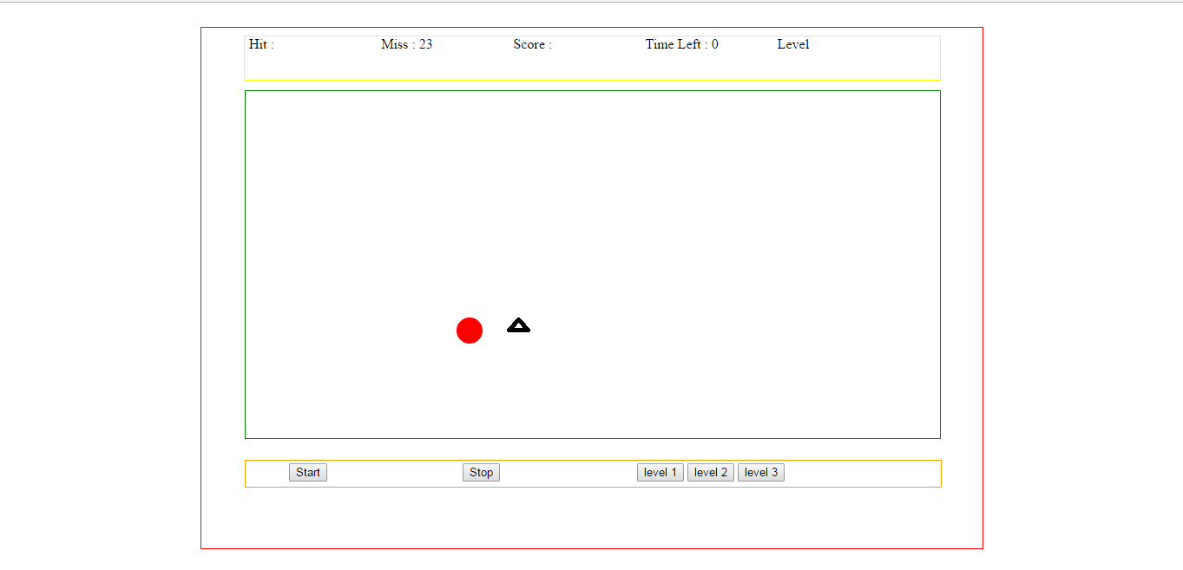
Building The Setup
3) Using JavaScript we can capture the event to get its X, Y location in the window.
var X1 = e.clientX;
var Y1= e.clientY;
“e” is the event fired
4) The above will give co-ordinates with reference to window. Hence we need to find the effective X1,Y1 co-ordinates of the event
X0,Y0
X1,Y1

Slide 16
Building The Setup
5) Using offsetLeft and offsetTop of the container we can get the distance of the outer container.
var left_width= document.getElementById('out_wrap').offsetLeft; //outer container
var can_left=document.getElementById('canvas').offsetLeft; // canvas
var top_height=document.getElementById('out_wrap').offsetTop; //outer container
var can_height=document.getElementById('canvas').offsetTop; //canvas
Left width
Can left

Slide 17
Building The Setup
6) Now we have to calculate the effective width and height.
var X1 = e.clientX;
var Y1= e.clientY;
var total_left=X1-(left_width+can_left);
var total_height=Y1-(top_height+can_height);
total height
total left

Slide 18
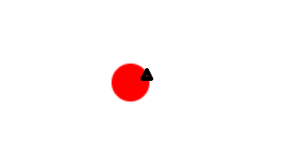
Building The Setup
7) Setting up the equation of the circle
1) Now we need to check if the event fire was on the ball or on the container
X,Y
total left, total height
2) Now we need to check if the event fire was on the ball or on the container
3) Xnew= total_left-x, Ynew=total_height-y. this co-ordinate will lie somewhere in the circle
4) var distance=Math.sqrt(Math.pow((total_left-x),2)+Math.pow((total_height-y),2));

Slide 19
Building The Setup
5) Framing the logic to find if the ball has been hit or not
if(distance<=circle.r) // an hit
else // an miss
If the effective distance is less that the length of the radius of that circle , it means co-ordinates of the click event is somewhere within the circle.
6) The final task is to register the on-click event on canvas , which means whenever there is a click on canvas or that container fire an event by calling function
var canvas=document.getElementById('canvas'); //getting the canvas id
canvas.addEventListener("click", function(e){ // registering on-click event
countHit(e)
}, false);

Slide 20
Building The Setup
8) Setting up the timer
function showTime(time)
{
time=time-1;
document.getElementById("timer").innerHTML=time; // setting the value in html
if(time==0)
{
GameOver(); // stopping the game time is zero
}
else
{
looptime=setTimeout('showTime('+time+')',1000); //recursively calling
}
}

Slide 21
Building The Setup
9) Starting the Game
function GameStart(){
draw(circle.x,circle.y); // all logic to draw
showTime(30); //saw in last slide
}
10) Stopping the Game
function GameOver(){
clearTimeout(looptime);
clearTimeout(loopdraw);
}

